Slide 1
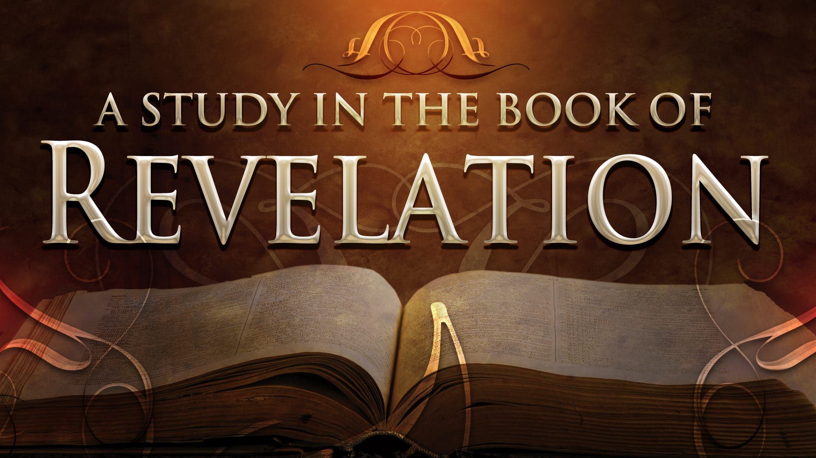
FBC Liberty Small Group
The Revelation of John
Revelation 2 - #4
February 16, 2025

Slide 2
FBC Liberty Small Group
The Revelation of John
Who Are the Witnesses ???
Revelation 12
June 22 , 2025

Slide 3
Most of all, it is the Revelation of Jesus Christ to us. If we catch everything else, but miss Jesus in the book, we miss the Book of Revelation.
3
Notes:
The baseball diamond is used to represent the growth and progress as it relates to the Christian Life and Service Seminars.
Today’s Agenda/Housekeeping

Slide 4
Apostles Creed
June 16, 325
1700 Year Anniversary
4
Notes:
The baseball diamond is used to represent the growth and progress as it relates to the Christian Life and Service Seminars.
Today’s Agenda/Housekeeping

Slide 5
Apostles Creed
I believe in God, the Father almighty,
Maker of heaven and earth,
and in Jesus Christ, his only Son, our Lord,
who was conceived by the Holy Spirit,
born of the Virgin Mary,
5
Notes:
The baseball diamond is used to represent the growth and progress as it relates to the Christian Life and Service Seminars.
Today’s Agenda/Housekeeping

Slide 6
Apostles Creed
suffered under Pontius Pilate,
was crucified, died and was buried;
on the third day he rose from the dead and ascended into heaven,
6
Notes:
The baseball diamond is used to represent the growth and progress as it relates to the Christian Life and Service Seminars.
Today’s Agenda/Housekeeping

Slide 7
Apostles Creed
and is seated at the right hand of God the Father almighty;
from there he will come to judge the living and the dead.
7
Notes:
The baseball diamond is used to represent the growth and progress as it relates to the Christian Life and Service Seminars.
Today’s Agenda/Housekeeping

Slide 8
Apostles Creed
I believe in the Holy Spirit,
the holy catholic Church,
the communion of saints,
the forgiveness of sins,
the resurrection of the body,
and life everlasting. Amen.
8
Notes:
The baseball diamond is used to represent the growth and progress as it relates to the Christian Life and Service Seminars.
Today’s Agenda/Housekeeping

Slide 9
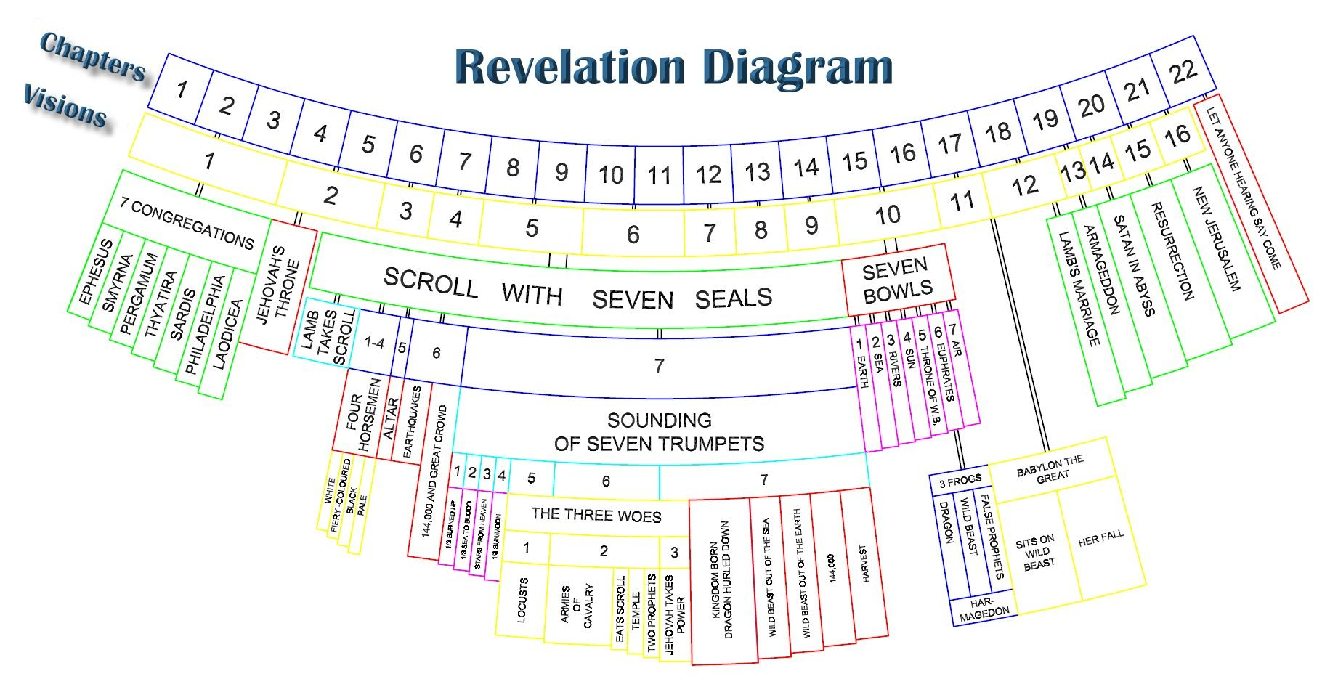
9
Notes:
The baseball diamond is used to represent the growth and progress as it relates to the Christian Life and Service Seminars.
Today’s Agenda/Housekeeping

Slide 10
Revelation 4 Focus
The Throne
10
Notes:
The baseball diamond is used to represent the growth and progress as it relates to the Christian Life and Service Seminars.
Today’s Agenda/Housekeeping

Slide 11
Revelation 5 Focus
The Scroll
&
Who Holds the Scroll
11
Notes:
The baseball diamond is used to represent the growth and progress as it relates to the Christian Life and Service Seminars.
Today’s Agenda/Housekeeping

Slide 12
Revelation 6 Focus
The 4 Horsemen
The Tribulation Begins !
12
Notes:
The baseball diamond is used to represent the growth and progress as it relates to the Christian Life and Service Seminars.
Today’s Agenda/Housekeeping

Slide 13
Revelation 7 Focus
The 144,000 & The Multitude
God Seals the Believers
13
Notes:
The baseball diamond is used to represent the growth and progress as it relates to the Christian Life and Service Seminars.
Today’s Agenda/Housekeeping

Slide 14
Revelation 8 Focus
The Trumpets Begin
14
Notes:
The baseball diamond is used to represent the growth and progress as it relates to the Christian Life and Service Seminars.
Today’s Agenda/Housekeeping

Slide 15
Revelation 9 Focus
The Dreaded Scorpions
Punishment Changes
15
Notes:
The baseball diamond is used to represent the growth and progress as it relates to the Christian Life and Service Seminars.
Today’s Agenda/Housekeeping

Slide 16
Revelation 9 Focus
The Dreaded Scorpions
Punishment Changes
16
Notes:
The baseball diamond is used to represent the growth and progress as it relates to the Christian Life and Service Seminars.
Today’s Agenda/Housekeeping

Slide 17
Revelation 10 Focus
The Little Scroll
Break in the Tribulation
17
Notes:
The baseball diamond is used to represent the growth and progress as it relates to the Christian Life and Service Seminars.
Today’s Agenda/Housekeeping

Slide 18
Revelation 11 Focus
The Two Witnesses
Tribulation Break Continues
18
Notes:
The baseball diamond is used to represent the growth and progress as it relates to the Christian Life and Service Seminars.
Today’s Agenda/Housekeeping

Slide 19
Revelation 11 – The Witnesses & 7th Trumpet
3 And I will appoint my two witnesses, and they will prophesy for 1,260 days, clothed in sackcloth.”
4 They are “the two olive trees” and the two lampstands, and “they stand before the Lord of the earth.”
5 If anyone tries to harm them, fire comes from their mouths and devours their enemies. This is how anyone who wants to harm them must die.
19
Notes:
The baseball diamond is used to represent the growth and progress as it relates to the Christian Life and Service Seminars.
Today’s Agenda/Housekeeping

Slide 20
Zachariah’s Witnesses
2 He asked me, “What do you see?” I answered, “I see a solid gold lamp stand with a bowl at the top and seven lamps on it, with seven channels to the lamps.
3 Also there are two olive trees by it, one on the right of the bowl and the other on its left.”
20
Notes:
The baseball diamond is used to represent the growth and progress as it relates to the Christian Life and Service Seminars.
Today’s Agenda/Housekeeping

Slide 21
Zachariah’s Witnesses
11 Then I asked the angel, “What are these two olive trees on the right and the left of the lampstand?”
12 Again I asked him, “What are these two olive branches beside the two gold pipes that pour out golden oil?”
21
Notes:
The baseball diamond is used to represent the growth and progress as it relates to the Christian Life and Service Seminars.
Today’s Agenda/Housekeeping

Slide 22
Zachariah’s Witnesses
13 He replied, “Do you not know what these are?” “No, my lord,” I said.
14 So he said, “These are the two who are anointed to serve the Lord of all the earth.”
22
Notes:
The baseball diamond is used to represent the growth and progress as it relates to the Christian Life and Service Seminars.
Today’s Agenda/Housekeeping

Slide 23
Revelation 11 – The Witnesses & 7th Trumpet
6 They have power to shut up the heavens so that it will not rain during the time they are prophesying; and they have power to turn the waters into blood and to strike the earth with every kind of plague as often as they want.
7 Now when they have finished their testimony, the beast that comes up from the Abyss will attack them, and overpower and kill them.
23
Notes:
The baseball diamond is used to represent the growth and progress as it relates to the Christian Life and Service Seminars.
Today’s Agenda/Housekeeping

Slide 24
Revelation 11 – The Witnesses & 7th Trumpet
8 Their bodies will lie in the public square of the great city—which is figuratively called Sodom and Egypt—where also their Lord was crucified.
9 For three and a half days some from every people, tribe, language and nation will gaze on their bodies and refuse them burial.
24
Notes:
The baseball diamond is used to represent the growth and progress as it relates to the Christian Life and Service Seminars.
Today’s Agenda/Housekeeping

Slide 25
Revelation 11 – The Witnesses & 7th Trumpet
10 The inhabitants of the earth will gloat over them and will celebrate by sending each other gifts, because these two prophets had tormented those who live on the earth.
11 But after the three and a half days the breath of life from God entered them, and they stood on their feet, and terror struck those who saw them.
25
Notes:
The baseball diamond is used to represent the growth and progress as it relates to the Christian Life and Service Seminars.
Today’s Agenda/Housekeeping

Slide 26
Who Are the Witnesses ????
26
Notes:
The baseball diamond is used to represent the growth and progress as it relates to the Christian Life and Service Seminars.
Today’s Agenda/Housekeeping

Slide 27
Potential Candidates
Plain Christian people
Moses
Elijah
Enoch
27
Notes:
The baseball diamond is used to represent the growth and progress as it relates to the Christian Life and Service Seminars.
Today’s Agenda/Housekeeping

Slide 28
Case for Elijah & Moses
28 About eight days after Jesus said this, he took Peter, John and James with him and went up onto a mountain to pray.
29 As he was praying, the appearance of his face changed, and his clothes became as bright as a flash of lightning.
30 Two men, Moses and Elijah, appeared in glorious splendor, talking with Jesus.
31 They spoke about his departure, which he was about to bring to fulfillment at Jerusalem.
28
Notes:
The baseball diamond is used to represent the growth and progress as it relates to the Christian Life and Service Seminars.
Today’s Agenda/Housekeeping

Slide 29
Case for Elijah
His ministry seems like one of these two witnesses (2 Kings 1 and James 5:17-18).
He was carried up to heaven (2 Kings 2:11).
Enemies of Elijah were destroyed by fire (2 Kings 1).
29
Notes:
The baseball diamond is used to represent the growth and progress as it relates to the Christian Life and Service Seminars.
Today’s Agenda/Housekeeping

Slide 30
Case for Elijah
It is specifically prophesied that Elijah will return before the end of the age (Malachi 4:5-6).
Elijah had a unique “conference” with Jesus at the Mount of Transfiguration (Matthew 17:1-6).
30
Notes:
The baseball diamond is used to represent the growth and progress as it relates to the Christian Life and Service Seminars.
Today’s Agenda/Housekeeping

Slide 31
Case for Elijah
4 “Remember the law of my servant Moses, the decrees and laws I gave him at Horeb for all Israel.
5 “See, I will send the prophet Elijah to you before that great and dreadful day of the LORD comes.
6 He will turn the hearts of the parents to their children, and the hearts of the children to their parents; or else I will come and strike the land with total destruction.” (Malachi 4:5-6).
31
Notes:
The baseball diamond is used to represent the growth and progress as it relates to the Christian Life and Service Seminars.
Today’s Agenda/Housekeeping

Slide 32
Case for Moses
His ministry seems like one of these witnesses (Exodus 7:20-21).
God seems to have a special purpose for the body of Moses that Satan wanted to defeat
Moses’ body was never found (Jude 1:9).
The enemies of Moses were destroyed by fire (Numbers 16:35).
32
Notes:
The baseball diamond is used to represent the growth and progress as it relates to the Christian Life and Service Seminars.
Today’s Agenda/Housekeeping

Slide 33
Case for Moses
Moses had a unique “conference” with Jesus at the Mount of Transfiguration (Matthew 17:1-6).
Moses has already turned water to blood Exodus 7
33
Notes:
The baseball diamond is used to represent the growth and progress as it relates to the Christian Life and Service Seminars.
Today’s Agenda/Housekeeping

Slide 34
Case for Moses
9 But even the archangel Michael, when he was disputing with the devil about the body of Moses, did not himself dare to condemn him for slander but said, “The Lord rebuke you!” (Jude 1:9)
34
Notes:
The baseball diamond is used to represent the growth and progress as it relates to the Christian Life and Service Seminars.
Today’s Agenda/Housekeeping

Slide 35
Case for Moses
14 Then the LORD said to Moses, “Pharaoh’s heart is unyielding; he refuses to let the people go.
15 Go to Pharaoh in the morning as he goes out to the river. Confront him on the bank of the Nile, and take in your hand the staff that was changed into a snake.
17 This is what the LORD says: By this you will know that I am the LORD: With the staff that is in my hand I will strike the water of the Nile, and it will be changed into blood. Exodus 7
35
Notes:
The baseball diamond is used to represent the growth and progress as it relates to the Christian Life and Service Seminars.
Today’s Agenda/Housekeeping

Slide 36
Case for Moses
20 Moses and Aaron did just as the LORD had commanded. He raised his staff in the presence of Pharaoh and his officials and struck the water of the Nile, and all the water was changed into blood.
21 The fish in the Nile died, and the river smelled so bad that the Egyptians could not drink its water. Blood was everywhere in Egypt.
Exodus 7
36
Notes:
The baseball diamond is used to represent the growth and progress as it relates to the Christian Life and Service Seminars.
Today’s Agenda/Housekeeping

Slide 37
Case for Enoch
Enoch was taken straight to heaven
Jude foretells the actions of Enoch as a witness
37
Notes:
The baseball diamond is used to represent the growth and progress as it relates to the Christian Life and Service Seminars.
Today’s Agenda/Housekeeping

Slide 38
Case for Enoch
21 When Enoch had lived 65 years, he became the father of Methuselah.
22 After he became the father of Methuselah, Enoch walked faithfully with God 300 years and had other sons and daughters.
23 Altogether, Enoch lived a total of 365 years.
24 Enoch walked faithfully with God; then he was no more, because God took him away. Genesis 5
38
Notes:
The baseball diamond is used to represent the growth and progress as it relates to the Christian Life and Service Seminars.
Today’s Agenda/Housekeeping

Slide 39
Case for Enoch
5 By faith Enoch was taken from this life, so that he did not experience death: “He could not be found, because God had taken him away.” For before he was taken, he was commended as one who pleased God.
6 And without faith it is impossible to please God, because anyone who comes to him must believe that he exists and that he rewards those who earnestly seek him. Hebrews 5
39
Notes:
The baseball diamond is used to represent the growth and progress as it relates to the Christian Life and Service Seminars.
Today’s Agenda/Housekeeping

Slide 40
Case for Enoch
14 Enoch, the seventh from Adam, prophesied about them: “See, the Lord is coming with thousands upon thousands of his holy ones
15 to judge everyone, and to convict all of them of all the ungodly acts they have committed in their ungodliness, and of all the defiant words ungodly sinners have spoken against him.” Jude 1
40
Notes:
The baseball diamond is used to represent the growth and progress as it relates to the Christian Life and Service Seminars.
Today’s Agenda/Housekeeping

Slide 41
Revelation 11 – The Witnesses & 7th Trumpet
12 Then they heard a loud voice from heaven saying to them, “Come up here.” And they went up to heaven in a cloud, while their enemies looked on.
13 At that very hour there was a severe earthquake and a tenth of the city collapsed. Seven thousand people were killed in the earthquake, and the survivors were terrified and gave glory to the God of heaven.
14 The second woe has passed; the third woe is coming soon.
41
Notes:
The baseball diamond is used to represent the growth and progress as it relates to the Christian Life and Service Seminars.
Today’s Agenda/Housekeeping

Slide 42
Revelation 11 – The Witnesses & 7th Trumpet
15 The seventh angel sounded his trumpet, and there were loud voices in heaven, which said: “The kingdom of the world has become the kingdom of our Lord and of his Messiah, and he will reign for ever and ever.”
16 And the twenty-four elders, who were seated on their thrones before God, fell on their faces and worshiped God,
42
Notes:
The baseball diamond is used to represent the growth and progress as it relates to the Christian Life and Service Seminars.
Today’s Agenda/Housekeeping

Slide 43
Revelation 11 – The Witnesses & 7th Trumpet
17 saying: “We give thanks to you, Lord God Almighty, the One who is and who was, because you have taken your great power and have begun to reign.
18 The nations were angry, and your wrath has come. The time has come for judging the dead, and for rewarding your servants the prophets and your people who revere your name, both great and small— and for destroying those who destroy the earth.”
43
Notes:
The baseball diamond is used to represent the growth and progress as it relates to the Christian Life and Service Seminars.
Today’s Agenda/Housekeeping

Slide 44
Revelation 11 – The Witnesses & 7th Trumpet
19 Then God’s temple in heaven was opened, and within his temple was seen the ark of his covenant. And there came flashes of lightning, rumblings, peals of thunder, an earthquake and a severe hailstorm.
44
Notes:
The baseball diamond is used to represent the growth and progress as it relates to the Christian Life and Service Seminars.
Today’s Agenda/Housekeeping

Slide 45
Revelation 12 – The Woman & Dragon
1 A great sign appeared in heaven: a woman (Israel) clothed with the sun, and the moon under her feet, and on her head a crown of twelve stars (12 tribes);
2 and she was with child (Jesus); and she cried out, being in labor and in pain to give birth.
45
Notes:
The baseball diamond is used to represent the growth and progress as it relates to the Christian Life and Service Seminars.
Today’s Agenda/Housekeeping

Slide 46
Revelation 12 – The Woman & Dragon
3 Then another sign appeared in heaven: and behold, a great red dragon (Satan) having seven heads and ten horns, and on his heads were seven diadems.
4 And his tail swept away a third of the stars of heaven and threw them to the earth. And the dragon stood before the woman who was about to give birth, so that when she gave birth he might devour her child.
46
Notes:
The baseball diamond is used to represent the growth and progress as it relates to the Christian Life and Service Seminars.
Today’s Agenda/Housekeeping

Slide 47
Revelation 12 – The Woman & Dragon
5 And she gave birth to a son, a male child, who is to rule all the nations with a rod of iron; and her child was caught up to God and to His throne.
6 Then the woman fled into the wilderness where she had a place prepared by God, so that there she would be nourished for one thousand two hundred and sixty days.
47
Notes:
The baseball diamond is used to represent the growth and progress as it relates to the Christian Life and Service Seminars.
Today’s Agenda/Housekeeping

Slide 48
Revelation 12 – Daniel 9
24 “Seventy ‘sevens’ are decreed for your people and your holy city to finish transgression, to put an end to sin, to atone for wickedness, to bring in everlasting righteousness, to seal up vision and prophecy and to anoint the Most Holy Place.
25 “Know and understand this: From the time the word goes out to restore and rebuild Jerusalem until the Anointed One, the ruler, comes, there will be seven ‘sevens,’ and sixty-two ‘sevens.’ It will be rebuilt with streets and a trench, but in times of trouble.
48
Notes:
The baseball diamond is used to represent the growth and progress as it relates to the Christian Life and Service Seminars.
Today’s Agenda/Housekeeping

Slide 49
Revelation 12 – Daniel 9
26 After the sixty-two ‘sevens,’ the Anointed One will be put to death and will have nothing. The people of the ruler who will come will destroy the city and the sanctuary. The end will come like a flood: War will continue until the end, and desolations have been decreed.
27 He will confirm a covenant with many for one ‘seven.’ In the middle of the ‘seven’ he will put an end to sacrifice and offering. And at the temple he will set up an abomination that causes desolation, until the end that is decreed is poured out on him. ”
49
Notes:
The baseball diamond is used to represent the growth and progress as it relates to the Christian Life and Service Seminars.
Today’s Agenda/Housekeeping

Slide 50
Revelation 12 – The Woman & Dragon
7 And there was war in heaven, Michael and his angels waging war with the dragon. The dragon and his angels waged war,
8 and they were not strong enough, and there was no longer a place found for them in heaven.
50
Notes:
The baseball diamond is used to represent the growth and progress as it relates to the Christian Life and Service Seminars.
Today’s Agenda/Housekeeping

Slide 51
Revelation 12 – The Woman & Dragon
9 And the great dragon was thrown down, the serpent of old who is called the devil and Satan, who deceives the whole world; he was thrown down to the earth, and his angels were thrown down with him.
10 Then I heard a loud voice in heaven, saying, "Now the salvation, and the power, and the kingdom of our God and the authority of His Christ have come, for the accuser of our brethren has been thrown down, he who accuses them before our God day and night.
51
Notes:
The baseball diamond is used to represent the growth and progress as it relates to the Christian Life and Service Seminars.
Today’s Agenda/Housekeeping

Slide 52
Revelation 12 – The Woman & Dragon
11 "And they overcame him because of the blood of the Lamb and because of the word of their testimony, and they did not love their life even when faced with death.
12 "For this reason, rejoice, O heavens and you who dwell in them. Woe to the earth and the sea, because the devil has come down to you, having great wrath, knowing that he has only a short time."
52
Notes:
The baseball diamond is used to represent the growth and progress as it relates to the Christian Life and Service Seminars.
Today’s Agenda/Housekeeping

Slide 53
Revelation 12 – The Woman & Dragon
13 And when the dragon saw that he was thrown down to the earth, he persecuted the woman who gave birth to the male child.
14 But the two wings of the great eagle were given to the woman, so that she could fly into the wilderness to her place, where she was nourished for a time and times and half a time, from the presence of the serpent.
53
Notes:
The baseball diamond is used to represent the growth and progress as it relates to the Christian Life and Service Seminars.
Today’s Agenda/Housekeeping

Slide 54
Revelation 12 – The Woman & Dragon
15 And the serpent poured water like a river out of his mouth after the woman, so that he might cause her to be swept away with the flood.
16 But the earth helped the woman, and the earth opened its mouth and drank up the river which the dragon poured out of his mouth.
54
Notes:
The baseball diamond is used to represent the growth and progress as it relates to the Christian Life and Service Seminars.
Today’s Agenda/Housekeeping

Slide 55
Revelation 12 – The Woman & Dragon
17 So the dragon was enraged with the woman, and went off to make war with the rest of her children, who keep the commandments of God and hold to the testimony of Jesus.
55
Notes:
The baseball diamond is used to represent the growth and progress as it relates to the Christian Life and Service Seminars.
Today’s Agenda/Housekeeping

