Slide 1
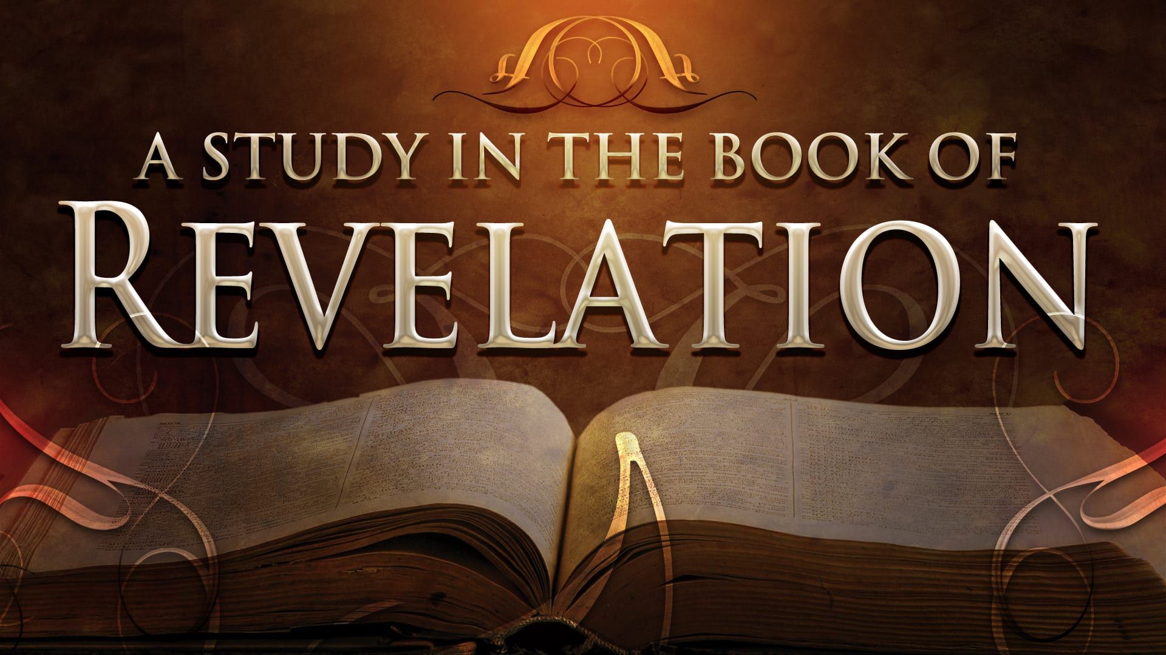
FBC Liberty Small Group
The Revelation of John
Revelation 2 - #4
February 16, 2025

Slide 2
FBC Liberty Small Group
The Revelation of John
Revelation 9
May 25, 2025

Slide 3
Most of all, it is the Revelation of Jesus Christ to us. If we catch everything else, but miss Jesus in the book, we miss the Book of Revelation.
3
Notes:
The baseball diamond is used to represent the growth and progress as it relates to the Christian Life and Service Seminars.
Today’s Agenda/Housekeeping

Slide 4
Apostles Creed
I believe in God, the Father almighty,
Maker of heaven and earth,
and in Jesus Christ, his only Son, our Lord,
who was conceived by the Holy Spirit,
born of the Virgin Mary,
4
Notes:
The baseball diamond is used to represent the growth and progress as it relates to the Christian Life and Service Seminars.
Today’s Agenda/Housekeeping

Slide 5
Apostles Creed
suffered under Pontius Pilate,
was crucified, died and was buried;
on the third day he rose from the dead and ascended into heaven,
5
Notes:
The baseball diamond is used to represent the growth and progress as it relates to the Christian Life and Service Seminars.
Today’s Agenda/Housekeeping

Slide 6
Apostles Creed
and is seated at the right hand of God the Father almighty;
from there he will come to judge the living and the dead.
6
Notes:
The baseball diamond is used to represent the growth and progress as it relates to the Christian Life and Service Seminars.
Today’s Agenda/Housekeeping

Slide 7
Apostles Creed
I believe in the Holy Spirit,
the holy catholic Church,
the communion of saints,
the forgiveness of sins,
the resurrection of the body,
and life everlasting. Amen.
7
Notes:
The baseball diamond is used to represent the growth and progress as it relates to the Christian Life and Service Seminars.
Today’s Agenda/Housekeeping

Slide 8
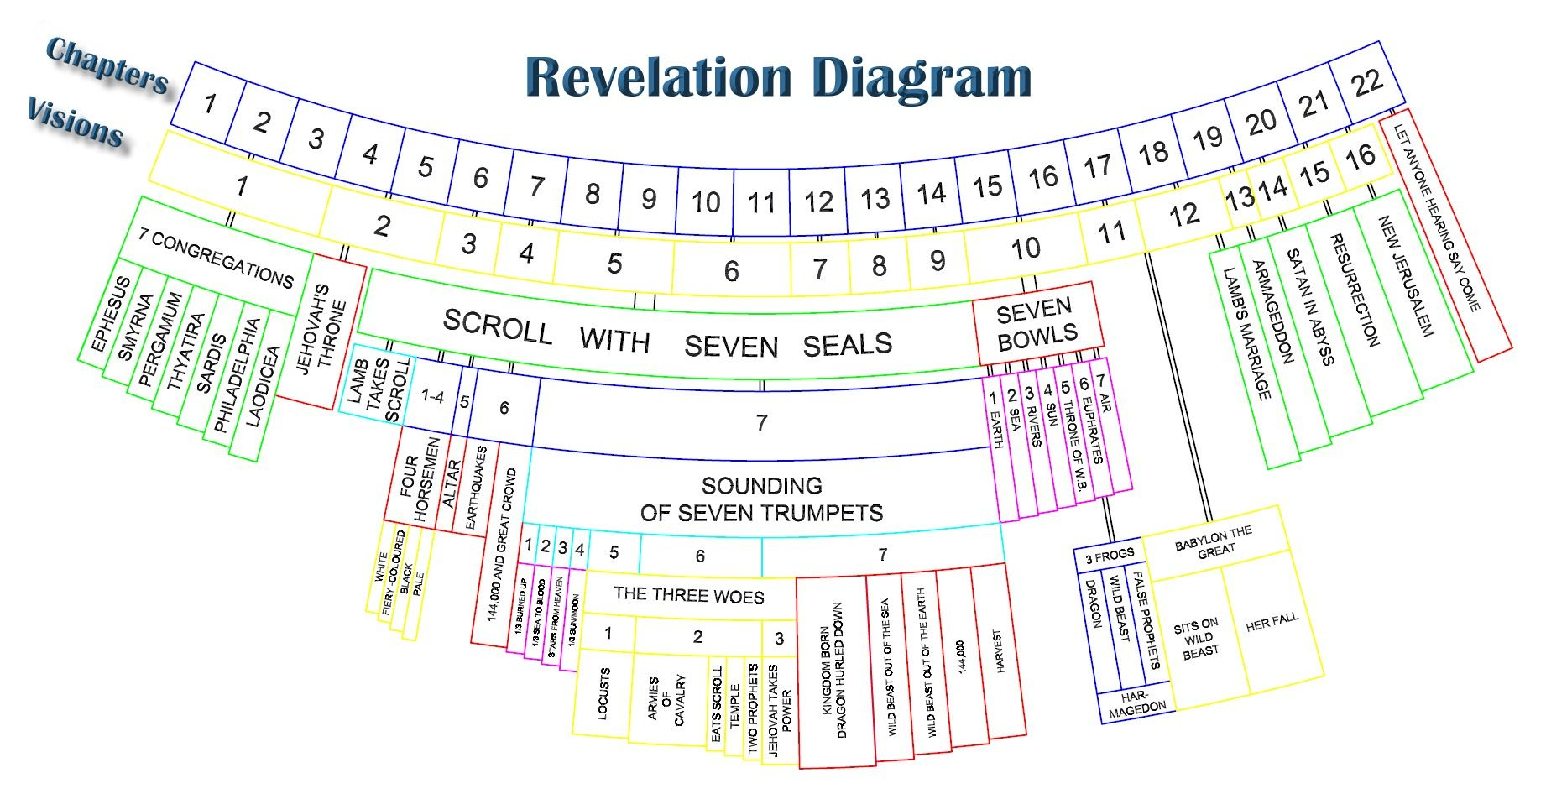
8
Notes:
The baseball diamond is used to represent the growth and progress as it relates to the Christian Life and Service Seminars.
Today’s Agenda/Housekeeping

Slide 9
Revelation 4 Focus
The Throne
9
Notes:
The baseball diamond is used to represent the growth and progress as it relates to the Christian Life and Service Seminars.
Today’s Agenda/Housekeeping

Slide 10
Revelation 5 Focus
The Scroll
&
Who Holds the Scroll
10
Notes:
The baseball diamond is used to represent the growth and progress as it relates to the Christian Life and Service Seminars.
Today’s Agenda/Housekeeping

Slide 11
Revelation 6 Focus
The 4 Horsemen
The Tribulation Begins !
11
Notes:
The baseball diamond is used to represent the growth and progress as it relates to the Christian Life and Service Seminars.
Today’s Agenda/Housekeeping

Slide 12
Revelation 7 Focus
The 144,000 & The Multitude
God Seals the Believers
12
Notes:
The baseball diamond is used to represent the growth and progress as it relates to the Christian Life and Service Seminars.
Today’s Agenda/Housekeeping

Slide 13
Revelation 8 Focus
The Trumpets Begin
Wormwood and 1/3 dead
13
Notes:
The baseball diamond is used to represent the growth and progress as it relates to the Christian Life and Service Seminars.
Today’s Agenda/Housekeeping

Slide 14
Revelation 9 Focus
The Worst of the Worst
Scorpions
Satan’s Angels Loosed
14
Notes:
The baseball diamond is used to represent the growth and progress as it relates to the Christian Life and Service Seminars.
Today’s Agenda/Housekeeping

Slide 15
The Seven Trumpets of Revelation
#1 Hail, fire, & blood and 1/3 burned up
#2 Mountain hurled to sea & blood. 1/3 ships & sea creatures dead
#3 Star Wormwood crashes and water bitter, many die
#4 1/3 sun, moon, stars go dark
15
Notes:
The baseball diamond is used to represent the growth and progress as it relates to the Christian Life and Service Seminars.
Today’s Agenda/Housekeeping

Slide 16
Revelation 9 – The Worst of the Worst
Luke’s Prophecy for Chapter 9
35 For it will come on all those who live on the face of the whole earth.
36 Be always on the watch, and pray that you may be able to escape all that is about to happen, and that you may be able to stand before the Son of Man.”
16
Notes:
The baseball diamond is used to represent the growth and progress as it relates to the Christian Life and Service Seminars.
Today’s Agenda/Housekeeping

Slide 17
Revelation 7 – The 1st Four Angels
1 After this I saw four angels standing at the four corners of the earth, holding back the four winds of the earth to prevent any wind from blowing on the land or on the sea or on any tree.
2 Then I saw another angel coming up from the east, having the seal of the living God. He called out in a loud voice to the four angels who had been given power to harm the land and the sea:
17
Notes:
The baseball diamond is used to represent the growth and progress as it relates to the Christian Life and Service Seminars.
Today’s Agenda/Housekeeping

Slide 18
Revelation 7 – The 1st Four Angels
3 “Do not harm the land or the sea or the trees until we put a seal on the foreheads of the servants of our God.”
9 After this I looked, and there before me was a great multitude that no one could count, from every nation, tribe, people and language, standing before the throne and before the Lamb. They were wearing white robes and were holding palm branches in their hands.
18
Notes:
The baseball diamond is used to represent the growth and progress as it relates to the Christian Life and Service Seminars.
Today’s Agenda/Housekeeping

Slide 19
Revelation 9 – The Worst of the Worst
1 The fifth angel sounded his trumpet, and I saw a star that had fallen from the sky to the earth. The star was given the key to the shaft of the Abyss.
2 When he opened the Abyss, smoke rose from it like the smoke from a gigantic furnace. The sun and sky were darkened by the smoke from the Abyss.
19
Notes:
The baseball diamond is used to represent the growth and progress as it relates to the Christian Life and Service Seminars.
Today’s Agenda/Housekeeping

Slide 20
Revelation 9 – The Worst of the Worst
3 And out of the smoke locusts came down on the earth and were given power like that of scorpions of the earth.
4 They were told not to harm the grass of the earth or any plant or tree, but only those people who did not have the seal of God on their foreheads.
20
Notes:
The baseball diamond is used to represent the growth and progress as it relates to the Christian Life and Service Seminars.
Today’s Agenda/Housekeeping

Slide 21
Revelation 9 – The Worst of the Worst
5 They were not allowed to kill them but only to torture them for five months. And the agony they suffered was like that of the sting of a scorpion when it strikes.
6 During those days people will seek death but will not find it; they will long to die, but death will elude them.
21
Notes:
The baseball diamond is used to represent the growth and progress as it relates to the Christian Life and Service Seminars.
Today’s Agenda/Housekeeping

Slide 22
Revelation 9 – The Worst of the Worst
7 The locusts looked like horses prepared for battle. On their heads they wore something like crowns of gold, and their faces resembled human faces.
8 Their hair was like women’s hair, and their teeth were like lions’ teeth.
22
Notes:
The baseball diamond is used to represent the growth and progress as it relates to the Christian Life and Service Seminars.
Today’s Agenda/Housekeeping

Slide 23
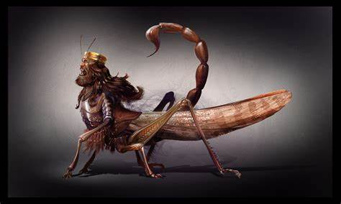
Dreaded Locusts
23
Notes:
The baseball diamond is used to represent the growth and progress as it relates to the Christian Life and Service Seminars.
Today’s Agenda/Housekeeping

Slide 24
Paul’s message for the 5 months
4 For he chose us in him before the creation of the world to be holy and blameless in his sight. In love
5 he predestined us for adoption to sonship through Jesus Christ, in accordance with his pleasure and will—
9 he made known to us the mystery of his will according to his good pleasure, which he purposed in Christ,
24
Notes:
The baseball diamond is used to represent the growth and progress as it relates to the Christian Life and Service Seminars.
Today’s Agenda/Housekeeping

Slide 25
Paul’s message for the 5 months
10 to be put into effect when the times reach their fulfillment—to bring unity to all things in heaven and on earth under Christ.
11 In him we were also chosen, having been predestined according to the plan of him who works out everything in conformity with the purpose of his will,
25
Notes:
The baseball diamond is used to represent the growth and progress as it relates to the Christian Life and Service Seminars.
Today’s Agenda/Housekeeping

Slide 26
Revelation 9 – The Worst of the Worst
9 They had breastplates like breastplates of iron, and the sound of their wings was like the thundering of many horses and chariots rushing into battle.
10 They had tails with stingers, like scorpions, and in their tails they had power to torment people for five months.
26
Notes:
The baseball diamond is used to represent the growth and progress as it relates to the Christian Life and Service Seminars.
Today’s Agenda/Housekeeping

Slide 27
Revelation 9 – The Worst of the Worst
11 They had as king over them the angel of the Abyss, whose name in Hebrew is Abaddon and in Greek is Apollyon (that is, Destroyer).
12 The first woe is past; two other woes are yet to come.
27
Notes:
The baseball diamond is used to represent the growth and progress as it relates to the Christian Life and Service Seminars.
Today’s Agenda/Housekeeping

Slide 28
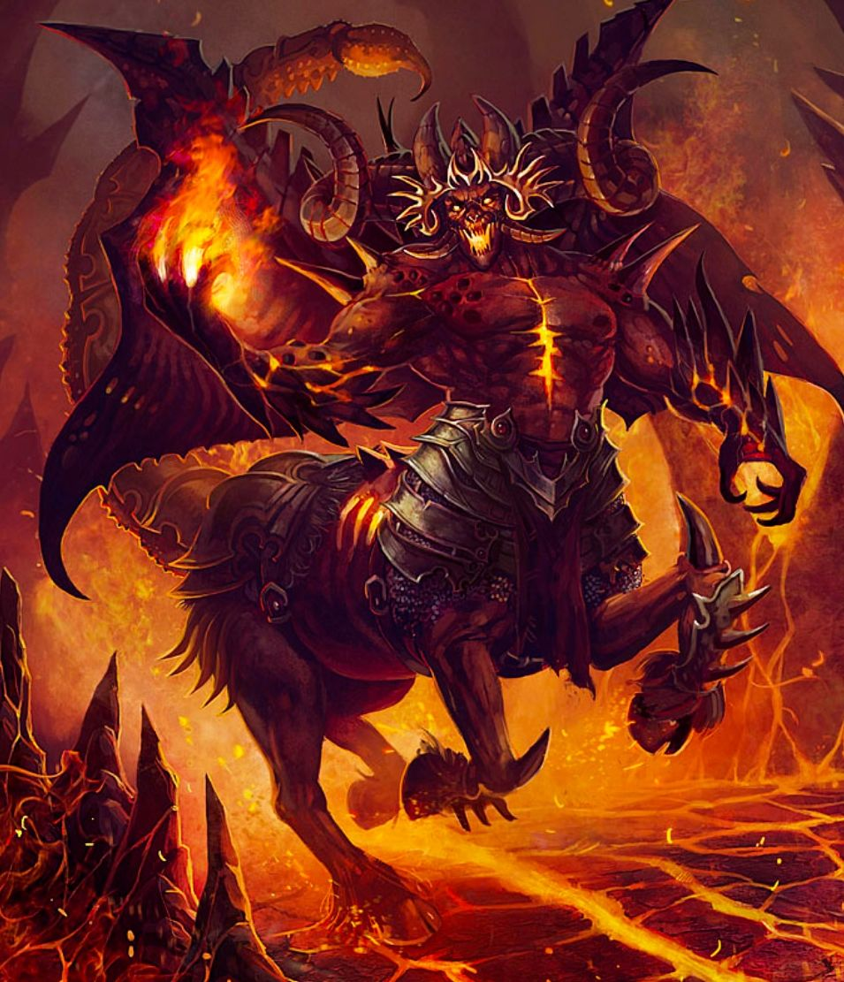
Abaddon
Apollyon (that is, Destroyer).
28
Notes:
The baseball diamond is used to represent the growth and progress as it relates to the Christian Life and Service Seminars.
Today’s Agenda/Housekeeping

Slide 29
Revelation 9 – The Worst of the Worst
13 The sixth angel sounded his trumpet, and I heard a voice coming from the four horns of the golden altar that is before God.
14 It said to the sixth angel who had the trumpet, “Release the four angels who are bound at the great river Euphrates.”
29
Notes:
The baseball diamond is used to represent the growth and progress as it relates to the Christian Life and Service Seminars.
Today’s Agenda/Housekeeping

Slide 30
Revelation 9 – The Worst of the Worst
15 And the four angels who had been kept ready for this very hour and day and month and year were released to kill a third of mankind.
16 The number of the mounted troops was twice ten thousand times ten thousand. I heard their number.
30
Notes:
The baseball diamond is used to represent the growth and progress as it relates to the Christian Life and Service Seminars.
Today’s Agenda/Housekeeping

Slide 31
Revelation 9 – The Worst of the Worst
17 The horses and riders I saw in my vision looked like this: Their breastplates were fiery red, dark blue, and yellow as sulfur. The heads of the horses resembled the heads of lions, and out of their mouths came fire, smoke and sulfur.
18 A third of mankind was killed by the three plagues of fire, smoke and sulfur that came out of their mouths.
31
Notes:
The baseball diamond is used to represent the growth and progress as it relates to the Christian Life and Service Seminars.
Today’s Agenda/Housekeeping

Slide 32
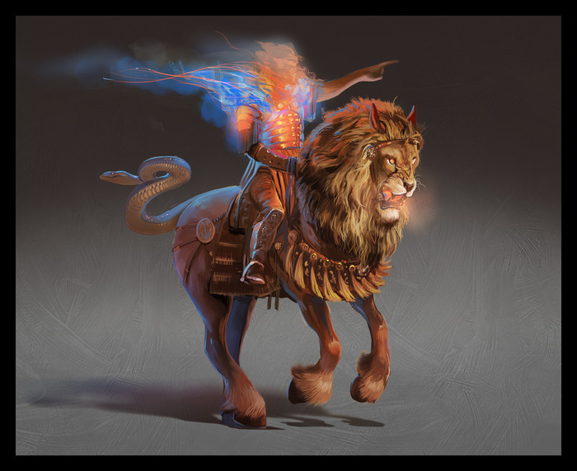
Rev 9:17
Soldiers
32
Notes:
The baseball diamond is used to represent the growth and progress as it relates to the Christian Life and Service Seminars.
Today’s Agenda/Housekeeping

Slide 33
Joel 2 Prophesy
3 Before them fire devours, behind them a flame blazes. Before them the land is like the garden of Eden, behind them, a desert waste— nothing escapes them.
4 They have the appearance of horses; they gallop along like cavalry.
5 With a noise like that of chariots they leap over the mountaintops, like a crackling fire consuming stubble, like a mighty army drawn up for battle.
33
Notes:
The baseball diamond is used to represent the growth and progress as it relates to the Christian Life and Service Seminars.
Today’s Agenda/Housekeeping

Slide 34
Joel 2 Prophesy
6 At the sight of them, nations are in anguish; every face turns pale.
7 They charge like warriors; they scale walls like soldiers. They all march in line, not swerving from their course.
8 They do not jostle each other; each marches straight ahead. They plunge through defenses without breaking ranks.
34
Notes:
The baseball diamond is used to represent the growth and progress as it relates to the Christian Life and Service Seminars.
Today’s Agenda/Housekeeping

Slide 35
Nahum Prophesy
2 The LORD will restore the splendor of Jacob like the splendor of Israel, though destroyers have laid them waste and have ruined their vines.
3 The shields of the soldiers are red; the warriors are clad in scarlet. The metal on the chariots flashes on the day they are made ready; the spears of juniper are brandished.
4 The chariots storm through the streets, rushing back and forth through the squares. They look like flaming torches; they dart about like lightning.
35
Notes:
The baseball diamond is used to represent the growth and progress as it relates to the Christian Life and Service Seminars.
Today’s Agenda/Housekeeping

Slide 36
Revelation 9 – The Worst of the Worst
19 The power of the horses was in their mouths and in their tails; for their tails were like snakes, having heads with which they inflict injury.
20 The rest of mankind who were not killed by these plagues still did not repent of the work of their hands; they did not stop worshiping demons, and idols of gold, silver, bronze, stone and wood—idols that cannot see or hear or walk.
36
Notes:
The baseball diamond is used to represent the growth and progress as it relates to the Christian Life and Service Seminars.
Today’s Agenda/Housekeeping

Slide 37
Revelation 9 – The Worst of the Worst
21 Nor did they repent of their murders, their magic arts, their sexual immorality or their thefts.
37
Notes:
The baseball diamond is used to represent the growth and progress as it relates to the Christian Life and Service Seminars.
Today’s Agenda/Housekeeping

