Slide 1

FBC Liberty Small Group
The Revelation of John
Revelation 2 - #4
February 16, 2025

Slide 2
FBC Liberty Small Group
The Revelation of John
Daniel’s Prophecy and the 490
July 13 , 2025

Slide 3
Most of all, it is the Revelation of Jesus Christ to us. If we catch everything else, but miss Jesus in the book, we miss the Book of Revelation.
3
Notes:
The baseball diamond is used to represent the growth and progress as it relates to the Christian Life and Service Seminars.
Today’s Agenda/Housekeeping

Slide 4
Apostles Creed
I believe in God, the Father almighty,
Maker of heaven and earth,
and in Jesus Christ, his only Son, our Lord,
who was conceived by the Holy Spirit,
born of the Virgin Mary,
4
Notes:
The baseball diamond is used to represent the growth and progress as it relates to the Christian Life and Service Seminars.
Today’s Agenda/Housekeeping

Slide 5
Apostles Creed
suffered under Pontius Pilate,
was crucified, died and was buried;
on the third day he rose from the dead and ascended into heaven,
5
Notes:
The baseball diamond is used to represent the growth and progress as it relates to the Christian Life and Service Seminars.
Today’s Agenda/Housekeeping

Slide 6
Apostles Creed
and is seated at the right hand of God the Father almighty;
from there he will come to judge the living and the dead.
6
Notes:
The baseball diamond is used to represent the growth and progress as it relates to the Christian Life and Service Seminars.
Today’s Agenda/Housekeeping

Slide 7
Apostles Creed
I believe in the Holy Spirit,
the holy catholic Church,
the communion of saints,
the forgiveness of sins,
the resurrection of the body,
and life everlasting. Amen.
7
Notes:
The baseball diamond is used to represent the growth and progress as it relates to the Christian Life and Service Seminars.
Today’s Agenda/Housekeeping

Slide 8
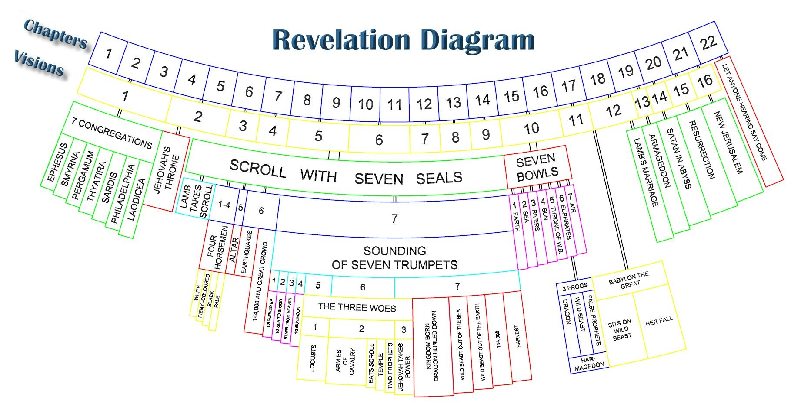
8
Notes:
The baseball diamond is used to represent the growth and progress as it relates to the Christian Life and Service Seminars.
Today’s Agenda/Housekeeping

Slide 9
Revelation 4 Focus
The Throne
9
Notes:
The baseball diamond is used to represent the growth and progress as it relates to the Christian Life and Service Seminars.
Today’s Agenda/Housekeeping

Slide 10
Revelation 5 Focus
The Scroll
&
Who Holds the Scroll
10
Notes:
The baseball diamond is used to represent the growth and progress as it relates to the Christian Life and Service Seminars.
Today’s Agenda/Housekeeping

Slide 11
Revelation 6 Focus
The 4 Horsemen
The Tribulation Begins !
11
Notes:
The baseball diamond is used to represent the growth and progress as it relates to the Christian Life and Service Seminars.
Today’s Agenda/Housekeeping

Slide 12
Revelation 7 Focus
The 144,000 & The Multitude
God Seals the Believers
12
Notes:
The baseball diamond is used to represent the growth and progress as it relates to the Christian Life and Service Seminars.
Today’s Agenda/Housekeeping

Slide 13
Revelation 8 Focus
The Trumpets Begin
13
Notes:
The baseball diamond is used to represent the growth and progress as it relates to the Christian Life and Service Seminars.
Today’s Agenda/Housekeeping

Slide 14
Revelation 9 Focus
The Dreaded Scorpions
Punishment Changes
14
Notes:
The baseball diamond is used to represent the growth and progress as it relates to the Christian Life and Service Seminars.
Today’s Agenda/Housekeeping

Slide 15
Revelation 9 Focus
The Dreaded Scorpions
Punishment Changes
15
Notes:
The baseball diamond is used to represent the growth and progress as it relates to the Christian Life and Service Seminars.
Today’s Agenda/Housekeeping

Slide 16
Revelation 10 Focus
The Little Scroll
Break in the Tribulation
16
Notes:
The baseball diamond is used to represent the growth and progress as it relates to the Christian Life and Service Seminars.
Today’s Agenda/Housekeeping

Slide 17
Revelation 11 Focus
The Two Witnesses
Tribulation Break Continues
17
Notes:
The baseball diamond is used to represent the growth and progress as it relates to the Christian Life and Service Seminars.
Today’s Agenda/Housekeeping

Slide 18
Revelation 12 Focus
The Woman, the Dragon & the War
18
Notes:
The baseball diamond is used to represent the growth and progress as it relates to the Christian Life and Service Seminars.
Today’s Agenda/Housekeeping

Slide 19
Revelation 13 Focus
The Beast
19
Notes:
The baseball diamond is used to represent the growth and progress as it relates to the Christian Life and Service Seminars.
Today’s Agenda/Housekeeping

Slide 20
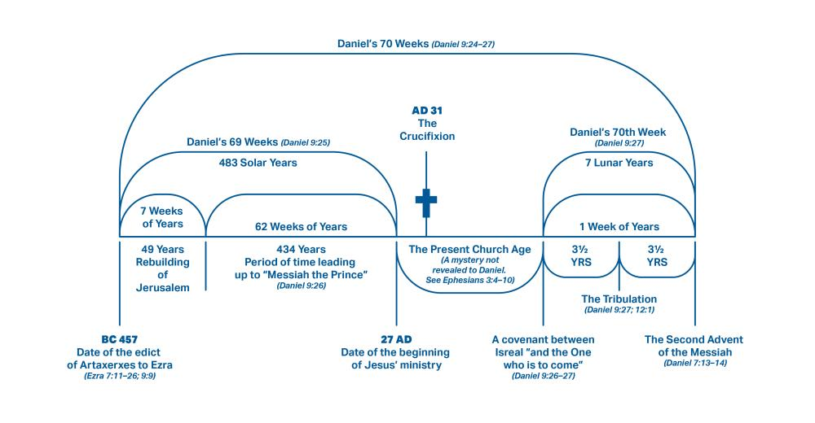
20
Notes:
The baseball diamond is used to represent the growth and progress as it relates to the Christian Life and Service Seminars.
Today’s Agenda/Housekeeping

Slide 21
How To Count ????
1 Month = 30 days, a lunar month
Julian calendar began in 45 BC, 365.25 days per year
1 week = 7 years in Daniel’s counting
Half a time -- ½ x 7 = 3 ½
21
Notes:
The baseball diamond is used to represent the growth and progress as it relates to the Christian Life and Service Seminars.
Today’s Agenda/Housekeeping

Slide 22
How To Count ????
Christ was born somewhere between 2 BC and 6 AD
Christ was crucified in 33 AD, BUT
Time between crucifixion and tribulation was NOT revealed to Daniel
22
Notes:
The baseball diamond is used to represent the growth and progress as it relates to the Christian Life and Service Seminars.
Today’s Agenda/Housekeeping

Slide 23
Daniel 9 – The 70 Sevens Prophecy
24 “Seventy ‘sevens’ are decreed for your people and your holy city to finish transgression, to put an end to sin, to atone for wickedness, to bring in everlasting righteousness, to seal up vision and prophecy and to anoint the Most Holy Place.
23
Notes:
The baseball diamond is used to represent the growth and progress as it relates to the Christian Life and Service Seminars.
Today’s Agenda/Housekeeping

Slide 24
What will be accomplished in the seventy weeks
Finish the transgression
Make an end of sins
Make reconciliation for iniquity
Bring in everlasting righteousness
Seal up vision and prophecy
Anoint the Most Holy
24
Notes:
The baseball diamond is used to represent the growth and progress as it relates to the Christian Life and Service Seminars.
Today’s Agenda/Housekeeping

Slide 25
Daniel 9 – The 70 Sevens Prophecy
25 “Know and understand this: From the time the word goes out to restore and rebuild Jerusalem until the Anointed One, the ruler, comes, there will be seven ‘sevens,’ and sixty-two ‘sevens.’ It will be rebuilt with streets and a trench, but in times of trouble.
25
Notes:
The baseball diamond is used to represent the growth and progress as it relates to the Christian Life and Service Seminars.
Today’s Agenda/Housekeeping

Slide 26
Ezra 7 – The Beginning of the Prophecy
12 "Artaxerxes, king of kings, to Ezra the priest, the scribe of the law of the God of heaven, perfect peace. And now
13 I have issued a decree that any of the people of Israel and their priests and the Levites in my kingdom who are willing to go to Jerusalem, may go with you.
26
Notes:
The baseball diamond is used to represent the growth and progress as it relates to the Christian Life and Service Seminars.
Today’s Agenda/Housekeeping

Slide 27
Ezra 7 – The Beginning of the Prophecy
14 "Forasmuch * * as you are sent by the king and his seven counselors to inquire concerning Judah and Jerusalem according to the law of your God which is in your hand,
15 and to bring the silver and gold, which the king and his counselors have freely offered to the God of Israel, whose dwelling is in Jerusalem,
27
Notes:
The baseball diamond is used to represent the growth and progress as it relates to the Christian Life and Service Seminars.
Today’s Agenda/Housekeeping

Slide 28
Ezra 7 – The Beginning of the Prophecy
16 with all the silver and gold which you find in the whole province of Babylon, along with the freewill offering of the people and of the priests, who offered willingly for the house of their God which is in Jerusalem;
28
Notes:
The baseball diamond is used to represent the growth and progress as it relates to the Christian Life and Service Seminars.
Today’s Agenda/Housekeeping

Slide 29
Daniel 9 – The 70 Sevens Prophecy
26 After the sixty-two ‘sevens,’ the Anointed One will be put to death and will have nothing. The people of the ruler who will come will destroy the city and the sanctuary. The end will come like a flood: War will continue until the end, and desolations have been decreed.
29
Notes:
The baseball diamond is used to represent the growth and progress as it relates to the Christian Life and Service Seminars.
Today’s Agenda/Housekeeping

Slide 30
Daniel 9 – The 70 Sevens Prophecy
27 He will confirm a covenant with many for one ‘seven.’ In the middle of the ‘seven’ he will put an end to sacrifice and offering. And at the temple he will set up an abomination that causes desolation, until the end that is decreed is poured out on him. ”
30
Notes:
The baseball diamond is used to represent the growth and progress as it relates to the Christian Life and Service Seminars.
Today’s Agenda/Housekeeping

Slide 31
Daniel 9 – The 70 Sevens Prophecy
26 After the sixty-two ‘sevens,’ the Anointed One will be put to death and will have nothing. The people of the ruler who will come will destroy the city and the sanctuary. The end will come like a flood: War will continue until the end, and desolations have been decreed.
31
Notes:
The baseball diamond is used to represent the growth and progress as it relates to the Christian Life and Service Seminars.
Today’s Agenda/Housekeeping

Slide 32
Daniel 9 – The 70 Sevens Prophecy
the Anointed One will be put to death
Crucifixion -- 33 AD
People of the ruler who will come will destroy the city
Jerusalem destroyed -- 70 AD
He will confirm a covenant with many for one ‘seven’
7 years of Tribulation
32
Notes:
The baseball diamond is used to represent the growth and progress as it relates to the Christian Life and Service Seminars.
Today’s Agenda/Housekeeping

Slide 33
Ephesians 3 – Reign of the Church - Gentiles
4 In reading this, then, you will be able to understand my insight into the mystery of Christ,
5 which was not made known to people in other generations as it has now been revealed by the Spirit to God’s holy apostles and prophets.
33
Notes:
The baseball diamond is used to represent the growth and progress as it relates to the Christian Life and Service Seminars.
Today’s Agenda/Housekeeping

Slide 34
Ephesians 3 – Reign of the Church - Gentiles
6 This mystery is that through the gospel the Gentiles are heirs together with Israel, members together of one body, and sharers together in the promise in Christ Jesus.
7 I became a servant of this gospel by the gift of God’s grace given me through the working of his power.
34
Notes:
The baseball diamond is used to represent the growth and progress as it relates to the Christian Life and Service Seminars.
Today’s Agenda/Housekeeping

Slide 35
Ephesians 3 – Reign of the Church - Gentiles
8 Although I am less than the least of all the Lord’s people, this grace was given me: to preach to the Gentiles the boundless riches of Christ,
9 and to make plain to everyone the administration of this mystery, which for ages past was kept hidden in God, who created all things.
10 His intent was that now, through the church, the manifold wisdom of God should be made known to the rulers and authorities in the heavenly realms,
35
Notes:
The baseball diamond is used to represent the growth and progress as it relates to the Christian Life and Service Seminars.
Today’s Agenda/Housekeeping

Slide 36
Daniel 9 – The 70 Sevens Prophecy
27 He will confirm a covenant with many for one ‘seven.’ In the middle of the ‘seven’ he will put an end to sacrifice and offering. And at the temple he will set up an abomination that causes desolation, until the end that is decreed is poured out on him. ”
36
Notes:
The baseball diamond is used to represent the growth and progress as it relates to the Christian Life and Service Seminars.
Today’s Agenda/Housekeeping

Slide 37
Daniel 9 – The 70 Sevens Prophecy
He will confirm a covenant with many for one ‘seven’
7 years of Tribulation
37
Notes:
The baseball diamond is used to represent the growth and progress as it relates to the Christian Life and Service Seminars.
Today’s Agenda/Housekeeping

Slide 38
Daniel 9 – The 70 Sevens Prophecy
In the middle of the ‘seven’ he will put an end to sacrifice and offering. And at the temple he will set up an abomination that causes desolation
3 -1/2 years
38
Notes:
The baseball diamond is used to represent the growth and progress as it relates to the Christian Life and Service Seminars.
Today’s Agenda/Housekeeping

Slide 39
Daniel 7 – Christ’s Second Coming
11 “Then I continued to watch because of the boastful words the horn was speaking. I kept looking until the beast was slain and its body destroyed and thrown into the blazing fire.
12 (The other beasts had been stripped of their authority, but were allowed to live for a period of time.)
39
Notes:
The baseball diamond is used to represent the growth and progress as it relates to the Christian Life and Service Seminars.
Today’s Agenda/Housekeeping

Slide 40
Daniel 7 – Christ’s Second Coming
13 “In my vision at night I looked, and there before me was one like a son of man, coming with the clouds of heaven. He approached the Ancient of Days and was led into his presence.
14 He was given authority, glory and sovereign power; all nations and peoples of every language worshiped him. His dominion is an everlasting dominion that will not pass away, and his kingdom is one that will never be destroyed.
40
Notes:
The baseball diamond is used to represent the growth and progress as it relates to the Christian Life and Service Seminars.
Today’s Agenda/Housekeeping

Slide 41
Revelation 13 – The Beast
1 And the dragon stood on the sand of the seashore. Then I saw a beast coming up out of the sea, having ten horns and seven heads, and on his horns were ten diadems, and on his heads were blasphemous names.
2 And the beast which I saw was like a leopard, and his feet were like those of a bear, and his mouth like the mouth of a lion. And the dragon gave him his power and his throne and great authority.
41
Notes:
The baseball diamond is used to represent the growth and progress as it relates to the Christian Life and Service Seminars.
Today’s Agenda/Housekeeping

Slide 42
Revelation 13 – The Beast
3 I saw one of his heads as if it had been slain, and his fatal wound was healed. And the whole earth was amazed and followed after the beast;
4 they worshiped the dragon because he gave his authority to the beast; and they worshiped the beast, saying, "Who is like the beast, and who is able to wage war with him?"
42
Notes:
The baseball diamond is used to represent the growth and progress as it relates to the Christian Life and Service Seminars.
Today’s Agenda/Housekeeping

Slide 43
Revelation 13 – The Beast
5 There was given to him a mouth speaking arrogant words and blasphemies, and authority to act for forty-two * months was given to him.
6 And he opened his mouth in blasphemies against God, to blaspheme His name and His tabernacle, that is, those who dwell in heaven.
43
Notes:
The baseball diamond is used to represent the growth and progress as it relates to the Christian Life and Service Seminars.
Today’s Agenda/Housekeeping

Slide 44
Revelation 13 – The Beast
7 It was also given to him to make war with the saints and to overcome them, and authority over every tribe and people and tongue and nation was given to him.
8 All who dwell on the earth will worship him, everyone whose name has not been written from the foundation of the world in the book of life of the Lamb who has been slain.
44
Notes:
The baseball diamond is used to represent the growth and progress as it relates to the Christian Life and Service Seminars.
Today’s Agenda/Housekeeping

Slide 45
Revelation 13 – The Beast
9 If anyone has an ear, let him hear.
10 If anyone is destined for captivity, to captivity he goes; if anyone kills with the sword, with the sword he must be killed. Here is the perseverance and the faith of the saints.
45
Notes:
The baseball diamond is used to represent the growth and progress as it relates to the Christian Life and Service Seminars.
Today’s Agenda/Housekeeping

Slide 46
Revelation 13 – The Beast
11 Then I saw a second beast, coming out of the earth. It had two horns like a lamb, but it spoke like a dragon.
12 It exercised all the authority of the first beast on its behalf, and made the earth and its inhabitants worship the first beast, whose fatal wound had been healed.
46
Notes:
The baseball diamond is used to represent the growth and progress as it relates to the Christian Life and Service Seminars.
Today’s Agenda/Housekeeping

Slide 47
Revelation 13 – The Beast
13 And it performed great signs, even causing fire to come down from heaven to the earth in full view of the people.
14 Because of the signs it was given power to perform on behalf of the first beast, it deceived the inhabitants of the earth. It ordered them to set up an image in honor of the beast who was wounded by the sword and yet lived.
47
Notes:
The baseball diamond is used to represent the growth and progress as it relates to the Christian Life and Service Seminars.
Today’s Agenda/Housekeeping

Slide 48
Revelation 13 – The Beast
15 The second beast was given power to give breath to the image of the first beast, so that the image could speak and cause all who refused to worship the image to be killed.
16 It also forced all people, great and small, rich and poor, free and slave, to receive a mark on their right hands or on their foreheads,
48
Notes:
The baseball diamond is used to represent the growth and progress as it relates to the Christian Life and Service Seminars.
Today’s Agenda/Housekeeping

Slide 49
Revelation 13 – The Beast
17 so that they could not buy or sell unless they had the mark, which is the name of the beast or the number of its name.
18 This calls for wisdom. Let the person who has insight calculate the number of the beast, for it is the number of a man. That number is 666.
49
Notes:
The baseball diamond is used to represent the growth and progress as it relates to the Christian Life and Service Seminars.
Today’s Agenda/Housekeeping

Slide 50
The Devil in the Tribulation
The Angel of the Abyss – Abaddon/Apollyon Rev 10
The Witnesses & the Beast of the Abyss Rev 11
The Great Red Dragon Rev 12
The Beast Comes out of the Sea Rev 13
The 2nd Beast Comes out of the Earth Rev 13
50
Notes:
The baseball diamond is used to represent the growth and progress as it relates to the Christian Life and Service Seminars.
Today’s Agenda/Housekeeping

