Slide 1
FBC Liberty Small Group
The Revelation of John
Armageddon
August 10 , 2025

Slide 2
Most of all, it is the Revelation of Jesus Christ to us. If we catch everything else, but miss Jesus in the book, we miss the Book of Revelation.
2
Notes:
The baseball diamond is used to represent the growth and progress as it relates to the Christian Life and Service Seminars.
Today’s Agenda/Housekeeping

Slide 3
Apostles Creed
I believe in God, the Father almighty,
Maker of heaven and earth,
and in Jesus Christ, his only Son, our Lord,
who was conceived by the Holy Spirit,
born of the Virgin Mary,
3
Notes:
The baseball diamond is used to represent the growth and progress as it relates to the Christian Life and Service Seminars.
Today’s Agenda/Housekeeping

Slide 4
Apostles Creed
suffered under Pontius Pilate,
was crucified, died and was buried;
on the third day he rose from the dead and ascended into heaven,
4
Notes:
The baseball diamond is used to represent the growth and progress as it relates to the Christian Life and Service Seminars.
Today’s Agenda/Housekeeping

Slide 5
Apostles Creed
and is seated at the right hand of God the Father almighty;
from there he will come to judge the living and the dead.
5
Notes:
The baseball diamond is used to represent the growth and progress as it relates to the Christian Life and Service Seminars.
Today’s Agenda/Housekeeping

Slide 6
Apostles Creed
I believe in the Holy Spirit,
the holy catholic Church,
the communion of saints,
the forgiveness of sins,
the resurrection of the body,
and life everlasting. Amen.
6
Notes:
The baseball diamond is used to represent the growth and progress as it relates to the Christian Life and Service Seminars.
Today’s Agenda/Housekeeping

Slide 7
BE AWARE OF MANY WRITINGS FROM:
  Mormon
      latterdaysaints.com
      churchofjesuschrist.org
  Jehovah Witness
      jw.org
7
Notes:
The baseball diamond is used to represent the growth and progress as it relates to the Christian Life and Service Seminars.
Today’s Agenda/Housekeeping

Slide 8
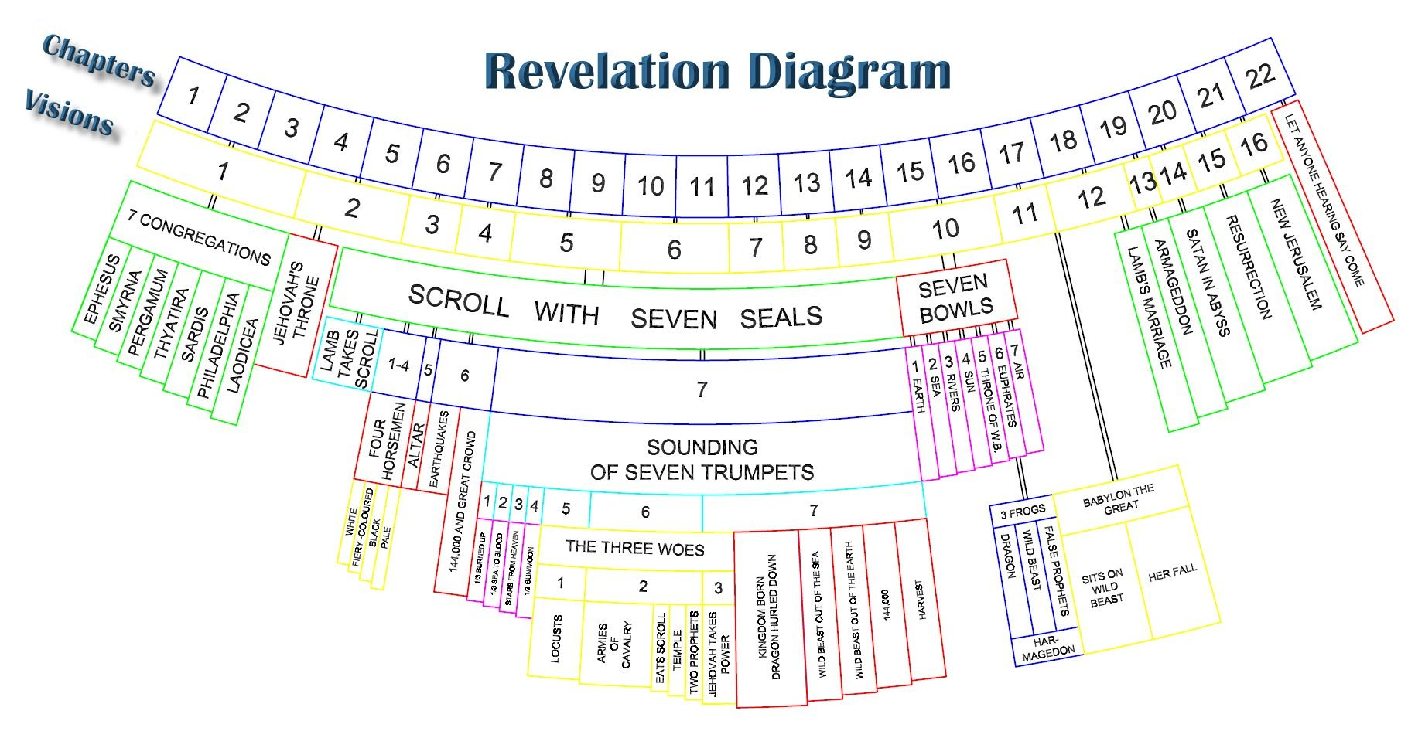
8
Notes:
The baseball diamond is used to represent the growth and progress as it relates to the Christian Life and Service Seminars.
Today’s Agenda/Housekeeping

Slide 9
What Are the 3 Most Important (To You) Items in Revelation ?????
1.
2.
3.
9
Notes:
The baseball diamond is used to represent the growth and progress as it relates to the Christian Life and Service Seminars.
Today’s Agenda/Housekeeping

Slide 10
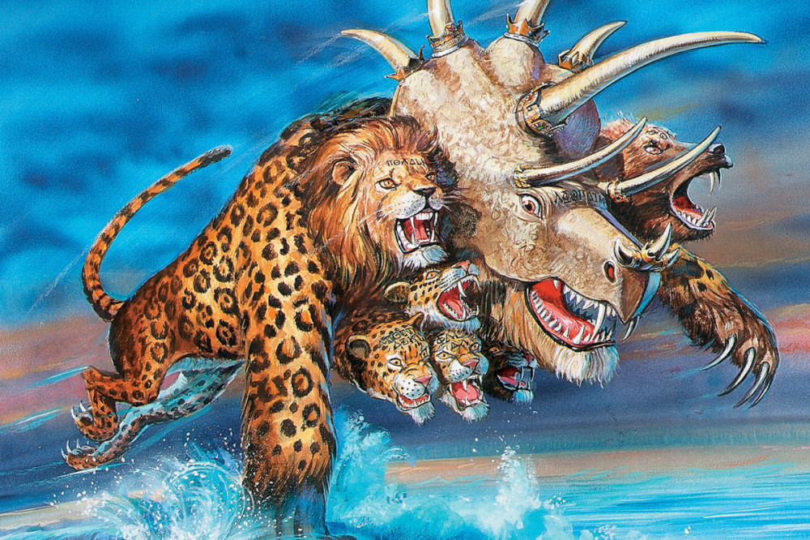
10
Notes:
The baseball diamond is used to represent the growth and progress as it relates to the Christian Life and Service Seminars.
Today’s Agenda/Housekeeping

Slide 11
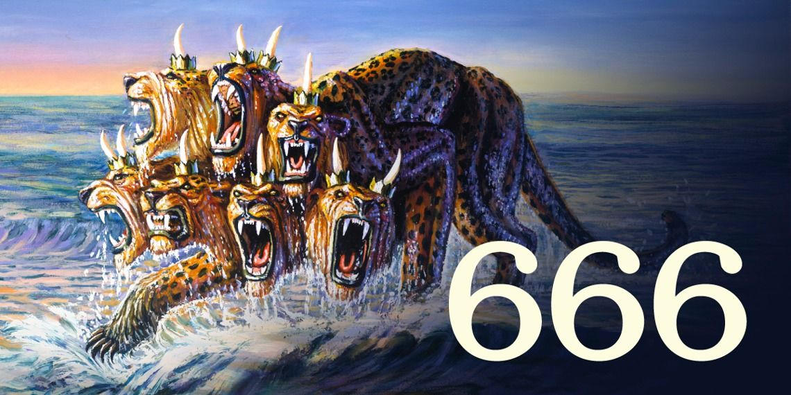
11
Notes:
The baseball diamond is used to represent the growth and progress as it relates to the Christian Life and Service Seminars.
Today’s Agenda/Housekeeping

Slide 12
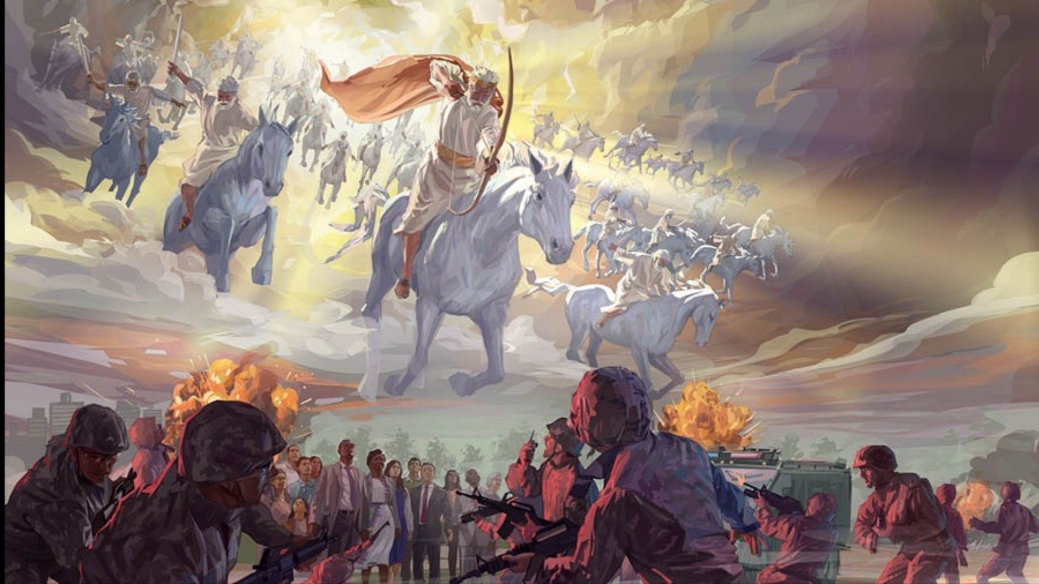
12
Notes:
The baseball diamond is used to represent the growth and progress as it relates to the Christian Life and Service Seminars.
Today’s Agenda/Housekeeping

Slide 13
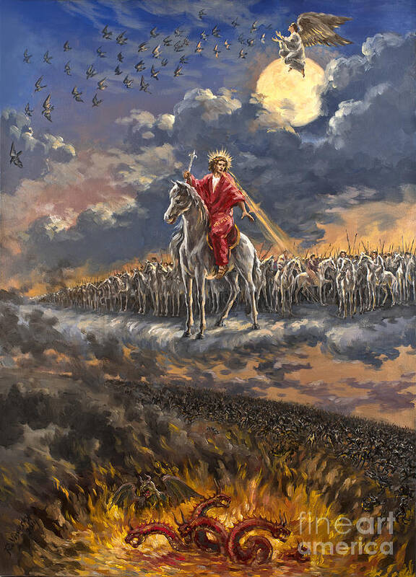
13
Notes:
The baseball diamond is used to represent the growth and progress as it relates to the Christian Life and Service Seminars.
Today’s Agenda/Housekeeping

Slide 14
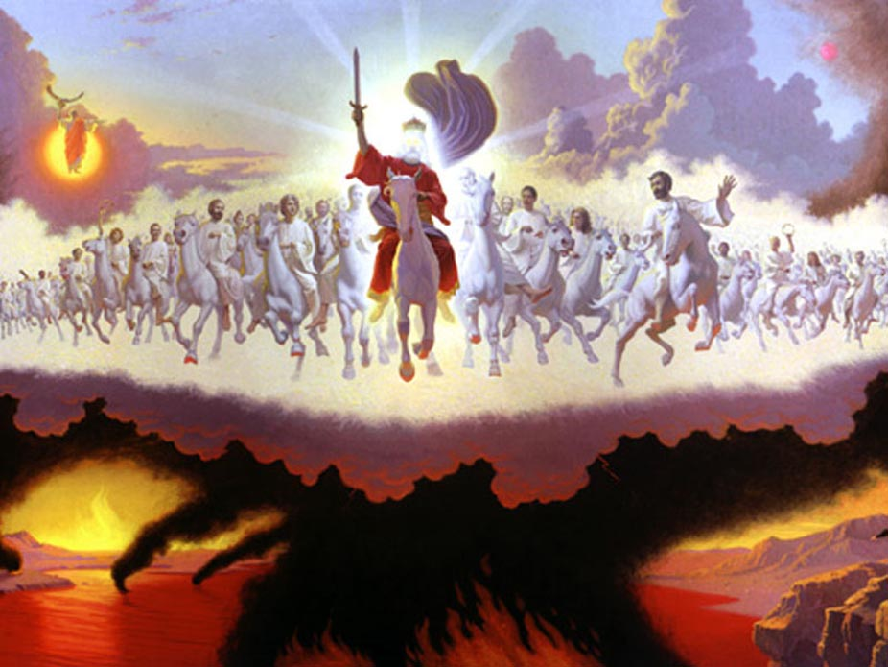
14
Notes:
The baseball diamond is used to represent the growth and progress as it relates to the Christian Life and Service Seminars.
Today’s Agenda/Housekeeping

Slide 15
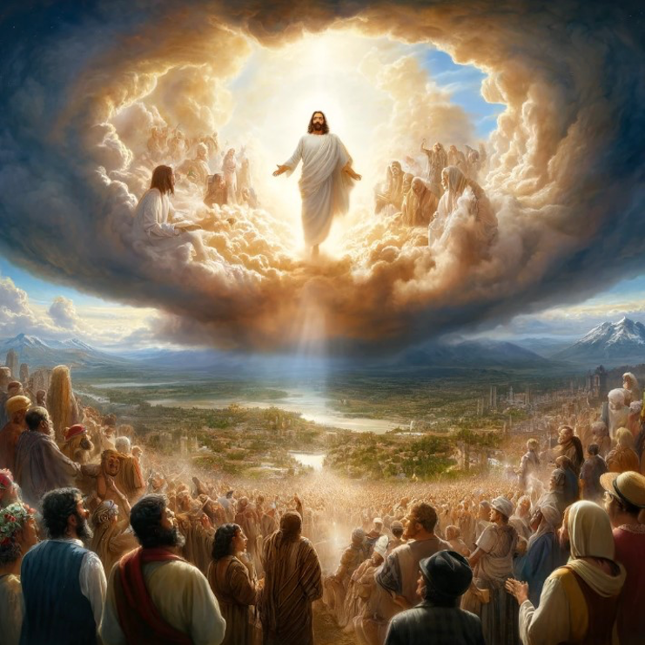
15
Notes:
The baseball diamond is used to represent the growth and progress as it relates to the Christian Life and Service Seminars.
Today’s Agenda/Housekeeping

Slide 16
Map of Israel
Plain of Megiddo
Pictures
16
Notes:
The baseball diamond is used to represent the growth and progress as it relates to the Christian Life and Service Seminars.
Today’s Agenda/Housekeeping

Slide 17
Megiddo wars
19 “Kings came, they fought, the kings of Canaan fought. At Taanach, by the waters of Megiddo, they took no plunder of silver.
Judges 5
17
Notes:
The baseball diamond is used to represent the growth and progress as it relates to the Christian Life and Service Seminars.
Today’s Agenda/Housekeeping

Slide 18
Map of Israel
Plain of Megiddo
Pictures
18
Notes:
The baseball diamond is used to represent the growth and progress as it relates to the Christian Life and Service Seminars.
Today’s Agenda/Housekeeping

Slide 19
Armageddon/Revelation Pathway
Chapter 17
Chapter 16
Chapter 19
Chapter 14
19
Notes:
The baseball diamond is used to represent the growth and progress as it relates to the Christian Life and Service Seminars.
Today’s Agenda/Housekeeping

Slide 20
Revelation 12 -- 1st War
3 Then another sign appeared in heaven: an enormous red dragon with seven heads and ten horns and seven crowns on its heads.
4 Its tail swept a third of the stars out of the sky and flung them to the earth. The dragon stood in front of the woman who was about to give birth, so that it might devour her child the moment he was born.
20
Notes:
The baseball diamond is used to represent the growth and progress as it relates to the Christian Life and Service Seminars.
Today’s Agenda/Housekeeping

Slide 21
Revelation 12 -- 1st War
7 Then war broke out in heaven. Michael and his angels fought against the dragon, and the dragon and his angels fought back.
8 But he was not strong enough, and they lost their place in heaven.
9 The great dragon was hurled down—that ancient serpent called the devil, or Satan, who leads the whole world astray. He was hurled to the earth, and his angels with him.
21
Notes:
The baseball diamond is used to represent the growth and progress as it relates to the Christian Life and Service Seminars.
Today’s Agenda/Housekeeping

Slide 22
Revelation 17 -- 2nd War Warning
11 The beast who once was, and now is not, is an eighth king. He belongs to the seven and is going to his destruction.
12 “The ten horns you saw are ten kings who have not yet received a kingdom, but who for one hour will receive authority as kings along with the beast.
22
Notes:
The baseball diamond is used to represent the growth and progress as it relates to the Christian Life and Service Seminars.
Today’s Agenda/Housekeeping

Slide 23
Revelation 17 -- 2nd War Warning
13 They have one purpose and will give their power and authority to the beast.
14 They will wage war against the Lamb, but the Lamb will triumph over them because he is Lord of lords and King of kings—and with him will be his called, chosen and faithful followers.”
23
Notes:
The baseball diamond is used to represent the growth and progress as it relates to the Christian Life and Service Seminars.
Today’s Agenda/Housekeeping

Slide 24
Revelation 16 -- Gathering for the Slaughter
14 They are demonic spirits that perform signs, and they go out to the kings of the whole world, to gather them for the battle on the great day of God Almighty.
15 “Look, I come like a thief! Blessed is the one who stays awake and remains clothed, so as not to go naked and be shamefully exposed.”
16 Then they gathered the kings together to the place that in Hebrew is called Armageddon.
24
Notes:
The baseball diamond is used to represent the growth and progress as it relates to the Christian Life and Service Seminars.
Today’s Agenda/Housekeeping

Slide 25
Matthew 24 -- Thief in the Night
36 “But about that day or hour no one knows, not even the angels in heaven, nor the Son, but only the Father.
43 But understand this: If the owner of the house had known at what time of night the thief was coming, he would have kept watch and would not have let his house be broken into.
44 So you also must be ready, because the Son of Man will come at an hour when you do not expect him.
25
Notes:
The baseball diamond is used to represent the growth and progress as it relates to the Christian Life and Service Seminars.
Today’s Agenda/Housekeeping

Slide 26
Revelation 19 -- Armageddon
11 I saw heaven standing open and there before me was a white horse, whose rider is called Faithful and True. With justice he judges and wages war.
12 His eyes are like blazing fire, and on his head are many crowns. He has a name written on him that no one knows but he himself.
26
Notes:
The baseball diamond is used to represent the growth and progress as it relates to the Christian Life and Service Seminars.
Today’s Agenda/Housekeeping

Slide 27
Revelation 19 -- Armageddon
13 He is dressed in a robe dipped in blood, and his name is the Word of God.
14 The armies of heaven were following him, riding on white horses and dressed in fine linen, white and clean.
15 Coming out of his mouth is a sharp sword with which to strike down the nations. “He will rule them with an iron scepter.” He treads the winepress of the fury of the wrath of God Almighty.
27
Notes:
The baseball diamond is used to represent the growth and progress as it relates to the Christian Life and Service Seminars.
Today’s Agenda/Housekeeping

Slide 28
Revelation 19 -- Armageddon
16 On his robe and on his thigh he has this name written: KING OF KINGS AND LORD OF LORDS.
17 And I saw an angel standing in the sun, who cried in a loud voice to all the birds flying in midair, “Come, gather together for the great supper of God,
28
Notes:
The baseball diamond is used to represent the growth and progress as it relates to the Christian Life and Service Seminars.
Today’s Agenda/Housekeeping

Slide 29
Revelation 19 -- Armageddon
18 so that you may eat the flesh of kings, generals, and the mighty, of horses and their riders, and the flesh of all people, free and slave, great and small.”
19 Then I saw the beast and the kings of the earth and their armies gathered together to wage war against the rider on the horse and his army.
29
Notes:
The baseball diamond is used to represent the growth and progress as it relates to the Christian Life and Service Seminars.
Today’s Agenda/Housekeeping

Slide 30
Revelation 19 -- Armageddon
20 But the beast was captured, and with it the false prophet who had performed the signs on its behalf. With these signs he had deluded those who had received the mark of the beast and worshiped its image. The two of them were thrown alive into the fiery lake of burning sulfur.
21 The rest were killed with the sword coming out of the mouth of the rider on the horse, and all the birds gorged themselves on their flesh.
30
Notes:
The baseball diamond is used to represent the growth and progress as it relates to the Christian Life and Service Seminars.
Today’s Agenda/Housekeeping

Slide 31
Revelation 14 -- Armageddon Results
14 I looked, and there before me was a white cloud, and seated on the cloud was one like a son of man with a crown of gold on his head and a sharp sickle in his hand.
15 Then another angel came out of the temple and called in a loud voice to him who was sitting on the cloud, “Take your sickle and reap, because the time to reap has come, for the harvest of the earth is ripe.”
31
Notes:
The baseball diamond is used to represent the growth and progress as it relates to the Christian Life and Service Seminars.
Today’s Agenda/Housekeeping

Slide 32
Revelation 14 -- Armageddon Results
16 So he who was seated on the cloud swung his sickle over the earth, and the earth was harvested.
17 Another angel came out of the temple in heaven, and he too had a sharp sickle.
18 Still another angel, who had charge of the fire, came from the altar and called in a loud voice to him who had the sharp sickle, “Take your sharp sickle and gather the clusters of grapes from the earth’s vine, because its grapes are ripe.”
32
Notes:
The baseball diamond is used to represent the growth and progress as it relates to the Christian Life and Service Seminars.
Today’s Agenda/Housekeeping

Slide 33
Revelation 14 -- Armageddon Results
19 The angel swung his sickle on the earth, gathered its grapes and threw them into the great winepress of God’s wrath.
20 They were trampled in the winepress outside the city, and blood flowed out of the press, rising as high as the horses’ bridles for a distance of 1,600 stadia.
33
Notes:
The baseball diamond is used to represent the growth and progress as it relates to the Christian Life and Service Seminars.
Today’s Agenda/Housekeeping

