Slide 1
FBC Liberty Small Group
The Revelation of John
Revelation 15
August 17 , 2025

Slide 2
Most of all, it is the Revelation of Jesus Christ to us. If we catch everything else, but miss Jesus in the book, we miss the Book of Revelation.
2
Notes:
The baseball diamond is used to represent the growth and progress as it relates to the Christian Life and Service Seminars.
Today’s Agenda/Housekeeping

Slide 3
Apostles Creed
I believe in God, the Father almighty,
Maker of heaven and earth,
and in Jesus Christ, his only Son, our Lord,
who was conceived by the Holy Spirit,
born of the Virgin Mary,
3
Notes:
The baseball diamond is used to represent the growth and progress as it relates to the Christian Life and Service Seminars.
Today’s Agenda/Housekeeping

Slide 4
Apostles Creed
suffered under Pontius Pilate,
was crucified, died and was buried;
on the third day he rose from the dead and ascended into heaven,
4
Notes:
The baseball diamond is used to represent the growth and progress as it relates to the Christian Life and Service Seminars.
Today’s Agenda/Housekeeping

Slide 5
Apostles Creed
and is seated at the right hand of God the Father almighty;
from there he will come to judge the living and the dead.
5
Notes:
The baseball diamond is used to represent the growth and progress as it relates to the Christian Life and Service Seminars.
Today’s Agenda/Housekeeping

Slide 6
Apostles Creed
I believe in the Holy Spirit,
the holy catholic Church,
the communion of saints,
the forgiveness of sins,
the resurrection of the body,
and life everlasting. Amen.
6
Notes:
The baseball diamond is used to represent the growth and progress as it relates to the Christian Life and Service Seminars.
Today’s Agenda/Housekeeping

Slide 7
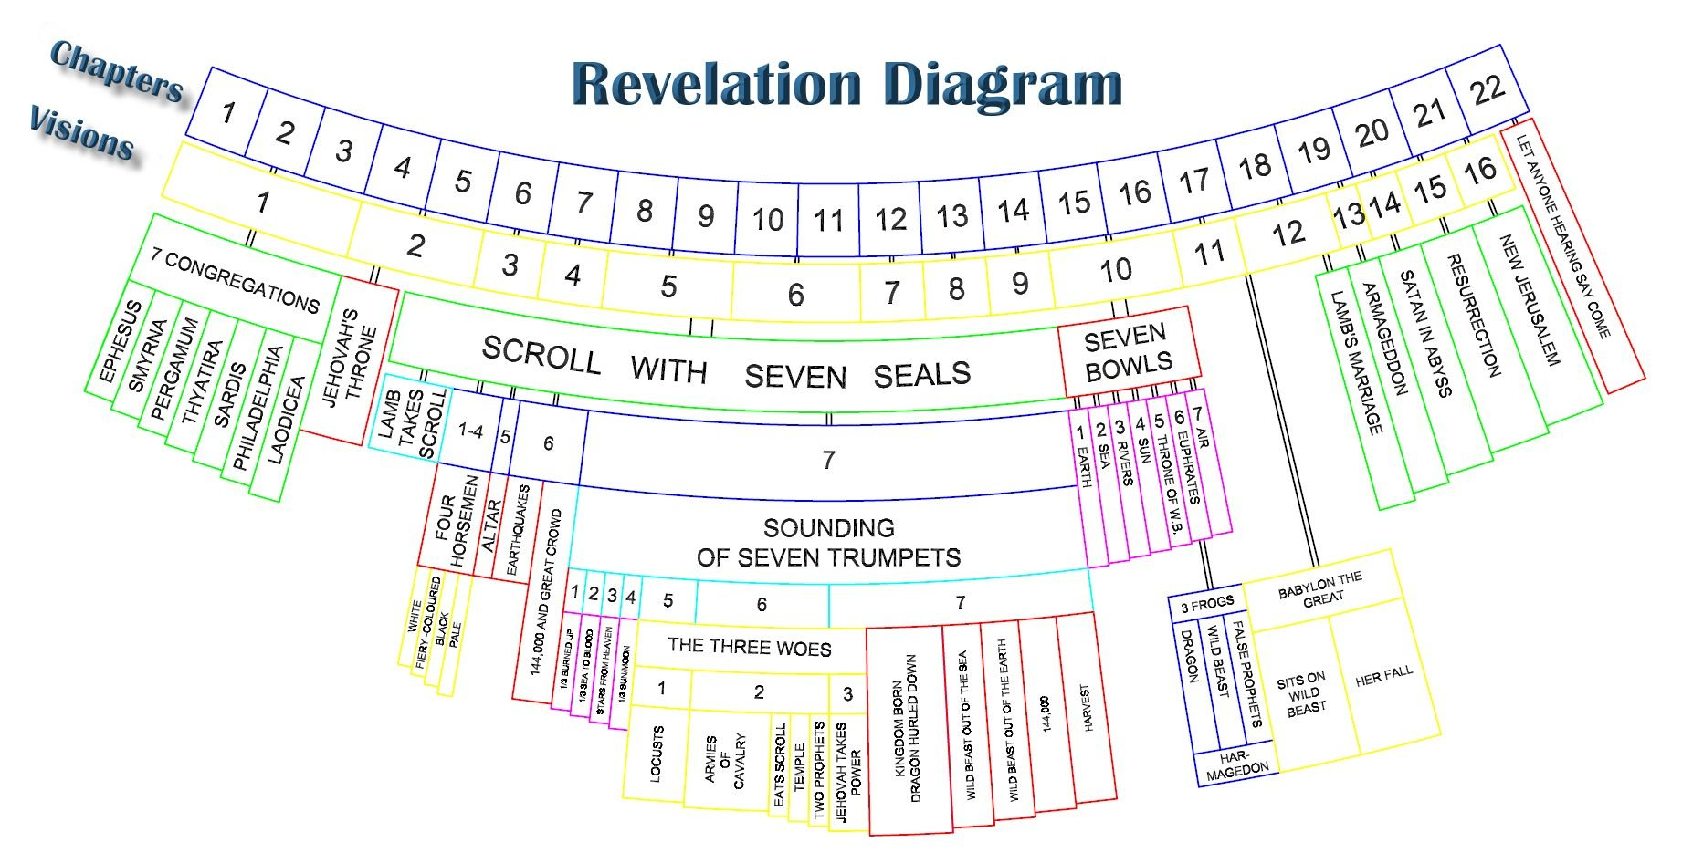
7
Notes:
The baseball diamond is used to represent the growth and progress as it relates to the Christian Life and Service Seminars.
Today’s Agenda/Housekeeping

Slide 8
Armageddon/Revelation Pathway
Chapter 17 - Warning
Chapter 16 - Gathering
Chapter 19 – The War & Results
Chapter 14 – Aftermath
8
Notes:
The baseball diamond is used to represent the growth and progress as it relates to the Christian Life and Service Seminars.
Today’s Agenda/Housekeeping

Slide 9
Revelation 15 -- Last 7 Plagues
1 I saw in heaven another great and marvelous sign: seven angels with the seven last plagues—last, because with them God’s wrath is completed.
2 And I saw what looked like a sea of glass glowing with fire and, standing beside the sea, those who had been victorious over the beast and its image and over the number of its name. They held harps given them by God
9
Notes:
The baseball diamond is used to represent the growth and progress as it relates to the Christian Life and Service Seminars.
Today’s Agenda/Housekeeping

Slide 10
Revelation 8 -- The 1st Seven Angels
1 When he opened the seventh seal, there was silence in heaven for about half an hour.
2 And I saw the seven angels who stand before God, and seven trumpets were given to them.
10
Notes:
The baseball diamond is used to represent the growth and progress as it relates to the Christian Life and Service Seminars.
Today’s Agenda/Housekeeping

Slide 11
Leviticus 26 -- The Original Seven Plagues
21 ‘Then, if you walk contrary to Me, and are not willing to obey Me, I will bring on you seven times more plagues, according to your sins.
22 I will also send wild beasts among you, which shall rob you of your children, destroy your livestock, and make you few in number; and your highways shall be desolate.
11
Notes:
The baseball diamond is used to represent the growth and progress as it relates to the Christian Life and Service Seminars.
Today’s Agenda/Housekeeping

Slide 12
Revelation 6 -- The 1st End
12 I watched as he opened the sixth seal. There was a great earthquake. The sun turned black like sackcloth made of goat hair, the whole moon turned blood red,
13 and the stars in the sky fell to earth, as figs drop from a fig tree when shaken by a strong wind.
12
Notes:
The baseball diamond is used to represent the growth and progress as it relates to the Christian Life and Service Seminars.
Today’s Agenda/Housekeeping

Slide 13
Revelation 6 -- The 1st End
14 The heavens receded like a scroll being rolled up, and every mountain and island was removed from its place.
15 Then the kings of the earth, the princes, the generals, the rich, the mighty, and everyone else, both slave and free, hid in caves and among the rocks of the mountains.
13
Notes:
The baseball diamond is used to represent the growth and progress as it relates to the Christian Life and Service Seminars.
Today’s Agenda/Housekeeping

Slide 14
Revelation 6 -- The 1st End
16 They called to the mountains and the rocks, “Fall on us and hide us from the face of him who sits on the throne and from the wrath of the Lamb!
17 For the great day of their wrath has come, and who can withstand it?”
14
Notes:
The baseball diamond is used to represent the growth and progress as it relates to the Christian Life and Service Seminars.
Today’s Agenda/Housekeeping

Slide 15
Revelation 7 -- Delivery from the Beast
9 After this I looked, and there before me was a great multitude that no one could count, from every nation, tribe, people and language, standing before the throne and before the Lamb. They were wearing white robes and were holding palm branches in their hands.
10 And they cried out in a loud voice: “Salvation belongs to our God, who sits on the throne, and to the Lamb.”
15
Notes:
The baseball diamond is used to represent the growth and progress as it relates to the Christian Life and Service Seminars.
Today’s Agenda/Housekeeping

Slide 16
Revelation 15 -- Last 7 Plagues
3 and sang the song of God’s servant Moses and of the Lamb: “Great and marvelous are your deeds, Lord God Almighty. Just and true are your ways, King of the nations.
4 Who will not fear you, Lord, and bring glory to your name? For you alone are holy. All nations will come and worship before you, for your righteous acts have been revealed.”
16
Notes:
The baseball diamond is used to represent the growth and progress as it relates to the Christian Life and Service Seminars.
Today’s Agenda/Housekeeping

Slide 17
Revelation 15 -- Last 7 Plagues
5 After this I looked, and I saw in heaven the temple—that is, the tabernacle of the covenant law—and it was opened.
6 Out of the temple came the seven angels with the seven plagues. They were dressed in clean, shining linen and wore golden sashes around their chests.
17
Notes:
The baseball diamond is used to represent the growth and progress as it relates to the Christian Life and Service Seminars.
Today’s Agenda/Housekeeping

Slide 18
Revelation 15 -- Last 7 Plagues
7 Then one of the four living creatures gave to the seven angels seven golden bowls filled with the wrath of God, who lives for ever and ever.
8 And the temple was filled with smoke from the glory of God and from his power, and no one could enter the temple until the seven plagues of the seven angels were completed.
18
Notes:
The baseball diamond is used to represent the growth and progress as it relates to the Christian Life and Service Seminars.
Today’s Agenda/Housekeeping

Slide 19
Revelation 15 -- Last 7 Plagues
7 Then one of the four living creatures gave to the seven angels seven golden bowls filled with the wrath of God, who lives for ever and ever.
8 And the temple was filled with smoke from the glory of God and from his power, and no one could enter the temple until the seven plagues of the seven angels were completed.
19
Notes:
The baseball diamond is used to represent the growth and progress as it relates to the Christian Life and Service Seminars.
Today’s Agenda/Housekeeping

