Slide 1

FBC Liberty Small Group
The Revelation of John
Revelation 2 - #4
February 16, 2025

Slide 2
FBC Liberty Small Group
The Revelation of John
Revelation 15
August 17 , 2025

Slide 3
Revelation of John Started One Year Ago
August 18 , 2024

Slide 4
Most of all, it is the Revelation of Jesus Christ to us. If we catch everything else, but miss Jesus in the book, we miss the Book of Revelation.
4
Notes:
The baseball diamond is used to represent the growth and progress as it relates to the Christian Life and Service Seminars.
Today’s Agenda/Housekeeping

Slide 5
Apostles Creed
I believe in God, the Father almighty,
Maker of heaven and earth,
and in Jesus Christ, his only Son, our Lord,
who was conceived by the Holy Spirit,
born of the Virgin Mary,
5
Notes:
The baseball diamond is used to represent the growth and progress as it relates to the Christian Life and Service Seminars.
Today’s Agenda/Housekeeping

Slide 6
Apostles Creed
suffered under Pontius Pilate,
was crucified, died and was buried;
on the third day he rose from the dead and ascended into heaven,
6
Notes:
The baseball diamond is used to represent the growth and progress as it relates to the Christian Life and Service Seminars.
Today’s Agenda/Housekeeping

Slide 7
Apostles Creed
and is seated at the right hand of God the Father almighty;
from there he will come to judge the living and the dead.
7
Notes:
The baseball diamond is used to represent the growth and progress as it relates to the Christian Life and Service Seminars.
Today’s Agenda/Housekeeping

Slide 8
Apostles Creed
I believe in the Holy Spirit,
the holy catholic Church,
the communion of saints,
the forgiveness of sins,
the resurrection of the body,
and life everlasting. Amen.
8
Notes:
The baseball diamond is used to represent the growth and progress as it relates to the Christian Life and Service Seminars.
Today’s Agenda/Housekeeping

Slide 9
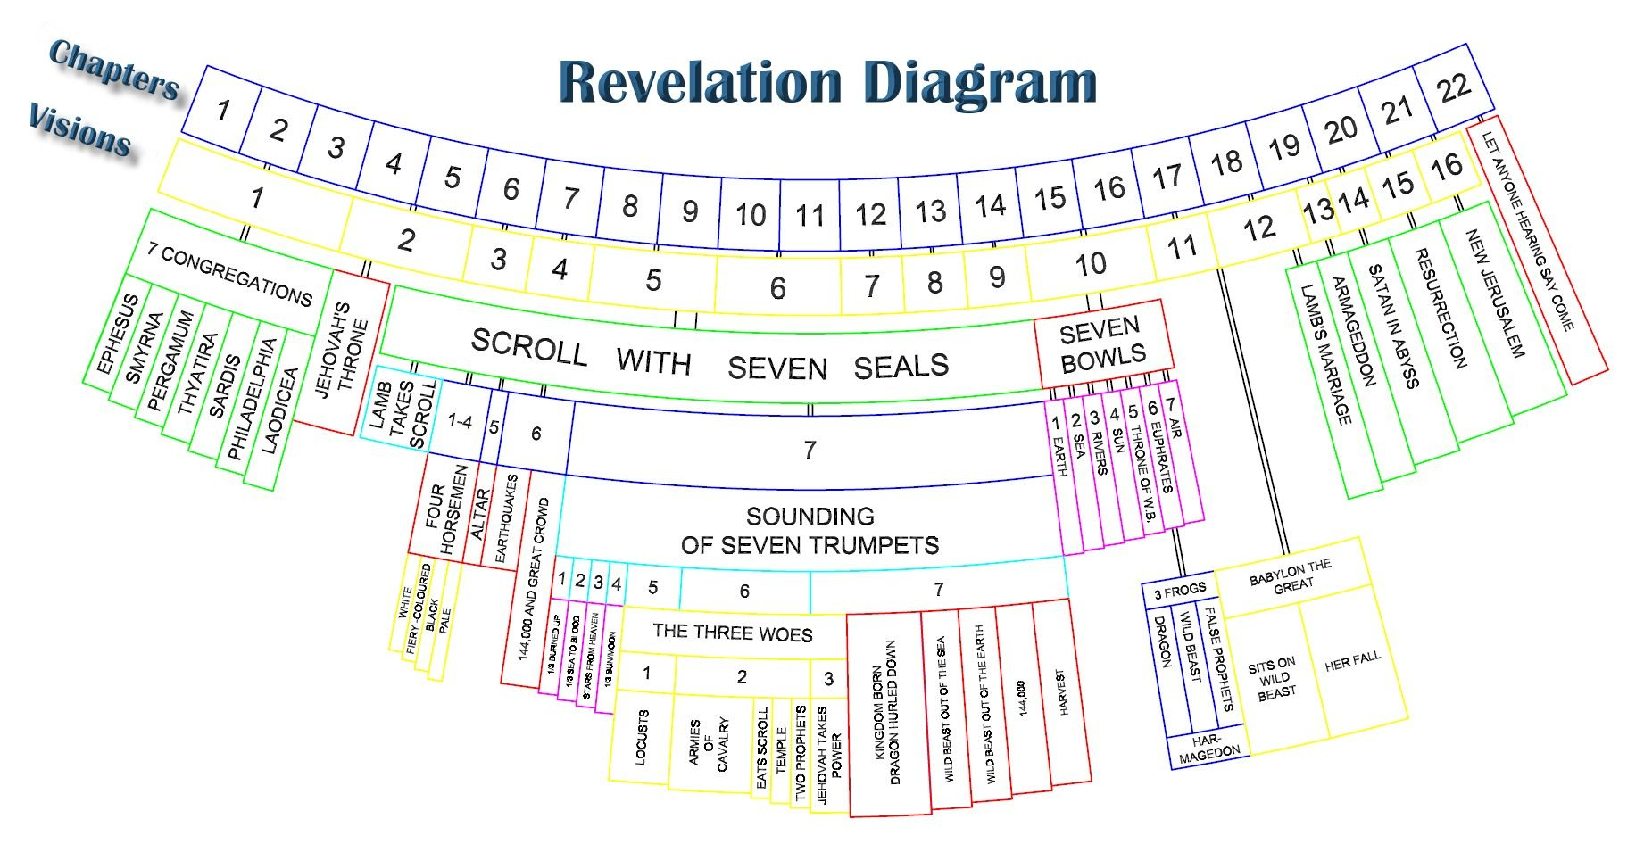
9
Notes:
The baseball diamond is used to represent the growth and progress as it relates to the Christian Life and Service Seminars.
Today’s Agenda/Housekeeping

Slide 10
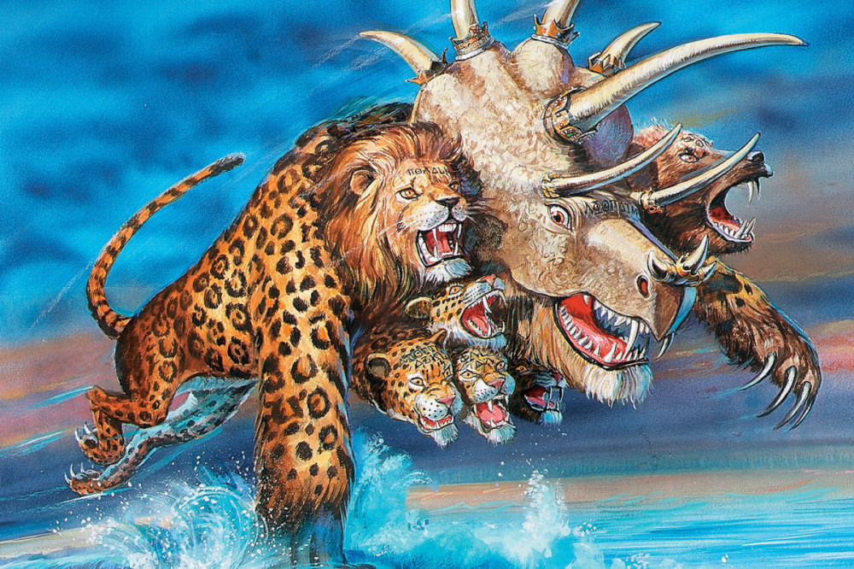
10
Notes:
The baseball diamond is used to represent the growth and progress as it relates to the Christian Life and Service Seminars.
Today’s Agenda/Housekeeping

Slide 11
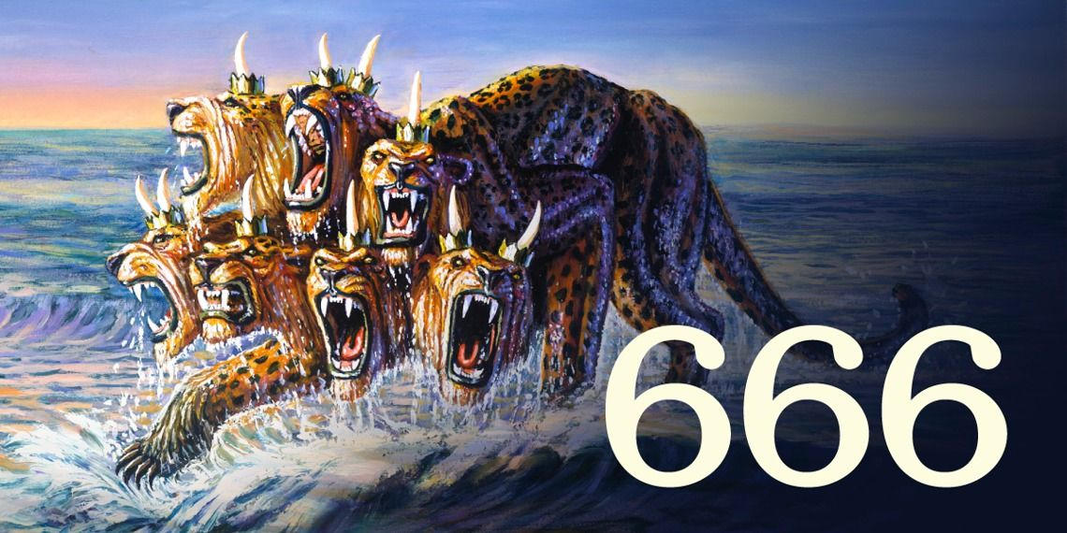
11
Notes:
The baseball diamond is used to represent the growth and progress as it relates to the Christian Life and Service Seminars.
Today’s Agenda/Housekeeping

Slide 12
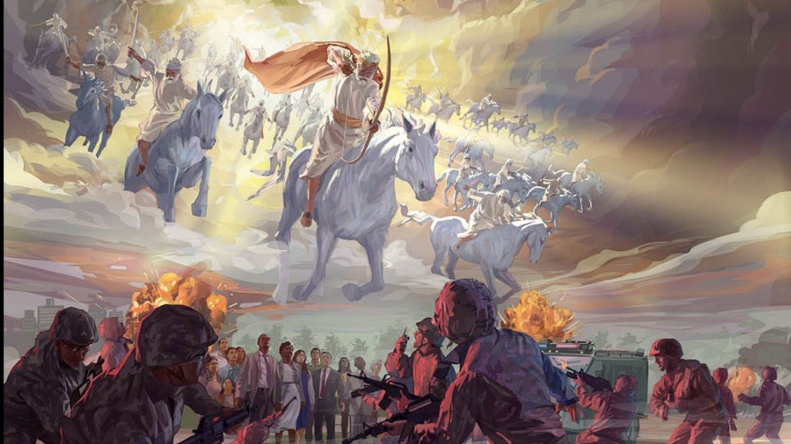
12
Notes:
The baseball diamond is used to represent the growth and progress as it relates to the Christian Life and Service Seminars.
Today’s Agenda/Housekeeping

Slide 13
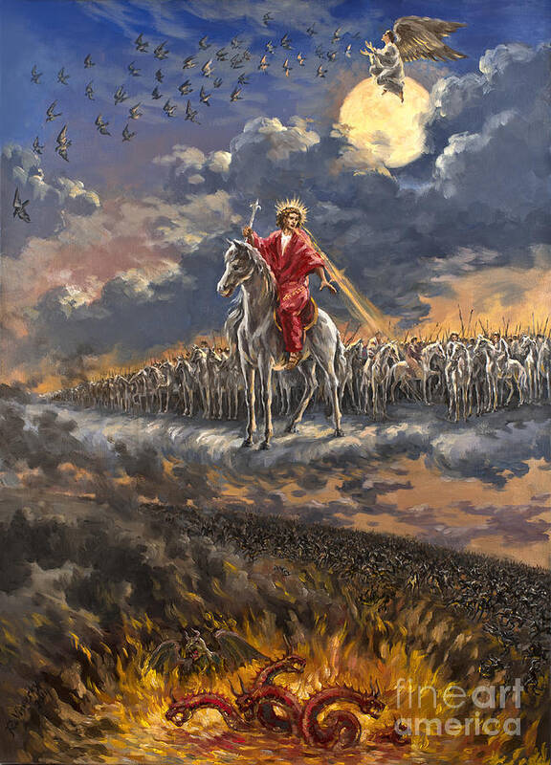
13
Notes:
The baseball diamond is used to represent the growth and progress as it relates to the Christian Life and Service Seminars.
Today’s Agenda/Housekeeping

Slide 14
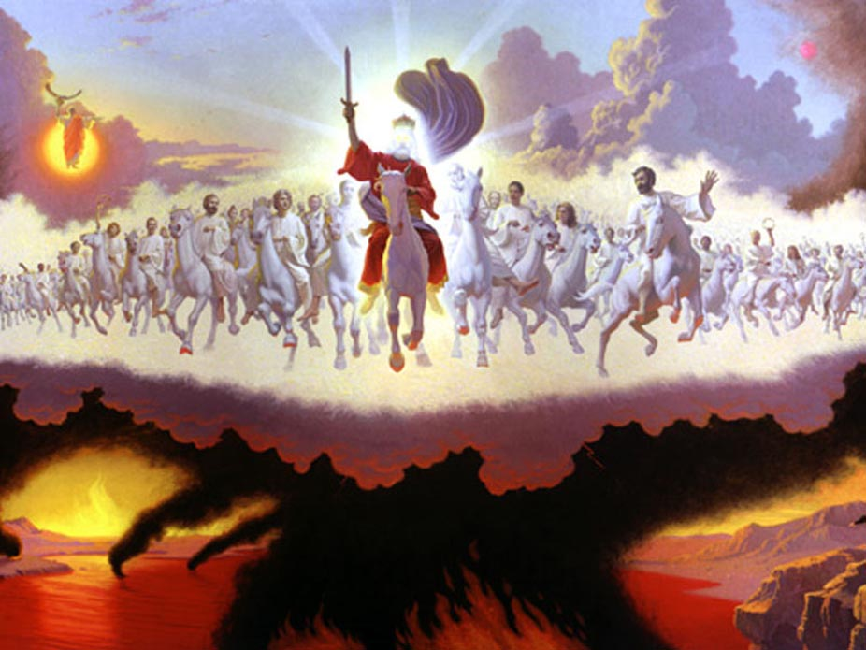
14
Notes:
The baseball diamond is used to represent the growth and progress as it relates to the Christian Life and Service Seminars.
Today’s Agenda/Housekeeping

Slide 15
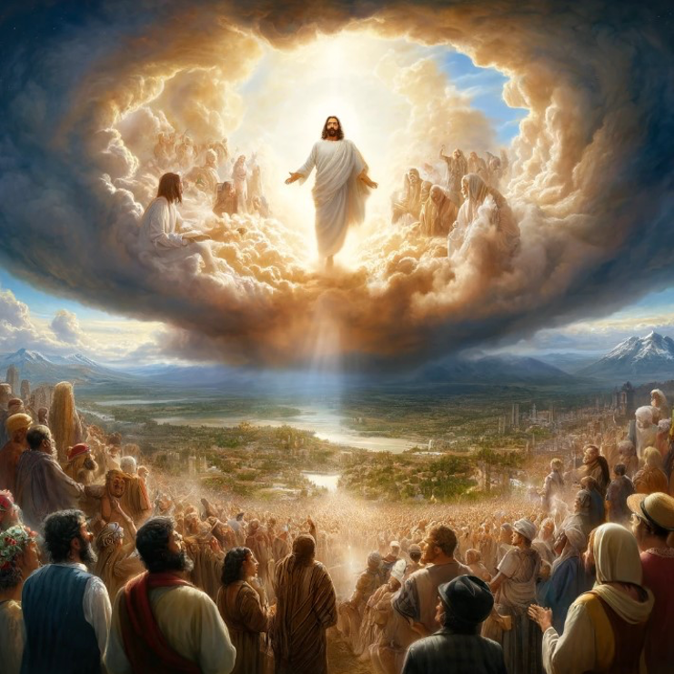
15
Notes:
The baseball diamond is used to represent the growth and progress as it relates to the Christian Life and Service Seminars.
Today’s Agenda/Housekeeping

Slide 16
Little Man
16
Notes:
The baseball diamond is used to represent the growth and progress as it relates to the Christian Life and Service Seminars.
Today’s Agenda/Housekeeping

Slide 17
Armageddon/Revelation Pathway
Chapter 17 - Warning
Chapter 16 - Gathering
Chapter 19 – The War & Results
Chapter 14 – Aftermath
17
Notes:
The baseball diamond is used to represent the growth and progress as it relates to the Christian Life and Service Seminars.
Today’s Agenda/Housekeeping

Slide 18
Revelation 15 -- Last 7 Plagues
1 I saw in heaven another great and marvelous sign: seven angels with the seven last plagues—last, because with them God’s wrath is completed.
2 And I saw what looked like a sea of glass glowing with fire and, standing beside the sea, those who had been victorious over the beast and its image and over the number of its name. They held harps given them by God
18
Notes:
The baseball diamond is used to represent the growth and progress as it relates to the Christian Life and Service Seminars.
Today’s Agenda/Housekeeping

Slide 19
Revelation 8 -- The 1st Seven Angels
1 When he opened the seventh seal, there was silence in heaven for about half an hour.
2 And I saw the seven angels who stand before God, and seven trumpets were given to them.
19
Notes:
The baseball diamond is used to represent the growth and progress as it relates to the Christian Life and Service Seminars.
Today’s Agenda/Housekeeping

Slide 20
Leviticus 26 -- The Original Seven Plagues
21 ‘Then, if you walk contrary to Me, and are not willing to obey Me, I will bring on you seven times more plagues, according to your sins.
22 I will also send wild beasts among you, which shall rob you of your children, destroy your livestock, and make you few in number; and your highways shall be desolate.
20
Notes:
The baseball diamond is used to represent the growth and progress as it relates to the Christian Life and Service Seminars.
Today’s Agenda/Housekeeping

Slide 21
Revelation 6 -- The 1st End
12 I watched as he opened the sixth seal. There was a great earthquake. The sun turned black like sackcloth made of goat hair, the whole moon turned blood red,
13 and the stars in the sky fell to earth, as figs drop from a fig tree when shaken by a strong wind.
21
Notes:
The baseball diamond is used to represent the growth and progress as it relates to the Christian Life and Service Seminars.
Today’s Agenda/Housekeeping

Slide 22
Revelation 6 -- The 1st End
14 The heavens receded like a scroll being rolled up, and every mountain and island was removed from its place.
15 Then the kings of the earth, the princes, the generals, the rich, the mighty, and everyone else, both slave and free, hid in caves and among the rocks of the mountains.
22
Notes:
The baseball diamond is used to represent the growth and progress as it relates to the Christian Life and Service Seminars.
Today’s Agenda/Housekeeping

Slide 23
Revelation 6 -- The 1st End
16 They called to the mountains and the rocks, “Fall on us and hide us from the face of him who sits on the throne and from the wrath of the Lamb!
17 For the great day of their wrath has come, and who can withstand it?”
23
Notes:
The baseball diamond is used to represent the growth and progress as it relates to the Christian Life and Service Seminars.
Today’s Agenda/Housekeeping

Slide 24
Revelation 7 -- Delivery from the Beast
9 After this I looked, and there before me was a great multitude that no one could count, from every nation, tribe, people and language, standing before the throne and before the Lamb. They were wearing white robes and were holding palm branches in their hands.
10 And they cried out in a loud voice: “Salvation belongs to our God, who sits on the throne, and to the Lamb.”
24
Notes:
The baseball diamond is used to represent the growth and progress as it relates to the Christian Life and Service Seminars.
Today’s Agenda/Housekeeping

Slide 25
Revelation 15 -- Last 7 Plagues
3 and sang the song of God’s servant Moses and of the Lamb: “Great and marvelous are your deeds, Lord God Almighty. Just and true are your ways, King of the nations.
4 Who will not fear you, Lord, and bring glory to your name? For you alone are holy. All nations will come and worship before you, for your righteous acts have been revealed.”
25
Notes:
The baseball diamond is used to represent the growth and progress as it relates to the Christian Life and Service Seminars.
Today’s Agenda/Housekeeping

Slide 26
Revelation 15 -- Last 7 Plagues
5 After this I looked, and I saw in heaven the temple—that is, the tabernacle of the covenant law—and it was opened.
6 Out of the temple came the seven angels with the seven plagues. They were dressed in clean, shining linen and wore golden sashes around their chests.
26
Notes:
The baseball diamond is used to represent the growth and progress as it relates to the Christian Life and Service Seminars.
Today’s Agenda/Housekeeping

Slide 27
Revelation 15 -- Last 7 Plagues
7 Then one of the four living creatures gave to the seven angels seven golden bowls filled with the wrath of God, who lives for ever and ever.
8 And the temple was filled with smoke from the glory of God and from his power, and no one could enter the temple until the seven plagues of the seven angels were completed.
27
Notes:
The baseball diamond is used to represent the growth and progress as it relates to the Christian Life and Service Seminars.
Today’s Agenda/Housekeeping

Slide 28
Revelation 15 -- Last 7 Plagues
7 Then one of the four living creatures gave to the seven angels seven golden bowls filled with the wrath of God, who lives for ever and ever.
8 And the temple was filled with smoke from the glory of God and from his power, and no one could enter the temple until the seven plagues of the seven angels were completed.
28
Notes:
The baseball diamond is used to represent the growth and progress as it relates to the Christian Life and Service Seminars.
Today’s Agenda/Housekeeping

Slide 29
Revelation 16 -- Last 7 Plagues
1 Then I heard a loud voice from the temple saying to the seven angels, “Go, pour out the seven bowls of God’s wrath on the earth.”
2 The first angel went and poured out his bowl on the land, and ugly, festering sores broke out on the people who had the mark of the beast and worshiped its image.
29
Notes:
The baseball diamond is used to represent the growth and progress as it relates to the Christian Life and Service Seminars.
Today’s Agenda/Housekeeping

Slide 30
Revelation 16 -- Last 7 Plagues
3 The second angel poured out his bowl on the sea, and it turned into blood like that of a dead person, and every living thing in the sea died.
4 The third angel poured out his bowl on the rivers and springs of water, and they became blood.
30
Notes:
The baseball diamond is used to represent the growth and progress as it relates to the Christian Life and Service Seminars.
Today’s Agenda/Housekeeping

Slide 31
Revelation 16 -- Last 7 Plagues
5 Then I heard the angel in charge of the waters say: “You are just in these judgments, O Holy One, you who are and who were;
6 for they have shed the blood of your holy people and your prophets, and you have given them blood to drink as they deserve.”
31
Notes:
The baseball diamond is used to represent the growth and progress as it relates to the Christian Life and Service Seminars.
Today’s Agenda/Housekeeping

Slide 32
Revelation 16 -- Last 7 Plagues
7 And I heard the altar respond: “Yes, Lord God Almighty, true and just are your judgments.”
8 The fourth angel poured out his bowl on the sun, and the sun was allowed to scorch people with fire.
32
Notes:
The baseball diamond is used to represent the growth and progress as it relates to the Christian Life and Service Seminars.
Today’s Agenda/Housekeeping

Slide 33
Revelation 16 -- Last 7 Plagues
9 They were seared by the intense heat and they cursed the name of God, who had control over these plagues, but they refused to repent and glorify him.
10 The fifth angel poured out his bowl on the throne of the beast, and its kingdom was plunged into darkness. People gnawed their tongues in agony
33
Notes:
The baseball diamond is used to represent the growth and progress as it relates to the Christian Life and Service Seminars.
Today’s Agenda/Housekeeping

Slide 34
Revelation 16 -- Last 7 Plagues
11 and cursed the God of heaven because of their pains and their sores, but they refused to repent of what they had done.
12 The sixth angel poured out his bowl on the great river Euphrates, and its water was dried up to prepare the way for the kings from the East.
34
Notes:
The baseball diamond is used to represent the growth and progress as it relates to the Christian Life and Service Seminars.
Today’s Agenda/Housekeeping

Slide 35
Revelation 16 -- Last 7 Plagues
13 Then I saw three impure spirits that looked like frogs; they came out of the mouth of the dragon, out of the mouth of the beast and out of the mouth of the false prophet.
14 They are demonic spirits that perform signs, and they go out to the kings of the whole world, to gather them for the battle on the great day of God Almighty.
35
Notes:
The baseball diamond is used to represent the growth and progress as it relates to the Christian Life and Service Seminars.
Today’s Agenda/Housekeeping

Slide 36
Revelation 16 -- Last 7 Plagues
15 “Look, I come like a thief! Blessed is the one who stays awake and remains clothed, so as not to go naked and be shamefully exposed.”
16 Then they gathered the kings together to the place that in Hebrew is called Armageddon.
36
Notes:
The baseball diamond is used to represent the growth and progress as it relates to the Christian Life and Service Seminars.
Today’s Agenda/Housekeeping

Slide 37
Revelation 16 -- Last 7 Plagues
17 The seventh angel poured out his bowl into the air, and out of the temple came a loud voice from the throne, saying, “It is done!”
18 Then there came flashes of lightning, rumblings, peals of thunder and a severe earthquake. No earthquake like it has ever occurred since mankind has been on earth, so tremendous was the quake.
37
Notes:
The baseball diamond is used to represent the growth and progress as it relates to the Christian Life and Service Seminars.
Today’s Agenda/Housekeeping

Slide 38
Revelation 16 -- Last 7 Plagues
19 The great city split into three parts, and the cities of the nations collapsed. God remembered Babylon the Great and gave her the cup filled with the wine of the fury of his wrath.
20 Every island fled away and the mountains could not be found.
38
Notes:
The baseball diamond is used to represent the growth and progress as it relates to the Christian Life and Service Seminars.
Today’s Agenda/Housekeeping

Slide 39
Revelation 16 -- Last 7 Plagues
21 From the sky huge hailstones, each weighing about a hundred pounds, fell on people. And they cursed God on account of the plague of hail, because the plague was so terrible.
39
Notes:
The baseball diamond is used to represent the growth and progress as it relates to the Christian Life and Service Seminars.
Today’s Agenda/Housekeeping

