Slide 1
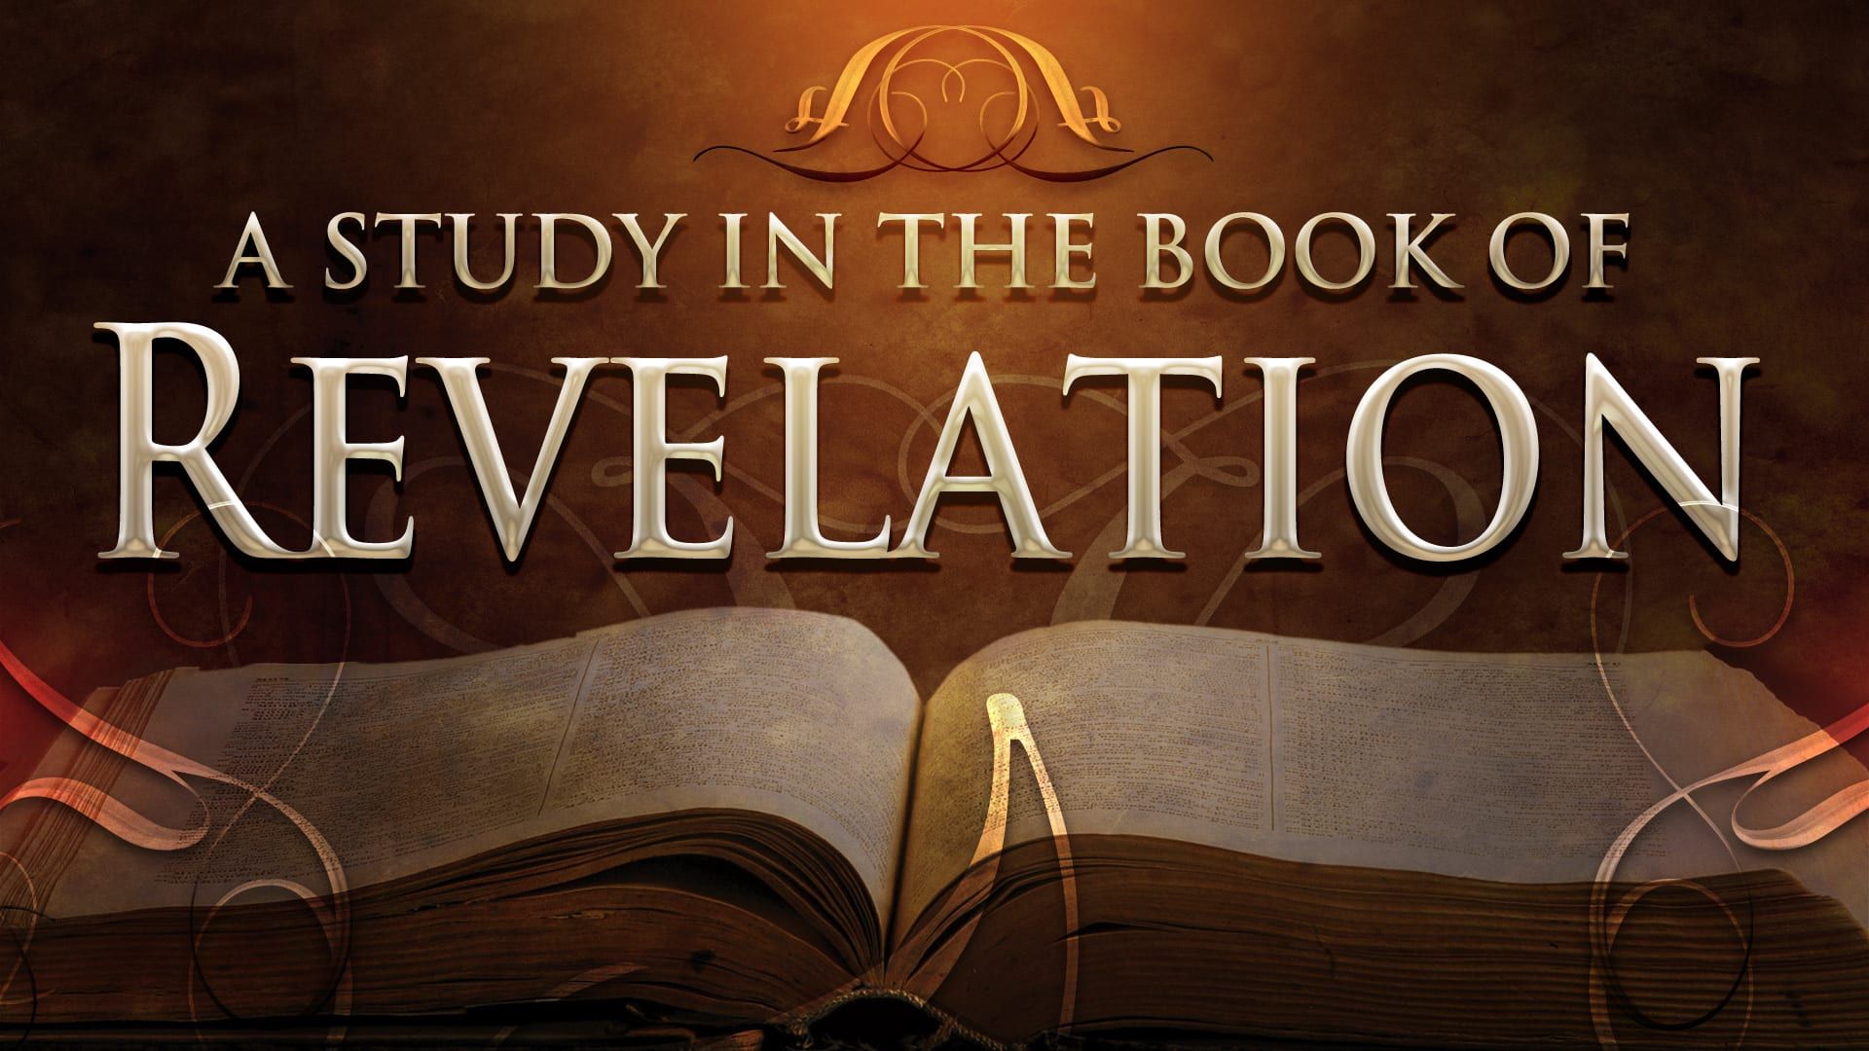
FBC Liberty Small Group
The Revelation of John
Revelation 2 - #4
February 16, 2025

Slide 2
FBC Liberty Small Group
The Revelation of John
Revelation 15
August 17 , 2025

Slide 3
Revelation of John Started One Year Ago
August 18 , 2024

Slide 4
Most of all, it is the Revelation of Jesus Christ to us. If we catch everything else, but miss Jesus in the book, we miss the Book of Revelation.
4
Notes:
The baseball diamond is used to represent the growth and progress as it relates to the Christian Life and Service Seminars.
Today’s Agenda/Housekeeping

Slide 5
Apostles Creed
I believe in God, the Father almighty,
Maker of heaven and earth,
and in Jesus Christ, his only Son, our Lord,
who was conceived by the Holy Spirit,
born of the Virgin Mary,
5
Notes:
The baseball diamond is used to represent the growth and progress as it relates to the Christian Life and Service Seminars.
Today’s Agenda/Housekeeping

Slide 6
Apostles Creed
suffered under Pontius Pilate,
was crucified, died and was buried;
on the third day he rose from the dead and ascended into heaven,
6
Notes:
The baseball diamond is used to represent the growth and progress as it relates to the Christian Life and Service Seminars.
Today’s Agenda/Housekeeping

Slide 7
Apostles Creed
and is seated at the right hand of God the Father almighty;
from there he will come to judge the living and the dead.
7
Notes:
The baseball diamond is used to represent the growth and progress as it relates to the Christian Life and Service Seminars.
Today’s Agenda/Housekeeping

Slide 8
Apostles Creed
I believe in the Holy Spirit,
the holy catholic Church,
the communion of saints,
the forgiveness of sins,
the resurrection of the body,
and life everlasting. Amen.
8
Notes:
The baseball diamond is used to represent the growth and progress as it relates to the Christian Life and Service Seminars.
Today’s Agenda/Housekeeping

Slide 9
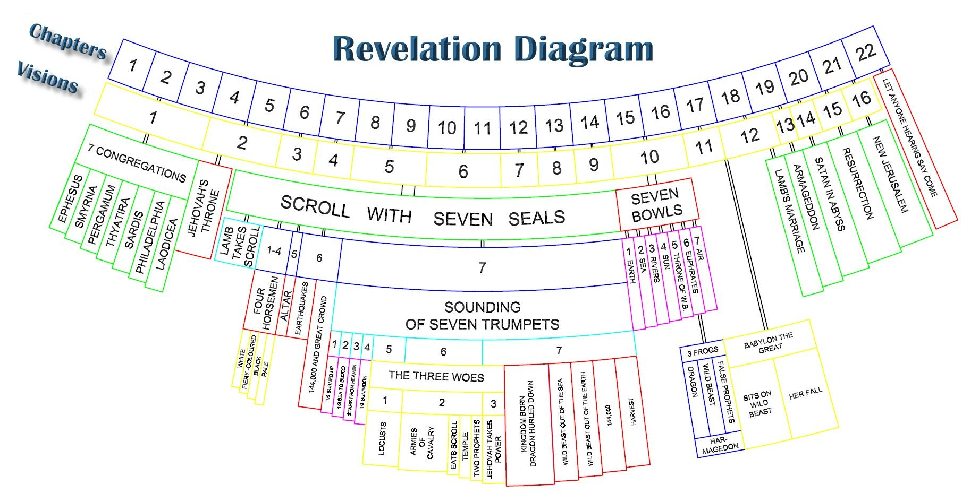
9
Notes:
The baseball diamond is used to represent the growth and progress as it relates to the Christian Life and Service Seminars.
Today’s Agenda/Housekeeping

Slide 10
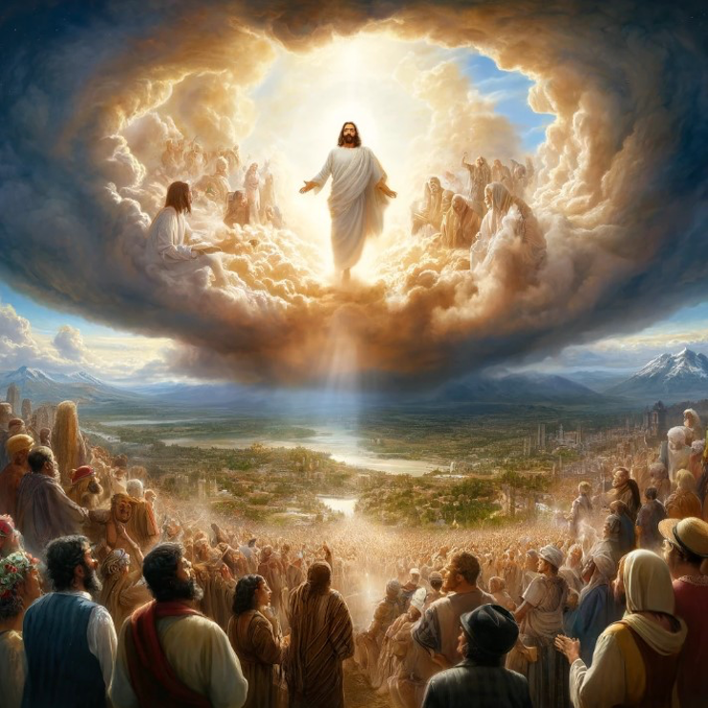
10
Notes:
The baseball diamond is used to represent the growth and progress as it relates to the Christian Life and Service Seminars.
Today’s Agenda/Housekeeping

Slide 11
Revelation Clarity
Revelation is apocalyptic—a genre defined by images, symbols, and references to the Old Testament and John’s ancient world.
It’s intended to help the churches to whom it’s written see the world in a different way.
11
Notes:
The baseball diamond is used to represent the growth and progress as it relates to the Christian Life and Service Seminars.
Today’s Agenda/Housekeeping

Slide 12
Revelation 15 -- Another Gathering
or
Repeat of Chapter
4 Then I heard the number of those who were sealed: 144,000 from all the tribes of Israel.
9 After this I looked, and there before me was a great multitude that no one could count, from every nation, tribe, people and language, standing before the throne and before the Lamb. They were wearing white robes and were holding palm branches in their hands.
12
Notes:
The baseball diamond is used to represent the growth and progress as it relates to the Christian Life and Service Seminars.
Today’s Agenda/Housekeeping

Slide 13
Revelation 11 -- Warning for the Bowls
14 The second woe has passed; the third woe is coming soon.
15 The seventh angel sounded his trumpet, and there were loud voices in heaven, which said: “The kingdom of the world has become the kingdom of our Lord and of his Messiah, and he will reign for ever and ever.”
13
Notes:
The baseball diamond is used to represent the growth and progress as it relates to the Christian Life and Service Seminars.
Today’s Agenda/Housekeeping

Slide 14
Revelation 11 to 15 Break
Chapter 12 -- Woman & the Dragon
Chapter 13 -- The Beast & the 2nd Beast
Chapter 14 -- The 144,000 Come Back
The 3 Angels
The fallout from Armageddon
Chapter 15 -- The Bowls Beginning
14
Notes:
The baseball diamond is used to represent the growth and progress as it relates to the Christian Life and Service Seminars.
Today’s Agenda/Housekeeping

Slide 15
Revelation 16 -- Last 7 Plagues
1 Then I heard a loud voice from the temple saying to the seven angels, “Go, pour out the seven bowls of God’s wrath on the earth.”
2 The first angel went and poured out his bowl on the land, and ugly, festering sores broke out on the people who had the mark of the beast and worshiped its image.
15
Notes:
The baseball diamond is used to represent the growth and progress as it relates to the Christian Life and Service Seminars.
Today’s Agenda/Housekeeping

Slide 16
Revelation 16 -- Last 7 Plagues
3 The second angel poured out his bowl on the sea, and it turned into blood like that of a dead person, and every living thing in the sea died.
4 The third angel poured out his bowl on the rivers and springs of water, and they became blood.
16
Notes:
The baseball diamond is used to represent the growth and progress as it relates to the Christian Life and Service Seminars.
Today’s Agenda/Housekeeping

Slide 17
Revelation 8 -- Precursor to 16
8 The second angel sounded his trumpet, and something like a huge mountain, all ablaze, was thrown into the sea. A third of the sea turned into blood,
9 a third of the living creatures in the sea died, and a third of the ships were destroyed.
17
Notes:
The baseball diamond is used to represent the growth and progress as it relates to the Christian Life and Service Seminars.
Today’s Agenda/Housekeeping

Slide 18
Revelation 8 -- Precursor to 16
10 The third angel sounded his trumpet, and a great star, blazing like a torch, fell from the sky on a third of the rivers and on the springs of water —
11 the name of the star is Wormwood. A third of the waters turned bitter, and many people died from the waters that had become bitter.
18
Notes:
The baseball diamond is used to represent the growth and progress as it relates to the Christian Life and Service Seminars.
Today’s Agenda/Housekeeping

Slide 19
Revelation 16 -- Last 7 Plagues
5 Then I heard the angel in charge of the waters say: “You are just in these judgments, O Holy One, you who are and who were;
6 for they have shed the blood of your holy people and your prophets, and you have given them blood to drink as they deserve.”
19
Notes:
The baseball diamond is used to represent the growth and progress as it relates to the Christian Life and Service Seminars.
Today’s Agenda/Housekeeping

Slide 20
Revelation 16 -- Last 7 Plagues
7 And I heard the altar respond: “Yes, Lord God Almighty, true and just are your judgments.”
8 The fourth angel poured out his bowl on the sun, and the sun was allowed to scorch people with fire.
20
Notes:
The baseball diamond is used to represent the growth and progress as it relates to the Christian Life and Service Seminars.
Today’s Agenda/Housekeeping

Slide 21
Revelation 16 -- Last 7 Plagues
9 They were seared by the intense heat and they cursed the name of God, who had control over these plagues, but they refused to repent and glorify him.
10 The fifth angel poured out his bowl on the throne of the beast, and its kingdom was plunged into darkness. People gnawed their tongues in agony
21
Notes:
The baseball diamond is used to represent the growth and progress as it relates to the Christian Life and Service Seminars.
Today’s Agenda/Housekeeping

Slide 22
Revelation 16 -- Last 7 Plagues
11 and cursed the God of heaven because of their pains and their sores, but they refused to repent of what they had done.
12 The sixth angel poured out his bowl on the great river Euphrates, and its water was dried up to prepare the way for the kings from the East.
22
Notes:
The baseball diamond is used to represent the growth and progress as it relates to the Christian Life and Service Seminars.
Today’s Agenda/Housekeeping

Slide 23
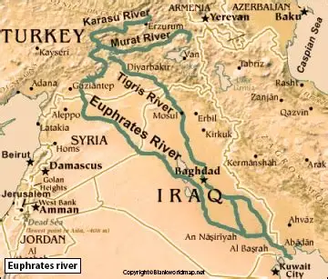
Revelation 16 -- Last 7 Plagues
23
Notes:
The baseball diamond is used to represent the growth and progress as it relates to the Christian Life and Service Seminars.
Today’s Agenda/Housekeeping

Slide 24
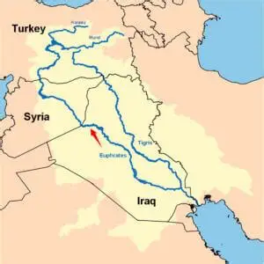
24
Notes:
The baseball diamond is used to represent the growth and progress as it relates to the Christian Life and Service Seminars.
Today’s Agenda/Housekeeping

Slide 25
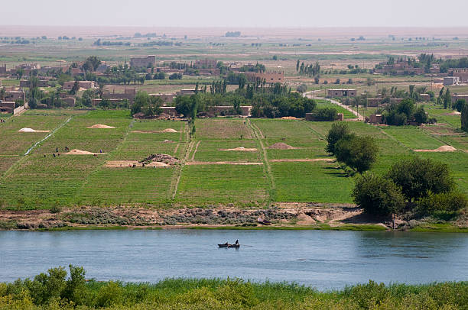
25
Notes:
The baseball diamond is used to represent the growth and progress as it relates to the Christian Life and Service Seminars.
Today’s Agenda/Housekeeping

Slide 26
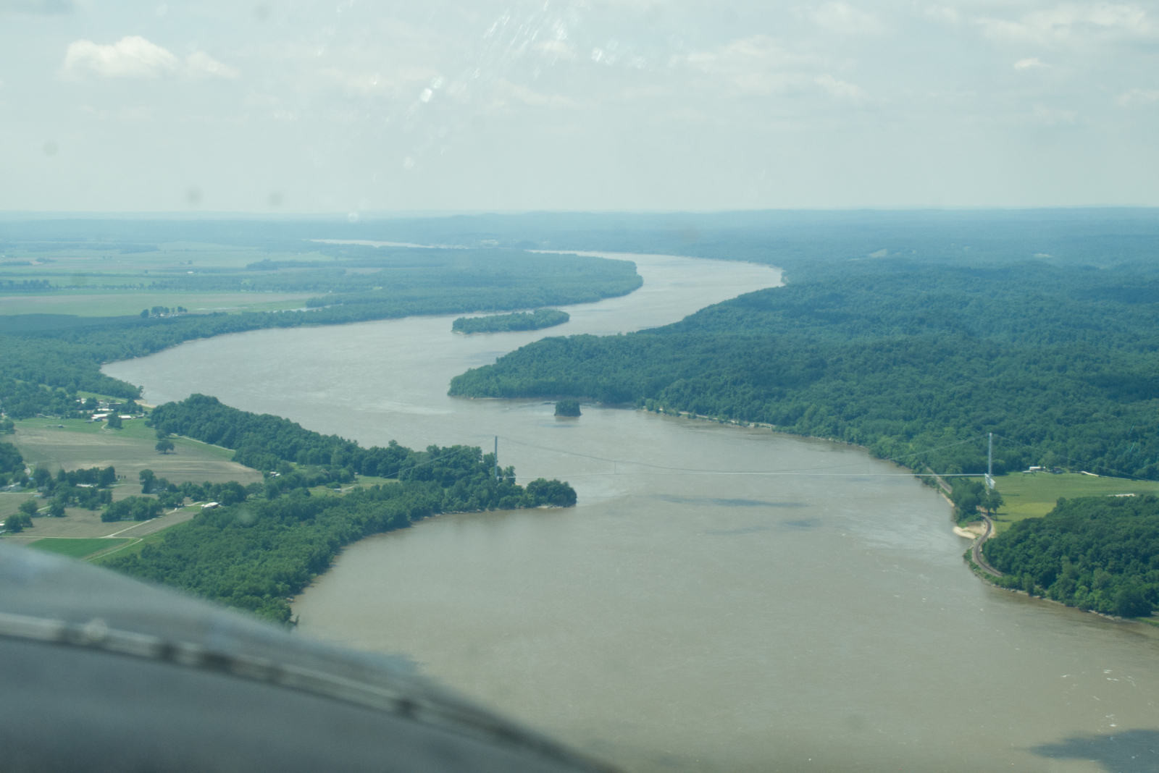
26
Notes:
The baseball diamond is used to represent the growth and progress as it relates to the Christian Life and Service Seminars.
Today’s Agenda/Housekeeping

Slide 27
Revelation 16 -- Last 7 Plagues
13 Then I saw three impure spirits that looked like frogs; they came out of the mouth of the dragon, out of the mouth of the beast and out of the mouth of the false prophet.
14 They are demonic spirits that perform signs, and they go out to the kings of the whole world, to gather them for the battle on the great day of God Almighty.
27
Notes:
The baseball diamond is used to represent the growth and progress as it relates to the Christian Life and Service Seminars.
Today’s Agenda/Housekeeping

Slide 28
Revelation 16 -- Last 7 Plagues
15 “Look, I come like a thief! Blessed is the one who stays awake and remains clothed, so as not to go naked and be shamefully exposed.”
28
Notes:
The baseball diamond is used to represent the growth and progress as it relates to the Christian Life and Service Seminars.
Today’s Agenda/Housekeeping

Slide 29
Matthew 24 -- The Thief Cometh
42 “Therefore keep watch, because you do not know on what day your Lord will come.
43 But understand this: If the owner of the house had known at what time of night the thief was coming, he would have kept watch and would not have let his house be broken into.
29
Notes:
The baseball diamond is used to represent the growth and progress as it relates to the Christian Life and Service Seminars.
Today’s Agenda/Housekeeping

Slide 30
Revelation 16 -- Last 7 Plagues
16 Then they gathered the kings together to the place that in Hebrew is called Armageddon.
30
Notes:
The baseball diamond is used to represent the growth and progress as it relates to the Christian Life and Service Seminars.
Today’s Agenda/Housekeeping

Slide 31
Revelation 16 -- Last 7 Plagues
17 The seventh angel poured out his bowl into the air, and out of the temple came a loud voice from the throne, saying, “It is done!”
18 Then there came flashes of lightning, rumblings, peals of thunder and a severe earthquake. No earthquake like it has ever occurred since mankind has been on earth, so tremendous was the quake.
31
Notes:
The baseball diamond is used to represent the growth and progress as it relates to the Christian Life and Service Seminars.
Today’s Agenda/Housekeeping

Slide 32
Revelation 16 -- Last 7 Plagues
19 The great city split into three parts, and the cities of the nations collapsed. God remembered Babylon the Great and gave her the cup filled with the wine of the fury of his wrath.
20 Every island fled away and the mountains could not be found.
32
Notes:
The baseball diamond is used to represent the growth and progress as it relates to the Christian Life and Service Seminars.
Today’s Agenda/Housekeeping

Slide 33
Revelation 16 -- Last 7 Plagues
21 From the sky huge hailstones, each weighing about a hundred pounds, fell on people. And they cursed God on account of the plague of hail, because the plague was so terrible.
33
Notes:
The baseball diamond is used to represent the growth and progress as it relates to the Christian Life and Service Seminars.
Today’s Agenda/Housekeeping

