Slide 1

FBC Liberty Small Group
The Revelation of John
Revelation 2 - #4
February 16, 2025

Slide 2
FBC Liberty Small Group
The Revelation of John
Recapitulation
September 14 , 2025

Slide 3
Most of all, it is the Revelation of Jesus Christ to us. If we catch everything else, but miss Jesus in the book, we miss the Book of Revelation.
3
Notes:
The baseball diamond is used to represent the growth and progress as it relates to the Christian Life and Service Seminars.
Today’s Agenda/Housekeeping

Slide 4
Apostles Creed
I believe in God, the Father almighty,
Maker of heaven and earth,
and in Jesus Christ, his only Son, our Lord,
who was conceived by the Holy Spirit,
born of the Virgin Mary,
4
Notes:
The baseball diamond is used to represent the growth and progress as it relates to the Christian Life and Service Seminars.
Today’s Agenda/Housekeeping

Slide 5
Apostles Creed
suffered under Pontius Pilate,
was crucified, died and was buried;
on the third day he rose from the dead and ascended into heaven,
5
Notes:
The baseball diamond is used to represent the growth and progress as it relates to the Christian Life and Service Seminars.
Today’s Agenda/Housekeeping

Slide 6
Apostles Creed
and is seated at the right hand of God the Father almighty;
from there he will come to judge the living and the dead.
6
Notes:
The baseball diamond is used to represent the growth and progress as it relates to the Christian Life and Service Seminars.
Today’s Agenda/Housekeeping

Slide 7
Apostles Creed
I believe in the Holy Spirit,
the holy catholic Church,
the communion of saints,
the forgiveness of sins,
the resurrection of the body,
and life everlasting. Amen.
7
Notes:
The baseball diamond is used to represent the growth and progress as it relates to the Christian Life and Service Seminars.
Today’s Agenda/Housekeeping

Slide 8
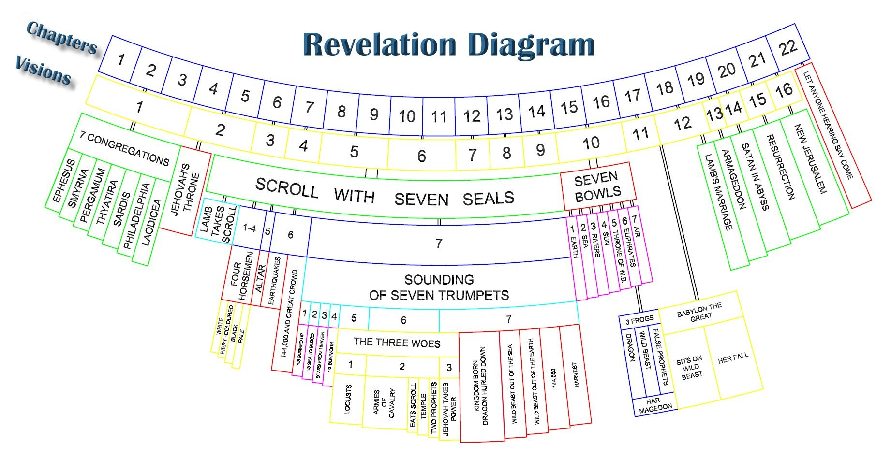
8
Notes:
The baseball diamond is used to represent the growth and progress as it relates to the Christian Life and Service Seminars.
Today’s Agenda/Housekeeping

Slide 9
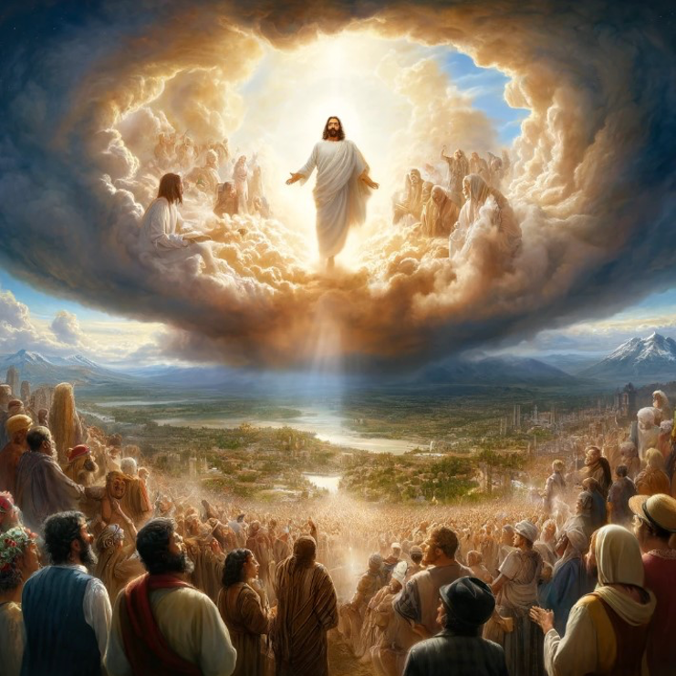
9
Notes:
The baseball diamond is used to represent the growth and progress as it relates to the Christian Life and Service Seminars.
Today’s Agenda/Housekeeping

Slide 10
Chronological
Vs.
Recapitulation
10
Notes:
The baseball diamond is used to represent the growth and progress as it relates to the Christian Life and Service Seminars.
Today’s Agenda/Housekeeping

Slide 11
Throughout the book, when John uses phrases like “after this” or “after these things,” he’s not denoting the historical chronology of the events he describes. Rather, he’s chronicling the order in which he saw a series of visions. The different angles display God’s judgment and ultimate triumph in Jesus Christ—the one great event of his return.
11
Notes:
The baseball diamond is used to represent the growth and progress as it relates to the Christian Life and Service Seminars.
Today’s Agenda/Housekeeping

Slide 12
Inter-advent
      The time between the 1st and 2nd coming of Christ
Recapitulation
      The telling of Revelation, through John’s visions, as 7 different views of the same story
12
Notes:
The baseball diamond is used to represent the growth and progress as it relates to the Christian Life and Service Seminars.
Today’s Agenda/Housekeeping

Slide 13
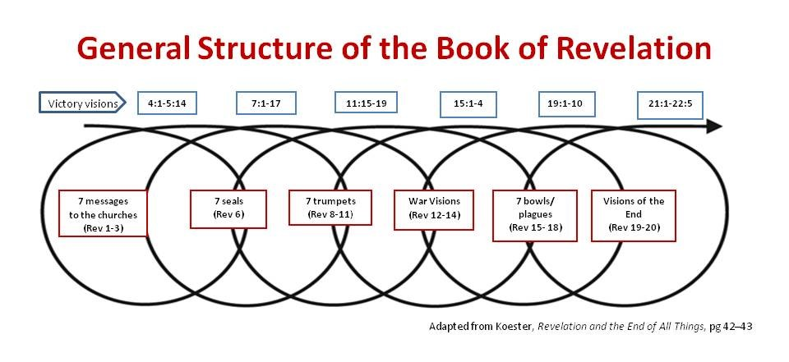
13
Notes:
The baseball diamond is used to represent the growth and progress as it relates to the Christian Life and Service Seminars.
Today’s Agenda/Housekeeping

Slide 14
The Seven Divisions of Revelation
Division #1 Rev 1:1 – 3:22
    The 7 Churches of the Inter-advent
Seal #2
    Red horse, fiery, power of peace & war
Seal #3
    Black horse with scales for expensive food
14
Notes:
The baseball diamond is used to represent the growth and progress as it relates to the Christian Life and Service Seminars.
Today’s Agenda/Housekeeping

Slide 15
Cycle 2 -- The Seals
Seal #1
    White horse ride with crown to conquer
Seal #2
    Red horse, fiery, power of peace & war
Seal #3
    Black horse with scales for expensive food
15
Notes:
The baseball diamond is used to represent the growth and progress as it relates to the Christian Life and Service Seminars.
Today’s Agenda/Housekeeping

Slide 16
Cycle 1 -- The Seven Churches
Seven – 7 – The Perfect Number
Jesus’ message to the Churches of the “Inter-advent period
Inter-advent -- Time between 1st and 2nd coming of Christ
16
Notes:
The baseball diamond is used to represent the growth and progress as it relates to the Christian Life and Service Seminars.
Today’s Agenda/Housekeeping

Slide 17
Cycle 2 -- The Seals
Seal #4
    Pale horse kills ¼ of the earth
Seal #5
    Martyred souls under the altar
Seal #6
    Earthquake, black sun, red moon
17
Notes:
The baseball diamond is used to represent the growth and progress as it relates to the Christian Life and Service Seminars.
Today’s Agenda/Housekeeping

Slide 18
Cycle 2 -- Christ’s Arrival
Chapter 7
    144,00 and multitude
    Christ arrives and ends suffering
18
Notes:
The baseball diamond is used to represent the growth and progress as it relates to the Christian Life and Service Seminars.
Today’s Agenda/Housekeeping

Slide 19
Cycle 2 -- Christ’s Arrival
9 After this I looked, and there before me was a great multitude that no one could count, from every nation, tribe, people and language, standing before the throne and before the Lamb. They were wearing white robes and were holding palm branches in their hands.
10 And they cried out in a loud voice: “Salvation belongs to our God, who sits on the throne, and to the Lamb.” Rev 7
19
Notes:
The baseball diamond is used to represent the growth and progress as it relates to the Christian Life and Service Seminars.
Today’s Agenda/Housekeeping

Slide 20
Cycle 3 -- The Trumpets
Trumpet #1
    Hail, fire, blood and 1/3 of earth burned up
Trumpet #2
    Sea to blood and 1/3 sea & ship dead
Trumpet #3
    Wormwood crashes in water & 1/3 bitter
20
Notes:
The baseball diamond is used to represent the growth and progress as it relates to the Christian Life and Service Seminars.
Today’s Agenda/Housekeeping

Slide 21
Cycle 3 -- The Trumpets
Trumpet #4
    1/3 sun, moon, stars dark
Trumpet #5
    Locusts torture beast followers
Trumpet #6
    Euphrates angels and soldiers kill 1/3 of mankind
21
Notes:
The baseball diamond is used to represent the growth and progress as it relates to the Christian Life and Service Seminars.
Today’s Agenda/Housekeeping

Slide 22
Cycle 3 -- Christ’s Arrival
Chapter 11
    Two witnesses
    7th trumpet sounds and Christ reigns
    Christ judges the dead
22
Notes:
The baseball diamond is used to represent the growth and progress as it relates to the Christian Life and Service Seminars.
Today’s Agenda/Housekeeping

Slide 23
Cycle 3 -- Christ’s Arrival
15 The seventh angel sounded his trumpet, and there were loud voices in heaven, which said: “The kingdom of the world has become the kingdom of our Lord and of his Messiah, and he will reign for ever and ever.”
16 And the twenty-four elders, who were seated on their thrones before God, fell on their faces and worshiped God,
Rev 11
23
Notes:
The baseball diamond is used to represent the growth and progress as it relates to the Christian Life and Service Seminars.
Today’s Agenda/Housekeeping

Slide 24
Cycle 3 -- Christ’s Arrival
17 saying: “We give thanks to you, Lord God Almighty, the One who is and who was, because you have taken your great power and have begun to reign.
18 The nations were angry, and your wrath has come. The time has come for judging the dead, and for rewarding your servants the prophets and your people who revere your name, both great and small— and for destroying those who destroy the earth.” Rev 11
24
Notes:
The baseball diamond is used to represent the growth and progress as it relates to the Christian Life and Service Seminars.
Today’s Agenda/Housekeeping

Slide 25
Cycle 3 -- Christ’s Arrival
11 Then I saw a great white throne and him who was seated on it. The earth and the heavens fled from his presence, and there was no place for them.
12 And I saw the dead, great and small, standing before the throne, and books were opened. Another book was opened, which is the book of life. The dead were judged according to what they had done as recorded in the books. Rev 20
25
Notes:
The baseball diamond is used to represent the growth and progress as it relates to the Christian Life and Service Seminars.
Today’s Agenda/Housekeeping

Slide 26
Cycle 4 -- Wars & visions of Wars
Chapter 12
    Woman & the dragon
    Devil fights Michael in heaven
    Devil loses to the woman and continues fight on earth
Chapter 13
    The Beast
    The 2nd Beast
    666
26
Notes:
The baseball diamond is used to represent the growth and progress as it relates to the Christian Life and Service Seminars.
Today’s Agenda/Housekeeping

Slide 27
Cycle 4 -- Christ arrives again
Chapter 14
    144,000 appear again
    Appear before the throne of Christ
    Again, Christ is triumphant
    Emphasis of judgement is the winepress
27
Notes:
The baseball diamond is used to represent the growth and progress as it relates to the Christian Life and Service Seminars.
Today’s Agenda/Housekeeping

Slide 28
Cycle 5 -- Bowls & Armageddon
Bowl #1
    Sores on the 666 people
Bowl #2
    Sea turned to blood & everything died
Bowl #3
    Fresh water turns to blood
28
Notes:
The baseball diamond is used to represent the growth and progress as it relates to the Christian Life and Service Seminars.
Today’s Agenda/Housekeeping

Slide 29
Cycle 5 -- Bowls & Armageddon
Bowl #4
    Sun scorches the unbelievers
Bowl #5
    Darkness everwhere
Bowl #6
    Euphrates dries up preparing for Armageddon
29
Notes:
The baseball diamond is used to represent the growth and progress as it relates to the Christian Life and Service Seminars.
Today’s Agenda/Housekeeping

Slide 30
Cycle 5 -- Christ arrives yet again
Chapter 16
    Christ says, “I come like a thief.”
    “It is done!”
30
Notes:
The baseball diamond is used to represent the growth and progress as it relates to the Christian Life and Service Seminars.
Today’s Agenda/Housekeeping

Slide 31
Cycle 5 -- Christ arrives yet again
    15 “Look, I come like a thief! Blessed is the one who stays awake and remains clothed, so as not to go naked and be shamefully exposed.”
    17 The seventh angel poured out his bowl into the air, and out of the temple came a loud voice from the throne, saying, “It is done!”
    Rev 16
31
Notes:
The baseball diamond is used to represent the growth and progress as it relates to the Christian Life and Service Seminars.
Today’s Agenda/Housekeeping

