Slide 1
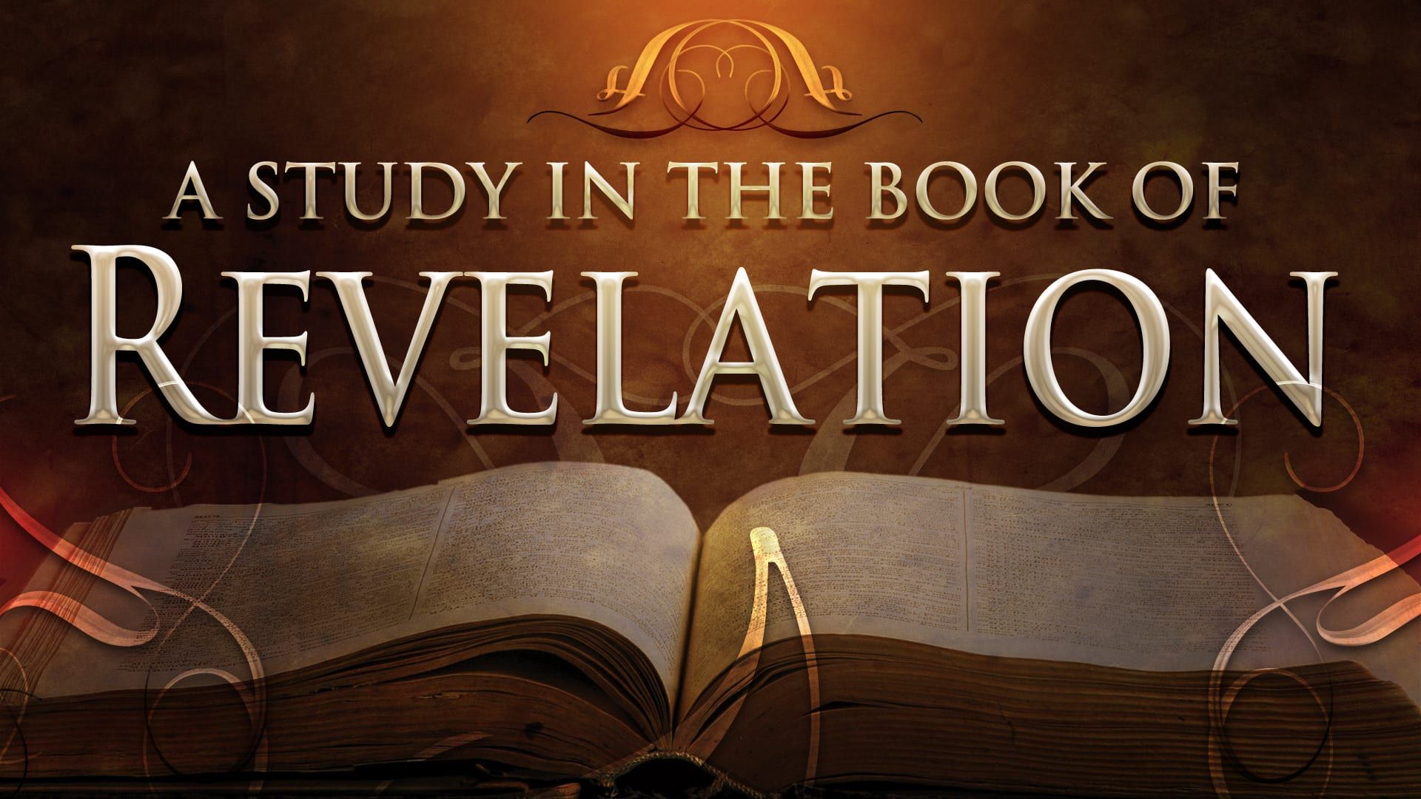
FBC Liberty Small Group
The Revelation of John
Revelation 2 - #4
February 16, 2025

Slide 2
FBC Liberty Small Group
The Revelation of John
Recapitulation
Chapter 17
September 21 , 2025

Slide 3
Most of all, it is the Revelation of Jesus Christ to us. If we catch everything else, but miss Jesus in the book, we miss the Book of Revelation.
3
Notes:
The baseball diamond is used to represent the growth and progress as it relates to the Christian Life and Service Seminars.
Today’s Agenda/Housekeeping

Slide 4
Apostles Creed
I believe in God, the Father almighty,
Maker of heaven and earth,
and in Jesus Christ, his only Son, our Lord,
who was conceived by the Holy Spirit,
born of the Virgin Mary,
4
Notes:
The baseball diamond is used to represent the growth and progress as it relates to the Christian Life and Service Seminars.
Today’s Agenda/Housekeeping

Slide 5
Apostles Creed
suffered under Pontius Pilate,
was crucified, died and was buried;
on the third day he rose from the dead and ascended into heaven,
5
Notes:
The baseball diamond is used to represent the growth and progress as it relates to the Christian Life and Service Seminars.
Today’s Agenda/Housekeeping

Slide 6
Apostles Creed
and is seated at the right hand of God the Father almighty;
from there he will come to judge the living and the dead.
6
Notes:
The baseball diamond is used to represent the growth and progress as it relates to the Christian Life and Service Seminars.
Today’s Agenda/Housekeeping

Slide 7
Apostles Creed
I believe in the Holy Spirit,
the holy catholic Church,
the communion of saints,
the forgiveness of sins,
the resurrection of the body,
and life everlasting. Amen.
7
Notes:
The baseball diamond is used to represent the growth and progress as it relates to the Christian Life and Service Seminars.
Today’s Agenda/Housekeeping

Slide 8
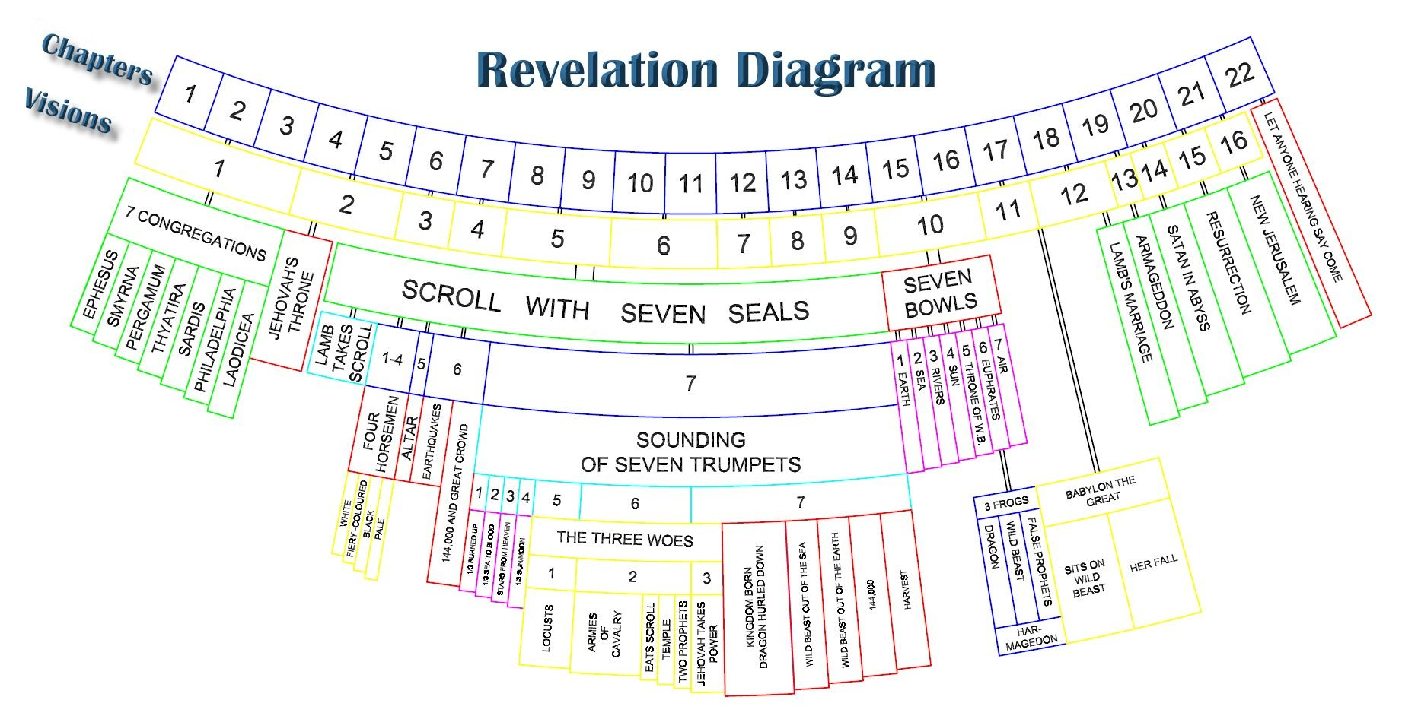
8
Notes:
The baseball diamond is used to represent the growth and progress as it relates to the Christian Life and Service Seminars.
Today’s Agenda/Housekeeping

Slide 9
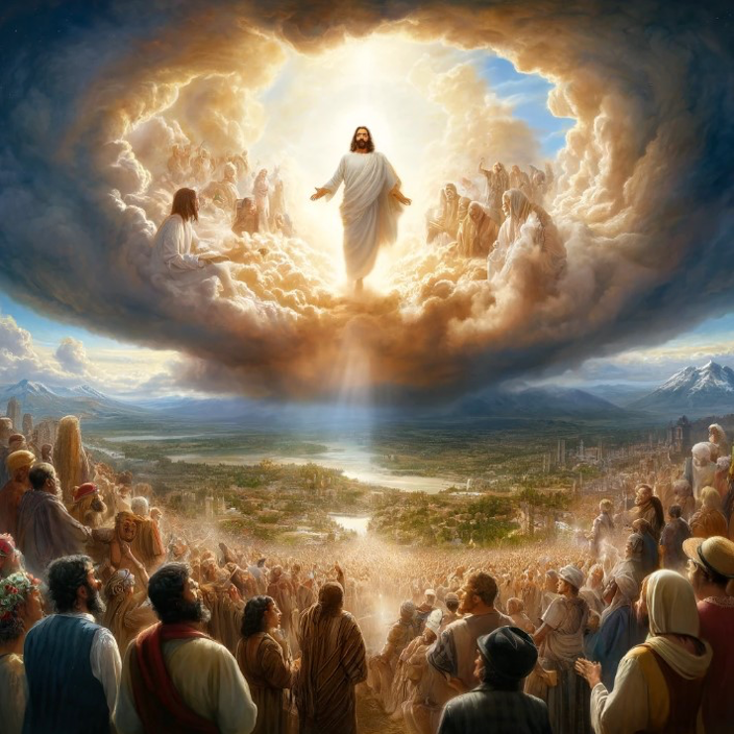
9
Notes:
The baseball diamond is used to represent the growth and progress as it relates to the Christian Life and Service Seminars.
Today’s Agenda/Housekeeping

Slide 10
Chronological
Vs.
Recapitulation
10
Notes:
The baseball diamond is used to represent the growth and progress as it relates to the Christian Life and Service Seminars.
Today’s Agenda/Housekeeping

Slide 11
Throughout the book, when John uses phrases like “after this” or “after these things,” he’s not denoting the historical chronology of the events he describes. Rather, he’s chronicling the order in which he saw a series of visions. The different angles display God’s judgment and ultimate triumph in Jesus Christ—the one great event of his return.
11
Notes:
The baseball diamond is used to represent the growth and progress as it relates to the Christian Life and Service Seminars.
Today’s Agenda/Housekeeping

Slide 12
Inter-advent
The time between the 1st and 2nd coming of Christ
Recapitulation
The telling of Revelation, through John’s visions, as 7 different views of the same story
12
Notes:
The baseball diamond is used to represent the growth and progress as it relates to the Christian Life and Service Seminars.
Today’s Agenda/Housekeeping

Slide 13
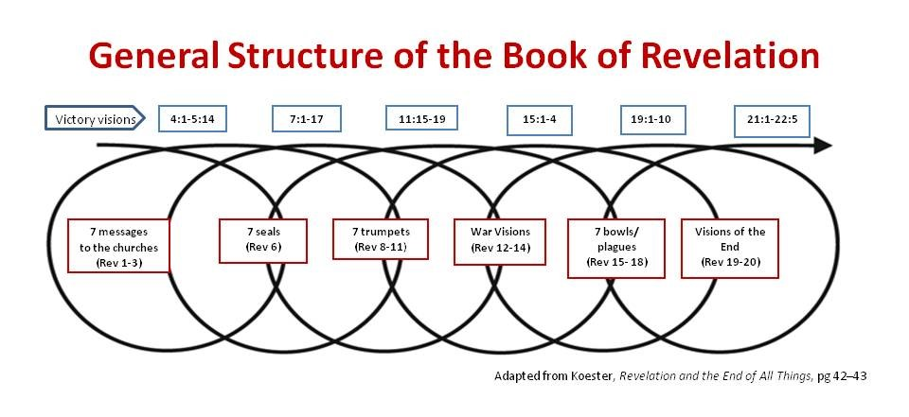
13
Notes:
The baseball diamond is used to represent the growth and progress as it relates to the Christian Life and Service Seminars.
Today’s Agenda/Housekeeping

Slide 14
Cycle 5 -- Bowls & Armageddon
Bowl #1
Sores on the 666 people
Bowl #2
Sea turned to blood & everything died
Bowl #3
Fresh water turns to blood
14
Notes:
The baseball diamond is used to represent the growth and progress as it relates to the Christian Life and Service Seminars.
Today’s Agenda/Housekeeping

Slide 15
Cycle 5 -- Bowls & Armageddon
Bowl #4
Sun scorches the unbelievers
Bowl #5
Darkness everwhere
Bowl #6
Euphrates dries up preparing for Armageddon
15
Notes:
The baseball diamond is used to represent the growth and progress as it relates to the Christian Life and Service Seminars.
Today’s Agenda/Housekeeping

Slide 16
Cycle 5 -- Christ arrives yet again
Chapter 16
Christ says, “I come like a thief.”
“It is done!”
16
Notes:
The baseball diamond is used to represent the growth and progress as it relates to the Christian Life and Service Seminars.
Today’s Agenda/Housekeeping

Slide 17
Cycle 5 -- Christ arrives yet again
15 “Look, I come like a thief! Blessed is the one who stays awake and remains clothed, so as not to go naked and be shamefully exposed.”
17 The seventh angel poured out his bowl into the air, and out of the temple came a loud voice from the throne, saying, “It is done!”
Rev 16
17
Notes:
The baseball diamond is used to represent the growth and progress as it relates to the Christian Life and Service Seminars.
Today’s Agenda/Housekeeping

Slide 18
Cycle 6 -- The Woman & Dragon - Again
All evil characters in Revelation fall
Babylon – representing all evil in the world
The Beast
The false prophet
The Devil himself
Armageddon retold
18
Notes:
The baseball diamond is used to represent the growth and progress as it relates to the Christian Life and Service Seminars.
Today’s Agenda/Housekeeping

Slide 19
Cycle 7 -- Christ’s Return in Omnipotent Glory
Satan is bound for 1000 years
Armageddon retold
New Heaven, New Earth, and Jerusalem Comes down
19
Notes:
The baseball diamond is used to represent the growth and progress as it relates to the Christian Life and Service Seminars.
Today’s Agenda/Housekeeping

Slide 20
Why Is Babylon So Despised?
Tower of Babel -- Genesis 11:1-10
Babylon Religion
Founded by Semiramis,
Wife of Nimrod, Noah’s great grandson
Tammuz, Semiramis’ son elevated to messiah
Tammuz, killed by beast and came back to life
Tammuz – Baal in Hebrew
Baalites, Baalzebub, etc.
20
Notes:
The baseball diamond is used to represent the growth and progress as it relates to the Christian Life and Service Seminars.
Today’s Agenda/Housekeeping

Slide 21
Why Is Babylon So Despised?
14 Then he brought me to the entrance of the north gate of the house of the LORD, and I saw women sitting there, mourning the god Tammuz.
15 He said to me, “Do you see this, son of man? You will see things that are even more detestable than this.”
Ezekiel 8
21
Notes:
The baseball diamond is used to represent the growth and progress as it relates to the Christian Life and Service Seminars.
Today’s Agenda/Housekeeping

Slide 22
Babylon Synonymous With Evil Cities
Revelation written about 95 AD
Rome -- “totally” evil to Christians in mid 60’s AD
Paul beheaded
Peter crucified
Christians persecuted
Rome was founded by Romulus & Remus in 753 BC
The city of 7 hills
22
Notes:
The baseball diamond is used to represent the growth and progress as it relates to the Christian Life and Service Seminars.
Today’s Agenda/Housekeeping

Slide 23
Chapter 17 -- Babylon is Destroyed
1 One of the seven angels who had the seven bowls came and said to me, “Come, I will show you the punishment of the great prostitute, who sits by many waters.
2 With her the kings of the earth committed adultery, and the inhabitants of the earth were intoxicated with the wine of her adulteries.”
Rev 17
23
Notes:
The baseball diamond is used to represent the growth and progress as it relates to the Christian Life and Service Seminars.
Today’s Agenda/Housekeeping

Slide 24
Chapter 17 -- Babylon is Destroyed
3 Then the angel carried me away in the Spirit into a wilderness. There I saw a woman sitting on a scarlet beast that was covered with blasphemous names and had seven heads and ten horns.
4 The woman was dressed in purple and scarlet, and was glittering with gold, precious stones and pearls. She held a golden cup in her hand, filled with abominable things and the filth of her adulteries.
Rev 17
24
Notes:
The baseball diamond is used to represent the growth and progress as it relates to the Christian Life and Service Seminars.
Today’s Agenda/Housekeeping

Slide 25
Chapter 17 -- Babylon is Destroyed
5 The name written on her forehead was a mystery: BABYLON THE GREAT THE MOTHER OF PROSTITUTES AND OF THE ABOMINATIONS OF THE EARTH.
6 I saw that the woman was drunk with the blood of God’s holy people, the blood of those who bore testimony to Jesus. When I saw her, I was greatly astonished.
Rev 17
25
Notes:
The baseball diamond is used to represent the growth and progress as it relates to the Christian Life and Service Seminars.
Today’s Agenda/Housekeeping

Slide 26
Chapter 17 -- Babylon is Destroyed
7 Then the angel said to me: “Why are you astonished? I will explain to you the mystery of the woman and of the beast she rides, which has the seven heads and ten horns.
8 The beast, which you saw, once was, now is not, and yet will come up out of the Abyss and go to its destruction. The inhabitants of the earth whose names have not been written in the book of life from the creation of the world will be astonished when they see the beast, because it once was, now is not, and yet will come.
Rev 17
26
Notes:
The baseball diamond is used to represent the growth and progress as it relates to the Christian Life and Service Seminars.
Today’s Agenda/Housekeeping

Slide 27
Chapter 17 -- Babylon is Destroyed
9 “This calls for a mind with wisdom. The seven heads are seven hills on which the woman sits.
10 They are also seven kings. Five have fallen, one is, the other has not yet come; but when he does come, he must remain for only a little while.
Rev 17
27
Notes:
The baseball diamond is used to represent the growth and progress as it relates to the Christian Life and Service Seminars.
Today’s Agenda/Housekeeping

Slide 28
Chapter 17 -- Babylon is Destroyed
11 The beast who once was, and now is not, is an eighth king. He belongs to the seven and is going to his destruction.
12 “The ten horns you saw are ten kings who have not yet received a kingdom, but who for one hour will receive authority as kings along with the beast.
Rev 17
28
Notes:
The baseball diamond is used to represent the growth and progress as it relates to the Christian Life and Service Seminars.
Today’s Agenda/Housekeeping

Slide 29
Chapter 17 -- Babylon is Destroyed
13 They have one purpose and will give their power and authority to the beast.
14 They will wage war against the Lamb, but the Lamb will triumph over them because he is Lord of lords and King of kings—and with him will be his called, chosen and faithful followers.”
Rev 17
29
Notes:
The baseball diamond is used to represent the growth and progress as it relates to the Christian Life and Service Seminars.
Today’s Agenda/Housekeeping

Slide 30
Chapter 17 -- Babylon is Destroyed
15 Then the angel said to me, “The waters you saw, where the prostitute sits, are peoples, multitudes, nations and languages.
16 The beast and the ten horns you saw will hate the prostitute. They will bring her to ruin and leave her naked; they will eat her flesh and burn her with fire.
Rev 17
30
Notes:
The baseball diamond is used to represent the growth and progress as it relates to the Christian Life and Service Seminars.
Today’s Agenda/Housekeeping

Slide 31
Chapter 17 -- Babylon is Destroyed
17 For God has put it into their hearts to accomplish his purpose by agreeing to hand over to the beast their royal authority, until God’s words are fulfilled.
18 The woman you saw is the great city that rules over the kings of the earth.”
Rev 17
31
Notes:
The baseball diamond is used to represent the growth and progress as it relates to the Christian Life and Service Seminars.
Today’s Agenda/Housekeeping

