Slide 1
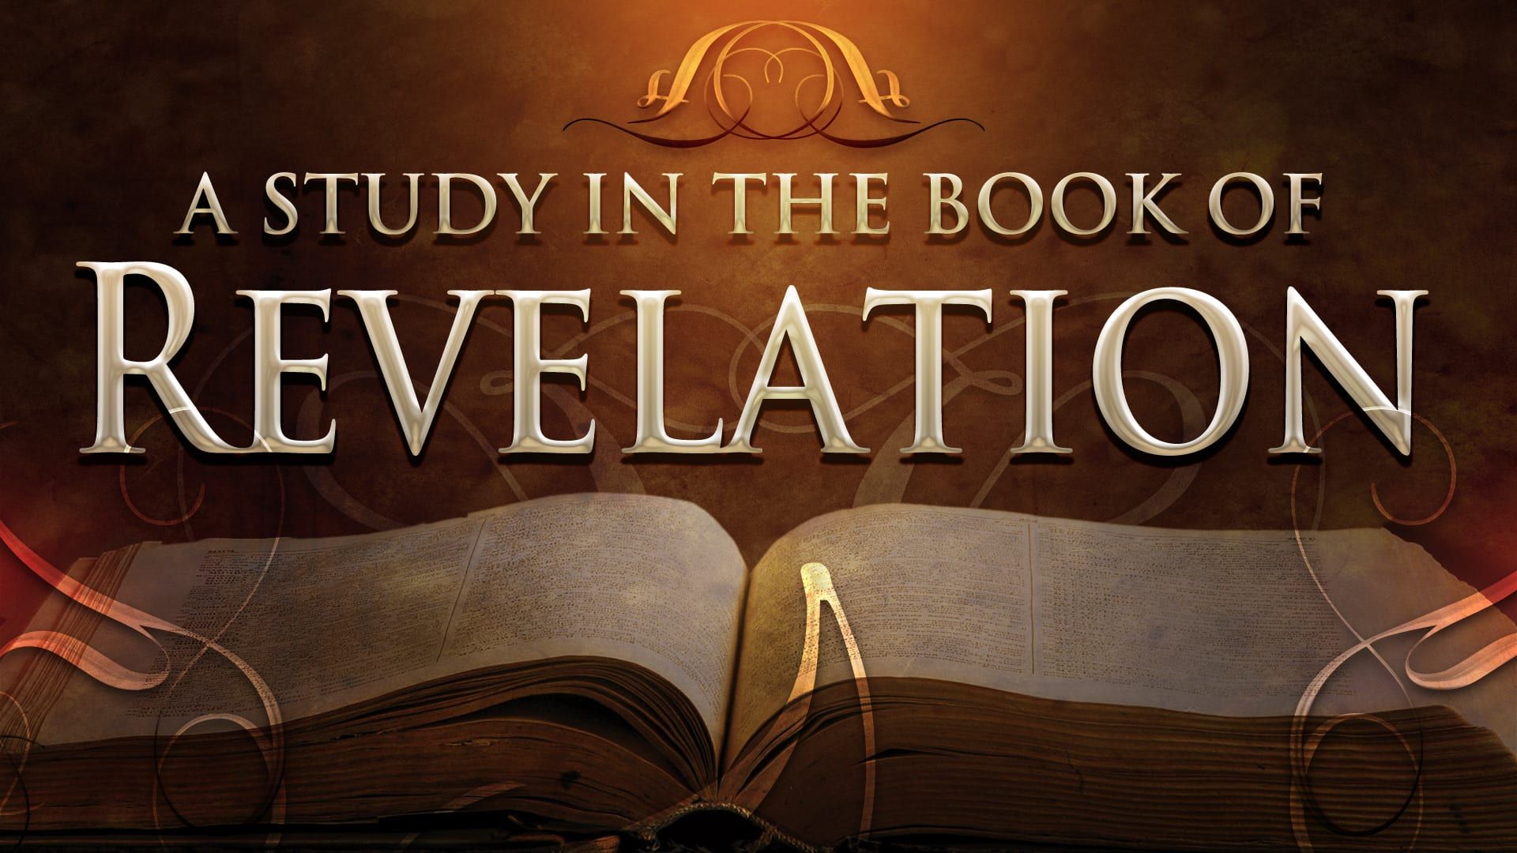
FBC Liberty Small Group
The Revelation of John
Revelation 2 - #4
February 16, 2025

Slide 2
FBC Liberty Small Group
The Revelation of John
Recapitulation
Chapter 18
September 28 , 2025

Slide 3
Most of all, it is the Revelation of Jesus Christ to us. If we catch everything else, but miss Jesus in the book, we miss the Book of Revelation.
3
Notes:
The baseball diamond is used to represent the growth and progress as it relates to the Christian Life and Service Seminars.
Today’s Agenda/Housekeeping

Slide 4
Apostles Creed
I believe in God, the Father almighty,
Maker of heaven and earth,
and in Jesus Christ, his only Son, our Lord,
who was conceived by the Holy Spirit,
born of the Virgin Mary,
4
Notes:
The baseball diamond is used to represent the growth and progress as it relates to the Christian Life and Service Seminars.
Today’s Agenda/Housekeeping

Slide 5
Apostles Creed
suffered under Pontius Pilate,
was crucified, died and was buried;
on the third day he rose from the dead and ascended into heaven,
5
Notes:
The baseball diamond is used to represent the growth and progress as it relates to the Christian Life and Service Seminars.
Today’s Agenda/Housekeeping

Slide 6
Apostles Creed
and is seated at the right hand of God the Father almighty;
from there he will come to judge the living and the dead.
6
Notes:
The baseball diamond is used to represent the growth and progress as it relates to the Christian Life and Service Seminars.
Today’s Agenda/Housekeeping

Slide 7
Apostles Creed
I believe in the Holy Spirit,
the holy catholic Church,
the communion of saints,
the forgiveness of sins,
the resurrection of the body,
and life everlasting. Amen.
7
Notes:
The baseball diamond is used to represent the growth and progress as it relates to the Christian Life and Service Seminars.
Today’s Agenda/Housekeeping

Slide 8
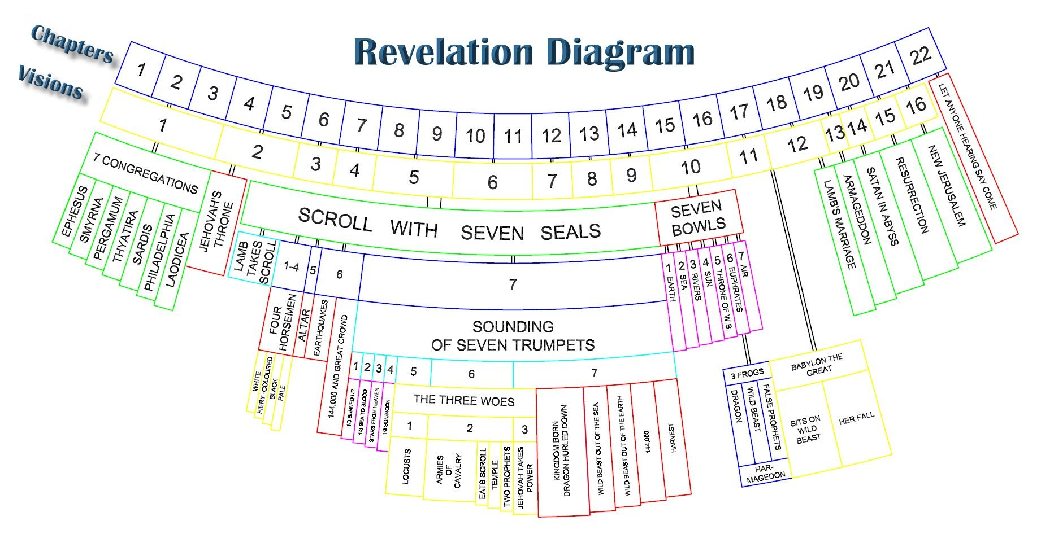
8
Notes:
The baseball diamond is used to represent the growth and progress as it relates to the Christian Life and Service Seminars.
Today’s Agenda/Housekeeping

Slide 9
Chronological
Vs.
Recapitulation
9
Notes:
The baseball diamond is used to represent the growth and progress as it relates to the Christian Life and Service Seminars.
Today’s Agenda/Housekeeping

Slide 10
Why Is Babylon So Despised?
Tower of Babel -- Genesis 11:1-10
Babylon Religion
Founded by Semiramis,
Wife of Nimrod, Noah’s great grandson
Tammuz, Semiramis’ son elevated to messiah
Tammuz, killed by beast and came back to life
Tammuz – Baal in Hebrew
Baalites, Baalzebub, etc.
10
Notes:
The baseball diamond is used to represent the growth and progress as it relates to the Christian Life and Service Seminars.
Today’s Agenda/Housekeeping

Slide 11
Babylon Synonymous With Evil Cities
Revelation written about 95 AD
Rome -- “totally” evil to Christians in mid 60’s AD
Paul beheaded
Peter crucified
Christians persecuted
Rome was founded by Romulus & Remus in 753 BC
The city of 7 hills
11
Notes:
The baseball diamond is used to represent the growth and progress as it relates to the Christian Life and Service Seminars.
Today’s Agenda/Housekeeping

Slide 12
Alternatives to Chapter 17 & 18
Babylon could be:
Symbolism for Rome
Babylon itself
Symbolism for all evil cities on earth from then until now
12
Notes:
The baseball diamond is used to represent the growth and progress as it relates to the Christian Life and Service Seminars.
Today’s Agenda/Housekeeping

Slide 13
“The Babylon” of Chapter 17 & 18
Chapter 17 Babylon is tied to the Beast and his religion
Mystery is synonymous with religion
Beast of chapter 13 forces worship
The beast is handed over to Christ
13
Notes:
The baseball diamond is used to represent the growth and progress as it relates to the Christian Life and Service Seminars.
Today’s Agenda/Housekeeping

Slide 14
“The Babylon” of Chapter 17 & 18
Chapter 18 Babylon is tied to the beast’s commercial power
Beast of chapter 13 controls commerce through 666
The finality of “Babylon” is accomplished through the millstone
14
Notes:
The baseball diamond is used to represent the growth and progress as it relates to the Christian Life and Service Seminars.
Today’s Agenda/Housekeeping

Slide 15
Chapter 17 -- The Beast’s commerce is destroyed
1 After this I saw another angel coming down from heaven. He had great authority, and the earth was illuminated by his splendor.
2 With a mighty voice he shouted: “ ‘Fallen! Fallen is Babylon the Great! ’She has become a dwelling for demons and a haunt for every impure spirit, a haunt for every unclean bird, a haunt for every unclean and detestable animal.
Rev 18
15
Notes:
The baseball diamond is used to represent the growth and progress as it relates to the Christian Life and Service Seminars.
Today’s Agenda/Housekeeping

Slide 16
Chapter 17 -- The Beast’s commerce is destroyed
3 For all the nations have drunk the maddening wine of her adulteries. The kings of the earth committed adultery with her, and the merchants of the earth grew rich from her excessive luxuries.”
4 Then I heard another voice from heaven say: “ ‘Come out of her, my people,’so that you will not share in her sins, so that you will not receive any of her plagues;
Rev 18
16
Notes:
The baseball diamond is used to represent the growth and progress as it relates to the Christian Life and Service Seminars.
Today’s Agenda/Housekeeping

Slide 17
Chapter 17 -- The Beast’s commerce is destroyed
5 for her sins are piled up to heaven, and God has remembered her crimes.
6 Give back to her as she has given; pay her back double for what she has done. Pour her a double portion from her own cup.
Rev 18
17
Notes:
The baseball diamond is used to represent the growth and progress as it relates to the Christian Life and Service Seminars.
Today’s Agenda/Housekeeping

Slide 18
Chapter 17 -- The Beast’s commerce is destroyed
7 Give her as much torment and grief as the glory and luxury she gave herself. In her heart she boasts, ‘I sit enthroned as queen. I am not a widow; I will never mourn.’
8 Therefore in one day her plagues will overtake her: death, mourning and famine. She will be consumed by fire, for mighty is the Lord God who judges her.
Rev 18
18
Notes:
The baseball diamond is used to represent the growth and progress as it relates to the Christian Life and Service Seminars.
Today’s Agenda/Housekeeping

Slide 19
Chapter 17 -- The Beast’s commerce is destroyed
9 “When the kings of the earth who committed adultery with her and shared her luxury see the smoke of her burning, they will weep and mourn over her.
10 Terrified at her torment, they will stand far off and cry: “ ‘Woe! Woe to you, great city, you mighty city of Babylon! In one hour your doom has come!’
Rev 18
19
Notes:
The baseball diamond is used to represent the growth and progress as it relates to the Christian Life and Service Seminars.
Today’s Agenda/Housekeeping

Slide 20
Chapter 17 -- The Beast’s commerce is destroyed
11 “The merchants of the earth will weep and mourn over her because no one buys their cargoes anymore—
12 cargoes of gold, silver, precious stones and pearls; fine linen, purple, silk and scarlet cloth; every sort of citron wood, and articles of every kind made of ivory, costly wood, bronze, iron and marble;
Rev 18
20
Notes:
The baseball diamond is used to represent the growth and progress as it relates to the Christian Life and Service Seminars.
Today’s Agenda/Housekeeping

Slide 21
Chapter 17 -- The Beast’s commerce is destroyed
13 cargoes of cinnamon and spice, of incense, myrrh and frankincense, of wine and olive oil, of fine flour and wheat; cattle and sheep; horses and carriages; and human beings sold as slaves.
14 “They will say, ‘The fruit you longed for is gone from you. All your luxury and splendor have vanished, never to be recovered.’
Rev 18
21
Notes:
The baseball diamond is used to represent the growth and progress as it relates to the Christian Life and Service Seminars.
Today’s Agenda/Housekeeping

Slide 22
Chapter 17 -- The Beast’s commerce is destroyed
15 The merchants who sold these things and gained their wealth from her will stand far off, terrified at her torment. They will weep and mourn
16 and cry out: “ ‘Woe! Woe to you, great city, dressed in fine linen, purple and scarlet, and glittering with gold, precious stones and pearls!
Rev 18
22
Notes:
The baseball diamond is used to represent the growth and progress as it relates to the Christian Life and Service Seminars.
Today’s Agenda/Housekeeping

Slide 23
Chapter 17 -- The Beast’s commerce is destroyed
17 In one hour such great wealth has been brought to ruin!’ “Every sea captain, and all who travel by ship, the sailors, and all who earn their living from the sea, will stand far off.
18 When they see the smoke of her burning, they will exclaim, ‘Was there ever a city like this great city?’
Rev 18
23
Notes:
The baseball diamond is used to represent the growth and progress as it relates to the Christian Life and Service Seminars.
Today’s Agenda/Housekeeping

Slide 24
Chapter 17 -- The Beast’s commerce is destroyed
19 They will throw dust on their heads, and with weeping and mourning cry out: “ ‘Woe! Woe to you, great city, where all who had ships on the sea became rich through her wealth! In one hour she has been brought to ruin!’
20 “Rejoice over her, you heavens! Rejoice, you people of God! Rejoice, apostles and prophets! For God has judged her with the judgment she imposed on you.”
Rev 18
24
Notes:
The baseball diamond is used to represent the growth and progress as it relates to the Christian Life and Service Seminars.
Today’s Agenda/Housekeeping

Slide 25
Chapter 17 -- The Beast’s commerce is destroyed
21 Then a mighty angel picked up a boulder the size of a large millstone and threw it into the sea, and said: “With such violence the great city of Babylon will be thrown down, never to be found again.
22 The music of harpists and musicians, pipers and trumpeters, will never be heard in you again. No worker of any trade will ever be found in you again. The sound of a millstone will never be heard in you again.
Rev 18
25
Notes:
The baseball diamond is used to represent the growth and progress as it relates to the Christian Life and Service Seminars.
Today’s Agenda/Housekeeping

Slide 26
Chapter 17 -- The Beast’s commerce is destroyed
23 The light of a lamp will never shine in you again. The voice of bridegroom and bride will never be heard in you again. Your merchants were the world’s important people. By your magic spell all the nations were led astray.
24 In her was found the blood of prophets and of God’s holy people, of all who have been slaughtered on the earth.”
Rev 18
26
Notes:
The baseball diamond is used to represent the growth and progress as it relates to the Christian Life and Service Seminars.
Today’s Agenda/Housekeeping

