Slide 1

FBC Liberty Small Group
The Revelation of John
Revelation 2 - #4
February 16, 2025

Slide 2
FBC Liberty Small Group
The Revelation of John
Chapter 20
October 12 , 2025

Slide 3
Most of all, it is the Revelation of Jesus Christ to us. If we catch everything else, but miss Jesus in the book, we miss the Book of Revelation.
3
Notes:
The baseball diamond is used to represent the growth and progress as it relates to the Christian Life and Service Seminars.
Today’s Agenda/Housekeeping

Slide 4
Apostles Creed
I believe in God, the Father almighty,
Maker of heaven and earth,
and in Jesus Christ, his only Son, our Lord,
who was conceived by the Holy Spirit,
born of the Virgin Mary,
4
Notes:
The baseball diamond is used to represent the growth and progress as it relates to the Christian Life and Service Seminars.
Today’s Agenda/Housekeeping

Slide 5
Apostles Creed
suffered under Pontius Pilate,
was crucified, died and was buried;
on the third day he rose from the dead and ascended into heaven,
5
Notes:
The baseball diamond is used to represent the growth and progress as it relates to the Christian Life and Service Seminars.
Today’s Agenda/Housekeeping

Slide 6
Apostles Creed
and is seated at the right hand of God the Father almighty;
from there he will come to judge the living and the dead.
6
Notes:
The baseball diamond is used to represent the growth and progress as it relates to the Christian Life and Service Seminars.
Today’s Agenda/Housekeeping

Slide 7
Apostles Creed
I believe in the Holy Spirit,
the holy catholic Church,
the communion of saints,
the forgiveness of sins,
the resurrection of the body,
and life everlasting. Amen.
7
Notes:
The baseball diamond is used to represent the growth and progress as it relates to the Christian Life and Service Seminars.
Today’s Agenda/Housekeeping

Slide 8
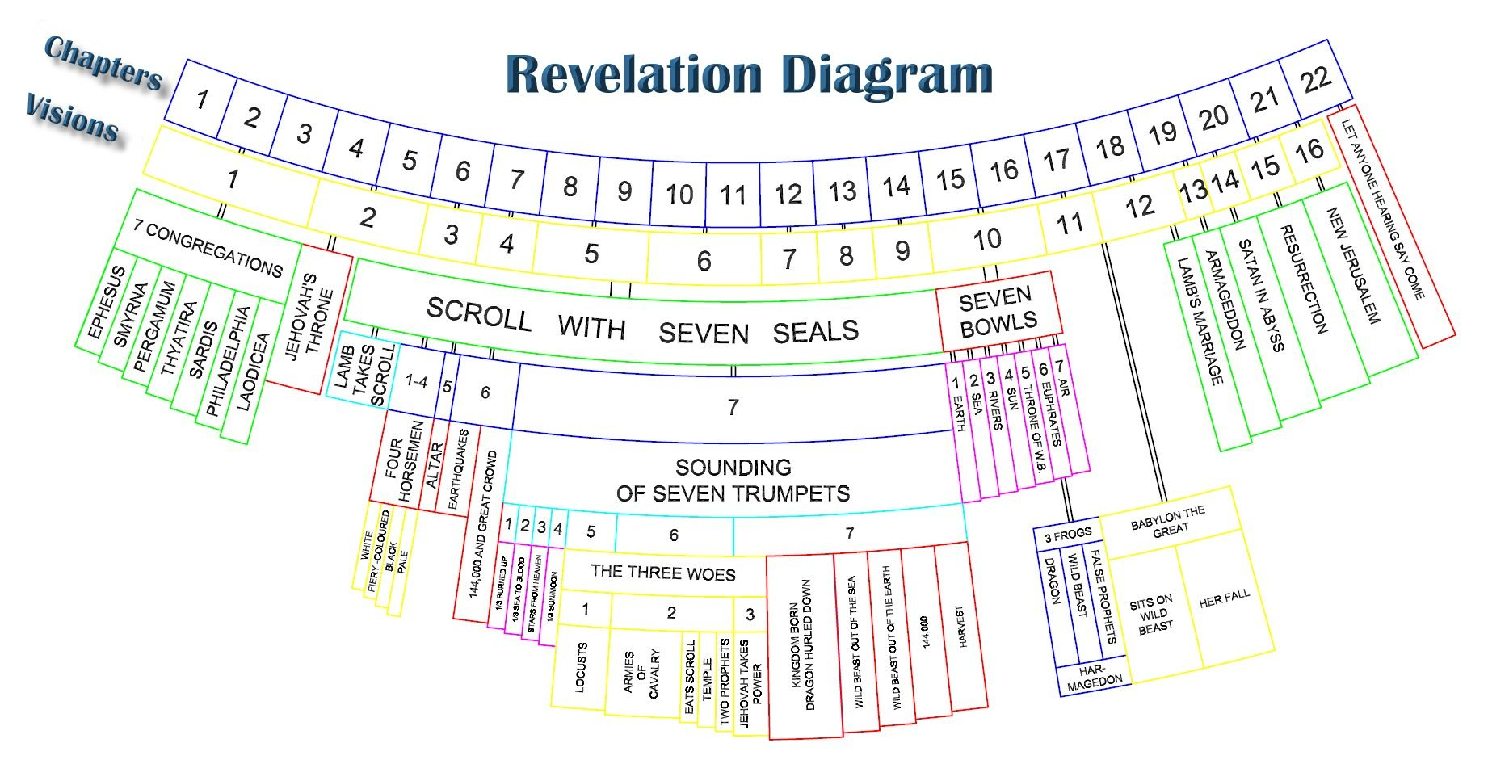
8
Notes:
The baseball diamond is used to represent the growth and progress as it relates to the Christian Life and Service Seminars.
Today’s Agenda/Housekeeping

Slide 9
Matthew 25 -- Christ & The End
31 “When the Son of Man comes in his glory, and all the angels with him, he will sit on his glorious throne.
32 All the nations will be gathered before him, and he will separate the people one from another as a shepherd separates the sheep from the goats.
Matthew 25
9
Notes:
The baseball diamond is used to represent the growth and progress as it relates to the Christian Life and Service Seminars.
Today’s Agenda/Housekeeping

Slide 10
Matthew 25 -- Christ & The End
33 He will put the sheep on his right and the goats on his left.
34 “Then the King will say to those on his right, ‘Come, you who are blessed by my Father; take your inheritance, the kingdom prepared for you since the creation of the world.
Matthew 25
10
Notes:
The baseball diamond is used to represent the growth and progress as it relates to the Christian Life and Service Seminars.
Today’s Agenda/Housekeeping

Slide 11
Matthew 25 -- Christ & The End
41 “Then he will say to those on his left, ‘Depart from me, you who are cursed, into the eternal fire prepared for the devil and his angels.
46 “Then they will go away to eternal punishment, but the righteous to eternal life.”
Matthew 25
11
Notes:
The baseball diamond is used to represent the growth and progress as it relates to the Christian Life and Service Seminars.
Today’s Agenda/Housekeeping

Slide 12
Chapter 20 -- The 1000 Yr Reign
1 And I saw an angel coming down out of heaven, having the key to the Abyss and holding in his hand a great chain.
2 He seized the dragon, that ancient serpent, who is the devil, or Satan, and bound him for a thousand years.
Rev 20
12
Notes:
The baseball diamond is used to represent the growth and progress as it relates to the Christian Life and Service Seminars.
Today’s Agenda/Housekeeping

Slide 13
Chapter 20 -- The 1000 Yr Reign
3 He threw him into the Abyss, and locked and sealed it over him, to keep him from deceiving the nations anymore until the thousand years were ended. After that, he must be set free for a short time.
Rev 20
13
Notes:
The baseball diamond is used to represent the growth and progress as it relates to the Christian Life and Service Seminars.
Today’s Agenda/Housekeeping

Slide 14
Chapter 20 -- The 1000 Yr Reign
4 I saw thrones on which were seated those who had been given authority to judge. And I saw the souls of those who had been beheaded because of their testimony about Jesus and because of the word of God. They had not worshiped the beast or its image and had not received its mark on their foreheads or their hands. They came to life and reigned with Christ a thousand years.
Rev 20
14
Notes:
The baseball diamond is used to represent the growth and progress as it relates to the Christian Life and Service Seminars.
Today’s Agenda/Housekeeping

Slide 15
Chapter 20 -- The 1000 Yr Reign
5 (The rest of the dead did not come to life until the thousand years were ended.) This is the first resurrection.
6 Blessed and holy are those who share in the first resurrection. The second death has no power over them, but they will be priests of God and of Christ and will reign with him for a thousand years.
Rev 20
15
Notes:
The baseball diamond is used to represent the growth and progress as it relates to the Christian Life and Service Seminars.
Today’s Agenda/Housekeeping

Slide 16
Chapter 20 -- The 1000 Yr Reign
7 When the thousand years are over, Satan will be released from his prison
8 and will go out to deceive the nations in the four corners of the earth—Gog and Magog—and to gather them for battle. In number they are like the sand on the seashore.
Rev 20
16
Notes:
The baseball diamond is used to represent the growth and progress as it relates to the Christian Life and Service Seminars.
Today’s Agenda/Housekeeping

Slide 17
Chapter 20 -- The 1000 Yr Reign
9 They marched across the breadth of the earth and surrounded the camp of God’s people, the city he loves. But fire came down from heaven and devoured them.
10 And the devil, who deceived them, was thrown into the lake of burning sulfur, where the beast and the false prophet had been thrown. They will be tormented day and night for ever and ever.
Rev 20
17
Notes:
The baseball diamond is used to represent the growth and progress as it relates to the Christian Life and Service Seminars.
Today’s Agenda/Housekeeping

Slide 18
Chapter 20 -- The 1000 Yr Reign
11 Then I saw a great white throne and him who was seated on it. The earth and the heavens fled from his presence, and there was no place for them.
12 And I saw the dead, great and small, standing before the throne, and books were opened. Another book was opened, which is the book of life. The dead were judged according to what they had done as recorded in the books.
Rev 20
18
Notes:
The baseball diamond is used to represent the growth and progress as it relates to the Christian Life and Service Seminars.
Today’s Agenda/Housekeeping

Slide 19
Chapter 20 -- The 1000 Yr Reign
13 The sea gave up the dead that were in it, and death and Hades gave up the dead that were in them, and each person was judged according to what they had done.
14 Then death and Hades were thrown into the lake of fire. The lake of fire is the second death.
15 Anyone whose name was not found written in the book of life was thrown into the lake of fire.
Rev 20
19
Notes:
The baseball diamond is used to represent the growth and progress as it relates to the Christian Life and Service Seminars.
Today’s Agenda/Housekeeping

