Slide 1

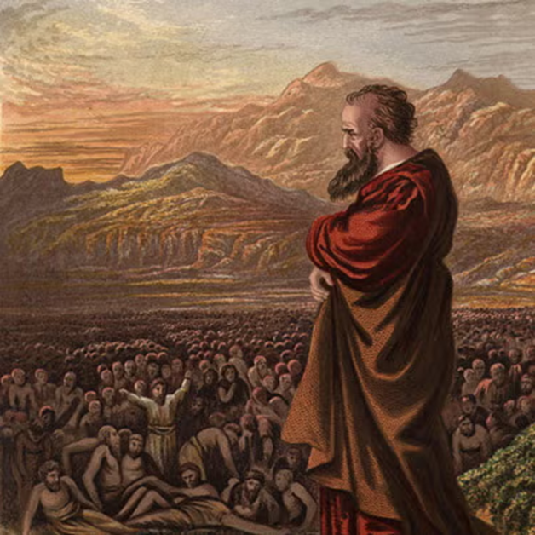
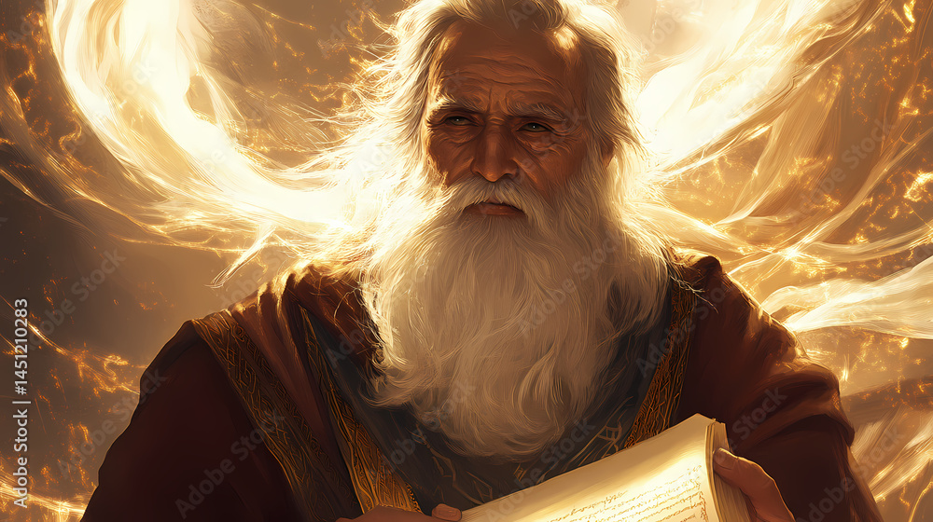
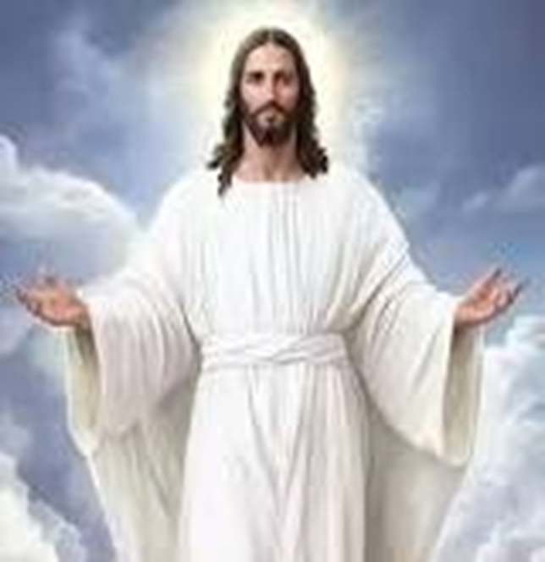
F
oretold &
Prophecies to Jesus Christ
ulfilled
Ezekiel
Isaiah
Jesus

Slide 2
FBC Liberty Small Group
The Purpose of the Old Testament
#1
March 15 , 2026

Slide 3
Apostles Creed
I believe in God, the Father almighty,
Maker of heaven and earth,
and in Jesus Christ, his only Son, our Lord,
who was conceived by the Holy Spirit,
born of the Virgin Mary,
3
Notes:
The baseball diamond is used to represent the growth and progress as it relates to the Christian Life and Service Seminars.
Today’s Agenda/Housekeeping

Slide 4
Apostles Creed
suffered under Pontius Pilate,
was crucified, died and was buried;
on the third day he rose from the dead and ascended into heaven,
4
Notes:
The baseball diamond is used to represent the growth and progress as it relates to the Christian Life and Service Seminars.
Today’s Agenda/Housekeeping

Slide 5
Apostles Creed
and is seated at the right hand of God the Father almighty;
from there he will come to judge the living and the dead.
5
Notes:
The baseball diamond is used to represent the growth and progress as it relates to the Christian Life and Service Seminars.
Today’s Agenda/Housekeeping

Slide 6
Apostles Creed
I believe in the Holy Spirit,
the holy catholic Church,
the communion of saints,
the forgiveness of sins,
the resurrection of the body,
and life everlasting. Amen.
6
Notes:
The baseball diamond is used to represent the growth and progress as it relates to the Christian Life and Service Seminars.
Today’s Agenda/Housekeeping

Slide 7
What Are We Going to Study ????
The makeup of the Old Testament
The reason for the Old Testament
The Prophets – the Foretelling
The Gospels -- The Fulfilling
7
Notes:
The baseball diamond is used to represent the growth and progress as it relates to the Christian Life and Service Seminars.
Today’s Agenda/Housekeeping

Slide 8
The Old Testament Arrangement
Pentateuch -- 5 Books
History -- 12 Books
Poetry & Wisdom -- 5 Books
Prophets -- 17 Books
8
Notes:
The baseball diamond is used to represent the growth and progress as it relates to the Christian Life and Service Seminars.
Today’s Agenda/Housekeeping

Slide 9
The Old Testament Arrangement
Pentateuch
  Genesis
  Exodus
  Leviticus
  Numbers
  Dueteronomy
9
Notes:
The baseball diamond is used to represent the growth and progress as it relates to the Christian Life and Service Seminars.
Today’s Agenda/Housekeeping

Slide 10
The Old Testament Arrangement
History -- 12 Books
  Joshua 1/2 Chronicles
  Judges 1/2 Kings
  Ruth Ezra
  1/2 Samuel Nehemiah
  Esther
10
Notes:
The baseball diamond is used to represent the growth and progress as it relates to the Christian Life and Service Seminars.
Today’s Agenda/Housekeeping

Slide 11
The Old Testament Arrangement
Poetry -- 5 Books
  Job
  Psalms
  Proverbs
  Ecclesiastes
11
Notes:
The baseball diamond is used to represent the growth and progress as it relates to the Christian Life and Service Seminars.
Today’s Agenda/Housekeeping

Slide 12
The Old Testament Arrangement
Major Prophets -- 5 Books
  Isaiah
  Jeremiah
  Lamentations
  Ezekiel
  Daniel
12
Notes:
The baseball diamond is used to represent the growth and progress as it relates to the Christian Life and Service Seminars.
Today’s Agenda/Housekeeping

Slide 13
The Old Testament Arrangement
Minor Prophets -- 12 Books
  Hosea Nahum
  Joel Habakkuk
  Amos Zephaniah
  Obadiah Haggai
  Jonah Zachariah
  Micah Malachi
13
Notes:
The baseball diamond is used to represent the growth and progress as it relates to the Christian Life and Service Seminars.
Today’s Agenda/Housekeeping

Slide 14
The Old Testament Timeline
Creation & Early History (Pre-2000 BC): Creation, Fall, Flood, and Babel (Genesis 1-11).
Patriarchal Period (c. 2100–1800 BC): Abraham, Isaac, Jacob, and Joseph move to Egypt.
Exodus & Wilderness (c. 1445 or 1290 BC): Moses leads the Israelites out of Egypt, receiving the law at Mount Sinai.
14
Notes:
The baseball diamond is used to represent the growth and progress as it relates to the Christian Life and Service Seminars.
Today’s Agenda/Housekeeping

Slide 15
The Old Testament Timeline
Conquest of Canaan (c. 1400 or 1250 BC): Joshua leads the conquest of the Promised Land.
Period of Judges (c. 1350–1050 BC): A cycle of disobedience, oppression, and liberation by leaders like Gideon, Samson, and Samuel.
United Monarchy (c. 1050–930 BC): King Saul, King David (c. 1000 BC), and King Solomon, who builds the first Temple.
15
Notes:
The baseball diamond is used to represent the growth and progress as it relates to the Christian Life and Service Seminars.
Today’s Agenda/Housekeeping

Slide 16
The Old Testament Timeline
Divided Monarchy (c. 930–722 BC): Kingdom splits into Israel (North) and Judah (South). The Northern Kingdom falls to Assyria in 722 BC.
Judah & Exile (722–538 BC): Judah falls to Babylon (586 BC); Temple destroyed and people taken into captivity.
Return & Post-Exilic Period (538–400 BC): Persia (Cyrus) allows Jews to return; Temple rebuilt (516 BC) under Zerubbabel; Ezra and Nehemiah rebuild Jerusalem walls.
16
Notes:
The baseball diamond is used to represent the growth and progress as it relates to the Christian Life and Service Seminars.
Today’s Agenda/Housekeeping

Slide 17
The Old Testament Arrangement
  Genesis
    The creation story
    The original sin
    Jewish lineage
    Early history
17
Notes:
The baseball diamond is used to represent the growth and progress as it relates to the Christian Life and Service Seminars.
Today’s Agenda/Housekeeping

Slide 18
The Old Testament Arrangement
  Genesis
    The creation story -- God as Supreme
18
Notes:
The baseball diamond is used to represent the growth and progress as it relates to the Christian Life and Service Seminars.
Today’s Agenda/Housekeeping

Slide 19
The Old Testament Arrangement
  Genesis
    The creation story -- God as Supreme
    The original sin -- Adam & Eve set the stage for the need for Christ
19
Notes:
The baseball diamond is used to represent the growth and progress as it relates to the Christian Life and Service Seminars.
Today’s Agenda/Housekeeping

Slide 20
The Old Testament Arrangement
  Genesis
    The creation story -- God as Supreme
    The original sin -- Adam & Eve set the stage for the need for Christ
    Jewish lineage -- The beginnings of Judaism
    Early history -- Noah and onward
20
Notes:
The baseball diamond is used to represent the growth and progress as it relates to the Christian Life and Service Seminars.
Today’s Agenda/Housekeeping

Slide 21
The Old Testament Arrangement
  Exodus
    Moses lead the Israelites out of Egypt and on to Canaan
21
Notes:
The baseball diamond is used to represent the growth and progress as it relates to the Christian Life and Service Seminars.
Today’s Agenda/Housekeeping

Slide 22
The Old Testament Arrangement
  Leviticus, Numbers, & Deuteronomy
    The foundation of Judaism and the laws to govern it
22
Notes:
The baseball diamond is used to represent the growth and progress as it relates to the Christian Life and Service Seminars.
Today’s Agenda/Housekeeping

