Slide 1

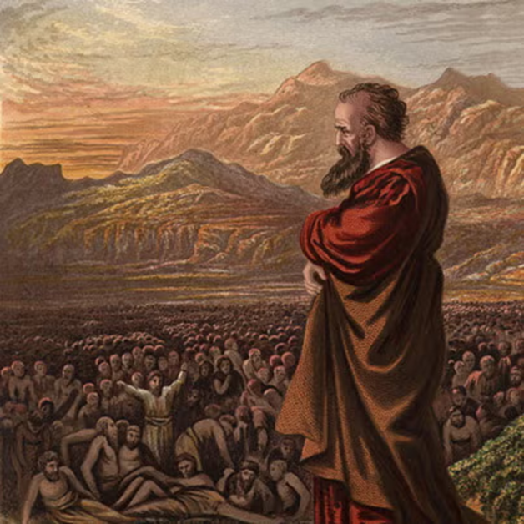
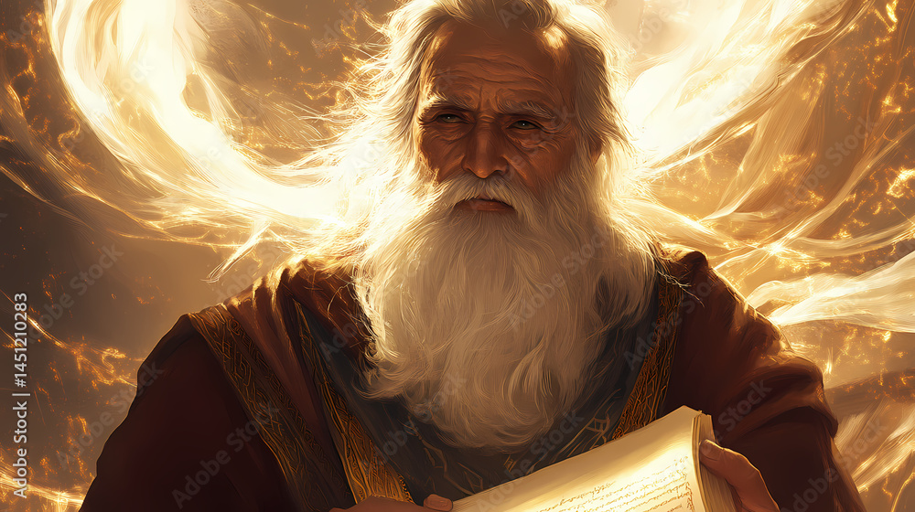
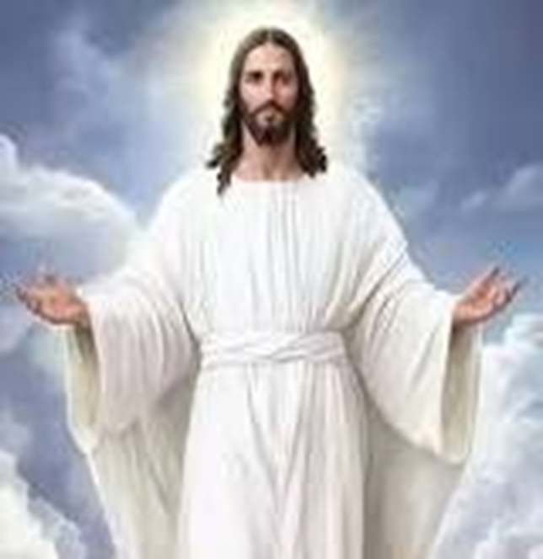
F
oretold &
Prophecies to Jesus Christ
ulfilled
Ezekiel
Isaiah
Jesus

Slide 2
F
FBC Liberty Small Group
oretold &
The First Prophecy
Bethlehem
Session #2 Mar. 22 , 2026
Prophecies to Jesus Christ
ulfilled

Slide 3
F
Apostles Creed
oretold &
Prophecies to Jesus Christ
ulfilled
I believe in God, the Father almighty,
Maker of heaven and earth,
and in Jesus Christ, his only Son, our Lord,
who was conceived by the Holy Spirit,
born of the Virgin Mary,
3
Notes:
The baseball diamond is used to represent the growth and progress as it relates to the Christian Life and Service Seminars.
Today’s Agenda/Housekeeping

Slide 4
F
Apostles Creed
oretold &
Prophecies to Jesus Christ
ulfilled
suffered under Pontius Pilate,
was crucified, died and was buried;
on the third day he rose from the dead and ascended into heaven,
4
Notes:
The baseball diamond is used to represent the growth and progress as it relates to the Christian Life and Service Seminars.
Today’s Agenda/Housekeeping

Slide 5
F
Apostles Creed
oretold &
Prophecies to Jesus Christ
ulfilled
and is seated at the right hand of God the Father almighty;
from thence he will come to judge the living and the dead.
5
Notes:
The baseball diamond is used to represent the growth and progress as it relates to the Christian Life and Service Seminars.
Today’s Agenda/Housekeeping

Slide 6
F
Apostles Creed
oretold &
Prophecies to Jesus Christ
ulfilled
I believe in the Holy Spirit, the holy catholic Church,
the communion of saints, the forgiveness of sins,
the resurrection of the body, and life everlasting. Amen.
6
Notes:
The baseball diamond is used to represent the growth and progress as it relates to the Christian Life and Service Seminars.
Today’s Agenda/Housekeeping

Slide 7
Micah The Minor Prophet
Why is Micah one of the 12 minor prophets?
  His book is one of the shorter books
YET ---
Micah served during the reigns of:
  Jotham 742 – 735 BC
  Ahaz 735 – 715 BC
  Hezekiah 715 – 696 BC
7
Notes:
The baseball diamond is used to represent the growth and progress as it relates to the Christian Life and Service Seminars.
Today’s Agenda/Housekeeping

Slide 8
Micah The Prophet
Rebuked the people of Judah for idolatry and dishonesty
Foretold the restoration of Judah after destruction as a result of Judah turning back to God’s way
Prophesied about Bethlehem and the birth of the Messiah
8
Notes:
The baseball diamond is used to represent the growth and progress as it relates to the Christian Life and Service Seminars.
Today’s Agenda/Housekeeping

Slide 9
Micah The Prophet
The Little Man clip
9
Notes:
The baseball diamond is used to represent the growth and progress as it relates to the Christian Life and Service Seminars.
Today’s Agenda/Housekeeping

Slide 10
The 1st Prophecy "Born in Bethlehem"
Micah 5: 1-2
1 Marshal your troops now, city of troops, for a siege is laid against us. They will strike Israel’s ruler on the cheek with a rod.
2 “But you, Bethlehem Ephrathah, though you are small among the clans of Judah, out of you will come for me one who will be ruler over Israel, whose origins are from of old, from ancient times.”
10
Notes:
The baseball diamond is used to represent the growth and progress as it relates to the Christian Life and Service Seminars.
Today’s Agenda/Housekeeping

Slide 11
The 1st Prophecy "Born in Bethlehem"
Micah 5: 3-4
3 Therefore Israel will be abandoned until the time when she who is in labor bears a son, and the rest of his brothers return to join the Israelites.
4 He will stand and shepherd his flock in the strength of the LORD, in the majesty of the name of the LORD his God. And they will live securely, for then his greatness will reach to the ends of the earth.
11
Notes:
The baseball diamond is used to represent the growth and progress as it relates to the Christian Life and Service Seminars.
Today’s Agenda/Housekeeping

Slide 12
The 1st Prophecy "Born in Bethlehem"
Matthew 2:1-4
1 After Jesus was born in Bethlehem in Judea, during the time of King Herod, Magi from the east came to Jerusalem
2 and asked, “Where is the one who has been born king of the Jews? We saw his star when it rose and have come to worship him.”
12
Notes:
The baseball diamond is used to represent the growth and progress as it relates to the Christian Life and Service Seminars.
Today’s Agenda/Housekeeping

Slide 13
The 1st Prophecy "Born in Bethlehem"
Matthew 2:1-6
3 When King Herod heard this he was disturbed, and all Jerusalem with him.
4 When he had called together all the people’s chief priests and teachers of the law, he asked them where the Messiah was to be born.
13
Notes:
The baseball diamond is used to represent the growth and progress as it relates to the Christian Life and Service Seminars.
Today’s Agenda/Housekeeping

Slide 14
The 1st Prophecy
"Born in Bethlehem"
Matthew 2:1-6
5 “In Bethlehem in Judea,” they replied, “for this is what the prophet has written:
6 “ ‘But you, Bethlehem, in the land of Judah, are by no means least among the rulers of Judah; for out of you will come a ruler who will shepherd my people Israel.’ ”
14
Notes:
The baseball diamond is used to represent the growth and progress as it relates to the Christian Life and Service Seminars.
Today’s Agenda/Housekeeping

Slide 15
F
Apostles Creed
Beit = Village
Bread = lechem
HaGalilit = northern Bethlehem
Beit Lechem HaGalilit = Bethlehem of Galilee
oretold &
Prophecies to Jesus Christ
ulfilled
15
Notes:
The baseball diamond is used to represent the growth and progress as it relates to the Christian Life and Service Seminars.
Today’s Agenda/Housekeeping

Slide 16
Apostles Creed
F
Beit = Village
Grace = Hanina
Village of Grace = Bethany
oretold &
Prophecies to Jesus Christ
ulfilled
16
Notes:
The baseball diamond is used to represent the growth and progress as it relates to the Christian Life and Service Seminars.
Today’s Agenda/Housekeeping

Slide 17
F
Bethlehem
oretold &
Beit = Village
Bread = lechem
Beit Lechem -- Bethlehem
HaGalilit = northern Bethlehem
Beit Lechem HaGalilit = Bethlehem of Galilee
Prophecies to Jesus Christ
ulfilled
17
Notes:
The baseball diamond is used to represent the growth and progress as it relates to the Christian Life and Service Seminars.
Today’s Agenda/Housekeeping

Slide 18
F
Bethlehem Ephrathah
oretold &
Prophecies to Jesus Christ
ulfilled
David was born in Bethlehem and went out to fight the Philistines from here
Jacob’s wife, Rachael, was buried in Ephrath
18
Notes:
The baseball diamond is used to represent the growth and progress as it relates to the Christian Life and Service Seminars.
Today’s Agenda/Housekeeping

Slide 19
Trivia – Bethlehem, Jesus, and the Romans
How was Jesus’ birthplace determined
  Helena, Constantine’s mother journeyed to Israel in 326-328
  Built churches on sites of Jesus’ birthplace, crucifixion, and Mount of Olives
  Set the principle of outsiders owning prime land in Israel
19
Notes:
The baseball diamond is used to represent the growth and progress as it relates to the Christian Life and Service Seminars.
Today’s Agenda/Housekeeping

Slide 20
Trivia – Bethlehem, Jesus, and the Romans
Romans took over Palestine for money
Romans were obsessed about documenting every administrative activity
Why take a census – accurate database for taxes
No documentation exists about the census that Joseph and Mary traveled for
20
Notes:
The baseball diamond is used to represent the growth and progress as it relates to the Christian Life and Service Seminars.
Today’s Agenda/Housekeeping

