Slide 1

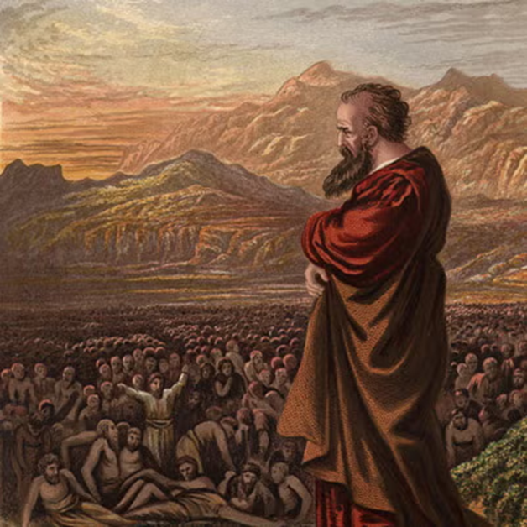
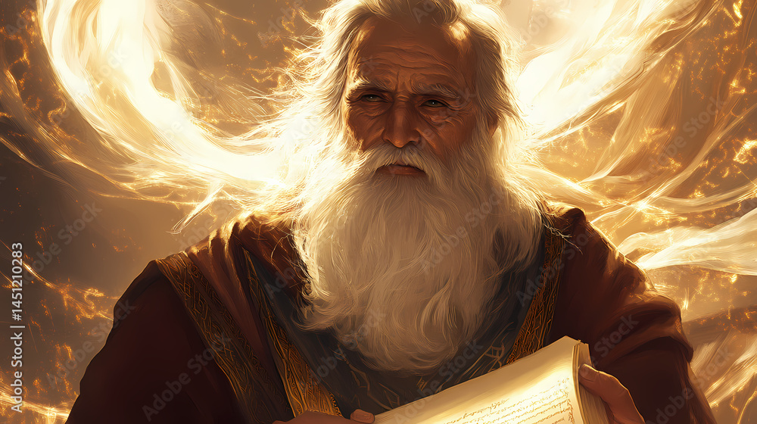
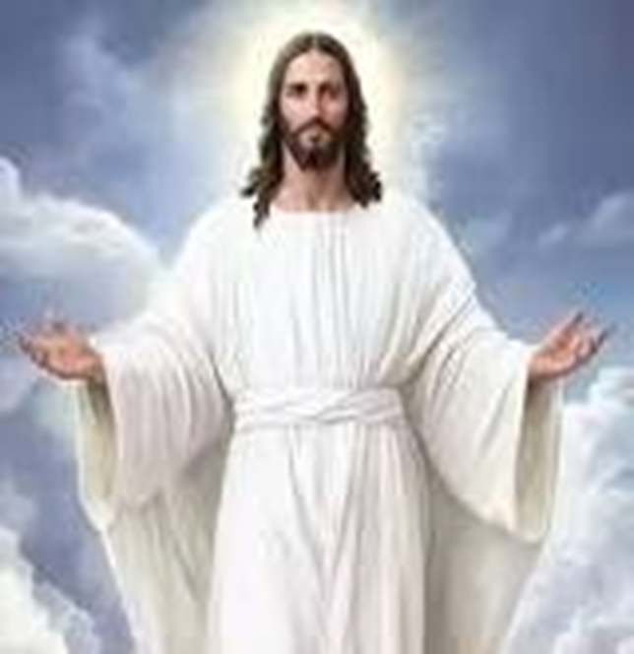
F
oretold &
Prophecies to Jesus Christ
ulfilled
Ezekiel
Isaiah
Jesus

Slide 2
FBC Liberty Small Group
The Purpose of the Old Testament
#3
March 29 , 2026

Slide 3

The Bethlehem's
Beit = Village Bread = lechem
Ephrathah = abundance
Bethlehem Ephrathah
Bethlehem of Judea -- Birthplace of Jesus
8 miles from Jerusalem
Hometown of King David
3
Notes:
The baseball diamond is used to represent the growth and progress as it relates to the Christian Life and Service Seminars.
Today’s Agenda/Housekeeping

Slide 4

The Bethlehem's
Beit = Village
Bread = lechem
Beit Lechem HaGalilit = Bethlehem of Galilee
HaGalilit = northern Bethlehem
4
Notes:
The baseball diamond is used to represent the growth and progress as it relates to the Christian Life and Service Seminars.
Today’s Agenda/Housekeeping

Slide 5
The Bethlehem's
Beit = Village
Comrades in arms = laham
Bethlehem of Samaria – currently under excavation
5
Notes:
The baseball diamond is used to represent the growth and progress as it relates to the Christian Life and Service Seminars.
Today’s Agenda/Housekeeping

Slide 6

The Old Testament Arrangement
Pentateuch -- 5 Books
History -- 12 Books
Poetry & Wisdom -- 5 Books
Prophets -- 17 Books
6
Notes:
The baseball diamond is used to represent the growth and progress as it relates to the Christian Life and Service Seminars.
Today’s Agenda/Housekeeping

Slide 7
The Old Testament Arrangement
Pentateuch
  Genesis
  Exodus
  Leviticus
  Numbers
  Dueteronomy
7
Notes:
The baseball diamond is used to represent the growth and progress as it relates to the Christian Life and Service Seminars.
Today’s Agenda/Housekeeping

Slide 8
The Old Testament Arrangement
History -- 12 Books
  Joshua 1/2 Chronicles
  Judges 1/2 Kings
  Ruth Ezra
  1/2 Samuel Nehemiah
  Esther
8
Notes:
The baseball diamond is used to represent the growth and progress as it relates to the Christian Life and Service Seminars.
Today’s Agenda/Housekeeping

Slide 9
The Old Testament Arrangement
Poetry -- 5 Books
  Job
  Psalms
  Proverbs
  Ecclesiastes
  Song of Solomon
9
Notes:
The baseball diamond is used to represent the growth and progress as it relates to the Christian Life and Service Seminars.
Today’s Agenda/Housekeeping

Slide 10
The Old Testament Arrangement
Major Prophets -- 5 Books
  Isaiah
  Jeremiah
  Lamentations
  Ezekiel
  Daniel
10
Notes:
The baseball diamond is used to represent the growth and progress as it relates to the Christian Life and Service Seminars.
Today’s Agenda/Housekeeping

Slide 11
The Old Testament Arrangement
Minor Prophets -- 12 Books
  Hosea Nahum
  Joel Habakkuk
  Amos Zephaniah
  Obadiah Haggai
  Jonah Zachariah
  Micah Malachi
11
Notes:
The baseball diamond is used to represent the growth and progress as it relates to the Christian Life and Service Seminars.
Today’s Agenda/Housekeeping

Slide 12
The Old Testament Arrangement
  Genesis
    The creation story
    The original sin
    Jewish lineage
    Early history
12
Notes:
The baseball diamond is used to represent the growth and progress as it relates to the Christian Life and Service Seminars.
Today’s Agenda/Housekeeping

Slide 13
The Old Testament Arrangement
  Genesis
    The creation story -- God as Supreme
13
Notes:
The baseball diamond is used to represent the growth and progress as it relates to the Christian Life and Service Seminars.
Today’s Agenda/Housekeeping

Slide 14
The Old Testament Arrangement
  Genesis
    The creation story -- God as Supreme
    The original sin -- Adam & Eve set the stage for the need for Christ
14
Notes:
The baseball diamond is used to represent the growth and progress as it relates to the Christian Life and Service Seminars.
Today’s Agenda/Housekeeping

Slide 15
The Old Testament Arrangement
  Genesis
    The creation story -- God as Supreme
    The original sin -- Adam & Eve set the stage for the need for Christ
    Jewish lineage -- The beginnings of Judaism
    Early history -- Noah and onward
15
Notes:
The baseball diamond is used to represent the growth and progress as it relates to the Christian Life and Service Seminars.
Today’s Agenda/Housekeeping

Slide 16
The Old Testament Arrangement
  Exodus
    Moses lead the Israelites out of Egypt and on to Canaan
16
Notes:
The baseball diamond is used to represent the growth and progress as it relates to the Christian Life and Service Seminars.
Today’s Agenda/Housekeeping

Slide 17
The Old Testament Arrangement
  Leviticus, Numbers, & Deuteronomy
    The foundation of Judaism and the laws to govern it
17
Notes:
The baseball diamond is used to represent the growth and progress as it relates to the Christian Life and Service Seminars.
Today’s Agenda/Housekeeping

Slide 18
The Old Testament Arrangement
History -- 12 Books
  Joshua 1/2 Chronicles
  Judges 1/2 Kings
  Ruth Ezra
  1/2 Samuel Nehemiah
  Esther
18
Notes:
The baseball diamond is used to represent the growth and progress as it relates to the Christian Life and Service Seminars.
Today’s Agenda/Housekeeping

Slide 19
The Old Testament Arrangement
History -- 12 Books
  History of Israel & Judah from 1200 BC to 400 BC
  Maccabees 1&2 give the history from 400 BC to 100 BC
  Very prolific prophets in 1&2 Kings
      Elijah
      Elisha
19
Notes:
The baseball diamond is used to represent the growth and progress as it relates to the Christian Life and Service Seminars.
Today’s Agenda/Housekeeping

Slide 20
The Old Testament Prophets
2 Kings 2
1 When the LORD was about to take Elijah up to heaven in a whirlwind, Elijah and Elisha were on their way from Gilgal.
2 Elijah said to Elisha, “Stay here; the LORD has sent me to Bethel.” But Elisha said, “As surely as the LORD lives and as you live, I will not leave you.” So they went down to Bethel.
3 The company of the prophets at Bethel came out to Elisha and asked, “Do you know that the LORD is going to take your master from you today?” “Yes, I know,” Elisha replied, “so be quiet.”
20
Notes:
The baseball diamond is used to represent the growth and progress as it relates to the Christian Life and Service Seminars.
Today’s Agenda/Housekeeping

Slide 21
The Old Testament Prophets
2 Kings 2
4 Then Elijah said to him, “Stay here, Elisha; the LORD has sent me to Jericho.” And he replied, “As surely as the LORD lives and as you live, I will not leave you.” So they went to Jericho.
5 The company of the prophets at Jericho went up to Elisha and asked him, “Do you know that the LORD is going to take your master from you today?” “Yes, I know,” he replied, “so be quiet.”
6 Then Elijah said to him, “Stay here; the LORD has sent me to the Jordan.” And he replied, “As surely as the LORD lives and as you live, I will not leave you.” So the two of them walked on.
21
Notes:
The baseball diamond is used to represent the growth and progress as it relates to the Christian Life and Service Seminars.
Today’s Agenda/Housekeeping

Slide 22
The Old Testament Prophets
2 Kings 2
7 Fifty men from the company of the prophets went and stood at a distance, facing the place where Elijah and Elisha had stopped at the Jordan.
8 Elijah took his cloak, rolled it up and struck the water with it. The water divided to the right and to the left, and the two of them crossed over on dry ground.
9 When they had crossed, Elijah said to Elisha, “Tell me, what can I do for you before I am taken from you?” “Let me inherit a double portion of your spirit,” Elisha replied.
22
Notes:
The baseball diamond is used to represent the growth and progress as it relates to the Christian Life and Service Seminars.
Today’s Agenda/Housekeeping

Slide 23
The Old Testament Prophets
2 Kings 2
10 “You have asked a difficult thing,” Elijah said, “yet if you see me when I am taken from you, it will be yours—otherwise, it will not.”
11 As they were walking along and talking together, suddenly a chariot of fire and horses of fire appeared and separated the two of them, and Elijah went up to heaven in a whirlwind.
23
Notes:
The baseball diamond is used to represent the growth and progress as it relates to the Christian Life and Service Seminars.
Today’s Agenda/Housekeeping

Slide 24
Christ & the Old Testament Prophets
Luke 4
24 “Truly I tell you,” he continued, “no prophet is accepted in his hometown.
25 I assure you that there were many widows in Israel in Elijah’s time, when the sky was shut for three and a half years and there was a severe famine throughout the land.
26 Yet Elijah was not sent to any of them, but to a widow in Zarephath in the region of Sidon.
24
Notes:
The baseball diamond is used to represent the growth and progress as it relates to the Christian Life and Service Seminars.
Today’s Agenda/Housekeeping

Slide 25
Christ & the Old Testament Prophets
Luke 4
27 And there were many in Israel with leprosy in the time of Elisha the prophet, yet not one of them was cleansed—only Naaman the Syrian.”
28 All the people in the synagogue were furious when they heard this.
25
Notes:
The baseball diamond is used to represent the growth and progress as it relates to the Christian Life and Service Seminars.
Today’s Agenda/Housekeeping

Slide 26
Old Testament Prophets
845 B.C.? Obadiah
830 B.C. Joel
780-750 B.C. Jonah
760-750 B.C. Amos
760-710 B.C. Hosea
740-690 B.C. Isaiah
735-700 B.C. Micah
650-612 B.C. Nahum
26
Notes:
The baseball diamond is used to represent the growth and progress as it relates to the Christian Life and Service Seminars.
Today’s Agenda/Housekeeping

Slide 27
Old Testament Prophets
627-585 B.C. Jeremiah
625 B.C. Zephaniah
612-606 B.C. Habakkuk
606-536 B.C. Daniel
592-570 B.C. Ezekiel
585 B.C. Lamentations
520 B.C. Haggai
520-518 B.C. Zechariah
445-425 B.C. Malachi
27
Notes:
The baseball diamond is used to represent the growth and progress as it relates to the Christian Life and Service Seminars.
Today’s Agenda/Housekeeping

