Slide 1

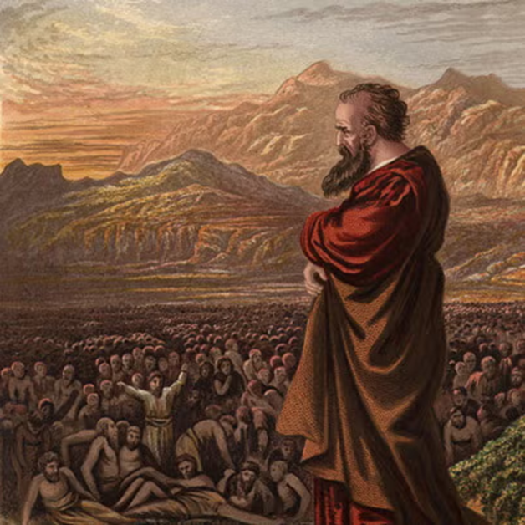
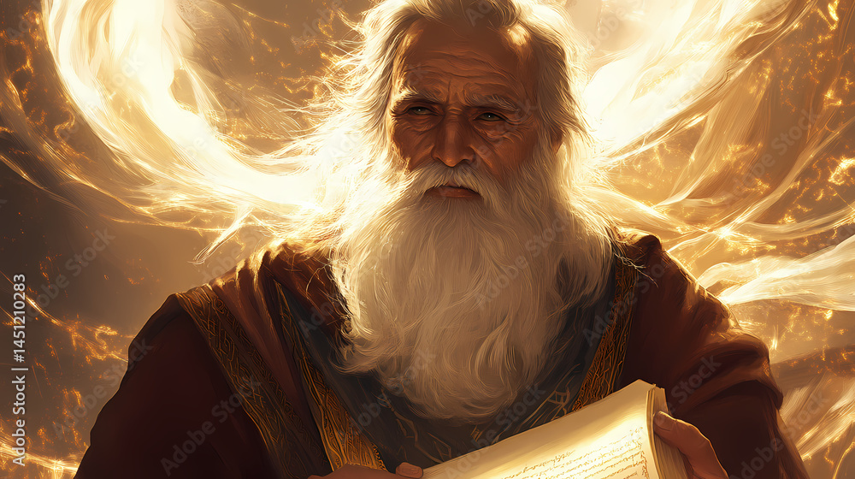
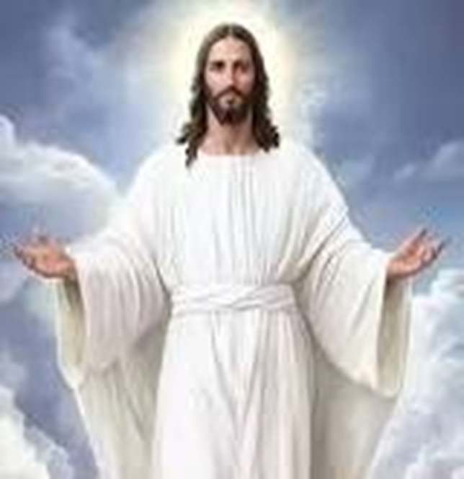
F
oretold &
Prophecies to Jesus Christ
ulfilled
Ezekiel
Isaiah
Jesus

Slide 2
F
FBC Liberty Small Group
oretold &
Judah & David
Session #4 April 12 , 2026
Prophecies to Jesus Christ
ulfilled

Slide 3
All the Way Back to Genesis
Genesis was word-of-mouth for 800 years from 2000 BC to 1200 BC
Abraham -- Isaac -- Jacob
Genesis ends with Israel in Egypt, ready for Moses to lead them out
Moses is assumed to be the writer of the Torah, hence Genesis
3
Notes:
The baseball diamond is used to represent the growth and progress as it relates to the Christian Life and Service Seminars.
Today’s Agenda/Housekeeping

Slide 4
Genesis 49 -- The Basis for the Messiah
Jacob is about to die
Gathers his sons to his side to bless them
12 sons, future leaders of 12 tribes
Rueben Simeon Levi Judah
Issachar Zebulun Gad Dan
Naphtali Asher Benjamin
Joseph – Ephraim & Manasseh
4
Notes:
The baseball diamond is used to represent the growth and progress as it relates to the Christian Life and Service Seminars.
Today’s Agenda/Housekeeping

Slide 5
Genesis 49
1 Then Jacob called for his sons and said: “Gather around so I can tell you what will happen to you in days to come.
2 “Assemble and listen, sons of Jacob; listen to your father Israel.
3 “Reuben, you are my firstborn, my might, the first sign of my strength, excelling in honor, excelling in power.
5
Notes:
The baseball diamond is used to represent the growth and progress as it relates to the Christian Life and Service Seminars.
Today’s Agenda/Housekeeping

Slide 6
Genesis 49
4 Turbulent as the waters, you will no longer excel, for you went up onto your father’s bed, onto my couch and defiled it.
5 “Simeon and Levi are brothers— their swords are weapons of violence.
6 Let me not enter their council, let me not join their assembly, for they have killed men in their anger and hamstrung oxen as they pleased.
6
Notes:
The baseball diamond is used to represent the growth and progress as it relates to the Christian Life and Service Seminars.
Today’s Agenda/Housekeeping

Slide 7
Genesis 49
7 Cursed be their anger, so fierce, and their fury, so cruel! I will scatter them in Jacob and disperse them in Israel.
7
Notes:
The baseball diamond is used to represent the growth and progress as it relates to the Christian Life and Service Seminars.
Today’s Agenda/Housekeeping

Slide 8
Genesis 49
8 “Judah, your brothers will praise you; your hand will be on the neck of your enemies; your father’s sons will bow down to you.
.
9 You are a lion’s cub, Judah; you return from the prey, my son. Like a lion he crouches and lies down, like a lioness—who dares to rouse him?
10 The scepter will not depart from Judah, nor the ruler’s staff from between his feet, until he to whom it belongs shall come and the obedience of the nations shall be his.
8
Notes:
The baseball diamond is used to represent the growth and progress as it relates to the Christian Life and Service Seminars.
Today’s Agenda/Housekeeping

Slide 9
Genesis 49
11 He will tether his donkey to a vine, his colt to the choicest branch; he will wash his garments in wine, his robes in the blood of grapes.
12 His eyes will be darker than wine, his teeth whiter than milk.
9
Notes:
The baseball diamond is used to represent the growth and progress as it relates to the Christian Life and Service Seminars.
Today’s Agenda/Housekeeping

Slide 10
Genesis 49
10 The sceptre shall not depart from Judah, nor a lawgiver from between his feet, until Shiloh come; and unto him shall the gathering of the people be.
KJV
Shiloh = the Messiah
Scepter = the ruler of all
10
Notes:
The baseball diamond is used to represent the growth and progress as it relates to the Christian Life and Service Seminars.
Today’s Agenda/Housekeeping

Slide 11
The Lion of Judah
Revelation 5
5 Then one of the elders said to me, “Do not weep! See, the Lion of the tribe of Judah, the Root of David, has triumphed. He is able to open the scroll and its seven seals.”
11
Notes:
The baseball diamond is used to represent the growth and progress as it relates to the Christian Life and Service Seminars.
Today’s Agenda/Housekeeping

Slide 12
David’s History
9th Century BC – 900 to 800 BC
David lived 70 years
1st king of the United Israel – Israel & Judah combined
Killed Goliath
Survived Saul and his hatred
12
Notes:
The baseball diamond is used to represent the growth and progress as it relates to the Christian Life and Service Seminars.
Today’s Agenda/Housekeeping

Slide 13
David’s History
Both Christians and Jews do not consider David a prophet
The Koran calls David an Israelite king and a prophet of Allah
13
Notes:
The baseball diamond is used to represent the growth and progress as it relates to the Christian Life and Service Seminars.
Today’s Agenda/Housekeeping

Slide 14
David & the Psalms
Psalm 22
1 My God, my God, why have you forsaken me? Why are you so far from saving me, so far from my cries of anguish?
2 My God, I cry out by day, but you do not answer, by night, but I find no rest.
3 Yet you are enthroned as the Holy One; you are the one Israel praises.
14
Notes:
The baseball diamond is used to represent the growth and progress as it relates to the Christian Life and Service Seminars.
Today’s Agenda/Housekeeping

Slide 15
David & the Psalms
Psalm 22
4 In you our ancestors put their trust; they trusted and you delivered them.
5 To you they cried out and were saved; in you they trusted and were not put to shame.
6 But I am a worm and not a man, scorned by everyone, despised by the people.
15
Notes:
The baseball diamond is used to represent the growth and progress as it relates to the Christian Life and Service Seminars.
Today’s Agenda/Housekeeping

Slide 16
David & the Psalms
Psalm 22
7 All who see me mock me; they hurl insults, shaking their heads.
8 “He trusts in the LORD,” they say, “let the LORD rescue him. Let him deliver him, since he delights in him.”
9 Yet you brought me out of the womb; you made me trust in you, even at my mother’s breast.
16
Notes:
The baseball diamond is used to represent the growth and progress as it relates to the Christian Life and Service Seminars.
Today’s Agenda/Housekeeping

Slide 17
David & the Psalms
Psalm 22
10 From birth I was cast on you; from my mother’s womb you have been my God.
11 Do not be far from me, for trouble is near and there is no one to help.
12 Many bulls surround me; strong bulls of Bashan encircle me.
17
Notes:
The baseball diamond is used to represent the growth and progress as it relates to the Christian Life and Service Seminars.
Today’s Agenda/Housekeeping

Slide 18
David & the Psalms
Psalm 22
13 Roaring lions that tear their prey open their mouths wide against me.
14 I am poured out like water, and all my bones are out of joint. My heart has turned to wax; it has melted within me.
15 My mouth is dried up like a potsherd, and my tongue sticks to the roof of my mouth; you lay me in the dust of death.
18
Notes:
The baseball diamond is used to represent the growth and progress as it relates to the Christian Life and Service Seminars.
Today’s Agenda/Housekeeping

Slide 19
David & the Psalms
Psalm 22
16 Dogs surround me, a pack of villains encircles me; they pierce my hands and my feet.
17 All my bones are on display; people stare and gloat over me.
18 They divide my clothes among them and cast lots for my garment.
19
Notes:
The baseball diamond is used to represent the growth and progress as it relates to the Christian Life and Service Seminars.
Today’s Agenda/Housekeeping

Slide 20
David & the Psalms
The Fulfillment
20
Notes:
The baseball diamond is used to represent the growth and progress as it relates to the Christian Life and Service Seminars.
Today’s Agenda/Housekeeping

Slide 21
David & the Psalms
Psalm 22
7 All who see me mock me; they hurl insults, shaking their heads.
8 “He trusts in the LORD,” they say, “let the LORD rescue him. Let him deliver him, since he delights in him.”
9 Yet you brought me out of the womb; you made me trust in you, even at my mother’s breast.
21
Notes:
The baseball diamond is used to represent the growth and progress as it relates to the Christian Life and Service Seminars.
Today’s Agenda/Housekeeping

Slide 22
Fulfillment
Matthew 27
41 In the same way the chief priests, the teachers of the law and the elders mocked him.
42 “He saved others,” they said, “but he can’t save himself! He’s the king of Israel! Let him come down now from the cross, and we will believe in him.
43 He trusts in God. Let God rescue him now if he wants him, for he said, ‘I am the Son of God.’ ”
44 In the same way the rebels who were crucified with him also heaped insults on him.
22
Notes:
The baseball diamond is used to represent the growth and progress as it relates to the Christian Life and Service Seminars.
Today’s Agenda/Housekeeping

Slide 23
David & the Psalms
Psalm 22
13 Roaring lions that tear their prey open their mouths wide against me.
14 I am poured out like water, and all my bones are out of joint. My heart has turned to wax; it has melted within me.
15 My mouth is dried up like a potsherd, and my tongue sticks to the roof of my mouth; you lay me in the dust of death.
23
Notes:
The baseball diamond is used to represent the growth and progress as it relates to the Christian Life and Service Seminars.
Today’s Agenda/Housekeeping

Slide 24
Fulfillment
John 19
31 Now it was the day of Preparation, and the next day was to be a special Sabbath. Because the Jewish leaders did not want the bodies left on the crosses during the Sabbath, they asked Pilate to have the legs broken and the bodies taken down.
32 The soldiers therefore came and broke the legs of the first man who had been crucified with Jesus, and then those of the other.
33 But when they came to Jesus and found that he was already dead, they did not break his legs.
34 Instead, one of the soldiers pierced Jesus’ side with a spear, bringing a sudden flow of blood and water.
24
Notes:
The baseball diamond is used to represent the growth and progress as it relates to the Christian Life and Service Seminars.
Today’s Agenda/Housekeeping

Slide 25
Fulfillment
John 19
28 Later, knowing that everything had now been finished, and so that Scripture would be fulfilled, Jesus said, “I am thirsty.”
29 A jar of wine vinegar was there, so they soaked a sponge in it, put the sponge on a stalk of the hyssop plant, and lifted it to Jesus’ lips.
30 When he had received the drink, Jesus said, “It is finished.” With that, he bowed his head and gave up his spirit.
25
Notes:
The baseball diamond is used to represent the growth and progress as it relates to the Christian Life and Service Seminars.
Today’s Agenda/Housekeeping

Slide 26
David & the Psalms
Psalm 22
16 Dogs surround me, a pack of villains encircles me; they pierce my hands and my feet.
17 All my bones are on display; people stare and gloat over me.
18 They divide my clothes among them and cast lots for my garment.
26
Notes:
The baseball diamond is used to represent the growth and progress as it relates to the Christian Life and Service Seminars.
Today’s Agenda/Housekeeping

Slide 27
Fulfillment
John 19
23 When the soldiers crucified Jesus, they took his clothes, dividing them into four shares, one for each of them, with the undergarment remaining. This garment was seamless, woven in one piece from top to bottom.
24 “Let’s not tear it,” they said to one another. “Let’s decide by lot who will get it.” This happened that the scripture might be fulfilled that said, “They divided my clothes among them and cast lots for my garment.”So this is what the soldiers did.
27
Notes:
The baseball diamond is used to represent the growth and progress as it relates to the Christian Life and Service Seminars.
Today’s Agenda/Housekeeping

