Slide 1

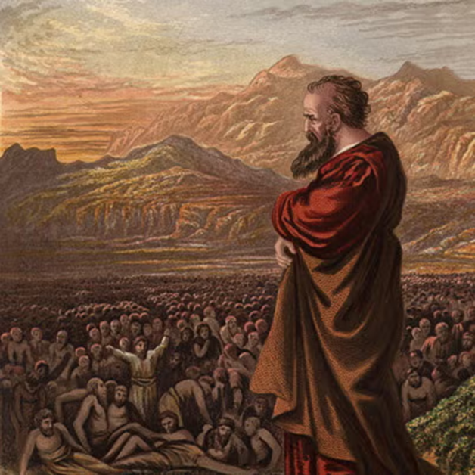
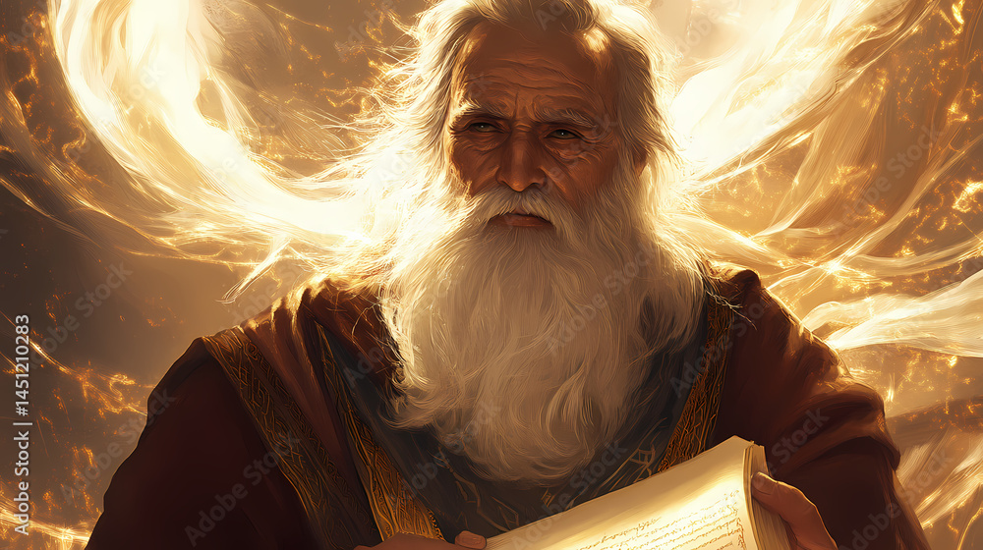
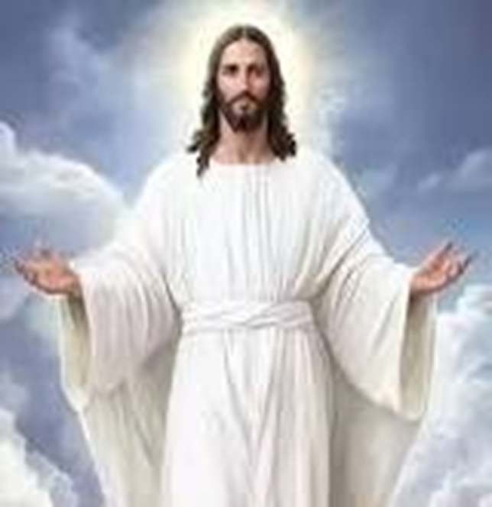
F
oretold &
Prophecies to Jesus Christ
ulfilled
Ezekiel
Isaiah
Jesus

Slide 2
F
FBC Liberty Small Group
oretold &
The Answer and Plan
Session #5 April 19, 2026
Prophecies to Jesus Christ
ulfilled

Slide 3
After the Revelation Study, God told me to get ready for another study. Several people chided me about not starting another soon after Revelation.
I did not want to do it and told God just so……
3
Notes:
The baseball diamond is used to represent the growth and progress as it relates to the Christian Life and Service Seminars.
Today’s Agenda/Housekeeping

Slide 4
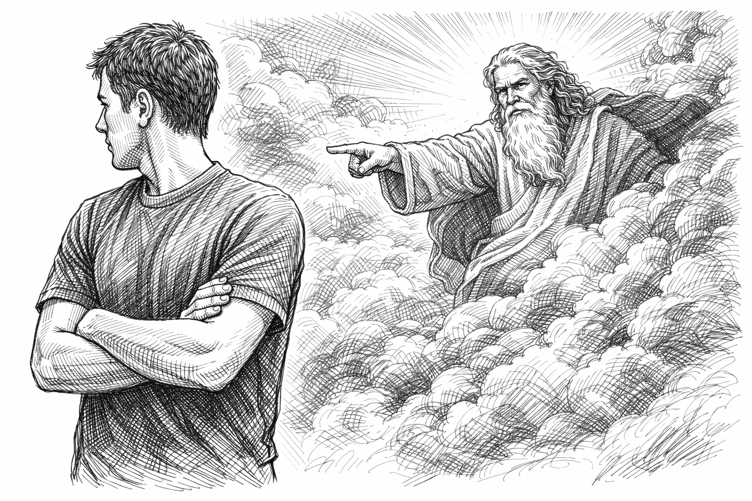
4
Notes:
The baseball diamond is used to represent the growth and progress as it relates to the Christian Life and Service Seminars.
Today’s Agenda/Housekeeping

Slide 5
But
I continued to refuse
I am tired
I want my Sunday afternoons
I just plain don’t want to
5
Notes:
The baseball diamond is used to represent the growth and progress as it relates to the Christian Life and Service Seminars.
Today’s Agenda/Housekeeping

Slide 6
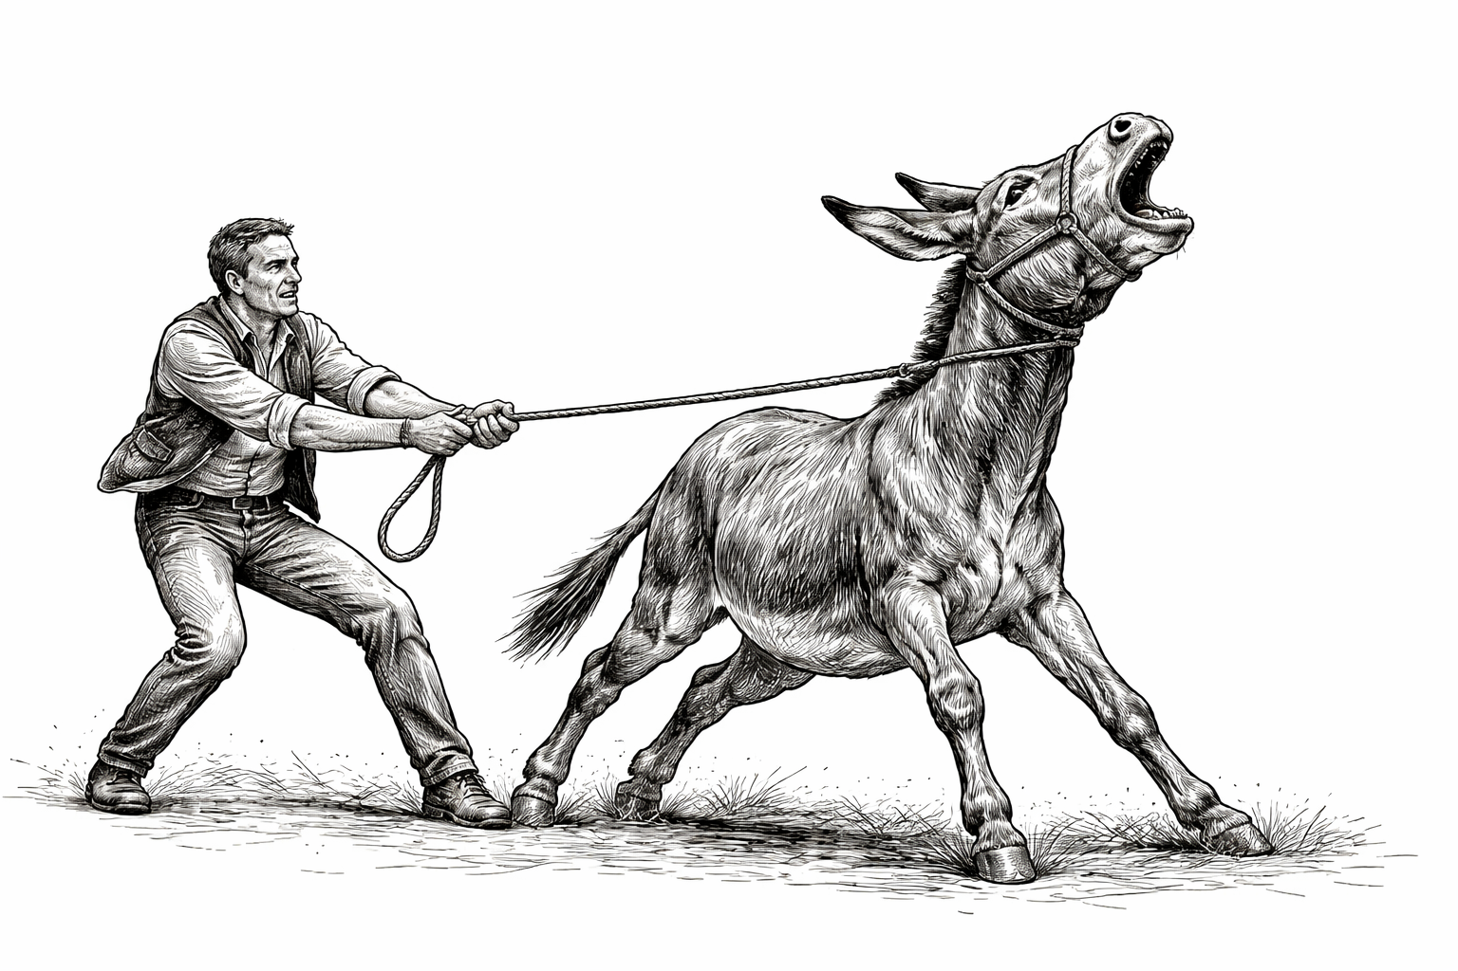
6
Notes:
The baseball diamond is used to represent the growth and progress as it relates to the Christian Life and Service Seminars.
Today’s Agenda/Housekeeping

Slide 7
But
You can lead a horse to water but you can’t make him drink
7
Notes:
The baseball diamond is used to represent the growth and progress as it relates to the Christian Life and Service Seminars.
Today’s Agenda/Housekeeping

Slide 8
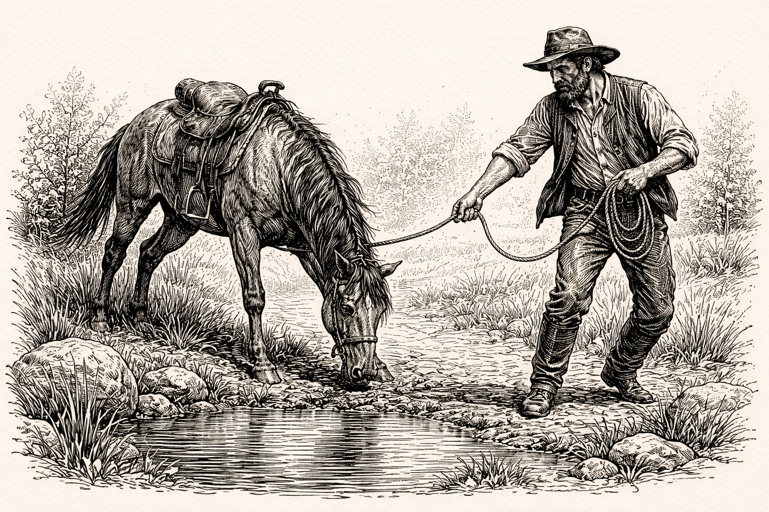
8
Notes:
The baseball diamond is used to represent the growth and progress as it relates to the Christian Life and Service Seminars.
Today’s Agenda/Housekeeping

Slide 9
Finally
I decided I would listen
But
I still did not have the study organized
Good publicity, good class,
Poor study
9
Notes:
The baseball diamond is used to represent the growth and progress as it relates to the Christian Life and Service Seminars.
Today’s Agenda/Housekeeping

Slide 10
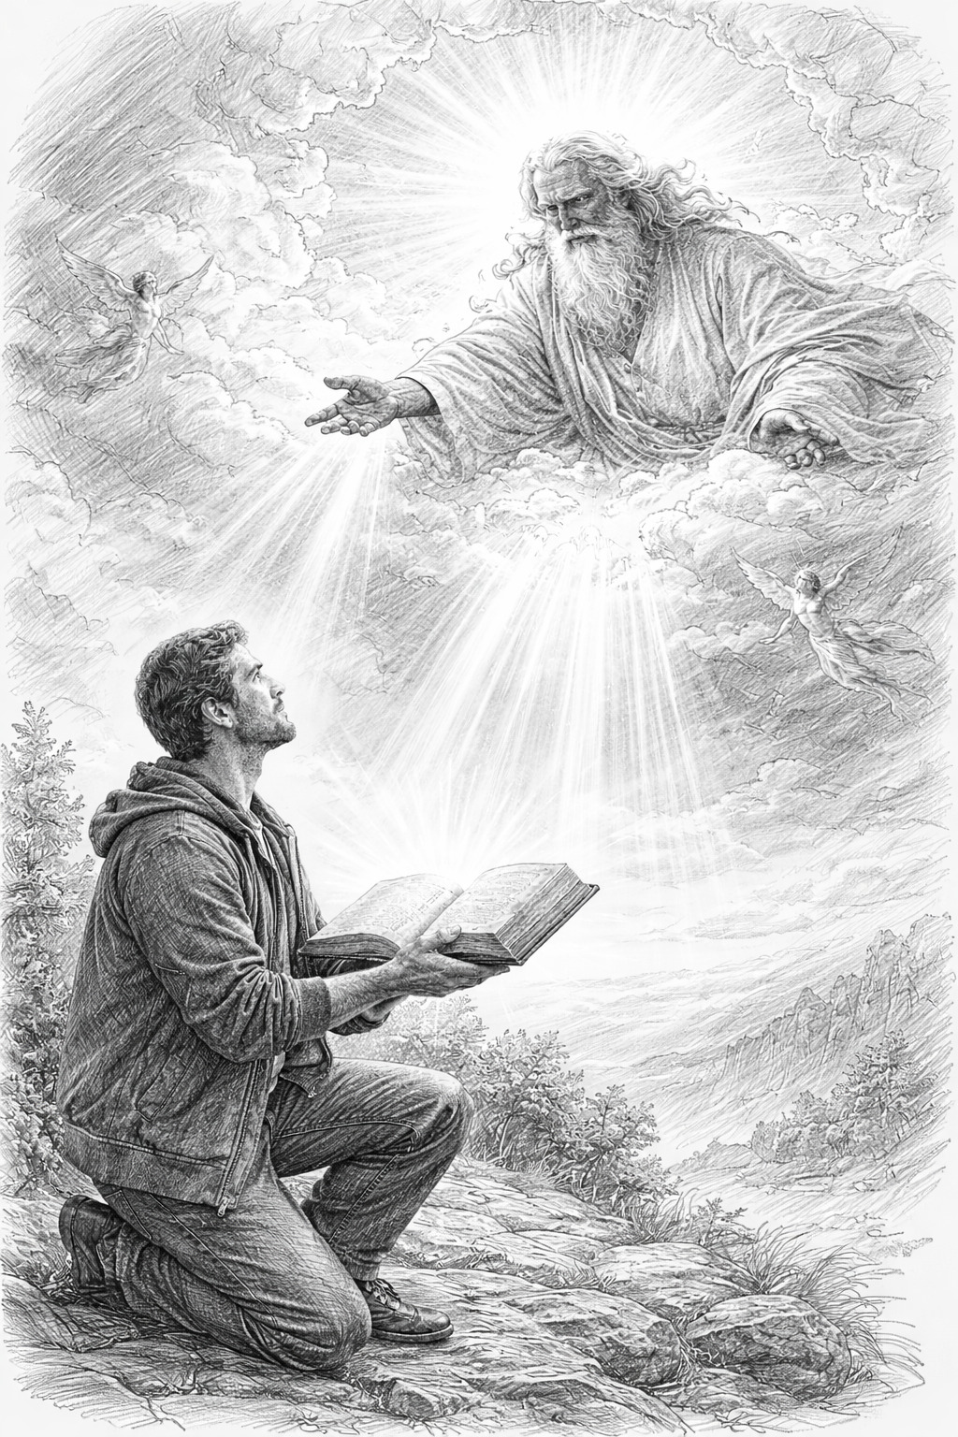
10
Notes:
The baseball diamond is used to represent the growth and progress as it relates to the Christian Life and Service Seminars.
Today’s Agenda/Housekeeping

Slide 11
God sent a friend to me to give me another tool to develop the study organization
So, tonight is the unveiling of the study organization
11
Notes:
The baseball diamond is used to represent the growth and progress as it relates to the Christian Life and Service Seminars.
Today’s Agenda/Housekeeping

Slide 12
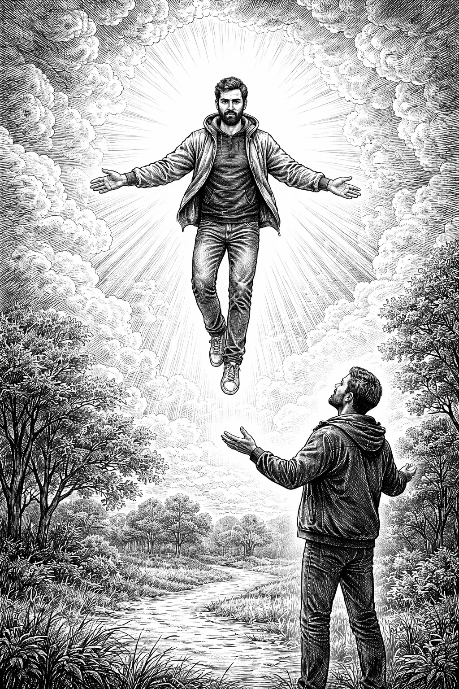
12
Notes:
The baseball diamond is used to represent the growth and progress as it relates to the Christian Life and Service Seminars.
Today’s Agenda/Housekeeping

Slide 13
So, tonight is the unveiling of the new & improved study
13
Notes:
The baseball diamond is used to represent the growth and progress as it relates to the Christian Life and Service Seminars.
Today’s Agenda/Housekeeping

Slide 14
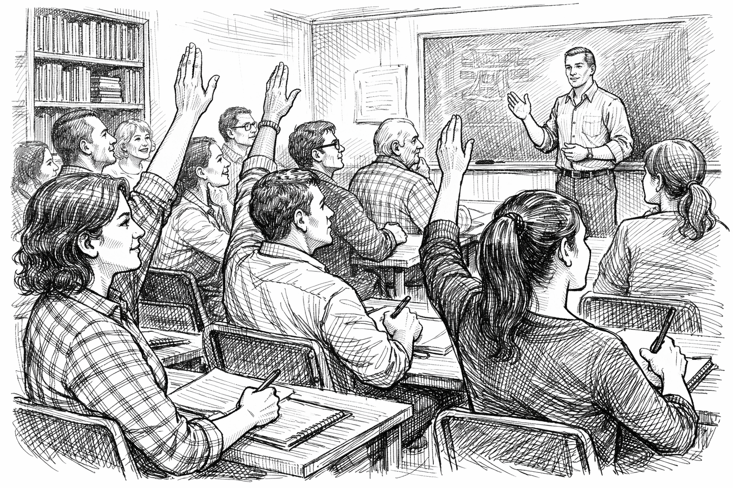
All the Way Back to Genesis
Clarence
Hinke
Dave Taylor
Cecelia
14
Notes:
The baseball diamond is used to represent the growth and progress as it relates to the Christian Life and Service Seminars.
Today’s Agenda/Housekeeping

Slide 15
Here is how you will know that I am the one true God,
and those so-called ‘gods’ are nothing: I will tell you
the end from the beginning; I will tell you what will
happen before it happens, and then when those
things come to pass, that will be the proof to you that I
alone am God. Isaiah 44:6-8; 46:9-10; 48:5-6
15
Notes:
The baseball diamond is used to represent the growth and progress as it relates to the Christian Life and Service Seminars.
Today’s Agenda/Housekeeping

Slide 16
Christ’s Probability
To meet the eight major OT prophecies
1 chance in 10¹⁷ power
1 in 100,000,000,000,000,000,
Cover all of Texas with silver dollars
Mark one silver dollar
A blind folded person picks the marked one on the first try
16
Notes:
The baseball diamond is used to represent the growth and progress as it relates to the Christian Life and Service Seminars.
Today’s Agenda/Housekeeping

Slide 17
Eight Major Prophecies
Born in Bethlehem
Messenger would prepare the way
Ride in on a donkey
Betrayed by a friend
Betrayed for 30 pieces of silver
Betrayal money used to purchase a potter’s field
Messiah will remain silent at the trial
Messiah will have his hands & feet pierced
17
Notes:
The baseball diamond is used to represent the growth and progress as it relates to the Christian Life and Service Seminars.
Today’s Agenda/Housekeeping

Slide 18
OT Prophecies are organized into 5 areas
Lineage of the Messiah
Birth of the Messiah
Ministry of the Messiah
Suffering Servant
The Crucifixion
18
Notes:
The baseball diamond is used to represent the growth and progress as it relates to the Christian Life and Service Seminars.
Today’s Agenda/Housekeeping

Slide 19
Lineage of the Messiah
Genesis & 2 Samuel
Establishes:
God controlled
Seed of a woman that God chose
Descendant of Abraham
Throne of David
Tribe of Judah
19
Notes:
The baseball diamond is used to represent the growth and progress as it relates to the Christian Life and Service Seminars.
Today’s Agenda/Housekeeping

Slide 20
Birth of the Messiah
Isaiah, Micah, Hosea, Jeremiah
Born of a Virgin
Born in Bethlehem
Flight to Egypt
Massacre of the Innocents
20
Notes:
The baseball diamond is used to represent the growth and progress as it relates to the Christian Life and Service Seminars.
Today’s Agenda/Housekeeping

Slide 21
Ministry of the Messiah
Isaiah, Malachi, Zacharia
Anointed with the Spirit
Ministry in Galilee
Triumphant entry on a donkey
Preceded by a Messenger
21
Notes:
The baseball diamond is used to represent the growth and progress as it relates to the Christian Life and Service Seminars.
Today’s Agenda/Housekeeping

Slide 22
Suffering Servant
Isaiah
Despised & Rejected
Bearing Our Sins
Silence Before His Accusers
Numbered with Transgressors
22
Notes:
The baseball diamond is used to represent the growth and progress as it relates to the Christian Life and Service Seminars.
Today’s Agenda/Housekeeping

Slide 23
The Crucifixion
Psalms, Zachariah
My God, Why Have You Forsaken Me?
Mocked by Onlookers
Cast Lots for His Clothing
23
Notes:
The baseball diamond is used to represent the growth and progress as it relates to the Christian Life and Service Seminars.
Today’s Agenda/Housekeeping

Slide 24
The Crucifixion, con’t.
Numbered with Transgressors
Betrayed for 30 Pieces of Silver
Not a Bone Broken
24
Notes:
The baseball diamond is used to represent the growth and progress as it relates to the Christian Life and Service Seminars.
Today’s Agenda/Housekeeping

Slide 25
Lineage of the Messiah - Prophecy
Genesis 3: 15 Seed of a Woman
Genesis 22: 18 Descendant of Abraham
2 Samuel 7: 12 – 13 Throne of David
Genesis 49: 10 Tribe of Judah
25
Notes:
The baseball diamond is used to represent the growth and progress as it relates to the Christian Life and Service Seminars.
Today’s Agenda/Housekeeping

Slide 26
Lineage of the Messiah - Prophecy
14 So the LORD God said to the serpent, “Because you have done this, “Cursed are you above all livestock and all wild animals! You will crawl on your belly and you will eat dust all the days of your life.
15 And I will put enmity between you and the woman, and between your offspring and hers; he will crush your head, and you will strike his heel.”
Genesis 3:14 - 15
26
Notes:
The baseball diamond is used to represent the growth and progress as it relates to the Christian Life and Service Seminars.
Today’s Agenda/Housekeeping

Slide 27
Lineage of the Messiah - Fulfillment
4 But when the set time had fully come, God sent his Son, born of a woman, born under the law,
5 to redeem those under the law, that we might receive adoption to sonship.
Galatians 4: 4 - 7
27
Notes:
The baseball diamond is used to represent the growth and progress as it relates to the Christian Life and Service Seminars.
Today’s Agenda/Housekeeping

Slide 28
Lineage of the Messiah - Fulfillment
6 Because you are his sons, God sent the Spirit of his Son into our hearts, the Spirit who calls out, “Abba, Father.”
7 So you are no longer a slave, but God’s child; and since you are his child, God has made you also an heir.
Galatians 4: 4 - 7
28
Notes:
The baseball diamond is used to represent the growth and progress as it relates to the Christian Life and Service Seminars.
Today’s Agenda/Housekeeping

