Slide 1

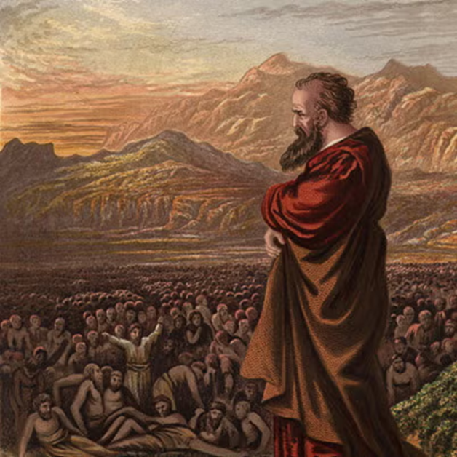
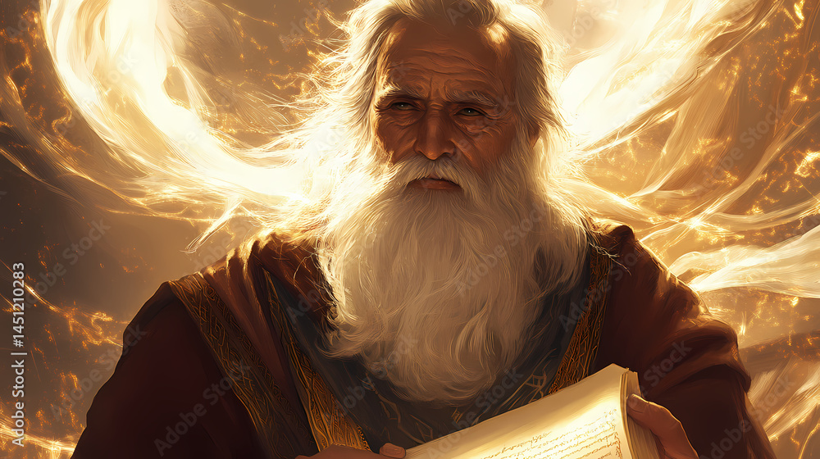
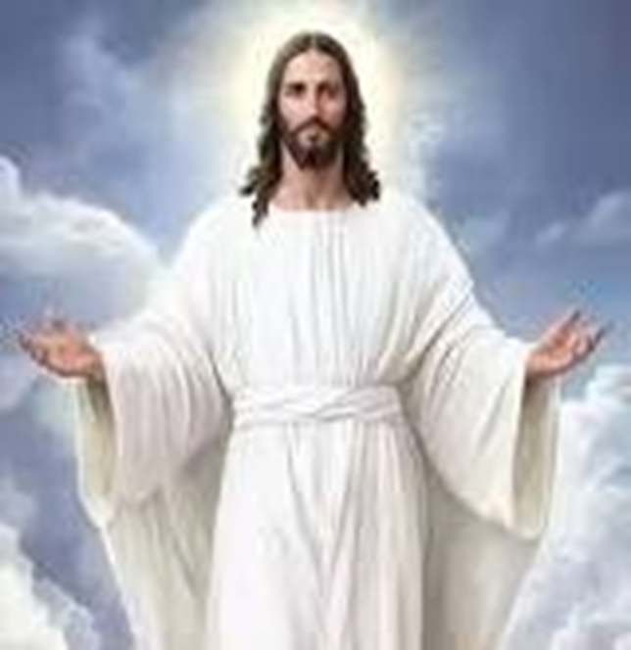
F
oretold &
Prophecies to Jesus Christ
ulfilled
Ezekiel
Isaiah
Jesus

Slide 2
F
FBC Liberty Small Group
oretold &
The Lineage
Session #6 May 3, 2026
Prophecies to Jesus Christ
ulfilled

Slide 3
Here is how you will know that I am the one true God,
and those so-called ‘gods’ are nothing: I will tell you
the end from the beginning; I will tell you what will
happen before it happens, and then when those
things come to pass, that will be the proof to you that I
alone am God. Isaiah 44:6-8; 46:9-10; 48:5-6
3
Notes:
The baseball diamond is used to represent the growth and progress as it relates to the Christian Life and Service Seminars.
Today’s Agenda/Housekeeping

Slide 4
When I bestow eggs to a believer, know that I am God…
4 John 1:1
4
Notes:
The baseball diamond is used to represent the growth and progress as it relates to the Christian Life and Service Seminars.
Today’s Agenda/Housekeeping

Slide 5
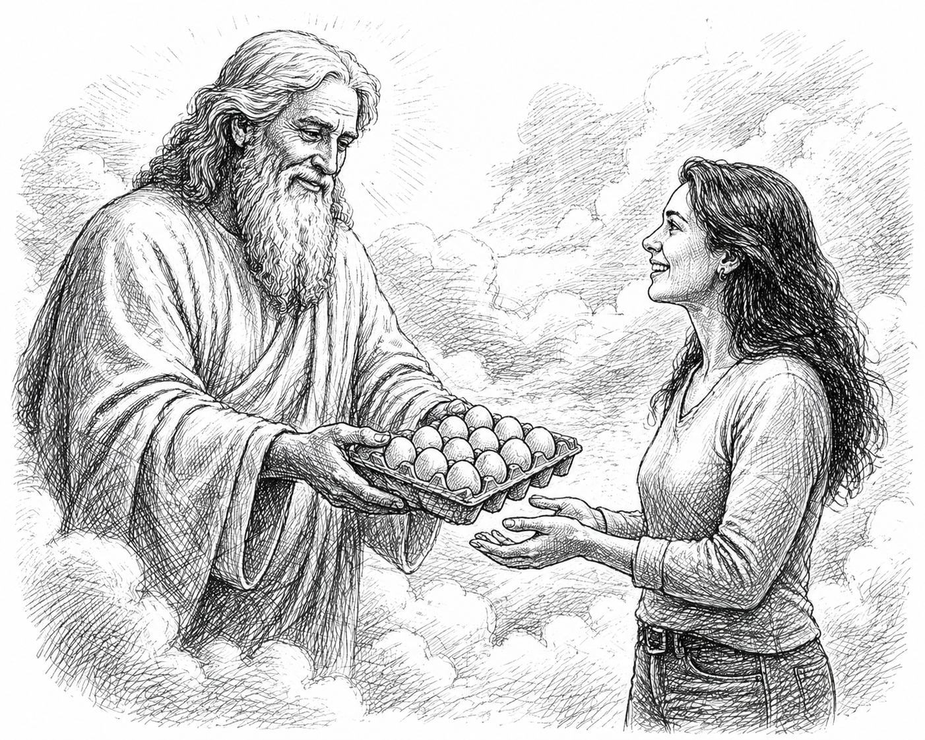
GOD
Margo
5
Notes:
The baseball diamond is used to represent the growth and progress as it relates to the Christian Life and Service Seminars.
Today’s Agenda/Housekeeping

Slide 6
OT Prophecies are organized into 5 areas
    Lineage of the Messiah
    Birth of the Messiah
    Ministry of the Messiah
    Suffering Servant
    The Crucifixion, Death, & Resurrection
6
Notes:
The baseball diamond is used to represent the growth and progress as it relates to the Christian Life and Service Seminars.
Today’s Agenda/Housekeeping

Slide 7
  Lineage of the Messiah
    Genesis, 2 Samuel & Deuteronomy
    Establishes:
      God controlled
      Seed of a woman that God chose
      Descendant of Abraham
      Throne of David
      Tribe of Judah
      Prophet like Moses
7
Notes:
The baseball diamond is used to represent the growth and progress as it relates to the Christian Life and Service Seminars.
Today’s Agenda/Housekeeping

Slide 8
  Birth of the Messiah
    Isaiah, Micah, Hosea, Jeremiah
    Born of a Virgin
    Born in Bethlehem
    Flight to Egypt
    Massacre of the Innocents
8
Notes:
The baseball diamond is used to represent the growth and progress as it relates to the Christian Life and Service Seminars.
Today’s Agenda/Housekeeping

Slide 9
  Ministry of the Messiah
    Isaiah, Malachi, Zacharia
    Anointed with the Spirit
    Ministry in Galilee
    Triumphant entry on a donkey
    Preceded by a Messenger
9
Notes:
The baseball diamond is used to represent the growth and progress as it relates to the Christian Life and Service Seminars.
Today’s Agenda/Housekeeping

Slide 10
  Suffering Servant
    Isaiah
    Despised & Rejected
    Bearing Our Sins
    Silence Before His Accusers
    Numbered with Transgressors
10
Notes:
The baseball diamond is used to represent the growth and progress as it relates to the Christian Life and Service Seminars.
Today’s Agenda/Housekeeping

Slide 11
  The Crucifixion
    Psalms, Zachariah
    My God, Why Have You Forsaken Me?
    Mocked by Onlookers
    Cast Lots for His Clothing
11
Notes:
The baseball diamond is used to represent the growth and progress as it relates to the Christian Life and Service Seminars.
Today’s Agenda/Housekeeping

Slide 12
  The Crucifixion, con’t.
    Numbered with Transgressors
    Betrayed for 30 Pieces of Silver
    Not a Bone Broken
12
Notes:
The baseball diamond is used to represent the growth and progress as it relates to the Christian Life and Service Seminars.
Today’s Agenda/Housekeeping

Slide 13
Lineage of the Messiah - Prophecy
  Genesis 3: 15 Seed of a Woman
  Genesis 22: 18 Descendant of Abraham
  2 Samuel 7: 12 – 13 Throne of David
  Genesis 49: 10 Tribe of Judah
  Deuteronomy 18:15 Just like Moses
13
Notes:
The baseball diamond is used to represent the growth and progress as it relates to the Christian Life and Service Seminars.
Today’s Agenda/Housekeeping

Slide 14
Lineage – Seed of Woman
14 So the LORD God said to the serpent, “Because you have done this, “Cursed are you above all livestock and all wild animals! You will crawl on your belly and you will eat dust all the days of your life.
15 And I will put enmity between you and the woman, and between your offspring and her offspring; he will crush your head, and you will strike his heel.”
Genesis 3:14 - 15
14
Notes:
The baseball diamond is used to represent the growth and progress as it relates to the Christian Life and Service Seminars.
Today’s Agenda/Housekeeping

Slide 15
Lineage -- Seed of Woman -- Fulfillment
4 But when the set time had fully come, God sent his Son, born of a woman, born under the law,
5 to redeem those under the law, that we might receive adoption to sonship.
Galatians 4: 4 - 7
15
Notes:
The baseball diamond is used to represent the growth and progress as it relates to the Christian Life and Service Seminars.
Today’s Agenda/Housekeeping

Slide 16
Lineage -- Seed of Woman -- Fulfillment
6 Because you are his sons, God sent the Spirit of his Son into our hearts, the Spirit who calls out, “Abba, Father.”
7 So you are no longer a slave, but God’s child; and since you are his child, God has made you also an heir.
Galatians 4: 4 - 7
16
Notes:
The baseball diamond is used to represent the growth and progress as it relates to the Christian Life and Service Seminars.
Today’s Agenda/Housekeeping

Slide 17
Lineage – Descendant of Abraham
17 I will surely bless you and make your descendants as numerous as the stars in the sky and as the sand on the seashore. Your descendants will take possession of the cities of their enemies,
18 and through your offspring all nations on earth will be blessed, because you have obeyed me.”
Genesis 22
17
Notes:
The baseball diamond is used to represent the growth and progress as it relates to the Christian Life and Service Seminars.
Today’s Agenda/Housekeeping

Slide 18
Lineage – Descendant of Abraham
Fulfillment
1 This is the genealogy of Jesus the Messiah the son of David, the son of Abraham:
Matthew 1:1
18
Notes:
The baseball diamond is used to represent the growth and progress as it relates to the Christian Life and Service Seminars.
Today’s Agenda/Housekeeping

Slide 19
Who is Samuel
Samuel -- 1070 BC to 1012 BC
Prophet through Philistine war while Saul was king
Prophet during Saul’s reign
  Denounced Saul at the Philistine battle
  Enraged that Saul did not kill Agag, Amalekite king
  Secretly anointed David as king
  Provided sanctuary for David as Saul searched
  Saul had the Witch on Endor conjure Samuel from Sheol to predict battle, Samuel told Saul God had left him
19
Notes:
The baseball diamond is used to represent the growth and progress as it relates to the Christian Life and Service Seminars.
Today’s Agenda/Housekeeping

Slide 20
Lineage – Throne of David
12 When your days are over and you rest with your ancestors, I will raise up your offspring to succeed you, your own flesh and blood, and I will establish his kingdom.
13 He is the one who will build a house for my Name, and I will establish the throne of his kingdom forever.
14 I will be his father, and he will be my son. When he does wrong, I will punish him with a rod wielded by men, with floggings inflicted by human hands.
2 Samuel 7
20
Notes:
The baseball diamond is used to represent the growth and progress as it relates to the Christian Life and Service Seminars.
Today’s Agenda/Housekeeping

Slide 21
Lineage – Throne of David -- Fulfillment
32 He will be great and will be called the Son of the Most High. The Lord God will give him the throne of his father David,
33 and he will reign over Jacob’s descendants forever; his kingdom will never end.”
Luke 1
21
Notes:
The baseball diamond is used to represent the growth and progress as it relates to the Christian Life and Service Seminars.
Today’s Agenda/Housekeeping

Slide 22
Lineage – Just Like Moses
15 The LORD your God will raise up for you a prophet like me from among you, from your fellow Israelites. You must listen to him.
16 For this is what you asked of the LORD your God at Horeb on the day of the assembly when you said, “Let us not hear the voice of the LORD our God nor see this great fire anymore, or we will die.”
Deuteronomy 18
22
Notes:
The baseball diamond is used to represent the growth and progress as it relates to the Christian Life and Service Seminars.
Today’s Agenda/Housekeeping

Slide 23
Lineage -- Just Like Moses
17 The LORD said to me: “What they say is good.
18 I will raise up for them a prophet like you from among their fellow Israelites, and I will put my words in his mouth. He will tell them everything I command him.
19 I myself will call to account anyone who does not listen to my words that the prophet speaks in my name.
Deuteronomy 18
23
Notes:
The baseball diamond is used to represent the growth and progress as it relates to the Christian Life and Service Seminars.
Today’s Agenda/Housekeeping

Slide 24
Lineage -- Just Like Moses -- Fulfillment
12 So they stirred up the people and the elders and the teachers of the law. They seized Stephen and brought him before the Sanhedrin.
13 They produced false witnesses, who testified, “This fellow never stops speaking against this holy place and against the law.
Acts 6 - 7
24
Notes:
The baseball diamond is used to represent the growth and progress as it relates to the Christian Life and Service Seminars.
Today’s Agenda/Housekeeping

Slide 25
Lineage -- Just Like Moses -- Fulfillment
14 For we have heard him say that this Jesus of Nazareth will destroy this place and change the customs Moses handed down to us.”
15 All who were sitting in the Sanhedrin looked intently at Stephen, and they saw that his face was like the face of an angel.
Acts 6 – 7
25
Notes:
The baseball diamond is used to represent the growth and progress as it relates to the Christian Life and Service Seminars.
Today’s Agenda/Housekeeping

Slide 26
Lineage – Tribe of Judah
9 You are a lion’s cub, Judah; you return from the prey, my son. Like a lion he crouches and lies down, like a lioness—who dares to rouse him?
10 The scepter will not depart from Judah, nor the ruler’s staff from between his feet,until he to whom it belongs shall come and the obedience of the nations shall be his.
11 He will tether his donkey to a vine, his colt to the choicest branch; he will wash his garments in wine, his robes in the blood of grapes.
Genesis 49
26
Notes:
The baseball diamond is used to represent the growth and progress as it relates to the Christian Life and Service Seminars.
Today’s Agenda/Housekeeping

Slide 27
Lineage – Tribe of Judah -- Fulfillment
5 Then one of the elders said to me, “Do not weep! See, the Lion of the tribe of Judah, the Root of David, has triumphed. He is able to open the scroll and its seven seals.”
Revelation 5
27
Notes:
The baseball diamond is used to represent the growth and progress as it relates to the Christian Life and Service Seminars.
Today’s Agenda/Housekeeping

