Slide 1

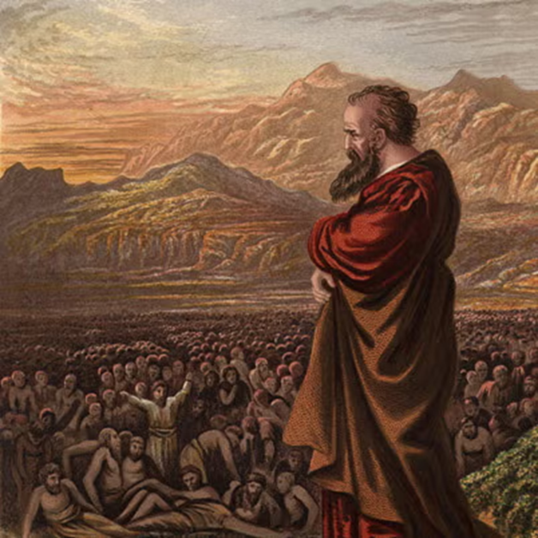
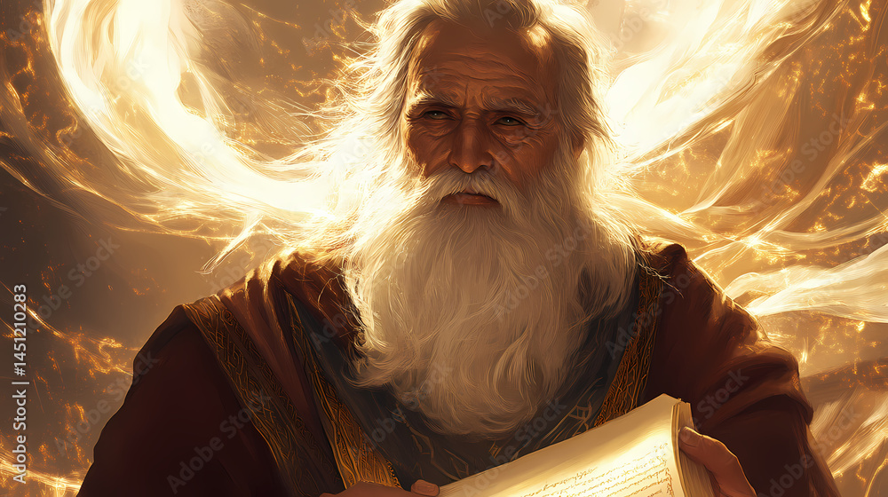
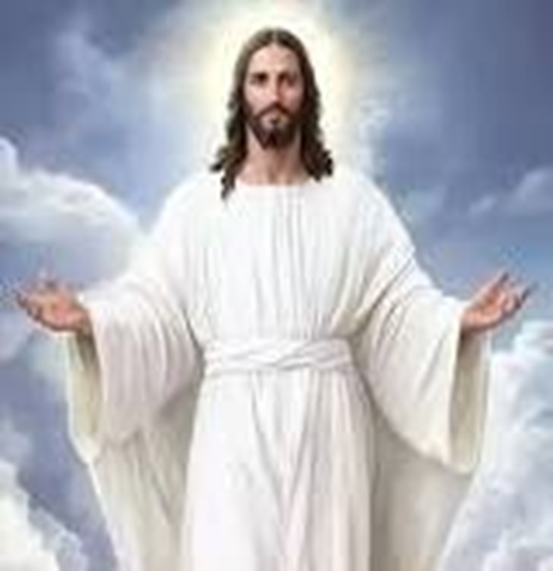
F
oretold &
Prophecies to Jesus Christ
ulfilled
Ezekiel
Isaiah
Jesus

Slide 2
F
FBC Liberty Small Group
oretold &
The Lineage
Session #7 May 17, 2026
Prophecies to Jesus Christ
ulfilled

Slide 3
Here is how you will know that I am the one true God,
and those so-called ‘gods’ are nothing: I will tell you
the end from the beginning; I will tell you what will
happen before it happens, and then when those
things come to pass, that will be the proof to you that I
alone am God. Isaiah 44:6-8; 46:9-10; 48:5-6
3
Notes:
The baseball diamond is used to represent the growth and progress as it relates to the Christian Life and Service Seminars.
Today’s Agenda/Housekeeping

Slide 4
How To Read A Prophecy?????
    Have the NT Fulfillment ready
      You know the “end of the book”
    Read 20 verses behind and ahead
      Get the context of what is written about
      But, be prepared to separate prophecy from context
    Be aware of nuances
    Check the nuances against Biblical times, not 21st century
    Watch for simple analogies
4
Notes:
The baseball diamond is used to represent the growth and progress as it relates to the Christian Life and Service Seminars.
Today’s Agenda/Housekeeping

Slide 5
Lineage – Seed of Woman
15 And I will put enmity between you and the woman, and between your offspring and her offspring; he will crush your head, and you will strike his heel.”
Genesis 3:14 - 15
5
Notes:
The baseball diamond is used to represent the growth and progress as it relates to the Christian Life and Service Seminars.
Today’s Agenda/Housekeeping

Slide 6
OT Prophecies are organized into 5 areas
    Lineage of the Messiah
    Birth of the Messiah
    Ministry of the Messiah
    Suffering Servant
    The Crucifixion, Death, & Resurrection
6
Notes:
The baseball diamond is used to represent the growth and progress as it relates to the Christian Life and Service Seminars.
Today’s Agenda/Housekeeping

Slide 7
  Birth of the Messiah
    Isaiah, Micah, Hosea, Jeremiah
    Establishes:
      God controlled
      Seed of a woman that God chose
      Descendant of Abraham
      Throne of David
      Tribe of Judah
      Prophet like Moses
7
Notes:
The baseball diamond is used to represent the growth and progress as it relates to the Christian Life and Service Seminars.
Today’s Agenda/Housekeeping

Slide 8
  Birth of the Messiah
    Isaiah, Micah, Hosea, Jeremiah
    Born of a Virgin
    Born in Bethlehem
    Flight to Egypt
    Massacre of the Innocents
8
Notes:
The baseball diamond is used to represent the growth and progress as it relates to the Christian Life and Service Seminars.
Today’s Agenda/Housekeeping

Slide 9
  Isaiah
    Prophesied from 740 BC to 686 BC to
        Uzziah
        Jotham
        Ahaz
        Hezekiah
    Kings of Judah
9
Notes:
The baseball diamond is used to represent the growth and progress as it relates to the Christian Life and Service Seminars.
Today’s Agenda/Housekeeping

Slide 10
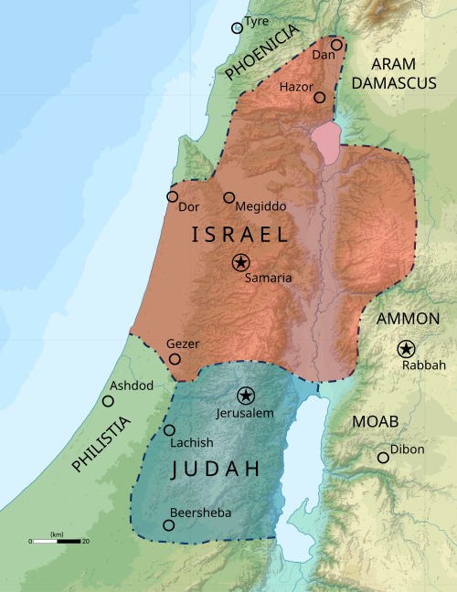
10
Notes:
The baseball diamond is used to represent the growth and progress as it relates to the Christian Life and Service Seminars.
Today’s Agenda/Housekeeping

Slide 11
  Ahaz
  2 Ahaz was twenty years old when he became king, and he reigned in Jerusalem sixteen years. Unlike David his father, he did not do what was right in the eyes of the LORD his God.
  2 Kings 16:2
  732 BC – 716 BC
11
Notes:
The baseball diamond is used to represent the growth and progress as it relates to the Christian Life and Service Seminars.
Today’s Agenda/Housekeeping

Slide 12
Born of a Virgin
10 Again the LORD spoke to Ahaz,
11 “Ask the LORD your God for a sign, whether in the deepest depths or in the highest heights.”
12 But Ahaz said, “I will not ask; I will not put the LORD to the test.”
Isaiah 7:14
12
Notes:
The baseball diamond is used to represent the growth and progress as it relates to the Christian Life and Service Seminars.
Today’s Agenda/Housekeeping

Slide 13
Born of a Virgin
13 Then Isaiah said, “Hear now, you house of David! Is it not enough to try the patience of humans? Will you try the patience of my God also?
14 Therefore the Lord himself will give you a sign: The virgin will conceive and give birth to a son, and will call him Immanuel.
Isaiah 7:14
13
Notes:
The baseball diamond is used to represent the growth and progress as it relates to the Christian Life and Service Seminars.
Today’s Agenda/Housekeeping

Slide 14
Names of the Messiah
6 For to us a child is born, to us a son is given, and the government will be on his shoulders. And he will be called Wonderful Counselor, Mighty God, Everlasting Father, Prince of Peace.
7 Of the greatness of his government and peace there will be no end. He will reign on David’s throne and over his kingdom, establishing and upholding it with justice and righteousness from that time on and forever. The zeal of the LORD Almighty will accomplish this.
Isaiah 9:6
14
Notes:
The baseball diamond is used to represent the growth and progress as it relates to the Christian Life and Service Seminars.
Today’s Agenda/Housekeeping

Slide 15
The Name of the Messiah
Immanuel = “God with us”
Jesus = “God is salvation”
15
Notes:
The baseball diamond is used to represent the growth and progress as it relates to the Christian Life and Service Seminars.
Today’s Agenda/Housekeeping

Slide 16
Born of a Virgin
20 But after he had considered this, an angel of the Lord appeared to him in a dream and said, “Joseph son of David, do not be afraid to take Mary home as your wife, because what is conceived in her is from the Holy Spirit.
21 She will give birth to a son, and you are to give him the name Jesus, because he will save his people from their sins.”
Matthew 1
16
Notes:
The baseball diamond is used to represent the growth and progress as it relates to the Christian Life and Service Seminars.
Today’s Agenda/Housekeeping

Slide 17
Born of a Virgin
22 All this took place to fulfill what the Lord had said through the prophet:
23 “The virgin will conceive and give birth to a son, and they will call him Immanuel” (which means “God with us”).
24 When Joseph woke up, he did what the angel of the Lord had commanded him and took Mary home as his wife.
25 But he did not consummate their marriage until she gave birth to a son. And he gave him the name Jesus.
Matthew 1
17
Notes:
The baseball diamond is used to represent the growth and progress as it relates to the Christian Life and Service Seminars.
Today’s Agenda/Housekeeping

Slide 18
Born in Bethlehem
2 “But you, Bethlehem Ephrathah, though you are small among the clans of Judah, out of you will come for me one who will be ruler over Israel, whose origins are from of old, from ancient times.”
Micah 2
18
Notes:
The baseball diamond is used to represent the growth and progress as it relates to the Christian Life and Service Seminars.
Today’s Agenda/Housekeeping

Slide 19
  Micah
    Prophesied from 740 BC to 698 BC to
        Jotham
        Ahaz
        Hezekiah
    Kings of Judah
19
Notes:
The baseball diamond is used to represent the growth and progress as it relates to the Christian Life and Service Seminars.
Today’s Agenda/Housekeeping

Slide 20
Flight to Egypt
1 “When Israel was a child, I loved him, and out of Egypt I called my son.
2 But the more they were called, the more they went away from me. They sacrificed to the Baals and they burned incense to images.
3 It was I who taught Ephraim to walk, taking them by the arms; but they did not realize it was I who healed them.
Hosea 1
20
Notes:
The baseball diamond is used to represent the growth and progress as it relates to the Christian Life and Service Seminars.
Today’s Agenda/Housekeeping

Slide 21
Flight to Egypt - Fulfilled
13 When they had gone, an angel of the Lord appeared to Joseph in a dream. “Get up,” he said, “take the child and his mother and escape to Egypt. Stay there until I tell you, for Herod is going to search for the child to kill him.”
14 So he got up, took the child and his mother during the night and left for Egypt,
15 where he stayed until the death of Herod. And so was fulfilled what the Lord had said through the prophet: “Out of Egypt I called my son.”
Matthew 2
21
Notes:
The baseball diamond is used to represent the growth and progress as it relates to the Christian Life and Service Seminars.
Today’s Agenda/Housekeeping

Slide 22
  Hosea
    Prophesied from 750 BC to 722 BC to
        Jeroboam
        Hoshea
    Kings of Israel – Northern kingdom
22
Notes:
The baseball diamond is used to represent the growth and progress as it relates to the Christian Life and Service Seminars.
Today’s Agenda/Housekeeping

Slide 23
Massacre of Innocents
15 This is what the LORD says: “A voice is heard in Ramah, mourning and great weeping, Rachel weeping for her children and refusing to be comforted, because they are no more.”
16 This is what the LORD says: “Restrain your voice from weeping and your eyes from tears, for your work will be rewarded,” declares the LORD. “They will return from the land of the enemy.
Jeremiah 31
23
Notes:
The baseball diamond is used to represent the growth and progress as it relates to the Christian Life and Service Seminars.
Today’s Agenda/Housekeeping

Slide 24
Massacre of Innocents
17 So there is hope for your descendants,” declares the LORD. “Your children will return to their own land.
18 “I have surely heard Ephraim’s moaning: ‘You disciplined me like an unruly calf, and I have been disciplined. Restore me, and I will return, because you are the LORD my God.
Jeremiah 31
24
Notes:
The baseball diamond is used to represent the growth and progress as it relates to the Christian Life and Service Seminars.
Today’s Agenda/Housekeeping

Slide 25
Massacre of Innocents - Fulfilled
16 When Herod realized that he had been outwitted by the Magi, he was furious, and he gave orders to kill all the boys in Bethlehem and its vicinity who were two years old and under, in accordance with the time he had learned from the Magi.
17 Then what was said through the prophet Jeremiah was fulfilled:
18 “A voice is heard in Ramah, weeping and great mourning, Rachel weeping for her children and refusing to be comforted, because they are no more.”
Matthew 2
25
Notes:
The baseball diamond is used to represent the growth and progress as it relates to the Christian Life and Service Seminars.
Today’s Agenda/Housekeeping

Slide 26
  Jeremiah
    Prophesied from 626 BC to ~580 BC to
    Israelites of Northern kingdom – Samaria
    4 books
        Jeremiah
        Lamentations
        1/2 Kings
        Scribe Baruch ben Neriah
26
Notes:
The baseball diamond is used to represent the growth and progress as it relates to the Christian Life and Service Seminars.
Today’s Agenda/Housekeeping

