Slide 1

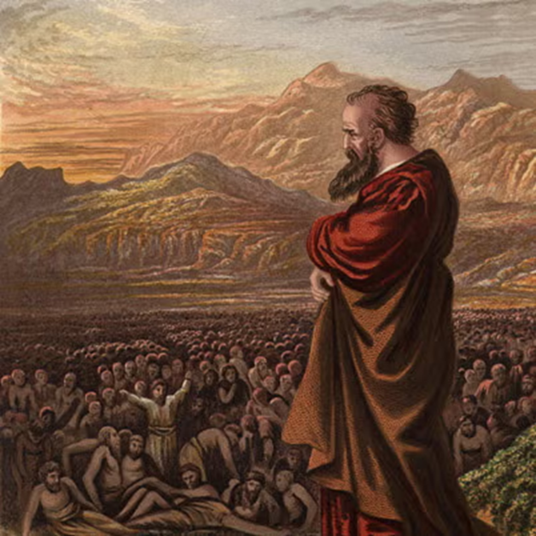
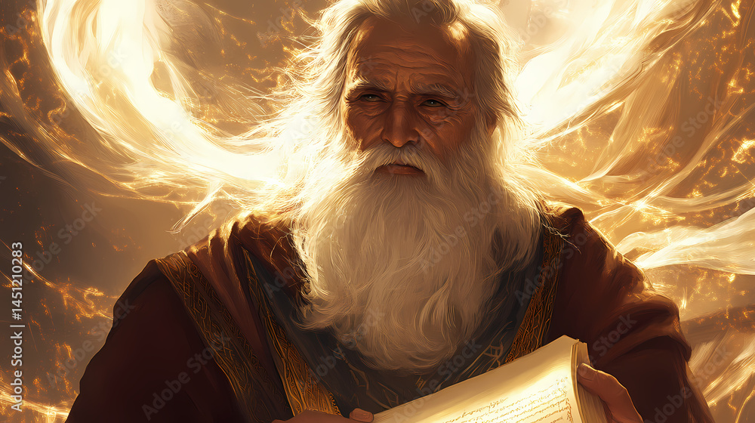
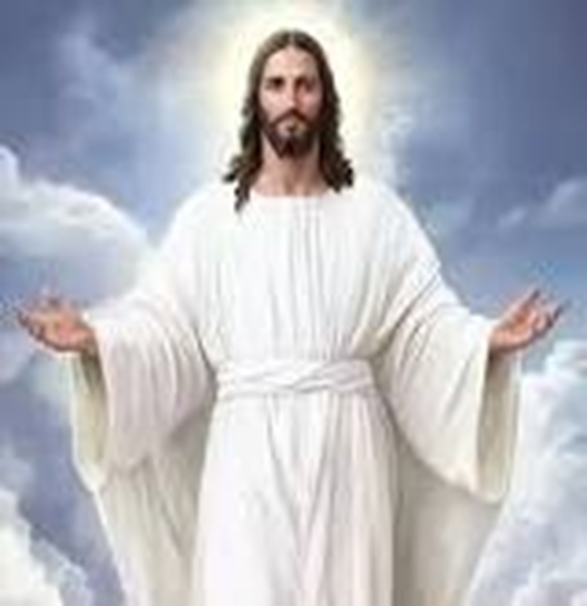
F
oretold &
Prophecies to Jesus Christ
ulfilled
Ezekiel
Isaiah
Jesus

Slide 2
F
FBC Liberty Small Group
oretold &
The Best Prophet
&
The Suffering Servant
Session #10 July 12, 2026
Prophecies to Jesus Christ
ulfilled

Slide 3
Here is how you will know that I am the one true God,
and those so-called ‘gods’ are nothing: I will tell you
the end from the beginning; I will tell you what will
happen before it happens, and then when those
things come to pass, that will be the proof to you that I
alone am God. Isaiah 44:6-8; 46:9-10; 48:5-6
3
Notes:
The baseball diamond is used to represent the growth and progress as it relates to the Christian Life and Service Seminars.
Today’s Agenda/Housekeeping

Slide 4
The Prophecy that is:
    Most accurate
    Most timely
    Most detailed
    Least understood
    Fulfilled quickest
    Prophecied by God himself
4
Notes:
The baseball diamond is used to represent the growth and progress as it relates to the Christian Life and Service Seminars.
Today’s Agenda/Housekeeping

Slide 5
Jesus Prophecies His Own Crucifixion
  Three Times
    Most accurate
    Most timely
    Most detailed
    Least understood
    Fulfilled quickest
    Prophesied by God himself
5
Notes:
The baseball diamond is used to represent the growth and progress as it relates to the Christian Life and Service Seminars.
Today’s Agenda/Housekeeping

Slide 6
Jesus Prophesies Crucifixion #1
18 Once when Jesus was praying in private and his disciples were with him, he asked them, “Who do the crowds say I am?”
19 They replied, “Some say John the Baptist; others say Elijah; and still others, that one of the prophets of long ago has come back to life.”
20 “But what about you?” he asked. “Who do you say I am?”Peter answered, “God’s Messiah.” Luke 9
6
Notes:
The baseball diamond is used to represent the growth and progress as it relates to the Christian Life and Service Seminars.
Today’s Agenda/Housekeeping

Slide 7
Jesus Prophesies Crucifixion #1
21 Jesus strictly warned them not to tell this to anyone.
22 And he said, “The Son of Man must suffer many things and be rejected by the elders, the chief priests and the teachers of the law, and he must be killed and on the third day be raised to life.”
Luke 9
7
Notes:
The baseball diamond is used to represent the growth and progress as it relates to the Christian Life and Service Seminars.
Today’s Agenda/Housekeeping

Slide 8
Jesus Prophesies Crucifixion #1
31 He then began to teach them that the Son of Man must suffer many things and be rejected by the elders, the chief priests and the teachers of the law, and that he must be killed and after three days rise again.
32 He spoke plainly about this, and Peter took him aside and began to rebuke him.
33 But when Jesus turned and looked at his disciples, he rebuked Peter. “Get behind me, Satan!” he said. “You do not have in mind the concerns of God, but merely human concerns.” Mark 8
8
Notes:
The baseball diamond is used to represent the growth and progress as it relates to the Christian Life and Service Seminars.
Today’s Agenda/Housekeeping

Slide 9
Jesus Prophesies Crucifixion #2
30 They left that place and passed through Galilee. Jesus did not want anyone to know where they were,
31 because he was teaching his disciples. He said to them, “The Son of Man is going to be delivered into the hands of men. They will kill him, and after three days he will rise.”
32 But they did not understand what he meant and were afraid to ask him about it.
Mark 9
9
Notes:
The baseball diamond is used to represent the growth and progress as it relates to the Christian Life and Service Seminars.
Today’s Agenda/Housekeeping

Slide 10
Jesus Prophesies Crucifixion #3
31 Jesus took the Twelve aside and told them, “We are going up to Jerusalem, and everything that is written by the prophets about the Son of Man will be fulfilled.
32 He will be delivered over to the Gentiles. They will mock him, insult him and spit on him;
33 they will flog him and kill him. On the third day he will rise again.”
33 The disciples did not understand any of this. Its meaning was hidden from them, and they did not know what he was talking about.
Luke 18
10
Notes:
The baseball diamond is used to represent the growth and progress as it relates to the Christian Life and Service Seminars.
Today’s Agenda/Housekeeping

Slide 11
Jesus References His Crucifixion #1
16 To those who sold doves he said, “Get these out of here! Stop turning my Father’s house into a market!”
17 His disciples remembered that it is written: “Zeal for your house will consume me.”
18 The Jews then responded to him, “What sign can you show us to prove your authority to do all this?”
John 2
11
Notes:
The baseball diamond is used to represent the growth and progress as it relates to the Christian Life and Service Seminars.
Today’s Agenda/Housekeeping

Slide 12
Jesus References His Crucifixion #1
19 Jesus answered them, “Destroy this temple, and I will raise it again in three days.”
20 They replied, “It has taken forty-six years to build this temple, and you are going to raise it in three days?”
21 But the temple he had spoken of was his body.
22 After he was raised from the dead, his disciples recalled what he had said. Then they believed the scripture and the words that Jesus had spoken.
John 2
12
Notes:
The baseball diamond is used to represent the growth and progress as it relates to the Christian Life and Service Seminars.
Today’s Agenda/Housekeeping

Slide 13
Jesus References His Crucifixion #2
38 Then some of the Pharisees and teachers of the law said to him, “Teacher, we want to see a sign from you.”
39 He answered, “A wicked and adulterous generation asks for a sign! But none will be given it except the sign of the prophet Jonah.
Matthew 12
13
Notes:
The baseball diamond is used to represent the growth and progress as it relates to the Christian Life and Service Seminars.
Today’s Agenda/Housekeeping

Slide 14
Jesus References His Crucifixion #2
40 For as Jonah was three days and three nights in the belly of a huge fish, so the Son of Man will be three days and three nights in the heart of the earth.
41 The men of Nineveh will stand up at the judgment with this generation and condemn it; for they repented at the preaching of Jonah, and now something greater than Jonah is here.
Matthew 12
14
Notes:
The baseball diamond is used to represent the growth and progress as it relates to the Christian Life and Service Seminars.
Today’s Agenda/Housekeeping

Slide 15
OT Prophecies are organized into 5 areas
    Lineage of the Messiah
    Birth of the Messiah
    Ministry of the Messiah
    Suffering Servant
    The Crucifixion
15
Notes:
The baseball diamond is used to represent the growth and progress as it relates to the Christian Life and Service Seminars.
Today’s Agenda/Housekeeping

Slide 16
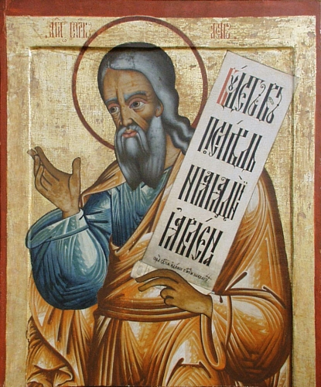
  Suffering Servant
    Isaiah 53
    Isaiah 740 – 686 BC
    Despised & Rejected
    Bearing Our Sins
    Silence Before His Accusers
    Numbered with Transgressors
16
Notes:
The baseball diamond is used to represent the growth and progress as it relates to the Christian Life and Service Seminars.
Today’s Agenda/Housekeeping

Slide 17
The Suffering Servant -- Isaiah 53
1 Who has believed our message and to whom has the arm of the LORD been revealed?
2 He grew up before him like a tender shoot, and like a root out of dry ground. He had no beauty or majesty to attract us to him, nothing in his appearance that we should desire him.
3 He was despised and rejected by mankind, a man of suffering, and familiar with pain. Like one from whom people hide their faces he was despised, and we held him in low esteem.
17
Notes:
The baseball diamond is used to represent the growth and progress as it relates to the Christian Life and Service Seminars.
Today’s Agenda/Housekeeping

Slide 18
The Suffering Servant -- Fulfilled
13 Pilate called together the chief priests, the rulers and the people,
14 and said to them, “You brought me this man as one who was inciting the people to rebellion. I have examined him in your presence and have found no basis for your charges against him.
15 Neither has Herod, for he sent him back to us; as you can see, he has done nothing to deserve death.
16 Therefore, I will punish him and then release him. ”
Luke 23
18
Notes:
The baseball diamond is used to represent the growth and progress as it relates to the Christian Life and Service Seminars.
Today’s Agenda/Housekeeping

Slide 19
The Suffering Servant -- Fulfilled
18 But the whole crowd shouted, “Away with this man! Release Barabbas to us!”
19 (Barabbas had been thrown into prison for an insurrection in the city, and for murder.)
20 Wanting to release Jesus, Pilate appealed to them again.
But they kept shouting, “Crucify him! Crucify him!”
Luke 23
19
Notes:
The baseball diamond is used to represent the growth and progress as it relates to the Christian Life and Service Seminars.
Today’s Agenda/Housekeeping

Slide 20
The Suffering Servant -- Fulfilled
21 But they kept shouting, “Crucify him! Crucify him!”
22 For the third time he spoke to them: “Why? What crime has this man committed? I have found in him no grounds for the death penalty. Therefore I will have him punished and then release him.”
23 But with loud shouts they insistently demanded that he be crucified, and their shouts prevailed.
Luke 23
20
Notes:
The baseball diamond is used to represent the growth and progress as it relates to the Christian Life and Service Seminars.
Today’s Agenda/Housekeeping

Slide 21
The Suffering Servant -- Fulfilled
24 So Pilate decided to grant their demand.
25 He released the man who had been thrown into prison for insurrection and murder, the one they asked for, and surrendered Jesus to their will.
Luke 23
21
Notes:
The baseball diamond is used to represent the growth and progress as it relates to the Christian Life and Service Seminars.
Today’s Agenda/Housekeeping

Slide 22
The Suffering Servant -- Isaiah 53
4 Surely he took up our pain and bore our suffering, yet we considered him punished by God, stricken by him, and afflicted.
5 But he was pierced for our transgressions, he was crushed for our iniquities; the punishment that brought us peace was on him, and by his wounds we are healed.
6 We all, like sheep, have gone astray, each of us has turned to our own way; and the LORD has laid on him the iniquity of us all.
22
Notes:
The baseball diamond is used to represent the growth and progress as it relates to the Christian Life and Service Seminars.
Today’s Agenda/Housekeeping

Slide 23
The Suffering Servant -- Fulfilled
21 To this you were called, because Christ suffered for you, leaving you an example, that you should follow in his steps.
22 “He committed no sin, and no deceit was found in his mouth.”
23 When they hurled their insults at him, he did not retaliate; when he suffered, he made no threats. Instead, he entrusted himself to him who judges justly.
1 Peter 2
23
Notes:
The baseball diamond is used to represent the growth and progress as it relates to the Christian Life and Service Seminars.
Today’s Agenda/Housekeeping

Slide 24
The Suffering Servant -- Fulfilled
24 “He himself bore our sins” in his body on the cross, so that we might die to sins and live for righteousness; “by his wounds you have been healed.”
25 For “you were like sheep going astray,” but now you have returned to the Shepherd and Overseer of your souls.
1 Peter 2
24
Notes:
The baseball diamond is used to represent the growth and progress as it relates to the Christian Life and Service Seminars.
Today’s Agenda/Housekeeping

Slide 25
The Suffering Servant -- Isaiah 53
7 He was oppressed and afflicted, yet he did not open his mouth; he was led like a lamb to the slaughter, and as a sheep before its shearers is silent, so he did not open his mouth.
8 By oppression and judgment he was taken away. Yet who of his generation protested? For he was cut off from the land of the living; for the transgression of my people he was punished.
25
Notes:
The baseball diamond is used to represent the growth and progress as it relates to the Christian Life and Service Seminars.
Today’s Agenda/Housekeeping

Slide 26
The Suffering Servant -- Fulfilled
11 Meanwhile Jesus stood before the governor, and the governor asked him, “Are you the king of the Jews?” “You have said so,” Jesus replied.
12 When he was accused by the chief priests and the elders, he gave no answer.
13 Then Pilate asked him, “Don’t you hear the testimony they are bringing against you?”
14 But Jesus made no reply, not even to a single charge—to the great amazement of the governor. Matthew 27
26
Notes:
The baseball diamond is used to represent the growth and progress as it relates to the Christian Life and Service Seminars.
Today’s Agenda/Housekeeping

Slide 27
The Suffering Servant -- Isaiah 53
12 Therefore I will give him a portion among the great,and he will divide the spoils with the strong, because he poured out his life unto death, and was numbered with the transgressors. For he bore the sin of many, and made intercession for the transgressors.
27
Notes:
The baseball diamond is used to represent the growth and progress as it relates to the Christian Life and Service Seminars.
Today’s Agenda/Housekeeping

Slide 28
The Suffering Servant -- Fulfilled
32 Two other men, both criminals, were also led out with him to be executed.
33 When they came to the place called the Skull, they crucified him there, along with the criminals—one on his right, the other on his left.
Luke 23
28
Notes:
The baseball diamond is used to represent the growth and progress as it relates to the Christian Life and Service Seminars.
Today’s Agenda/Housekeeping

