Slide 1

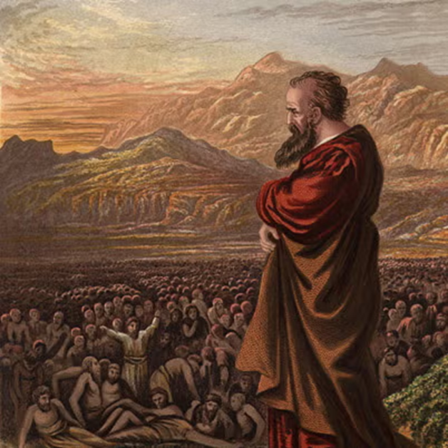
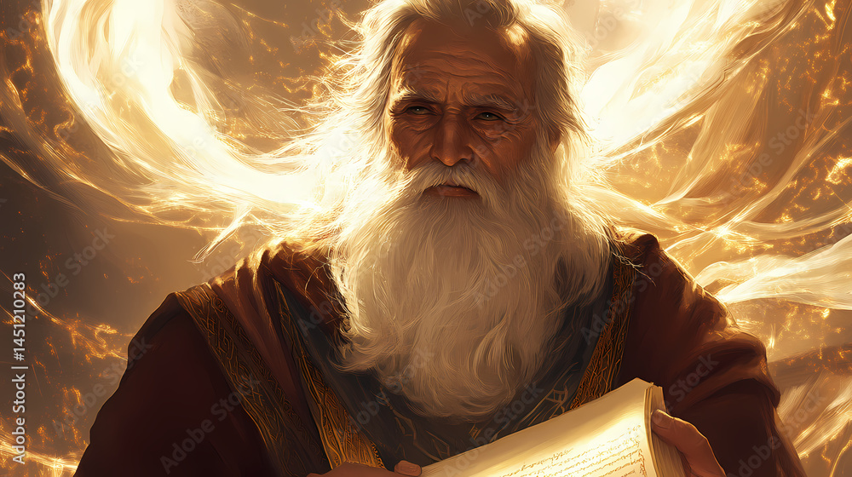
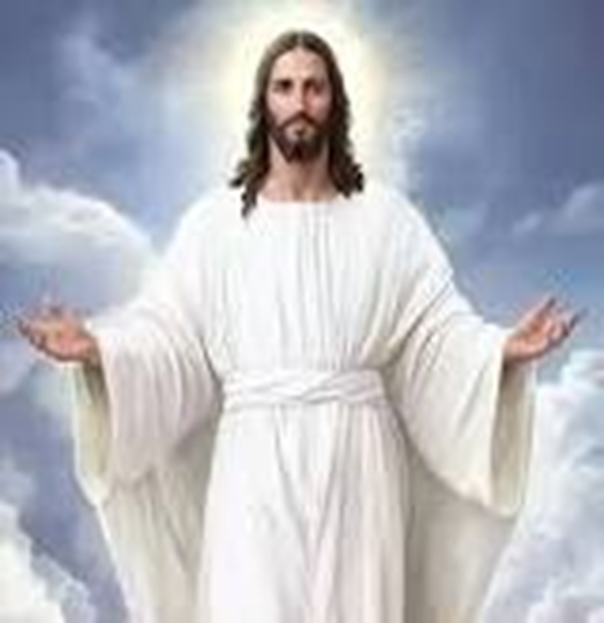
F
oretold &
Prophecies to Jesus Christ
ulfilled
Ezekiel
Isaiah
Jesus

Slide 2
F
FBC Liberty Small Group
oretold &
The Crucifixion
Session #11 July 19, 2026
Prophecies to Jesus Christ
ulfilled

Slide 3
Here is how you will know that I am the one true God,
and those so-called ‘gods’ are nothing: I will tell you
the end from the beginning; I will tell you what will
happen before it happens, and then when those
things come to pass, that will be the proof to you that I
alone am God. Isaiah 44:6-8; 46:9-10; 48:5-6
3
Notes:
The baseball diamond is used to represent the growth and progress as it relates to the Christian Life and Service Seminars.
Today’s Agenda/Housekeeping

Slide 4
OT Prophecies are organized into 5 areas
    Lineage of the Messiah
    Birth of the Messiah
    Ministry of the Messiah
    Suffering Servant
    The Crucifixion
4
Notes:
The baseball diamond is used to represent the growth and progress as it relates to the Christian Life and Service Seminars.
Today’s Agenda/Housekeeping

Slide 5
  Crucifixion
    Psalms 22
      Detailed description of crucifixion
      Crucifixion did not begin until Roman times, 100 BC
      David 1040 – 970 BC
    Crucifixion
      Used by the Romans beginning apx. 100 BC
      Public
      Slow agonizing death
      Primarily used on slaves and captured enemies
5
Notes:
The baseball diamond is used to represent the growth and progress as it relates to the Christian Life and Service Seminars.
Today’s Agenda/Housekeeping

Slide 6
The Crucifixion -- Matthew 27
6
Notes:
The baseball diamond is used to represent the growth and progress as it relates to the Christian Life and Service Seminars.
Today’s Agenda/Housekeeping

Slide 7
The Crucifixion -- Psalms 22 -- Prophecy
1 My God, my God, why have you forsaken me? Why are you so far from saving me, so far from my cries of anguish?
2 My God, I cry out by day, but you do not answer, by night, but I find no rest.
3 Yet you are enthroned as the Holy One; you are the one Israel praises.
4 In you our ancestors put their trust; they trusted and you delivered them.
7
Notes:
The baseball diamond is used to represent the growth and progress as it relates to the Christian Life and Service Seminars.
Today’s Agenda/Housekeeping

Slide 8
The Crucifixion -- Psalms 22 -- Prophecy
5 To you they cried out and were saved; in you they trusted and were not put to shame.
6 But I am a worm and not a man, scorned by everyone, despised by the people.
7 All who see me mock me; they hurl insults, shaking their heads.
8 “He trusts in the LORD,” they say, “let the LORD rescue him. Let him deliver him, since he delights in him.”
8
Notes:
The baseball diamond is used to represent the growth and progress as it relates to the Christian Life and Service Seminars.
Today’s Agenda/Housekeeping

Slide 9
The Crucifixion -- Psalms 22 -- Prophecy
9 Yet you brought me out of the womb; you made me trust in you, even at my mother’s breast.
10 From birth I was cast on you; from my mother’s womb you have been my God.
11 Do not be far from me, for trouble is near and there is no one to help.
12 Many bulls surround me; strong bulls of Bashan encircle me.
9
Notes:
The baseball diamond is used to represent the growth and progress as it relates to the Christian Life and Service Seminars.
Today’s Agenda/Housekeeping

Slide 10
The Crucifixion -- Psalms 22 -- Prophecy
13 Roaring lions that tear their prey open their mouths wide against me.
14 I am poured out like water, and all my bones are out of joint. My heart has turned to wax; it has melted within me.
15 My mouth is dried up like a potsherd, and my tongue sticks to the roof of my mouth; you lay me in the dust of death.
16 Dogs surround me, a pack of villains encircles me; they pierce my hands and my feet.
10
Notes:
The baseball diamond is used to represent the growth and progress as it relates to the Christian Life and Service Seminars.
Today’s Agenda/Housekeeping

Slide 11
The Crucifixion -- Zechariah 11 -- Prophecy
12 I told them, “If you think it best, give me my pay; but if not, keep it.” So they paid me thirty pieces of silver.
13 And the LORD said to me, “Throw it to the potter”—the handsome price at which they valued me! So I took the thirty pieces of silver and threw them to the potter at the house of the LORD.
11
Notes:
The baseball diamond is used to represent the growth and progress as it relates to the Christian Life and Service Seminars.
Today’s Agenda/Housekeeping

Slide 12
The Crucifixion -- John 19 -- Fulfilled
31 Now it was the day of Preparation, and the next day was to be a special Sabbath. Because the Jewish leaders did not want the bodies left on the crosses during the Sabbath, they asked Pilate to have the legs broken and the bodies taken down.
32 The soldiers therefore came and broke the legs of the first man who had been crucified with Jesus, and then those of the other.
12
Notes:
The baseball diamond is used to represent the growth and progress as it relates to the Christian Life and Service Seminars.
Today’s Agenda/Housekeeping

Slide 13
The Crucifixion -- John 19
33 But when they came to Jesus and found that he was already dead, they did not break his legs.
34 Instead, one of the soldiers pierced Jesus’ side with a spear, bringing a sudden flow of blood and water.
35 The man who saw it has given testimony, and his testimony is true. He knows that he tells the truth, and he testifies so that you also may believe.
13
Notes:
The baseball diamond is used to represent the growth and progress as it relates to the Christian Life and Service Seminars.
Today’s Agenda/Housekeeping

Slide 14
The Crucifixion -- John 19 -- Fulfilled
36 These things happened so that the scripture would be fulfilled: “Not one of his bones will be broken,”
37 and, as another scripture says, “They will look on the one they have pierced.”
14
Notes:
The baseball diamond is used to represent the growth and progress as it relates to the Christian Life and Service Seminars.
Today’s Agenda/Housekeeping

Slide 15
The Crucifixion -- Psalms 16 -- Prophecy
8 I keep my eyes always on the LORD. With him at my right hand, I will not be shaken.
9 Therefore my heart is glad and my tongue rejoices; my body also will rest secure,
15
Notes:
The baseball diamond is used to represent the growth and progress as it relates to the Christian Life and Service Seminars.
Today’s Agenda/Housekeeping

Slide 16
The Crucifixion -- Psalms 16 -- Prophecy
10 because you will not abandon me to the realm of the dead, nor will you let your faithful one see decay.
11 You make known to me the path of life; you will fill me with joy in your presence, with eternal pleasures at your right hand.
16
Notes:
The baseball diamond is used to represent the growth and progress as it relates to the Christian Life and Service Seminars.
Today’s Agenda/Housekeeping

Slide 17
The Crucifixion -- Acts 2 -- Fulfilled
22 “Fellow Israelites, listen to this: Jesus of Nazareth was a man accredited by God to you by miracles, wonders and signs, which God did among you through him, as you yourselves know.
23 This man was handed over to you by God’s deliberate plan and foreknowledge; and you, with the help of wicked men, put him to death by nailing him to the cross.
17
Notes:
The baseball diamond is used to represent the growth and progress as it relates to the Christian Life and Service Seminars.
Today’s Agenda/Housekeeping

Slide 18
The Crucifixion -- Acts 2 -- Fulfilled
24 But God raised him from the dead, freeing him from the agony of death, because it was impossible for death to keep its hold on him.
25 David said about him: “ ‘I saw the Lord always before me. Because he is at my right hand, I will not be shaken.
26 Therefore my heart is glad and my tongue rejoices; my body also will rest in hope,
18
Notes:
The baseball diamond is used to represent the growth and progress as it relates to the Christian Life and Service Seminars.
Today’s Agenda/Housekeeping

Slide 19
The Crucifixion -- Acts 2 -- Fulfilled
27 because you will not abandon me to the realm of the dead, you will not let your holy one see decay.
28 You have made known to me the paths of life; you will fill me with joy in your presence.’
29 “Fellow Israelites, I can tell you confidently that the patriarch David died and was buried, and his tomb is here to this day.
19
Notes:
The baseball diamond is used to represent the growth and progress as it relates to the Christian Life and Service Seminars.
Today’s Agenda/Housekeeping

Slide 20
The Crucifixion -- Acts 2 -- Fulfilled
30 But he was a prophet and knew that God had promised him on oath that he would place one of his descendants on his throne.
31 Seeing what was to come, he spoke of the resurrection of the Messiah, that he was not abandoned to the realm of the dead, nor did his body see decay.
32 God has raised this Jesus to life, and we are all witnesses of it.
20
Notes:
The baseball diamond is used to represent the growth and progress as it relates to the Christian Life and Service Seminars.
Today’s Agenda/Housekeeping

