Slide 1

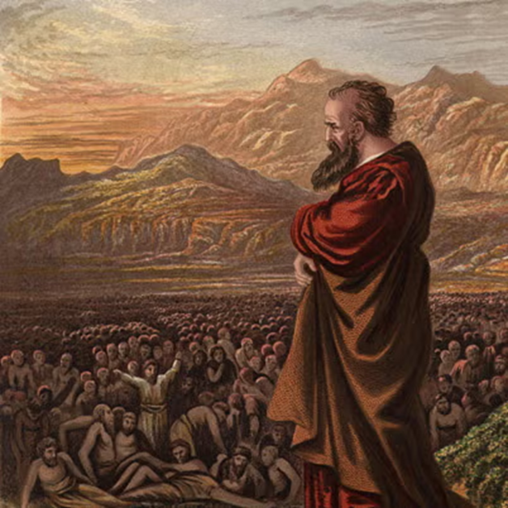
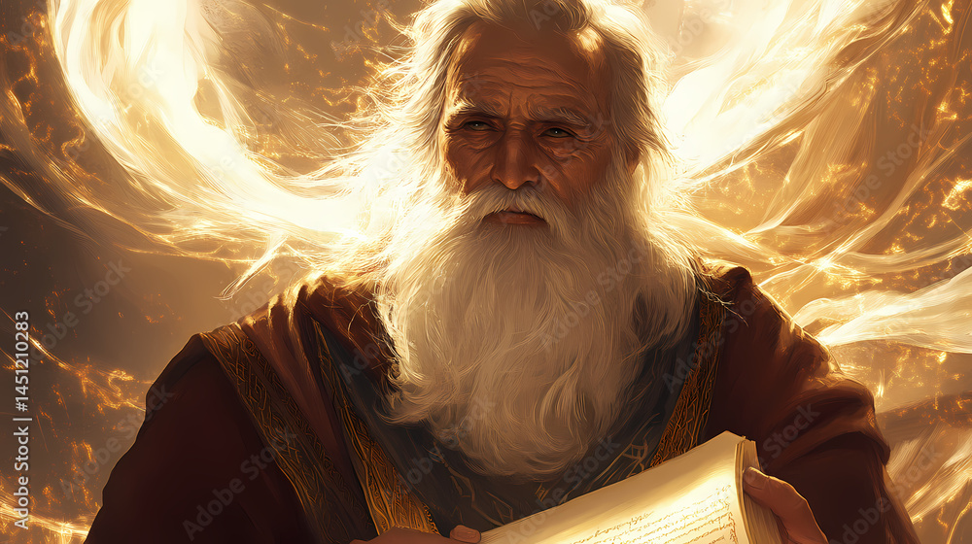
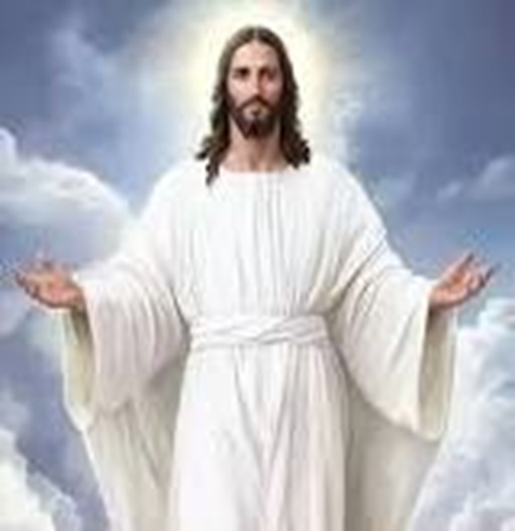
F
oretold &
Prophecies to Jesus Christ
ulfilled
Ezekiel
Isaiah
Jesus

Slide 2
F
FBC Liberty Small Group
oretold &
The Ministry of Jesus
Session #8 June 14, 2026
Prophecies to Jesus Christ
ulfilled

Slide 3
Here is how you will know that I am the one true God,
and those so-called ‘gods’ are nothing: I will tell you
the end from the beginning; I will tell you what will
happen before it happens, and then when those
things come to pass, that will be the proof to you that I
alone am God. Isaiah 44:6-8; 46:9-10; 48:5-6
3
Notes:
The baseball diamond is used to represent the growth and progress as it relates to the Christian Life and Service Seminars.
Today’s Agenda/Housekeeping

Slide 4
OT Prophecies are organized into 5 areas
    Lineage of the Messiah
    Birth of the Messiah
    Ministry of the Messiah
    Suffering Servant
    The Crucifixion, Death, & Resurrection
4
Notes:
The baseball diamond is used to represent the growth and progress as it relates to the Christian Life and Service Seminars.
Today’s Agenda/Housekeeping

Slide 5
OT Prophecies are organized into 5 areas
    Lineage of the Messiah
    Birth of the Messiah
    Ministry of the Messiah
    Suffering Servant
    The Crucifixion, Death, & Resurrection
5
Notes:
The baseball diamond is used to represent the growth and progress as it relates to the Christian Life and Service Seminars.
Today’s Agenda/Housekeeping

Slide 6
  Ministry of Jesus
    Isaiah, Zechariah, Malachi, Psalms,
    Prophecies:
      Jesus teaching in parables
      Miracles
      Jesus’ region of teaching
      Donkey
6
Notes:
The baseball diamond is used to represent the growth and progress as it relates to the Christian Life and Service Seminars.
Today’s Agenda/Housekeeping

Slide 7
  Isaiah
    Prophesied from 740 BC to 686 BC to
        Uzziah
        Jotham
        Ahaz
        Hezekiah
    Kings of Judah
7
Notes:
The baseball diamond is used to represent the growth and progress as it relates to the Christian Life and Service Seminars.
Today’s Agenda/Housekeeping

Slide 8
  Zechariah
    Prophesy began 540 BC to
        Darius the Great
    Main concern is the building of the 2nd temple
8
Notes:
The baseball diamond is used to represent the growth and progress as it relates to the Christian Life and Service Seminars.
Today’s Agenda/Housekeeping

Slide 9
  Malachi
    Prophesy somewhere between 516 BC and 312 BC, much doubt
    Malachi means “My messenger”
    Malachi was probably Ezra the Scribe
9
Notes:
The baseball diamond is used to represent the growth and progress as it relates to the Christian Life and Service Seminars.
Today’s Agenda/Housekeeping

Slide 10
Messenger
1 “I will send my messenger, who will prepare the way before me. Then suddenly the Lord you are seeking will come to his temple; the messenger of the covenant, whom you desire, will come,” says the LORD Almighty.
2 But who can endure the day of his coming? Who can stand when he appears? For he will be like a refiner’s fire or a launderer’s soap.
Malachi 3
10
Notes:
The baseball diamond is used to represent the growth and progress as it relates to the Christian Life and Service Seminars.
Today’s Agenda/Housekeeping

Slide 11
Messenger
3 A voice of one calling: “In the wilderness prepare the way for the LORD ; make straight in the desert a highway for our God.
4 Every valley shall be raised up, every mountain and hill made low; the rough ground shall become level, the rugged places a plain.
5 And the glory of the LORD will be revealed, and all people will see it together. For the mouth of the LORD has spoken.”
Isaiah 40
11
Notes:
The baseball diamond is used to represent the growth and progress as it relates to the Christian Life and Service Seminars.
Today’s Agenda/Housekeeping

Slide 12
Messenger - Fulfilled
2 as it is written in Isaiah the prophet: “I will send my messenger ahead of you, who will prepare your way” —
3 “a voice of one calling in the wilderness, ‘Prepare the way for the Lord, make straight paths for him.’ ”
4 And so John the Baptist appeared in the wilderness, preaching a baptism of repentance for the forgiveness of sins.
Mark 1
12
Notes:
The baseball diamond is used to represent the growth and progress as it relates to the Christian Life and Service Seminars.
Today’s Agenda/Housekeeping

Slide 13
Messenger - Fulfilled
5 The whole Judean countryside and all the people of Jerusalem went out to him. Confessing their sins, they were baptized by him in the Jordan River.
6 John wore clothing made of camel’s hair, with a leather belt around his waist, and he ate locusts and wild honey.
Mark 1
13
Notes:
The baseball diamond is used to represent the growth and progress as it relates to the Christian Life and Service Seminars.
Today’s Agenda/Housekeeping

Slide 14
Messenger - Fulfilled
7 And this was his message: “After me comes the one more powerful than I, the straps of whose sandals I am not worthy to stoop down and untie.
8 I baptize you with water, but he will baptize you with the Holy Spirit.”
Mark 1
14
Notes:
The baseball diamond is used to represent the growth and progress as it relates to the Christian Life and Service Seminars.
Today’s Agenda/Housekeeping

Slide 15
Jesus Annointed with the Spirit
1 The Spirit of the Sovereign LORD is on me, because the LORD has anointed me to proclaim good news to the poor. He has sent me to bind up the brokenhearted, to proclaim freedom for the captives and release from darkness for the prisoners,
2 to proclaim the year of the LORD’s favor and the day of vengeance of our God, to comfort all who mourn,
Isaiah 61
15
Notes:
The baseball diamond is used to represent the growth and progress as it relates to the Christian Life and Service Seminars.
Today’s Agenda/Housekeeping

Slide 16
Jesus Annointed with the Spirit
3 and provide for those who grieve in Zion— to bestow on them a crown of beauty instead of ashes, the oil of joy instead of mourning, and a garment of praise instead of a spirit of despair. They will be called oaks of righteousness, a planting of the LORD for the display of his splendor.
Isaiah 61
16
Notes:
The baseball diamond is used to represent the growth and progress as it relates to the Christian Life and Service Seminars.
Today’s Agenda/Housekeeping

Slide 17
Jesus Annointed with the Spirit - Fulfilled
14 Jesus returned to Galilee in the power of the Spirit, and news about him spread through the whole countryside.
15 He was teaching in their synagogues, and everyone praised him.
16 He went to Nazareth, where he had been brought up, and on the Sabbath day he went into the synagogue, as was his custom. He stood up to read,
Luke 4
17
Notes:
The baseball diamond is used to represent the growth and progress as it relates to the Christian Life and Service Seminars.
Today’s Agenda/Housekeeping

Slide 18
Jesus Annointed with the Spirit - Fulfilled
17 and the scroll of the prophet Isaiah was handed to him. Unrolling it, he found the place where it is written:
18 “The Spirit of the Lord is on me, because he has anointed me to proclaim good news to the poor. He has sent me to proclaim freedom for the prisoners and recovery of sight for the blind, to set the oppressed free,
Luke 4
18
Notes:
The baseball diamond is used to represent the growth and progress as it relates to the Christian Life and Service Seminars.
Today’s Agenda/Housekeeping

Slide 19
Jesus Annointed with the Spirit - Fulfilled
19 to proclaim the year of the Lord’s favor.”
20 Then he rolled up the scroll, gave it back to the attendant and sat down. The eyes of everyone in the synagogue were fastened on him.
21 He began by saying to them, “Today this scripture is fulfilled in your hearing.”
Luke 4
19
Notes:
The baseball diamond is used to represent the growth and progress as it relates to the Christian Life and Service Seminars.
Today’s Agenda/Housekeeping

Slide 20
Jesus’ Healing the Lame & Blind
4 say to those with fearful hearts, “Be strong, do not fear; your God will come, he will come with vengeance; with divine retribution he will come to save you.”
5 Then will the eyes of the blind be opened and the ears of the deaf unstopped.
6 Then will the lame leap like a deer, and the mute tongue shout for joy. Water will gush forth in the wilderness and streams in the desert.
Isaiah 35
20
Notes:
The baseball diamond is used to represent the growth and progress as it relates to the Christian Life and Service Seminars.
Today’s Agenda/Housekeeping

Slide 21
Jesus’ Healing the Lame & Blind - Fulfilled
1 After Jesus had finished instructing his twelve disciples, he went on from there to teach and preach in the towns of Galilee.
2 When John, who was in prison, heard about the deeds of the Messiah, he sent his disciples
3 to ask him, “Are you the one who is to come, or should we expect someone else?”
Matthew 11
21
Notes:
The baseball diamond is used to represent the growth and progress as it relates to the Christian Life and Service Seminars.
Today’s Agenda/Housekeeping

Slide 22
Jesus’ Healing the Lame & Blind - Fulfilled
4 Jesus replied, “Go back and report to John what you hear and see:
5 The blind receive sight, the lame walk, those who have leprosy are cleansed, the deaf hear, the dead are raised, and the good news is proclaimed to the poor.
6 Blessed is anyone who does not stumble on account of me.”
Matthew 11
22
Notes:
The baseball diamond is used to represent the growth and progress as it relates to the Christian Life and Service Seminars.
Today’s Agenda/Housekeeping

Slide 23
Jesus’ Healing the Lame & Blind - Fulfilled
7 As John’s disciples were leaving, Jesus began to speak to the crowd about John: “What did you go out into the wilderness to see? A reed swayed by the wind?
8 If not, what did you go out to see? A man dressed in fine clothes? No, those who wear fine clothes are in kings’ palaces.
9 Then what did you go out to see? A prophet? Yes, I tell you, and more than a prophet.
Matthew 11
23
Notes:
The baseball diamond is used to represent the growth and progress as it relates to the Christian Life and Service Seminars.
Today’s Agenda/Housekeeping

Slide 24
Jesus’ Healing the Lame & Blind - Fulfilled
10 This is the one about whom it is written: “ ‘I will send my messenger ahead of you, who will prepare your way before you.’
11 Truly I tell you, among those born of women there has not risen anyone greater than John the Baptist; yet whoever is least in the kingdom of heaven is greater than he.
12 From the days of John the Baptist until now, the kingdom of heaven has been subjected to violence, and violent people have been raiding it.
Matthew 11
24
Notes:
The baseball diamond is used to represent the growth and progress as it relates to the Christian Life and Service Seminars.
Today’s Agenda/Housekeeping

Slide 25
Jesus’ Healing the Lame & Blind - Fulfilled
10 This is the one about whom it is written: “ ‘I will send my messenger ahead of you, who will prepare your way before you.’
11 Truly I tell you, among those born of women there has not risen anyone greater than John the Baptist; yet whoever is least in the kingdom of heaven is greater than he.
12 From the days of John the Baptist until now, the kingdom of heaven has been subjected to violence, and violent people have been raiding it.
Matthew 11
25
Notes:
The baseball diamond is used to represent the growth and progress as it relates to the Christian Life and Service Seminars.
Today’s Agenda/Housekeeping

Slide 26
Jesus’ & Parables
1 My people, hear my teaching; listen to the words of my mouth.
2 I will open my mouth with a parable; I will utter hidden things, things from of old—
3 things we have heard and known, things our ancestors have told us.
4 We will not hide them from their descendants; we will tell the next generation the praiseworthy deeds of the LORD, his power, and the wonders he has done.
Psalms 78
26
Notes:
The baseball diamond is used to represent the growth and progress as it relates to the Christian Life and Service Seminars.
Today’s Agenda/Housekeeping

Slide 27
Jesus’ & Parables - Fulfilled
31 He told them another parable: “The kingdom of heaven is like a mustard seed, which a man took and planted in his field.
32 Though it is the smallest of all seeds, yet when it grows, it is the largest of garden plants and becomes a tree, so that the birds come and perch in its branches.”
33 He told them still another parable: “The kingdom of heaven is like yeast that a woman took and mixed into about sixty pounds of flour until it worked all through the dough.”
Matthew 13
27
Notes:
The baseball diamond is used to represent the growth and progress as it relates to the Christian Life and Service Seminars.
Today’s Agenda/Housekeeping

Slide 28
Jesus’ & Parables – Fulfilled
34 Jesus spoke all these things to the crowd in parables; he did not say anything to them without using a parable.
35 So was fulfilled what was spoken through the prophet: “I will open my mouth in parables, I will utter things hidden since the creation of the world.”
Matthew 13
28
Notes:
The baseball diamond is used to represent the growth and progress as it relates to the Christian Life and Service Seminars.
Today’s Agenda/Housekeeping

Slide 29
Jesus’ Ministry in Galilee
1 Nevertheless, there will be no more gloom for those who were in distress. In the past he humbled the land of Zebulun and the land of Naphtali, but in the future, he will honor Galilee of the nations, by the Way of the Sea, beyond the Jordan—
2 The people walking in darkness have seen a great light; on those living in the land of deep darkness a light has dawned.
Isaiah 9
29
Notes:
The baseball diamond is used to represent the growth and progress as it relates to the Christian Life and Service Seminars.
Today’s Agenda/Housekeeping

Slide 30
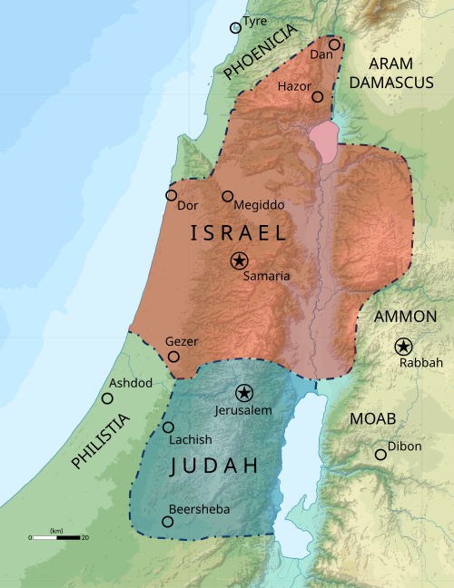
30
Notes:
The baseball diamond is used to represent the growth and progress as it relates to the Christian Life and Service Seminars.
Today’s Agenda/Housekeeping

Slide 31
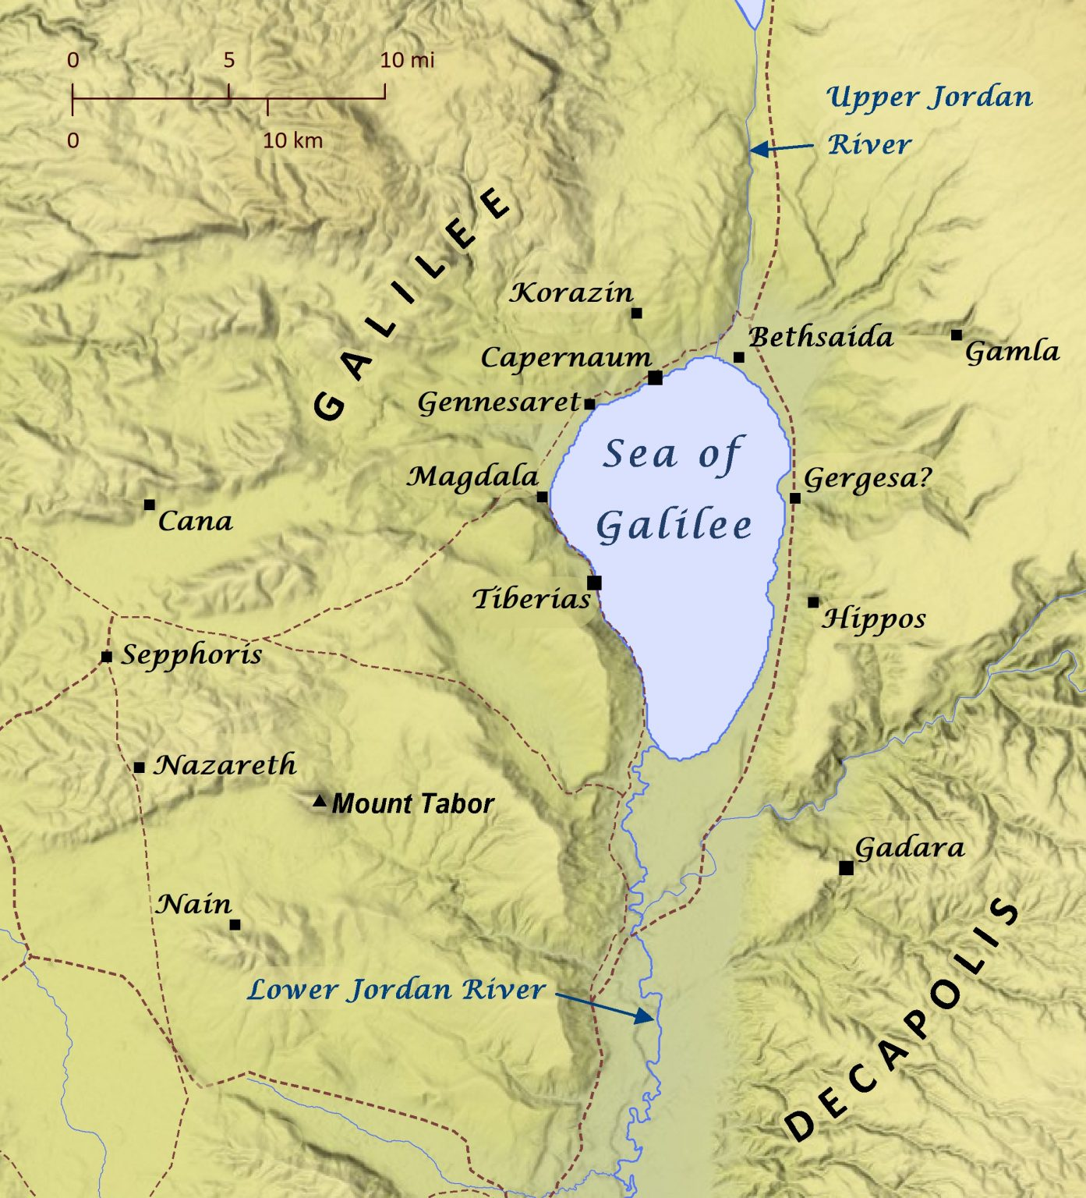
31
Notes:
The baseball diamond is used to represent the growth and progress as it relates to the Christian Life and Service Seminars.
Today’s Agenda/Housekeeping

Slide 32
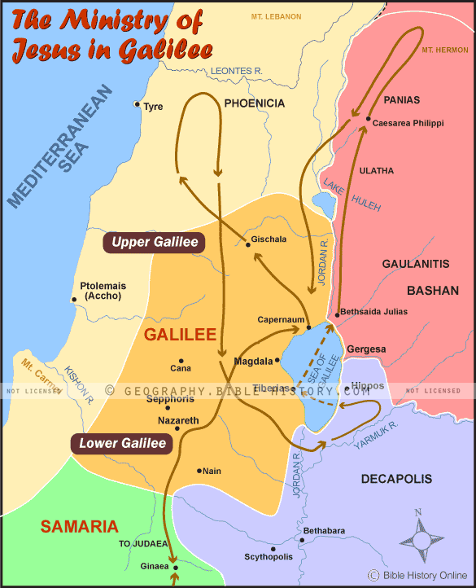
32
Notes:
The baseball diamond is used to represent the growth and progress as it relates to the Christian Life and Service Seminars.
Today’s Agenda/Housekeeping

Slide 33
Jesus’ Ministry in Galilee - Fulfilled
12 When Jesus heard that John had been put in prison, he withdrew to Galilee.
13 Leaving Nazareth, he went and lived in Capernaum, which was by the lake in the area of Zebulun and Naphtali—
14 to fulfill what was said through the prophet Isaiah:
Matthew 4
33
Notes:
The baseball diamond is used to represent the growth and progress as it relates to the Christian Life and Service Seminars.
Today’s Agenda/Housekeeping

Slide 34
Jesus’ Ministry in Galilee - Fulfilled
15 “Land of Zebulun and land of Naphtali, the Way of the Sea, beyond the Jordan, Galilee of the Gentiles—
16 the people living in darkness have seen a great light; on those living in the land of the shadow of death a light has dawned.”.
17 From that time on Jesus began to preach, “Repent, for the kingdom of heaven has come near.”
Matthew 4
34
Notes:
The baseball diamond is used to represent the growth and progress as it relates to the Christian Life and Service Seminars.
Today’s Agenda/Housekeeping

Slide 35
Jesus’ & the Donkey
9 Rejoice greatly, Daughter Zion! Shout, Daughter Jerusalem! See, your king comes to you, righteous and victorious, lowly and riding on a donkey, on a colt, the foal of a donkey.
10 I will take away the chariots from Ephraim and the warhorses from Jerusalem, and the battle bow will be broken. He will proclaim peace to the nations. His rule will extend from sea to sea and from the River to the ends of the earth.
Zechariah 9
35
Notes:
The baseball diamond is used to represent the growth and progress as it relates to the Christian Life and Service Seminars.
Today’s Agenda/Housekeeping

Slide 36
Jesus’ & the Donkey - Fulfilled
1 As they approached Jerusalem and came to Bethphage on the Mount of Olives, Jesus sent two disciples,
2 saying to them, “Go to the village ahead of you, and at once you will find a donkey tied there, with her colt by her. Untie them and bring them to me.
3 If anyone says anything to you, say that the Lord needs them, and he will send them right away.”
Matthew 21
36
Notes:
The baseball diamond is used to represent the growth and progress as it relates to the Christian Life and Service Seminars.
Today’s Agenda/Housekeeping

Slide 37
Jesus’ & the Donkey - Fulfilled
4 This took place to fulfill what was spoken through the prophet:
5 “Say to Daughter Zion, ‘See, your king comes to you, gentle and riding on a donkey, and on a colt, the foal of a donkey.’ ”
6 The disciples went and did as Jesus had instructed them.
7 They brought the donkey and the colt and placed their cloaks on them for Jesus to sit on.
Matthew 21
37
Notes:
The baseball diamond is used to represent the growth and progress as it relates to the Christian Life and Service Seminars.
Today’s Agenda/Housekeeping

Slide 38
Jesus’ & the Donkey - Fulfilled
4 This took place to fulfill what was spoken through the prophet:
5 “Say to Daughter Zion, ‘See, your king comes to you, gentle and riding on a donkey, and on a colt, the foal of a donkey.’ ”
6 The disciples went and did as Jesus had instructed them.
7 They brought the donkey and the colt and placed their cloaks on them for Jesus to sit on.
Matthew 21
38
Notes:
The baseball diamond is used to represent the growth and progress as it relates to the Christian Life and Service Seminars.
Today’s Agenda/Housekeeping

Slide 39
Jesus’ & the Donkey - Fulfilled
8 A very large crowd spread their cloaks on the road, while others cut branches from the trees and spread them on the road.
9 The crowds that went ahead of him and those that followed shouted, “Hosanna to the Son of David!” “Blessed is he who comes in the name of the Lord!”“Hosanna in the highest heaven!”
Matthew 21
39
Notes:
The baseball diamond is used to represent the growth and progress as it relates to the Christian Life and Service Seminars.
Today’s Agenda/Housekeeping

Slide 40
Jesus’ & the Donkey - Fulfilled
10 When Jesus entered Jerusalem, the whole city was stirred and asked, “Who is this?”
11 The crowds answered, “This is Jesus, the prophet from Nazareth in Galilee.”
Matthew 21
40
Notes:
The baseball diamond is used to represent the growth and progress as it relates to the Christian Life and Service Seminars.
Today’s Agenda/Housekeeping

