Slide 1

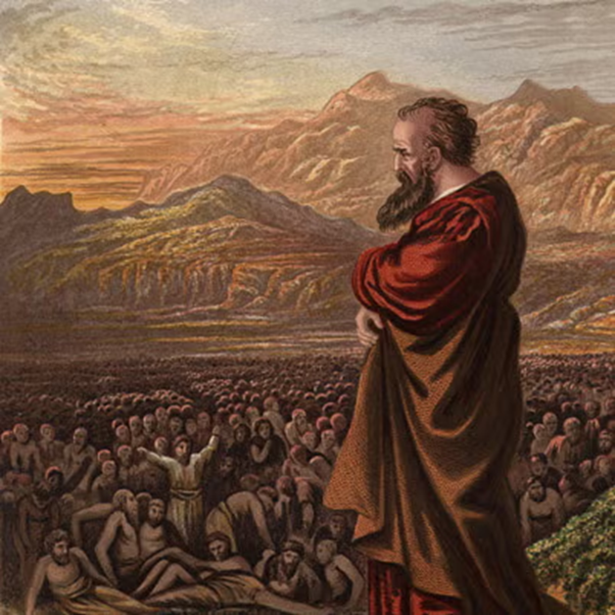
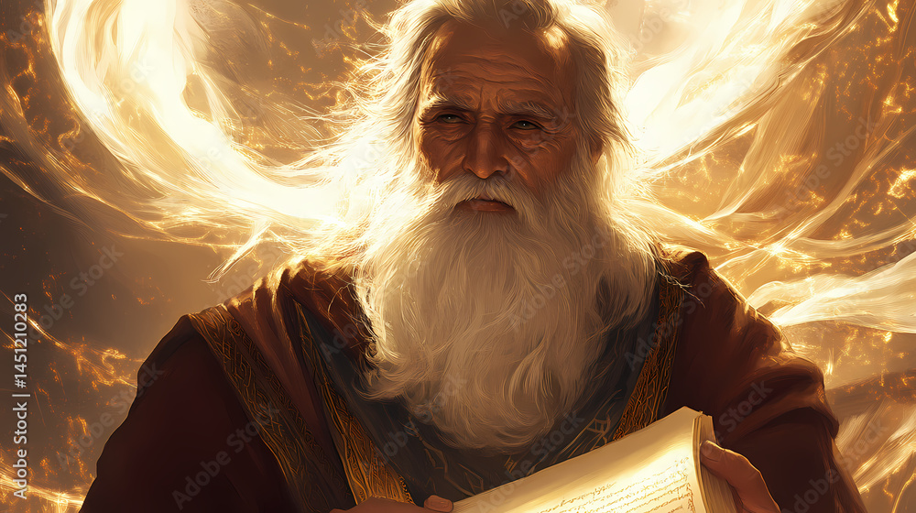
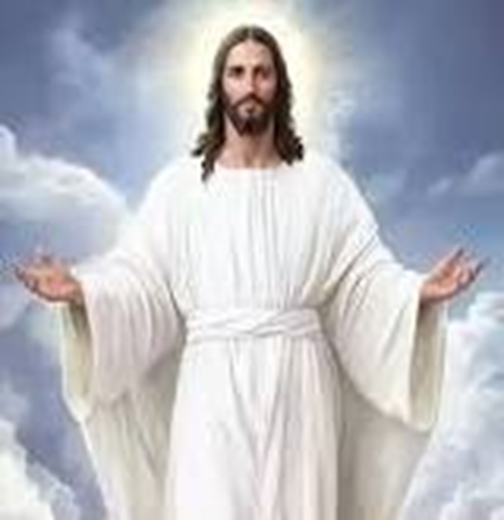
F
oretold &
Prophecies to Jesus Christ
ulfilled
Ezekiel
Isaiah
Jesus

Slide 2
F
FBC Liberty Small Group
oretold &
The Council of Jerusalem
Session #9 June 21, 2026
Prophecies to Jesus Christ
ulfilled

Slide 3
Here is how you will know that I am the one true God,
and those so-called ‘gods’ are nothing: I will tell you
the end from the beginning; I will tell you what will
happen before it happens, and then when those
things come to pass, that will be the proof to you that I
alone am God. Isaiah 44:6-8; 46:9-10; 48:5-6
3
Notes:
The baseball diamond is used to represent the growth and progress as it relates to the Christian Life and Service Seminars.
Today’s Agenda/Housekeeping

Slide 4
OT Prophecies are organized into 5 areas
    Lineage of the Messiah
    Birth of the Messiah
    Ministry of the Messiah
    Suffering Servant
    The Crucifixion, Death, & Resurrection
4
Notes:
The baseball diamond is used to represent the growth and progress as it relates to the Christian Life and Service Seminars.
Today’s Agenda/Housekeeping

Slide 5
Prophecy of Acts 15
    Council of Jerusalem
    Instigated by Paul & Barnabas
    Argument led by Paul, Peter, & James
    Include the Gentiles as they are
                OR
    Force new Christians to pass thru the Judaic principles first
        Circumcision
        Keep the law of Moses (be a good Jew)
5
Notes:
The baseball diamond is used to represent the growth and progress as it relates to the Christian Life and Service Seminars.
Today’s Agenda/Housekeeping

Slide 6
Paul & Barnabas
    Paul is a well-respected Pharisee Jew
    Paul oversees the persecution of Christians for years – present at the stoning of Stephen
    Paul converted on road to Damascus
    Spent 15 years preparing for his
      Christ-charged ministry
    Apostles skeptical of Paul’s heart
    Barnabas takes chance on Paul
    Completed the 1st Missionary journey
6
Notes:
The baseball diamond is used to represent the growth and progress as it relates to the Christian Life and Service Seminars.
Today’s Agenda/Housekeeping

Slide 7
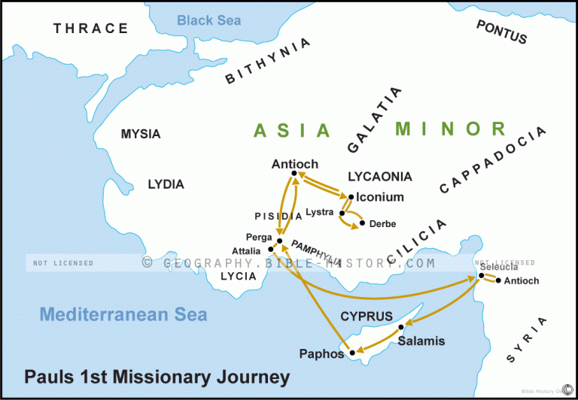
7
Notes:
The baseball diamond is used to represent the growth and progress as it relates to the Christian Life and Service Seminars.
Today’s Agenda/Housekeeping

Slide 8
Paul & Barnabas part ways
36 Some time later Paul said to Barnabas, “Let us go back and visit the believers in all the towns where we preached the word of the Lord and see how they are doing.”
37 Barnabas wanted to take John, also called Mark, with them,
38 but Paul did not think it wise to take him, because he had deserted them in Pamphylia and had not continued with them in the work.
Acts 15
8
Notes:
The baseball diamond is used to represent the growth and progress as it relates to the Christian Life and Service Seminars.
Today’s Agenda/Housekeeping

Slide 9
Paul & Barnabas part ways
39 They had such a sharp disagreement that they parted company. Barnabas took Mark and sailed for Cyprus, (AND into obscurity)
40 but Paul chose Silas and left, commended by the believers to the grace of the Lord.
41 He went through Syria and Cilicia, strengthening the churches.
Acts 15
9
Notes:
The baseball diamond is used to represent the growth and progress as it relates to the Christian Life and Service Seminars.
Today’s Agenda/Housekeeping

Slide 10
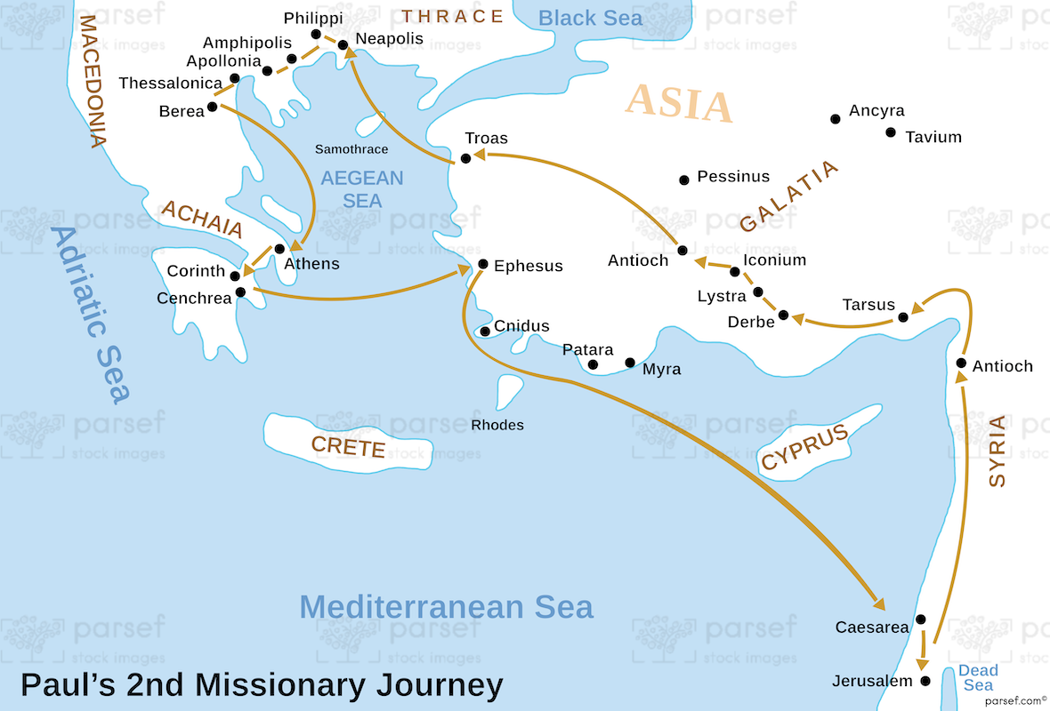
10
Notes:
The baseball diamond is used to represent the growth and progress as it relates to the Christian Life and Service Seminars.
Today’s Agenda/Housekeeping

Slide 11
Paul, Barnabas, & the Gentiles
1 Certain people came down from Judea to Antioch and were teaching the believers: “Unless you are circumcised, according to the custom taught by Moses, you cannot be saved.”
2 This brought Paul and Barnabas into sharp dispute and debate with them. So Paul and Barnabas were appointed, along with some other believers, to go up to Jerusalem to see the apostles and elders about this question.
Acts 15
11
Notes:
The baseball diamond is used to represent the growth and progress as it relates to the Christian Life and Service Seminars.
Today’s Agenda/Housekeeping

Slide 12
The Council of Jerusalem
3 The church sent them on their way, and as they traveled through Phoenicia and Samaria, they told how the Gentiles had been converted. This news made all the believers very glad.
4 When they came to Jerusalem, they were welcomed by the church and the apostles and elders, to whom they reported everything God had done through them.
5 Then some of the believers who belonged to the party of the Pharisees stood up and said, “The Gentiles must be circumcised and required to keep the law of Moses.”
Acts 15
12
Notes:
The baseball diamond is used to represent the growth and progress as it relates to the Christian Life and Service Seminars.
Today’s Agenda/Housekeeping

Slide 13
The Council of Jerusalem
6 The apostles and elders met to consider this question.
7 After much discussion, Peter got up and addressed them: “Brothers, you know that some time ago God made a choice among you that the Gentiles might hear from my lips the message of the gospel and believe.
8 God, who knows the heart, showed that he accepted them by giving the Holy Spirit to them, just as he did to us.
Acts 15
13
Notes:
The baseball diamond is used to represent the growth and progress as it relates to the Christian Life and Service Seminars.
Today’s Agenda/Housekeeping

Slide 14
The Council of Jerusalem
9 He did not discriminate between us and them, for he purified their hearts by faith.
10 Now then, why do you try to test God by putting on the necks of Gentiles a yoke that neither we nor our ancestors have been able to bear?
11 No! We believe it is through the grace of our Lord Jesus that we are saved, just as they are.”
Acts 15
14
Notes:
The baseball diamond is used to represent the growth and progress as it relates to the Christian Life and Service Seminars.
Today’s Agenda/Housekeeping

Slide 15
The Council of Jerusalem
12 The whole assembly became silent as they listened to Barnabas and Paul telling about the signs and wonders God had done among the Gentiles through them.
13 When they finished, James spoke up. “Brothers,” he said, “listen to me.
14 Simon has described to us how God first intervened to choose a people for his name from the Gentiles.
Acts 15
15
Notes:
The baseball diamond is used to represent the growth and progress as it relates to the Christian Life and Service Seminars.
Today’s Agenda/Housekeeping

Slide 16
The Council of Jerusalem
15 The words of the prophets are in agreement with this, as it is written:
16 “ ‘After this I will return and rebuild David’s fallen tent. Its ruins I will rebuild, and I will restore it,
17 that the rest of mankind may seek the Lord, even all the Gentiles who bear my name, says the Lord, who does these things’ —
18 things known from long ago.
Acts 15
16
Notes:
The baseball diamond is used to represent the growth and progress as it relates to the Christian Life and Service Seminars.
Today’s Agenda/Housekeeping

Slide 17
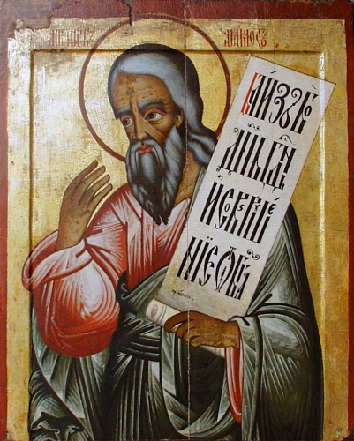
Amos
760 – 755 BC
Jeroboam & Uzziah
Same time as Hosea & Isaiah
Originally from Judah yet prophesied in Israel
17
Notes:
The baseball diamond is used to represent the growth and progress as it relates to the Christian Life and Service Seminars.
Today’s Agenda/Housekeeping

Slide 18
Prophecy of Amos – NIV translation
11 “In that day I will restore David’s fallen shelter— I will repair its broken walls and restore its ruins— and will rebuild it as it used to be,
12 so that they may possess the remnant of Edom and all the nations that bear my name, ” declares the LORD, who will do these things.
Amos 9
18
Notes:
The baseball diamond is used to represent the growth and progress as it relates to the Christian Life and Service Seminars.
Today’s Agenda/Housekeeping

Slide 19
Prophecy of Amos – James translation
11 "After this I will return, and I will rebuild the tent of David that has fallen; I will rebuild its ruins, and I will restore it,
12 that the remnant of mankind may seek the Lord, and all the Gentiles who are called by my name...“
Amos 9
19
Notes:
The baseball diamond is used to represent the growth and progress as it relates to the Christian Life and Service Seminars.
Today’s Agenda/Housekeeping

Slide 20
Why Is This a Prophecy ?
James understood Jesus as the promised Davidic Messiah.
The "rebuilding of David's fallen tent" was being fulfilled through:
Jesus' death and resurrection.
His exaltation as David's heir.
The establishment of the Church.
20
Notes:
The baseball diamond is used to represent the growth and progress as it relates to the Christian Life and Service Seminars.
Today’s Agenda/Housekeeping

Slide 21
What Does This Mean to Christians ?
Christianity Was Defined as Faith in Christ Rather Than Ethnic Identity
The Church Became a Multi-Ethnic People of God
The Gentile Mission Received Apostolic Approval
21
Notes:
The baseball diamond is used to represent the growth and progress as it relates to the Christian Life and Service Seminars.
Today’s Agenda/Housekeeping

Slide 22
What Does This Mean to Christians ?
4. Scripture Was Interpreted with Christ as the Cornerstone
    Jesus fulfills the Davidic promises.
    The restoration promised by the prophets begins in Christ.
    The gathering of the nations is evidence of messianic fulfillment.
    Thus prophecy was read through the lens of Christ's resurrection and reign.
22
Notes:
The baseball diamond is used to represent the growth and progress as it relates to the Christian Life and Service Seminars.
Today’s Agenda/Housekeeping

