Slide 1
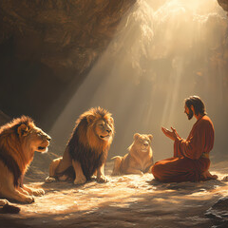
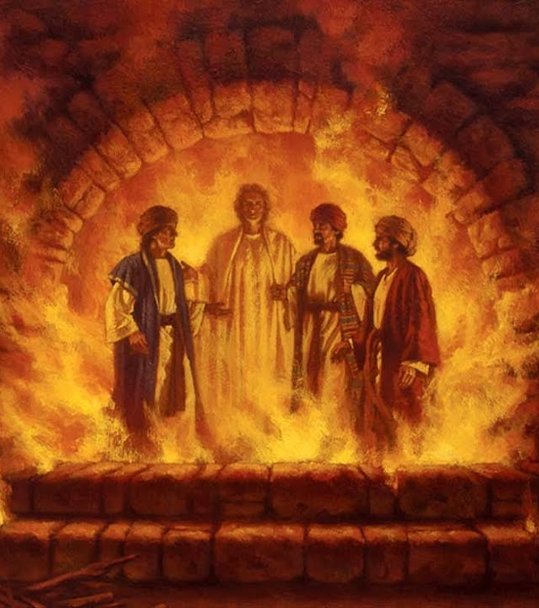
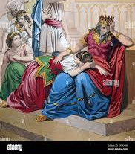
Daniel – The Prophet

Slide 2
FBC Liberty Small Group
Daniel – The Most Interesting Book of the Bible
Session #1 September 13, 2026

Slide 3
  Daniel’s Life
Daniel’s Life = 620 BC to 539 BC
A time of amazing political upheavel
3
Notes:
The baseball diamond is used to represent the growth and progress as it relates to the Christian Life and Service Seminars.
Today’s Agenda/Housekeeping

Slide 4
  What Did Daniel Look Like?
3 Then the king ordered Ashpenaz, chief of his court officials, to bring into the king’s service some of the Israelites from the royal family and the nobility—
4 young men without any physical defect, handsome, showing aptitude for every kind of learning, well informed, quick to understand, and qualified to serve in the king’s palace. He was to teach them the language and literature of the Babylonians. Daniel 1: 3-4
4
Notes:
The baseball diamond is used to represent the growth and progress as it relates to the Christian Life and Service Seminars.
Today’s Agenda/Housekeeping

Slide 5
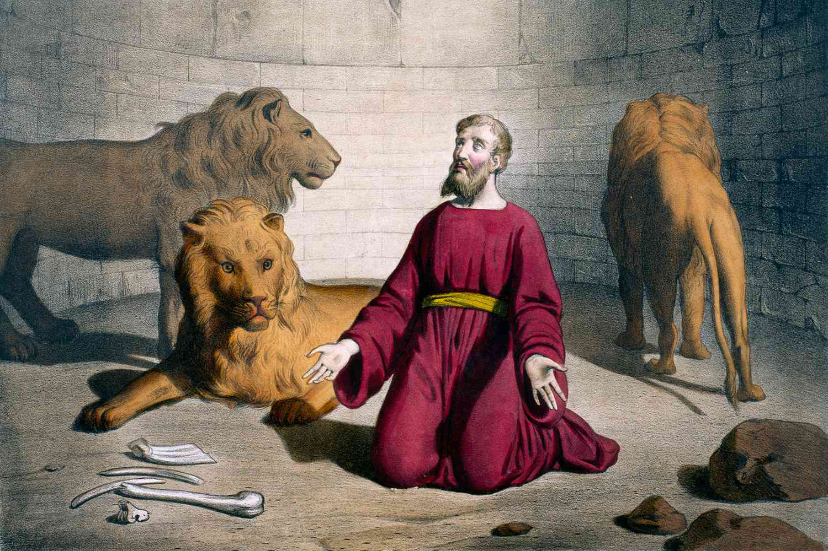
Daniel in the Lion’s Den
Belshazzar’s End
5
Notes:
The baseball diamond is used to represent the growth and progress as it relates to the Christian Life and Service Seminars.
Today’s Agenda/Housekeeping

Slide 6
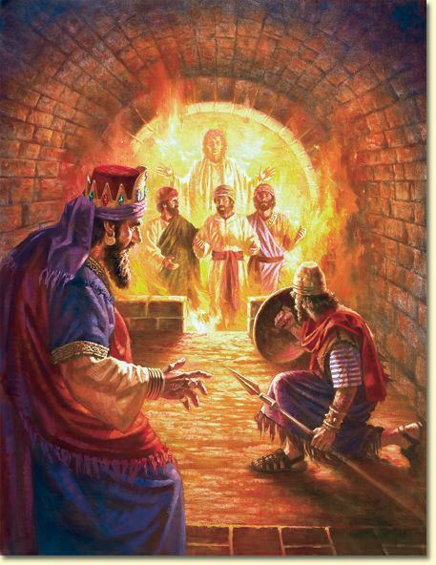
The Fiery Furnace
Shadrach
Meshach
Abednego
6
Notes:
The baseball diamond is used to represent the growth and progress as it relates to the Christian Life and Service Seminars.
Today’s Agenda/Housekeeping

Slide 7
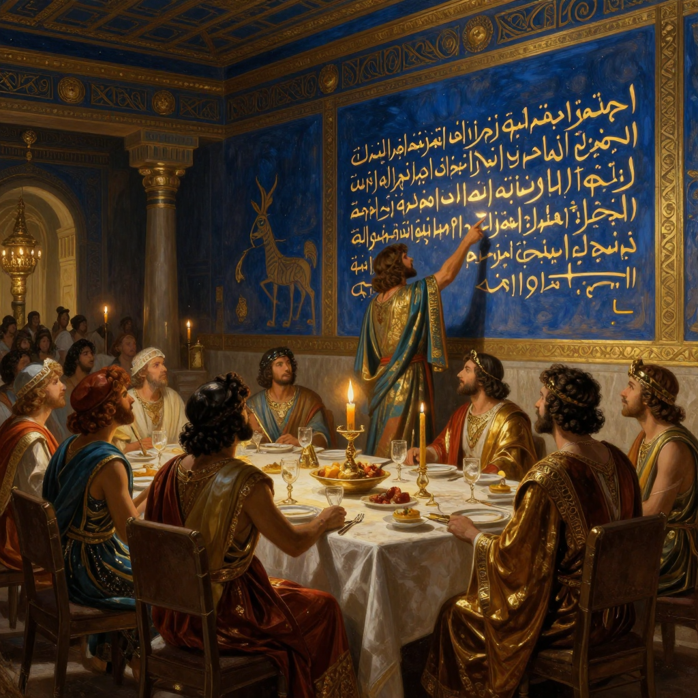
The Handwriting on the Wall
Belshazzar’s End
7
Notes:
The baseball diamond is used to represent the growth and progress as it relates to the Christian Life and Service Seminars.
Today’s Agenda/Housekeeping

Slide 8
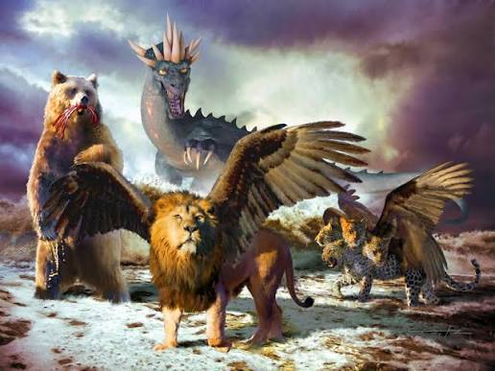
The Beasts
Daniel Chpt. 7
Precursor to Revelation
8
Notes:
The baseball diamond is used to represent the growth and progress as it relates to the Christian Life and Service Seminars.
Today’s Agenda/Housekeeping

Slide 9
Chapter Outline
9
Notes:
The baseball diamond is used to represent the growth and progress as it relates to the Christian Life and Service Seminars.
Today’s Agenda/Housekeeping

Slide 10
Middle East Map
10
Notes:
The baseball diamond is used to represent the growth and progress as it relates to the Christian Life and Service Seminars.
Today’s Agenda/Housekeeping

Slide 11
Geopolitical Summary
11
Notes:
The baseball diamond is used to represent the growth and progress as it relates to the Christian Life and Service Seminars.
Today’s Agenda/Housekeeping

Slide 12
  Apocrypha Additions to Daniel
The Prayer of Azariah and Song of the Three Holy Children -- Daniel 3 addition
Susanna and the Elders -- Daniel 13 addition
Bel and the Dragon -- Daniel 14 addition
12
Notes:
The baseball diamond is used to represent the growth and progress as it relates to the Christian Life and Service Seminars.
Today’s Agenda/Housekeeping

Slide 13
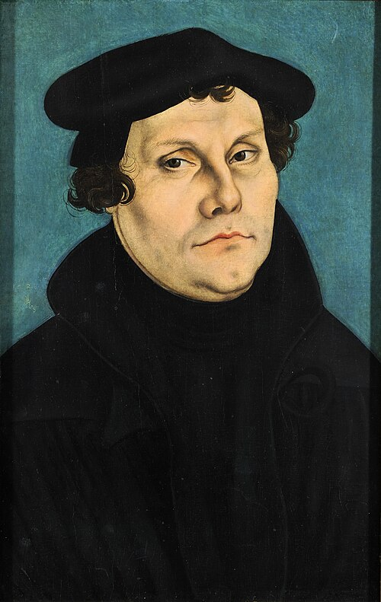
Martin Luther -- Protest Leader
1517 -- Ninety-five Theses
  Started the Protestant reformation
  Based on Grace was free
  No need for priests to charge for Church sacraments
  No need for a priest to intercede for a Christian
  The Bible is the guide and free for anyone to read/study/decide for themselves
13
Notes:
The baseball diamond is used to represent the growth and progress as it relates to the Christian Life and Service Seminars.
Today’s Agenda/Housekeeping

Slide 14
Martin Luther -- Protest Leader
  Excommunicated in 1521
  The Lutheran Church exploded in growth over the next 2 decades
  1534 Luther translated the Catholic Bible into German and distributed it widely
14
Notes:
The baseball diamond is used to represent the growth and progress as it relates to the Christian Life and Service Seminars.
Today’s Agenda/Housekeeping

Slide 15
Martin Luther -- Protest Leader
  Unless I am convinced by the testimony of the Scriptures or by clear reason (for I do not trust either in the pope or in councils alone, since it is well known that they have often erred and contradicted themselves), I am bound by the Scriptures I have quoted, and my conscience is captive to the Word of God. I cannot and will not recant anything since it is neither safe nor right to go against conscience. May God help me. Amen.
15
Notes:
The baseball diamond is used to represent the growth and progress as it relates to the Christian Life and Service Seminars.
Today’s Agenda/Housekeeping

Slide 16
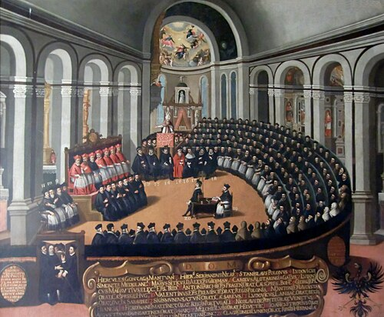
Council of Trent 1545 - 1553
  2 purposes:
  Condemn the protestant
  movement
  Canonize the Apocrypha books
Notes:
The baseball diamond is used to represent the growth and progress as it relates to the Christian Life and Service Seminars.
Today’s Agenda/Housekeeping

Slide 17
  Apocrypha Additions -- 1546
The Seven Complete Books
Tobit: A narrative about a pious Israelite and his son, Tobias, who is guided by the angel Raphael.
Judith: The story of a brave Jewish widow who saves her city from an invading Assyrian army.
Wisdom of Solomon: A philosophical and theological poetic book focused on righteousness and wisdom.
17
Notes:
The baseball diamond is used to represent the growth and progress as it relates to the Christian Life and Service Seminars.
Today’s Agenda/Housekeeping

Slide 18
  Apocrypha Additions -- 1546
The Seven Complete Books
Sirach (Ecclesiasticus): A massive collection of ethical teachings, proverbs, and practical life advice.
Baruch: A book attributed to Jeremiah's scribe, which includes a letter warning against idolatry.
18
Notes:
The baseball diamond is used to represent the growth and progress as it relates to the Christian Life and Service Seminars.
Today’s Agenda/Housekeeping

Slide 19
  Apocrypha Additions -- 1546
The Seven Complete Books
1 Maccabees: A historical account detailing the Jewish revolt against the Seleucid Empire.
2 Maccabees: A theological retelling of the same revolt, introducing concepts like praying for the dead.
19
Notes:
The baseball diamond is used to represent the growth and progress as it relates to the Christian Life and Service Seminars.
Today’s Agenda/Housekeeping

Slide 20
  Apocrypha Additions -- 1546
The Additions to Existing Books
Esther
  Six chapters that introduce explicit prayers and references to God
Daniel: Three stories
  The Prayer of Azariah and Song of the Three Holy Children, a prayer and hymn sung while inside the fiery furnace.
20
Notes:
The baseball diamond is used to represent the growth and progress as it relates to the Christian Life and Service Seminars.
Today’s Agenda/Housekeeping

Slide 21
  Apocrypha Additions -- 1546
The Additions to Existing Books
Daniel: Three stories
  Susanna, a story of a virtuous woman falsely accused of adultery, who is vindicated by Daniel's wisdom.
  Bel and the Dragon, two comedic and mocking accounts where Daniel exposes the fraud of Babylonian idol worship.
21
Notes:
The baseball diamond is used to represent the growth and progress as it relates to the Christian Life and Service Seminars.
Today’s Agenda/Housekeeping

