Slide 1
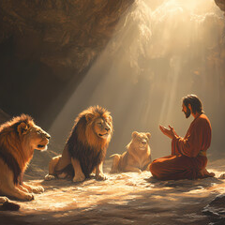
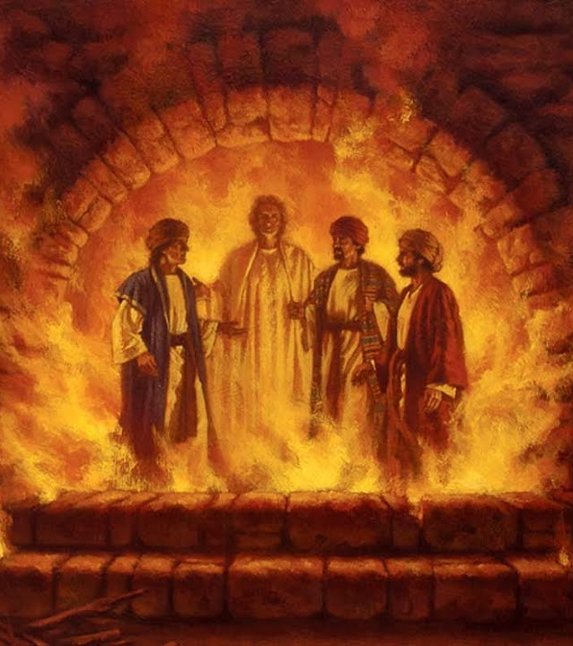
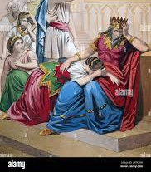
Daniel – The Prophet

Slide 2
FBC Liberty Small Group
Daniel – The Most Interesting Book of the Bible
Chapter 3
Session #6 October 11, 2026

Slide 3
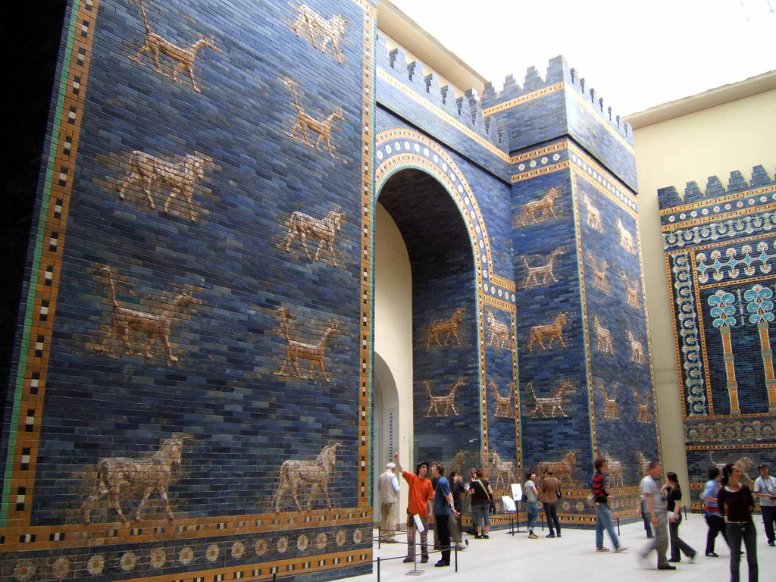
3
Notes:
The baseball diamond is used to represent the growth and progress as it relates to the Christian Life and Service Seminars.
Today’s Agenda/Housekeeping

Slide 4
  At the Beginning of Chapter 3
What is the status of the Nebuchadnezzar?
  603 BC
  Still basking in the glory of battle victory
  Enamored with Daniel, his ability to interpret his dream, & Daniel’s God
4
Notes:
The baseball diamond is used to represent the growth and progress as it relates to the Christian Life and Service Seminars.
Today’s Agenda/Housekeeping

Slide 5
  At the Beginning of Chapter 3
What is the status of the Nebuchadnezzar?
  47 The king said to Daniel, “Surely your God is the God of gods and the Lord of kings and a revealer of mysteries, for you were able to reveal this mystery.”
  Trust in Daniel is at an all time high
5
Notes:
The baseball diamond is used to represent the growth and progress as it relates to the Christian Life and Service Seminars.
Today’s Agenda/Housekeeping

Slide 6
  At the Beginning of Chapter 3
What is the status of the 4 amigos?
  Daniel
      Just completed interpretation of Nebuchadnezzar's dream
      Ruler of all of the province of Babylon
      In charge of all wise men
6
Notes:
The baseball diamond is used to represent the growth and progress as it relates to the Christian Life and Service Seminars.
Today’s Agenda/Housekeeping

Slide 7
  At the Beginning of Chapter 3
What is the status of the 4 amigos?
  Shadrach, Meshach, Abednego
      Administrators over the province of Babylon
      But, they are working for Daniel
      Without the power of Daniel
7
Notes:
The baseball diamond is used to represent the growth and progress as it relates to the Christian Life and Service Seminars.
Today’s Agenda/Housekeeping

Slide 8
  Daniel 3
1 King Nebuchadnezzar made an image of gold, sixty cubits high and six cubits wide, and set it up on the plain of Dura in the province of Babylon.
2 He then summoned the satraps, prefects, governors, advisers, treasurers, judges, magistrates and all the other provincial officials to come to the dedication of the image he had set up.
8
Notes:
The baseball diamond is used to represent the growth and progress as it relates to the Christian Life and Service Seminars.
Today’s Agenda/Housekeeping

Slide 9
  Daniel 3
3 So the satraps, prefects, governors, advisers, treasurers, judges, magistrates and all the other provincial officials assembled for the dedication of the image that King Nebuchadnezzar had set up, and they stood before it.
4 Then the herald loudly proclaimed, “Nations and peoples of every language, this is what you are commanded to do:
9
Notes:
The baseball diamond is used to represent the growth and progress as it relates to the Christian Life and Service Seminars.
Today’s Agenda/Housekeeping

Slide 10
  Daniel 3
5 As soon as you hear the sound of the horn, flute, zither, lyre, harp, pipe and all kinds of music, you must fall down and worship the image of gold that King Nebuchadnezzar has set up.
6 Whoever does not fall down and worship will immediately be thrown into a blazing furnace.”
10
Notes:
The baseball diamond is used to represent the growth and progress as it relates to the Christian Life and Service Seminars.
Today’s Agenda/Housekeeping

Slide 11
  Daniel 3
7 Therefore, as soon as they heard the sound of the horn, flute, zither, lyre, harp and all kinds of music, all the nations and peoples of every language fell down and worshiped the image of gold that King Nebuchadnezzar had set up.
8 At this time some astrologers came forward and denounced the Jews.
11
Notes:
The baseball diamond is used to represent the growth and progress as it relates to the Christian Life and Service Seminars.
Today’s Agenda/Housekeeping

Slide 12
  Daniel 3
9 They said to King Nebuchadnezzar, “May the king live forever!
10 Your Majesty has issued a decree that everyone who hears the sound of the horn, flute, zither, lyre, harp, pipe and all kinds of music must fall down and worship the image of gold,
12
Notes:
The baseball diamond is used to represent the growth and progress as it relates to the Christian Life and Service Seminars.
Today’s Agenda/Housekeeping

Slide 13
  Daniel 3
11 and that whoever does not fall down and worship will be thrown into a blazing furnace.
12 But there are some Jews whom you have set over the affairs of the province of Babylon—Shadrach, Meshach and Abednego—who pay no attention to you, Your Majesty. They neither serve your gods nor worship the image of gold you have set up.”
13
Notes:
The baseball diamond is used to represent the growth and progress as it relates to the Christian Life and Service Seminars.
Today’s Agenda/Housekeeping

Slide 14
  Daniel 3
13 Furious with rage, Nebuchadnezzar summoned Shadrach, Meshach and Abednego. So these men were brought before the king,
14 and Nebuchadnezzar said to them, “Is it true, Shadrach, Meshach and Abednego, that you do not serve my gods or worship the image of gold I have set up?
14
Notes:
The baseball diamond is used to represent the growth and progress as it relates to the Christian Life and Service Seminars.
Today’s Agenda/Housekeeping

Slide 15
  Daniel 3
15 Now when you hear the sound of the horn, flute, zither, lyre, harp, pipe and all kinds of music, if you are ready to fall down and worship the image I made, very good. But if you do not worship it, you will be thrown immediately into a blazing furnace. Then what god will be able to rescue you from my hand?”
16 Shadrach, Meshach and Abednego replied to him, “King Nebuchadnezzar, we do not need to defend ourselves before you in this matter.
15
Notes:
The baseball diamond is used to represent the growth and progress as it relates to the Christian Life and Service Seminars.
Today’s Agenda/Housekeeping

Slide 16
  Daniel 3
17 If we are thrown into the blazing furnace, the God we serve is able to deliver us from it, and he will deliver us from Your Majesty’s hand.
18 But even if he does not, we want you to know, Your Majesty, that we will not serve your gods or worship the image of gold you have set up.”
16
Notes:
The baseball diamond is used to represent the growth and progress as it relates to the Christian Life and Service Seminars.
Today’s Agenda/Housekeeping

Slide 17
  Daniel 3
19 Then Nebuchadnezzar was furious with Shadrach, Meshach and Abednego, and his attitude toward them changed. He ordered the furnace heated seven times hotter than usual
20 and commanded some of the strongest soldiers in his army to tie up Shadrach, Meshach and Abednego and throw them into the blazing furnace.
17
Notes:
The baseball diamond is used to represent the growth and progress as it relates to the Christian Life and Service Seminars.
Today’s Agenda/Housekeeping

Slide 18
  Daniel 3
21 So these men, wearing their robes, trousers, turbans and other clothes, were bound and thrown into the blazing furnace.
22 The king’s command was so urgent and the furnace so hot that the flames of the fire killed the soldiers who took up Shadrach, Meshach and Abednego,
18
Notes:
The baseball diamond is used to represent the growth and progress as it relates to the Christian Life and Service Seminars.
Today’s Agenda/Housekeeping

Slide 19
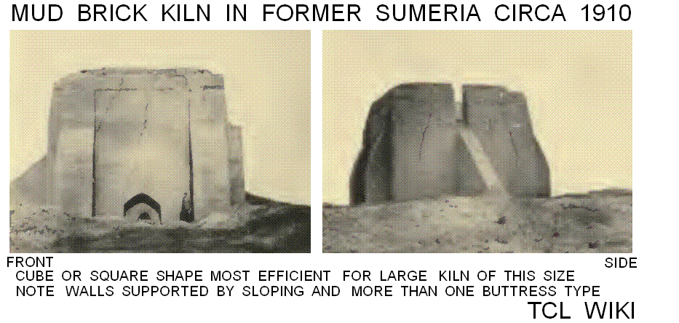
  Iraqi Kilns
19
Notes:
The baseball diamond is used to represent the growth and progress as it relates to the Christian Life and Service Seminars.
Today’s Agenda/Housekeeping

Slide 20
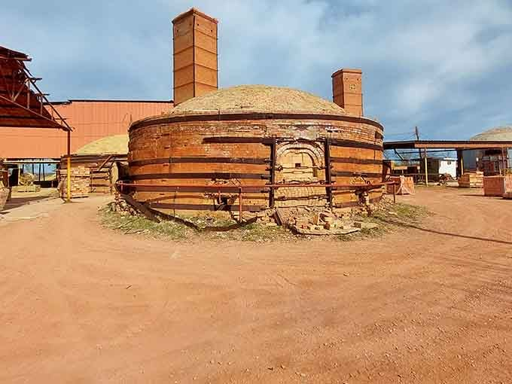
  D’Hanis Texas
20
Notes:
The baseball diamond is used to represent the growth and progress as it relates to the Christian Life and Service Seminars.
Today’s Agenda/Housekeeping

Slide 21
  Daniel 3
23 and these three men, firmly tied, fell into the blazing furnace, and walked in the midst of the flame, singing praise to God, and blessing the Lord.
21
Notes:
The baseball diamond is used to represent the growth and progress as it relates to the Christian Life and Service Seminars.
Today’s Agenda/Housekeeping

Slide 22
  Prayer of Azariah
1 Then Azariah stood up, and prayed in this manner; and opening his mouth in the midst of the fire said,
2 Blessed art thou, O Lord God of our fathers: thy name is worthy to be praised and glorified forevermore:
22
Notes:
The baseball diamond is used to represent the growth and progress as it relates to the Christian Life and Service Seminars.
Today’s Agenda/Housekeeping

Slide 23
  Prayer of Azariah
2 Blessed art thou, O Lord God of our fathers: thy name is worthy to be praised and glorified forevermore:
3 For thou art righteous in all the things that thou hast done to us: yea, true are all thy works, thy ways are right, and all thy judgments truth.
23
Notes:
The baseball diamond is used to represent the growth and progress as it relates to the Christian Life and Service Seminars.
Today’s Agenda/Housekeeping

Slide 24
  Prayer of Azariah
4 In all the things that thou hast brought upon us, and upon the holy city of our fathers, even Jerusalem, thou hast executed true judgment: for according to truth and judgment didst thou bring all these things upon us because of our sins.
5 For we have sinned and committed iniquity, departing from thee.
24
Notes:
The baseball diamond is used to represent the growth and progress as it relates to the Christian Life and Service Seminars.
Today’s Agenda/Housekeeping

Slide 25
  Prayer of Azariah
6 In all things have we trespassed, and not obeyed thy commandments, nor kept them, neither done as thou hast commanded us, that it might go well with us.
7 Therefore all that thou hast brought upon us, and everything that thou hast done to us, thou hast done in true judgment.
25
Notes:
The baseball diamond is used to represent the growth and progress as it relates to the Christian Life and Service Seminars.
Today’s Agenda/Housekeeping

Slide 26
  Prayer of Azariah
8 And thou didst deliver us into the hands of lawless enemies, most hateful forsakers of God, and to an unjust king, and the most wicked in all the world.
9 And now we cannot open our mouths, we have become a shame and reproach to thy servants; and to them that worship thee.
26
Notes:
The baseball diamond is used to represent the growth and progress as it relates to the Christian Life and Service Seminars.
Today’s Agenda/Housekeeping

Slide 27
  Prayer of Azariah
10 Yet deliver us not up wholly, for thy name's sake, neither disannul thou thy covenant:
11 And cause not thy mercy to depart from us, for thy beloved Abraham's sake, for thy servant Isaac's sake, and for thy holy Israel's sake;
27
Notes:
The baseball diamond is used to represent the growth and progress as it relates to the Christian Life and Service Seminars.
Today’s Agenda/Housekeeping

Slide 28
  Prayer of Azariah
12 To whom thou hast spoken and promised, that thou wouldst multiply their seed as the stars of heaven, and as the sand that lieth upon the seashore.
13 For we, O Lord, have become less than any nation, and are kept under this day in all the world because of our sins.
28
Notes:
The baseball diamond is used to represent the growth and progress as it relates to the Christian Life and Service Seminars.
Today’s Agenda/Housekeeping

Slide 29
  Prayer of Azariah
14 Neither is there at this time prince, or prophet, or leader, or burnt offering, or sacrifice, or oblation, or incense, or place to sacrifice before thee, and to find mercy.
15 Nevertheless in a contrite heart and a humble spirit let us be accepted.
29
Notes:
The baseball diamond is used to represent the growth and progress as it relates to the Christian Life and Service Seminars.
Today’s Agenda/Housekeeping

Slide 30
  Prayer of Azariah
16 Like as in the burnt offerings of rams and bullocks, and like as in ten thousands of fat lambs: so let our sacrifice be in thy sight this day, and grant that we may wholly go after thee: for they shall not be confounded that put their trust in thee.
17 And now we follow thee with all our heart, we fear thee, and seek thy face.
30
Notes:
The baseball diamond is used to represent the growth and progress as it relates to the Christian Life and Service Seminars.
Today’s Agenda/Housekeeping

Slide 31
  Prayer of Azariah
18 Put us not to shame: but deal with us after thy loving kindness, and according to the multitude of thy mercies.
19 Deliver us also according to thy marvelous works, and give glory to thy name, O Lord: and let all them that do thy servants hurt be ashamed;
31
Notes:
The baseball diamond is used to represent the growth and progress as it relates to the Christian Life and Service Seminars.
Today’s Agenda/Housekeeping

Slide 32
  Prayer of Azariah
20 And let them be confounded in all their power and might, and let their strength be broken;
21 And let them know that thou art God, the only God, and glorious over the whole world.
32
Notes:
The baseball diamond is used to represent the growth and progress as it relates to the Christian Life and Service Seminars.
Today’s Agenda/Housekeeping

Slide 33
  Prayer of Azariah
22 And the king's servants, that put them in, ceased not to make the oven hot with rosin, pitch, tow, and small wood;
23 So that the flame streamed forth above the furnace forty and nine cubits.
33
Notes:
The baseball diamond is used to represent the growth and progress as it relates to the Christian Life and Service Seminars.
Today’s Agenda/Housekeeping

Slide 34
  Prayer of Azariah
1 cubit = 18 inches
49 cubits = 73.5 feet
34
Notes:
The baseball diamond is used to represent the growth and progress as it relates to the Christian Life and Service Seminars.
Today’s Agenda/Housekeeping

Slide 35
  Prayer of Azariah
24 And it passed through, and burned those Chaldeans it found about the furnace.
25 But the angel of the Lord came down into the oven together with Azarias and his fellows, and smote the flame of the fire out of the oven;
35
Notes:
The baseball diamond is used to represent the growth and progress as it relates to the Christian Life and Service Seminars.
Today’s Agenda/Housekeeping

Slide 36
  Prayer of Azariah
26 And made the midst of the furnace as it had been a moist whistling wind, so that the fire touched them not at all, neither hurt nor troubled them.
27 Then the three, as out of one mouth, praised, glorified, and blessed God in the furnace, saying,
36
Notes:
The baseball diamond is used to represent the growth and progress as it relates to the Christian Life and Service Seminars.
Today’s Agenda/Housekeeping

Slide 37
  Prayer of Azariah
28 Blessed art thou, O Lord God of our fathers: and to be praised and exalted above all forever.
29 And blessed is thy glorious and holy name: and to be praised and exalted above all forever.
37
Notes:
The baseball diamond is used to represent the growth and progress as it relates to the Christian Life and Service Seminars.
Today’s Agenda/Housekeeping

Slide 38
  Prayer of Azariah
30 Blessed art thou in the temple of thine holy glory: and to be praised and glorified above all forever.
31 Blessed art thou that beholdest the depths, and sittest upon the cherubims: and to be praised and exalted above all forever.
38
Notes:
The baseball diamond is used to represent the growth and progress as it relates to the Christian Life and Service Seminars.
Today’s Agenda/Housekeeping

Slide 39
  Prayer of Azariah
32 Blessed art thou on the glorious throne of thy kingdom: and to be praised and glorified above all forever.
33 Blessed art thou in the firmament of heaven: and above all to be praised and glorified forever.
39
Notes:
The baseball diamond is used to represent the growth and progress as it relates to the Christian Life and Service Seminars.
Today’s Agenda/Housekeeping

Slide 40
  Prayer of Azariah
66 O give thanks to the Lord, because he is gracious: for his mercy endureth forever.
67 O all ye that worship the Lord, bless the God of gods, praise him, and give him thanks: for his mercy endureth forever.
40
Notes:
The baseball diamond is used to represent the growth and progress as it relates to the Christian Life and Service Seminars.
Today’s Agenda/Housekeeping

Slide 41
  Daniel 3
24 Then King Nebuchadnezzar leaped to his feet in amazement and asked his advisers, “Weren’t there three men that we tied up and threw into the fire?” They replied, “Certainly, Your Majesty.”
25 He said, “Look! I see four men walking around in the fire, unbound and unharmed, and the fourth looks like a son of the gods.”
41
Notes:
The baseball diamond is used to represent the growth and progress as it relates to the Christian Life and Service Seminars.
Today’s Agenda/Housekeeping

Slide 42
  Daniel 3
26 Nebuchadnezzar then approached the opening of the blazing furnace and shouted, “Shadrach, Meshach and Abednego, servants of the Most High God, come out! Come here!” So Shadrach, Meshach and Abednego came out of the fire,
27 and the satraps, prefects, governors and royal advisers crowded around them. They saw that the fire had not harmed their bodies, nor was a hair of their heads singed; their robes were not scorched, and there was no smell of fire on them.
42
Notes:
The baseball diamond is used to represent the growth and progress as it relates to the Christian Life and Service Seminars.
Today’s Agenda/Housekeeping

Slide 43
  Daniel 3
28 Then Nebuchadnezzar said, “Praise be to the God of Shadrach, Meshach and Abednego, who has sent his angel and rescued his servants! They trusted in him and defied the king’s command and were willing to give up their lives rather than serve or worship any god except their own God.
43
Notes:
The baseball diamond is used to represent the growth and progress as it relates to the Christian Life and Service Seminars.
Today’s Agenda/Housekeeping

Slide 44
  Daniel 3
29 Therefore I decree that the people of any nation or language who say anything against the God of Shadrach, Meshach and Abednego be cut into pieces and their houses be turned into piles of rubble, for no other god can save in this way.”
30 Then the king promoted Shadrach, Meshach and Abednego in the province of Babylon.
44
Notes:
The baseball diamond is used to represent the growth and progress as it relates to the Christian Life and Service Seminars.
Today’s Agenda/Housekeeping

Slide 45
  Daniel 3 & Prayer of Azariah
Why didn’t the Prayer make it in the 333 BC canonization?
  The 386 BC canonization required an original manuscript in either Hebrew or Aramaic
  The Prayer is a copy of an earlier manuscript and is in Greek
  No certification of where it came from
45
Notes:
The baseball diamond is used to represent the growth and progress as it relates to the Christian Life and Service Seminars.
Today’s Agenda/Housekeeping

