Slide 1
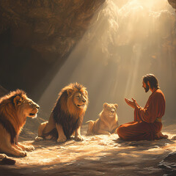
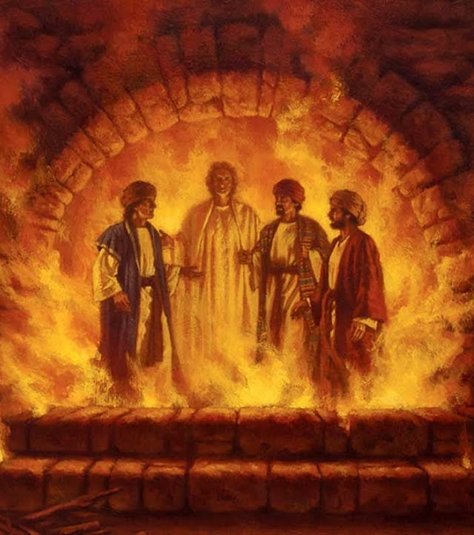
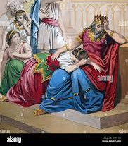
Daniel – The Prophet

Slide 2
FBC Liberty Small Group
Daniel – The Most Interesting Book of the Bible
Chapter 4
Session #7 November 8, 2026

Slide 3
  Fbcliberty.org example
3
Notes:
The baseball diamond is used to represent the growth and progress as it relates to the Christian Life and Service Seminars.
Today’s Agenda/Housekeeping

Slide 4
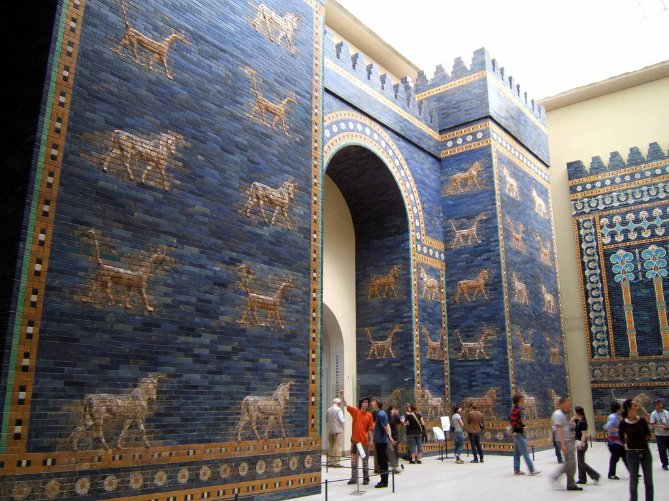
4
Notes:
The baseball diamond is used to represent the growth and progress as it relates to the Christian Life and Service Seminars.
Today’s Agenda/Housekeeping

Slide 5
  At the Beginning of Chapter 3
What is the status of the Nebuchadnezzar?
  603 BC
  Still basking in the glory of battle victory
  Enamored with Daniel, his ability to interpret his dream, & Daniel’s God
5
Notes:
The baseball diamond is used to represent the growth and progress as it relates to the Christian Life and Service Seminars.
Today’s Agenda/Housekeeping

Slide 6
  At the Beginning of Chapter 3
What is the status of the Nebuchadnezzar?
  47 The king said to Daniel, “Surely your God is the God of gods and the Lord of kings and a revealer of mysteries, for you were able to reveal this mystery.”
  Trust in Daniel is at an all time high
6
Notes:
The baseball diamond is used to represent the growth and progress as it relates to the Christian Life and Service Seminars.
Today’s Agenda/Housekeeping

Slide 7
  At the Beginning of Chapter 3
What is the status of the 4 amigos?
  Daniel
      Just completed interpretation of Nebuchadnezzar's dream
      Ruler of all of the province of Babylon
      In charge of all wise men
7
Notes:
The baseball diamond is used to represent the growth and progress as it relates to the Christian Life and Service Seminars.
Today’s Agenda/Housekeeping

Slide 8
  At the Beginning of Chapter 3
What is the status of the 4 amigos?
  Shadrach, Meshach, Abednego
      Administrators over the province of Babylon
      But, they are working for Daniel
      Without the power of Daniel
8
Notes:
The baseball diamond is used to represent the growth and progress as it relates to the Christian Life and Service Seminars.
Today’s Agenda/Housekeeping

Slide 9
  At the End of Chapter 3
What is the status of the 4 amigos?
  Shadrach, Meshach, Abednego promoted after:
      Surviving the hot furnace, walking with an angel
  Nebuchadnezzar now praises God and gives support among the people for God
9
Notes:
The baseball diamond is used to represent the growth and progress as it relates to the Christian Life and Service Seminars.
Today’s Agenda/Housekeeping

Slide 10
  Daniel 4
1 King Nebuchadnezzar, To the nations and peoples of every language, who live in all the earth: May you prosper greatly!
2 It is my pleasure to tell you about the miraculous signs and wonders that the Most High God has performed for me.
3 How great are his signs, how mighty his wonders! His kingdom is an eternal kingdom; his dominion endures from generation to generation.
10
Notes:
The baseball diamond is used to represent the growth and progress as it relates to the Christian Life and Service Seminars.
Today’s Agenda/Housekeeping

